Slide 1
Chapter 2: Administration and Professional Development
Unit 1: Professional and Administrative Aspects of Athletic Training

Slide 2
Objectives
Describe the concept of negligence
Understand types of medical paperwork and record keeping necessary
Describe why insurance is necessary
Explain why preventing injuries is best defense against legal liability
Describe typical organization of a preparticipation physical exam
Understand the concept of professional practice in athletic training
Describe the standards of professional practice in athletic training
Explain the importance of continuing education and the NATA requirements
Explain the elements of leadership
Describe characteristics that are helpful to being a future professional
Describe the primary aspects of an athletic training factiliy

Slide 3
Legal Issues
In addition to caring for and preventing athletic injuries, ATs must perform a variety of administrative duties and must be aware of certain legal issues
When athletes choose to participate in a sport, they risk becoming injured, or even permanently disabled
Duty of care: means an AT has an official job responsibility to render treatment and procedures related to the health and well-being of an athlete
Negligence: legal wrong characterized by the failure to act as a reasonably prudent person would act in a similar situation
Gross negligence: step beyond negligence; when an AT fails to provide even a slight amount of care when needed
Assumption of risk: not warning athletes of the hazards involved in sport

Slide 4
Legal Issues
Informed consent: permission by parents, after being informed of possible dangers of participation in athletic activities, for medical staff to treat their child if they are injured
Proximate cause: close connection between the way an AT acted and the resulting injury to an athlete

Slide 5
Avoiding LEgal Problems (choose 3)
Have a written contract
Use equipment that meets established safety standards
Require preparticipation physical examinations
Have all athletes and their parents or guardians sign an assumption-of-risk form
Maintain CPR and first aid certifications
Document all injuries and procedures
Maintain confidentiality
Build trust
Check for hazards
Stay educated

Slide 6
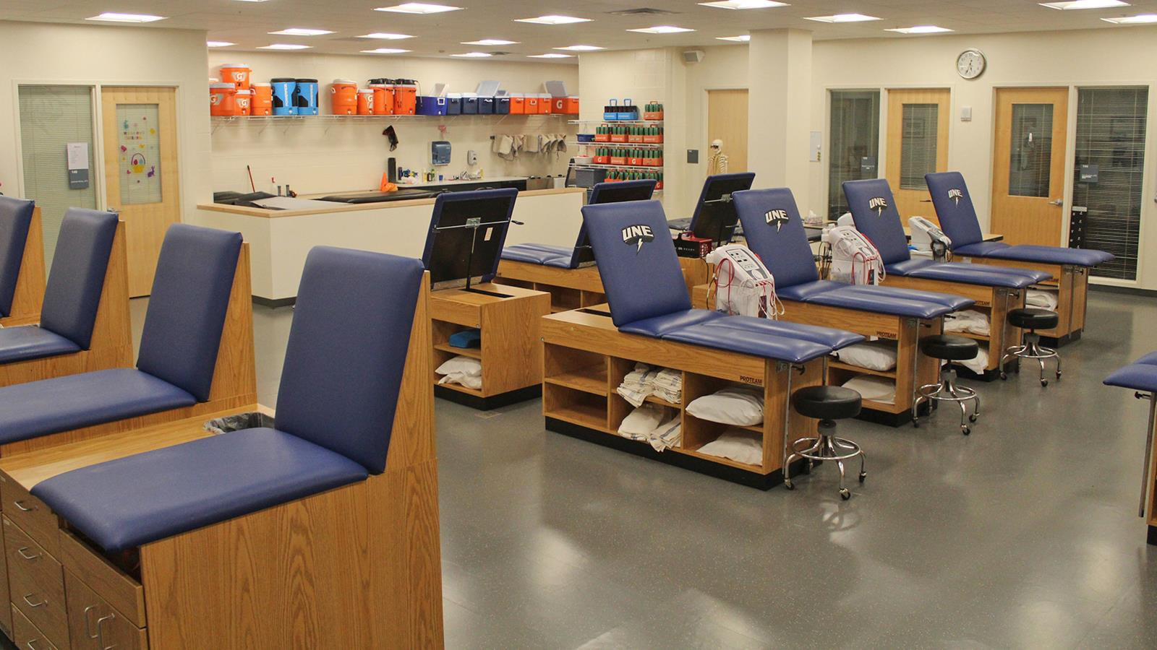
Athletic Training Facilities
When it comes to evaluating athletes, conducting prevention procedures, treating injuries, and providing first aid. ATs fulfill their professional obligations in athletic training rooms
Athletic training room must meet the patients' needs and all for proper care
Should be well organized, clean, and illuminated

Slide 7
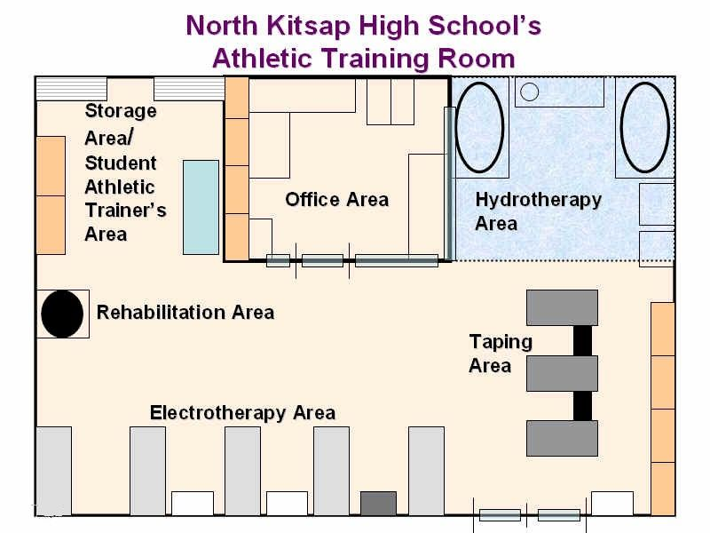
Athletic training rooms should contain: (choose 2)
Private examination room
Treatment area
Game and practice preparation area
Wound care and first aid area
Hydrotherapy area
Rehabilitation and reconditioning area
AT office or record-keeping area

Slide 8
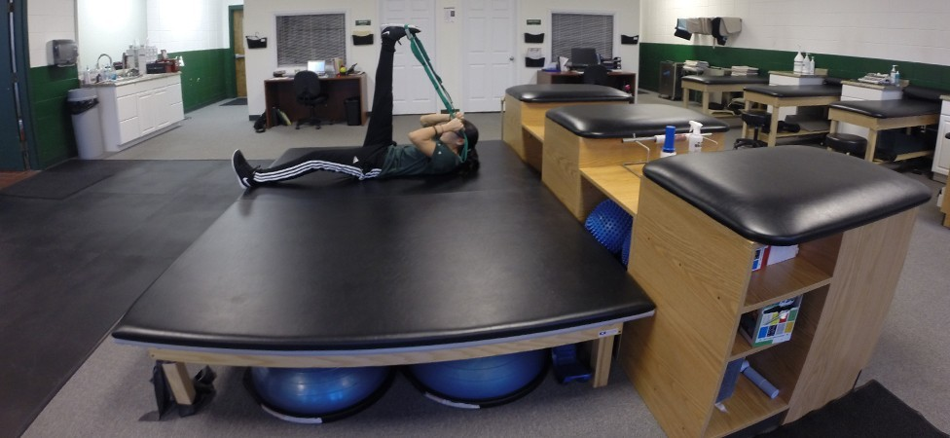
Athletic training facilities
Location
Electrical
Plumbing
Ventilation
Lighting
Office
Whirlpool room
Rehabilitation
Taping
Treatment
Storage

Slide 9
Preventing Injuries
Reducing the risk of legal liability includes practicing comprehensive injury prevention
Education
Rule enforcement
Proper matching of participants during practice
Elements of physical fitness
https://www.nata.org/advocacy/public-relations/at-your-own-risk

Slide 10
ADMINISTRATIVE issues AND documentation
It is essential that the members of the sports medicine team document all procedures they perform in order to prevent lawsuits and to provide the best care possible
ATs need to be able to compare current physical findings from a physical examination or injury report
It is very important that the AT make it a habit to review past medical history
Preparticipation exams
Performed by a medical doctor to determine if the athlete can participate in a sport without extra risk of injury or illness
Give baseline information from which to make comparisons if an injury does arise
Exams include: height, weight, skinfold measures, blood pressure, flexibility and joint stability, posture, ear, nose, and throat, heart, lungs, and abdomen

Slide 11
Administrative issues and documentation
Medical information forms
Medical information card as well as medical history form
Keep this information on the AT at all times
Insurance
Medical insurace is a written argreement between an insurance company and the person who buys it; this agreement clarifies the terms of reimbursement for medical costs after an athlete has been treated
In most organizations, athletes are required to have some type of medical insurance before they can participate in organized sport
Insurance forms are typically kept with permission-to-treat forms

Slide 12
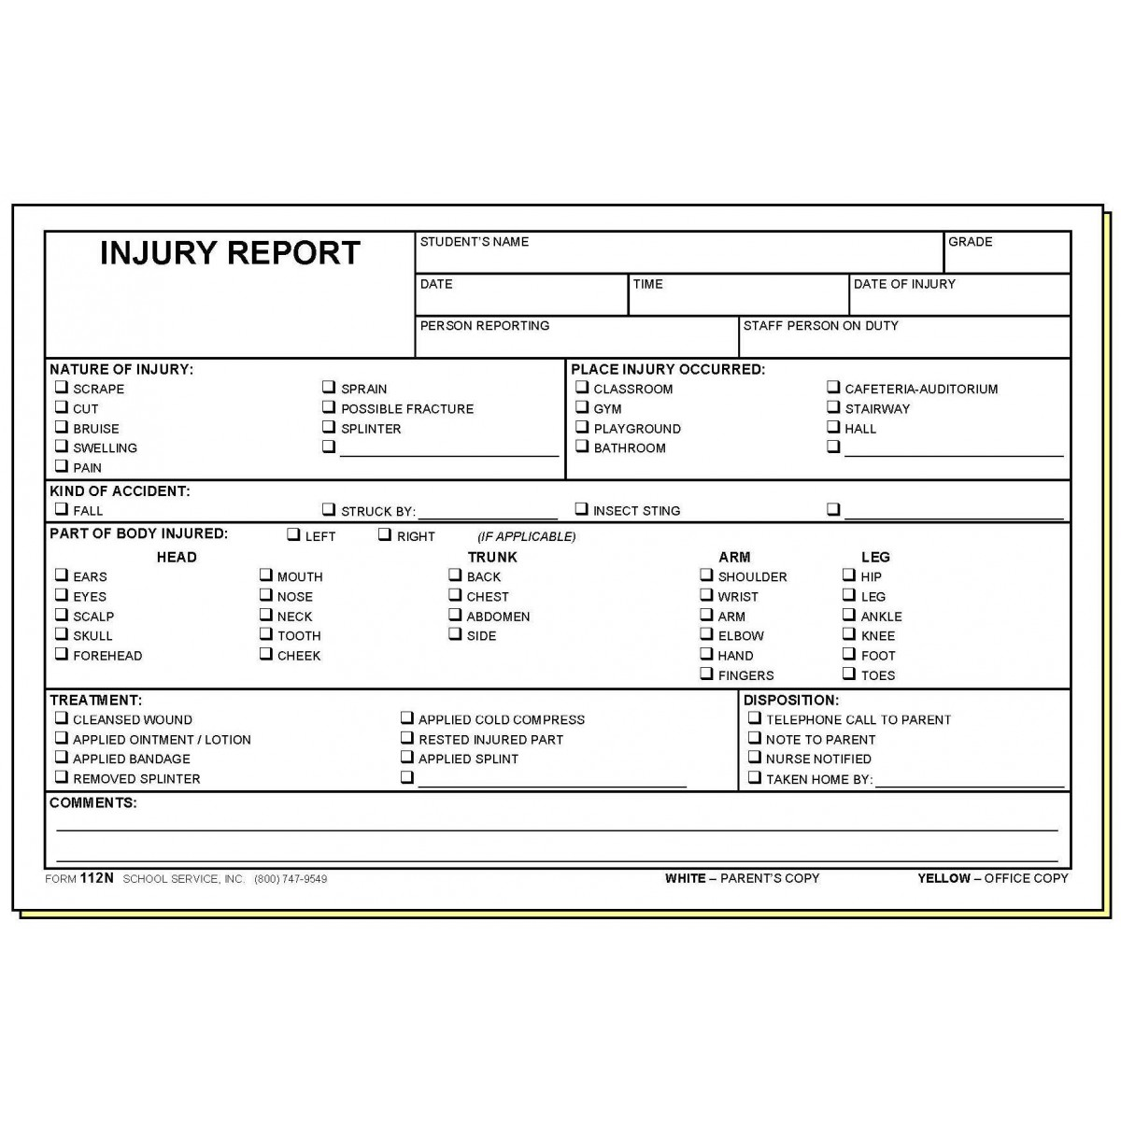
Administrative issues and documentation
Reports and charts
Accident and injury reports
Treatment logs
Rehabilitation charts

Slide 13
Professional Development
Refers to ongoing responsibility of improving one's skills and knowledge in order to deliver appropriate health care to injured athletes
Standards of professional practice: the way an AT is expected to act while doing this job
Standards of professional practice:
Principle 1: Members shall respect the rights, welfare, and dignity of all
Principle 2: Members shall comply with the laws and regulations governing the practice of athletic training
Principle 3: Members shall maintain and promote high standards in their provision of services
Principle 4: Members shall not engage in conduct that could be construed as a conflict of interest or that reflects negatively on the profession

Slide 14
Professional Development
Staying educated
For an athlete to receive the best care, an AT must stay updated on the latest technology
An AT must receive 75 continuing education hours known an CEUs every 3 days
Must stay up to date on CPR and First Aid
Communication
ATs communicate daily with athletes, parents, physicians, coaches, and administrators at every level
Failure to send the right message can result in anxious hours and negative consequences
Be a good listener, stay attentive, and open-minded
Establish good eye contact
Leadership
Integrity: conducting yourself in an ethical manner
Vision: refers to being able to anticipate the needs of the athletes
Inspiration: refers to being able to persuade people that your vision is appropriate
Competence: having the knowledge and skills necessary to perform effectively

Slide 15
BOC Standards of Professional practice
Detention: a physician directs the service provided by an AT
Prevention: an AT must use sound preventative measures to protect each patient
Immediate care: standards of immediate care procedures are used in all athletic training settings
Clinical evaluation and diagnosis: the AT is to use appropriate assessment procedures and clinical reasoning and decision making to diagnose a patient's injury
Treatment, rehabilitation, and reconditioning: the AT must use proper goal setting, intervention strategies, and assessment measure for the effective treatment of patients
Program discontinuation: the AT will collaborate with a physician to determine when a patient's treatment program can be discontinued
Organization and administration: any service rendered to a patient is appropriately documented and becomes part of the patient's permanent medical record. Members shall maintain and promote high standards in the provision of services

Slide 16
The Premier Model
P | PROMOTE a professional image
R | REMEMBER your vision
E | ENGAGE in learning
M | MAXIMIZE your strengths
I | INNOVATE and create
E | ENLIST the help of others
R | REFLECT

Slide 17
REFERENCE
Fundamentals of athletic training

