Slide 1
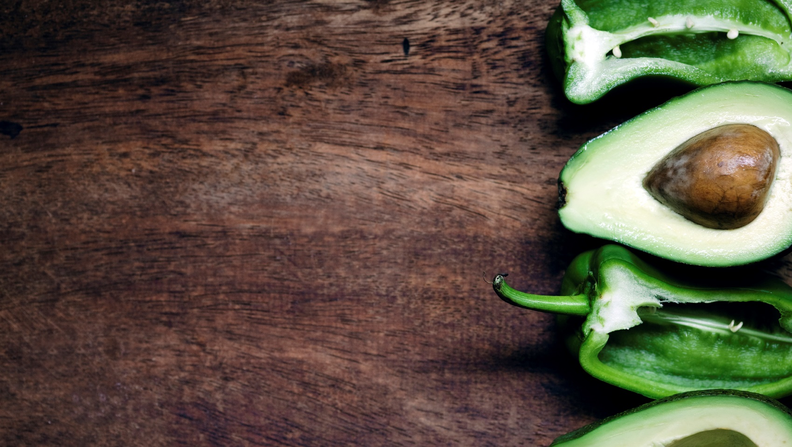
Chapter 3: Introduction to Anatomy
Unit 2: Basics of Human Anatomy and Physiology

Slide 2
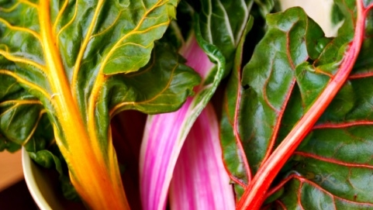
Objectives
Define the anatomical planes and describe the anatomical position
Label general muscular and bony anatomy
Describe the functions of skin, bone,muscle, ligament, tendon, and cartilage
Describe the types of bones and give examples
Describe the classification of joints and explain the types of motion produced

Slide 3
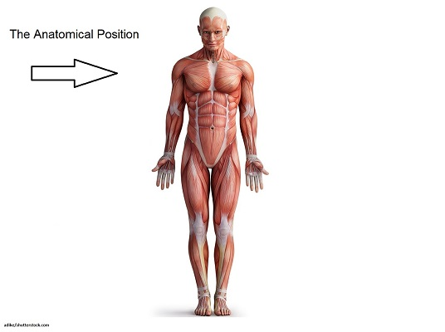
Anatomical Position
Anatomical position: A standing posture with the arms at the sides and the palms facing forward
Frontal plane: The plane that separates the body into front and back halves
Sagittal plane: A plane that divides the body into left and right halves
Transverse plane: The plane that divides the body into top and bottom halves

Slide 4
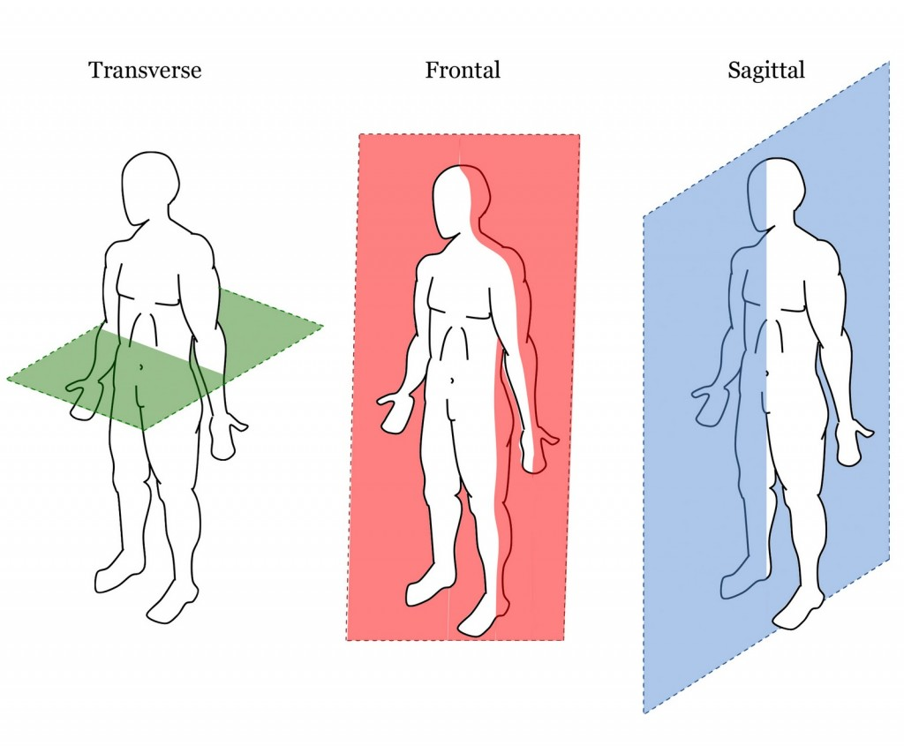

Slide 5
Anatomical Position
Anterior: front of the body
When you face an athlete, you are looking at the athlete's anterior aspect
Injury report: athlete hit at the anterior aspect of the lower leg
Ventral is used synonymously with anterior, but is used in reference to the hand and foot
Posterior: back of the body
When an athlete walks away from you, you are looking at the athlete's posterior aspect
Injury report: athlete complains of pain in the posterior aspect of their knee
Dorsal is used synonymously with anterior, but is used in reference to the hand and foot
Medial: toward the midline of the body
Looking at an athlete's calf that faces the other leg
Injury report: athlete is experiencing pain on the medial part of their knee
Lateral: away from the midline of the body
Looking at the side of the calf that faces out
Injury report: athlete complains of lateral pain on the elbow

Slide 6
Anatomical Position
Proximal: toward an attachment
The shoulder is proximal to the elbow and the hip is proximal to the knee
Injury report: proximal hamstring pain
Distal: away from an attachment
The knee is distal to the hip
Injury report: distal biceps injury
Superior: one point, or structure, being higher than another
Knee is superior to the ankle
Cephalic: towards the head
Can be used synonymously with superior

Slide 7
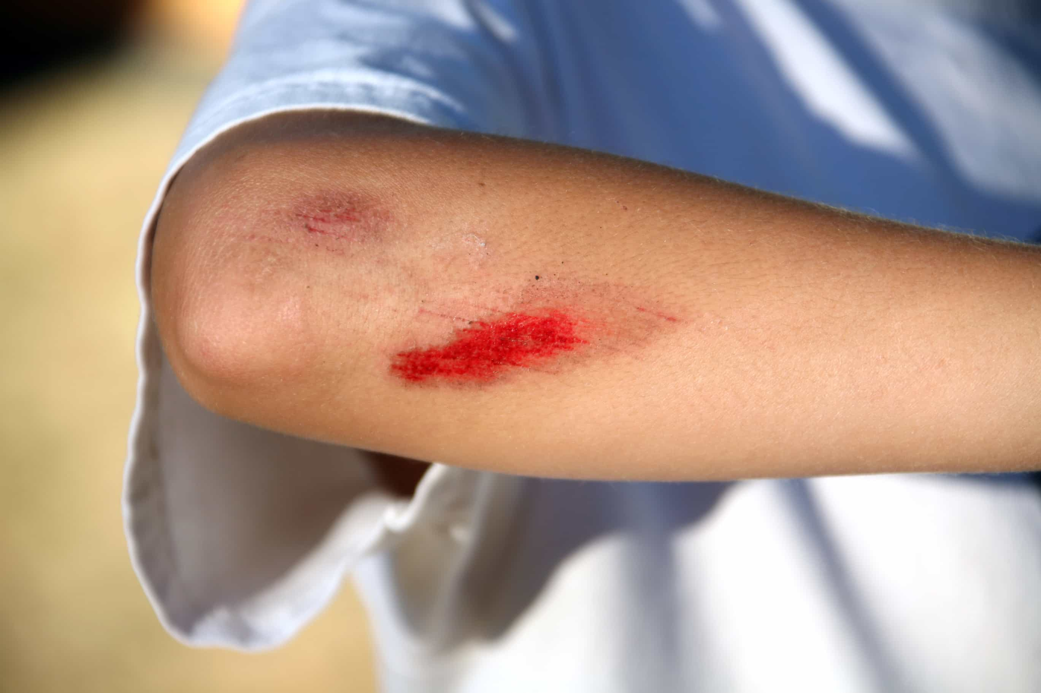
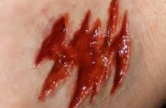
Anatomical Position
Inferior: one point, or structure, being lower than another
Pelvis is inferior to the ribs
Caudal: used synonymously with inferior
Superficial: close to the body's surface
Superficial cut
Deep: away from the body's surface
Deep wound

Slide 8
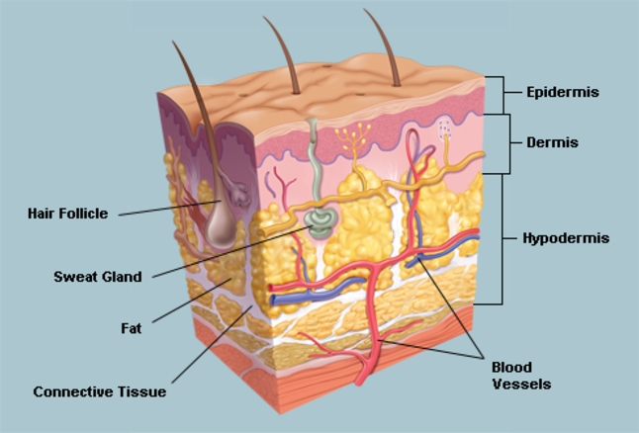
Body Tissues
Athletics related injuries typically involve injuries to the skin, bones, cartilage, muscle, tendons, and ligaments
Skin: outermost surface of the body
First line of defense against external forces such as insects, air, dirt, bacteria, and blows
Epidermis: the most superficial layer of skin
Dermis: a layer that helps hold the skin to underlying bone and muscle tissue
Below the dermis is the hypodermis, which is not technically considered a part of the skin; also called the subcutaneous layer and is responsible for storing about 50% of the body's fat

Slide 9
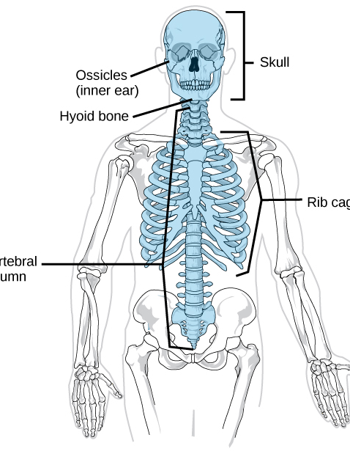
Body Tissues
Bones:
Three primary functions:
Protect vital organs and structures from trauma
Create movement
Produce blood cells and store minerals
Human body has 206 bones
Axial skeleton: includes the bones of the spine, thorax, and skull
Appendicular skeleton: includes the bones of the extremities

Slide 10
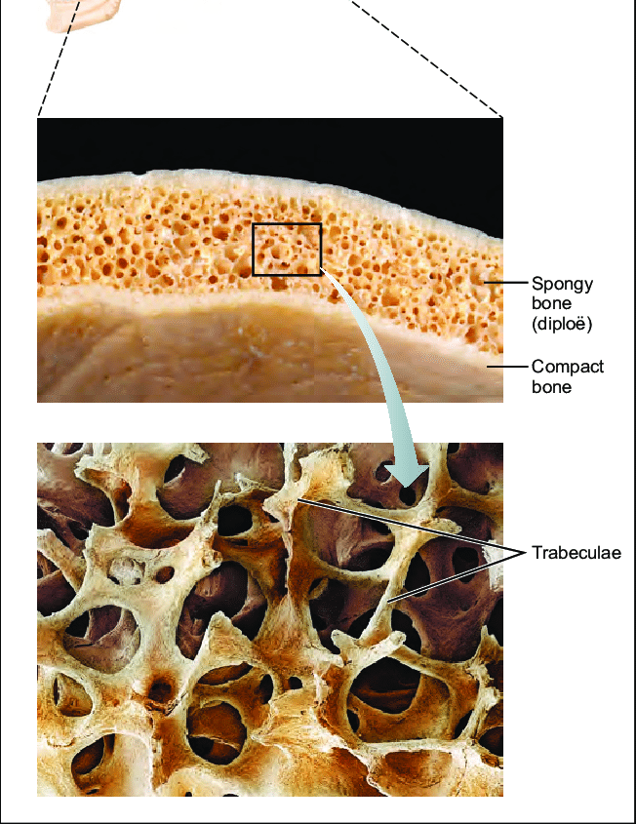
Body Tissues
Bones (continued):
Bones are classified by their shape:
Long, short, flat and irregular
Epiphysis: growth plate
Area of the growth plate can be somewhat spongy during adolescence and can be problematic for the adolescent athlete
Bones can often fracture at the growth plate

Slide 11
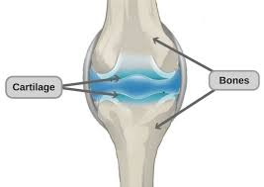
Body Tissue
Cartilage covers the end of long bones and can be found between bones
Functions to join structures, absorb shock, and permit smooth bone movement
Ribs and sternum

Slide 12
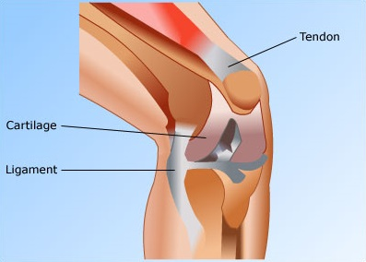
Body Tissues
Muscles, tendons, and ligaments
Muscle contractions allow the body to accelerate, decelerate, stop movement, and maintain normal postural alignment
Ligaments and tendons are both composed of connective tissue
Tendons: strong, fibrous cord that attach muscle to bone and transmit the force that a muscle exerts
Ligaments: connect bones and help to form joints

Slide 13
Body Tissues
Muscles, tendons, and ligaments
Skeletal muscles are made of fibers and each fiber can contract when a nerve impulse tells it to move
Skeletal muscles: attached to bones to create movement
As a person ages, the skeletal muscles degenerates and is replaced by fibrous connective tissue, which limits ROM
Sphincter muscles: reduce the size of an opening in the body. There are sphincter muscles in the eyes, stomach, bladder, and rectum
Cardiac muscle: found in the walls of the heart and is a muscle that contract on its own.
Smooth muscle: found in hollow organs such as the stomach, intestine, and blood vessels

Slide 14
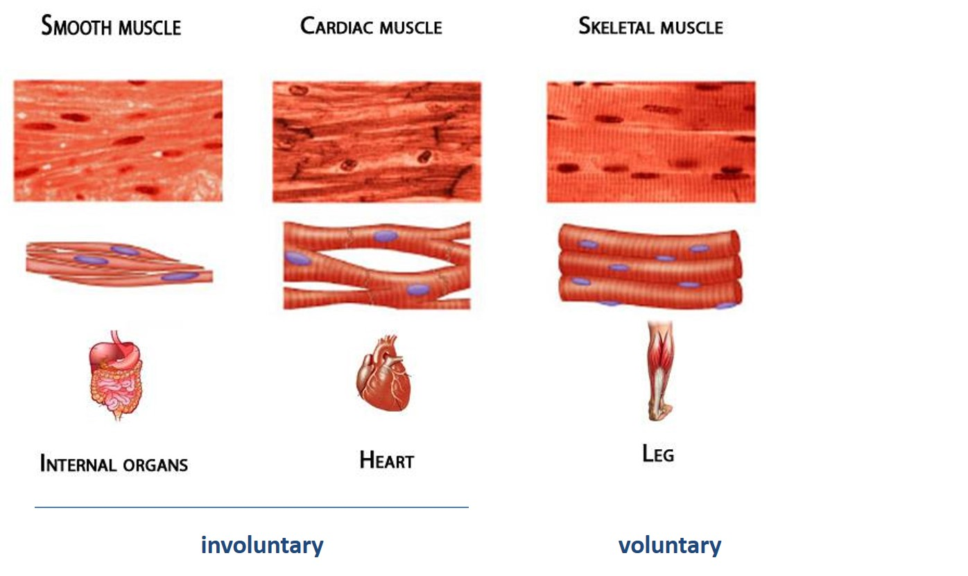

Slide 15
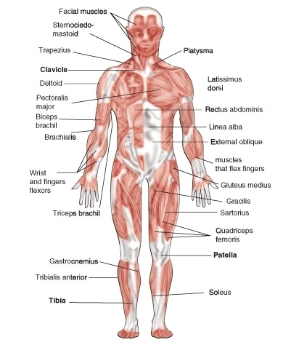

Slide 16
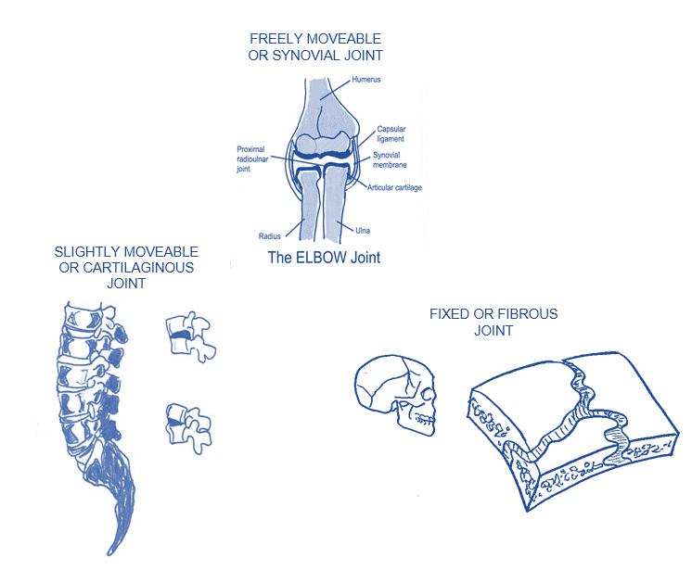
Classification of Joints
There are three classifications of joints:
Diarthrodial
Amphiarthrodial
Synarthrodial

Slide 17
Diarthrodial Joints
Diarthrodial joint: a freely movable joint and has a joint capsule, synovial membrane, cartilage, and ligaments
Also called synovial joints
Joint capsule: sleeve-like ligament that surrounds the entire joint
Synovial membrane: a slick lining on the sinde of the capsule
Hyaline cartilage: a thin layer of cushioning at the ends of the bones
Examples:
Hinge Joint: an articulation where the joint is able to move primarily in flexion and extension
Example: knee or elbow
Ball & Socket Joint: A joint where a rounded bone fits into a cuplike socket and swivels
Example: Hip or shoulder
Also called multiaxial joints

Slide 18
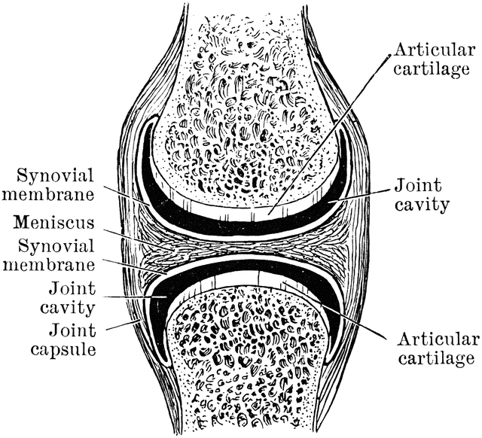
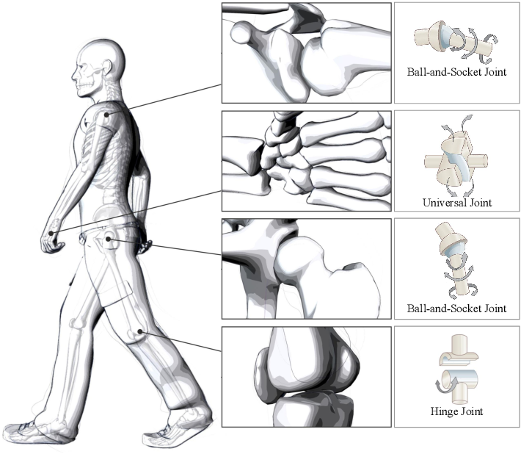

Slide 19
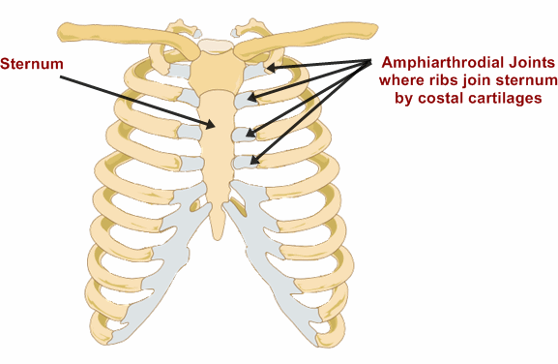
Amphiarthrodial Joints
Amphiarthrodial joint: A joint of cartilage that links bones that don’t move often
Also known as cartilaginous joints
Example: where the ribs meet the sterum

Slide 20
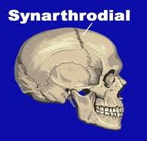
Snyarthrodial Joints
Synarthrodial: A type of joint in which bones are held together by tough connective tissue, making the joint immovable
Also called fibrous joints
Joint joins bones of the skull and the tibia and fibula in the lower leg

Slide 21
Movement
Without muscles, the body would not be able to move
An understanding of general muscular anatomy is essential for assessment of an athletic injury and rehabilitation following an injury; therefore, an AT must learn where muscles are located and what actions they perform
Muscle tissue is divided into two categories: voluntary and involuntary
Skeletal muscles generally attach at two points:
Origin: attachment to a joint that is usually at the proximal end of a bone
Insertion: attachment at the distal end of a joint
The muscle that is most responsible for a movement is called a prime mover
That muscle that relaxes the prime mover to cause movement is called the agonist
If both muscles become part of the primary movement, they become synergists

Slide 22
Movement
Flexion: bending movement around a joint in a limb away from its straightened position
Extension: straightening movement around a joint to restore it to anatomical position
Abduction: movement away from the midline of the body
Adduction: movement toward the midline of the body
Pronation: movement that turns the palm of the hand down as if it were emptying a bowl of soup
Supination: movement that turns the palm of the hand up as if it were holding a bowl of soup

Slide 23
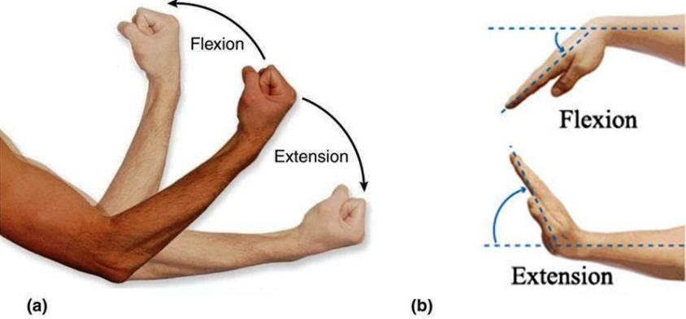
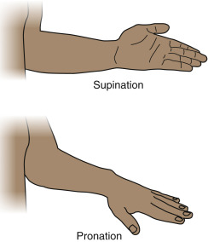
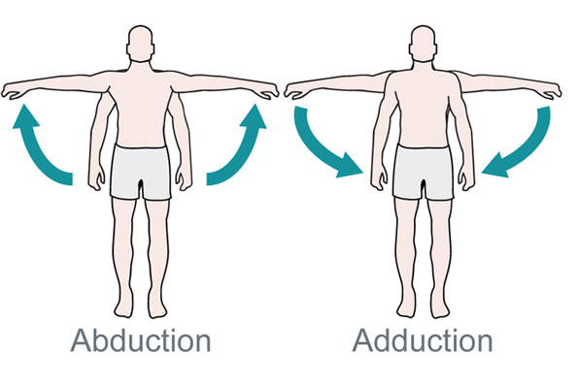
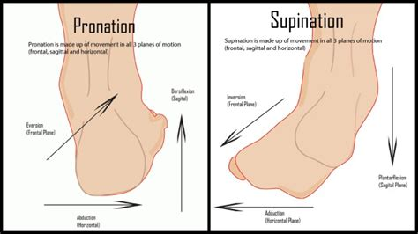

Slide 24
Movement
Inversion: movement that turns the sole of the foot inward toward the midline of the body
Eversion: movement that turns the sole of the foot outward, away from the midline of the body
Protraction: movement of the scapulas away from one another
Retraction: when the scapulas are moved or pulled together
Rotation: spinning or turning movement of a bony segment around an axis

Slide 25
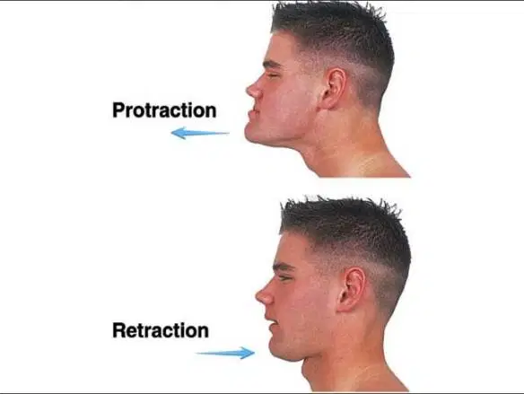
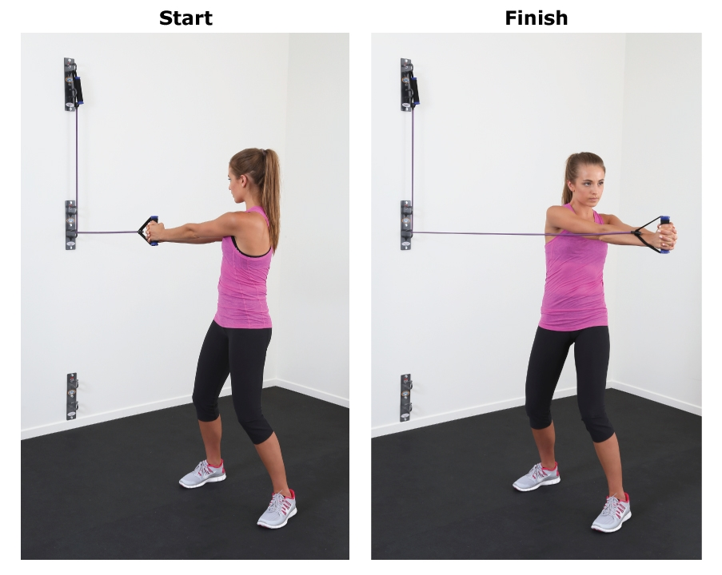
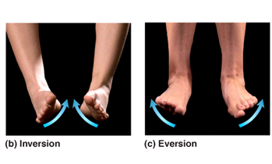

Slide 26
Movement
Circumduction: movement of a limb in a circular pattern
Elevation: when a bony segment is moved in a superior direction
Depression: when a bony segment is moved in an inferior position
Opposition: occurs when you move your thumb across your hand to meet your smallest finger
Reposition: returning your thumb and fifth digit to their starting position

Slide 27
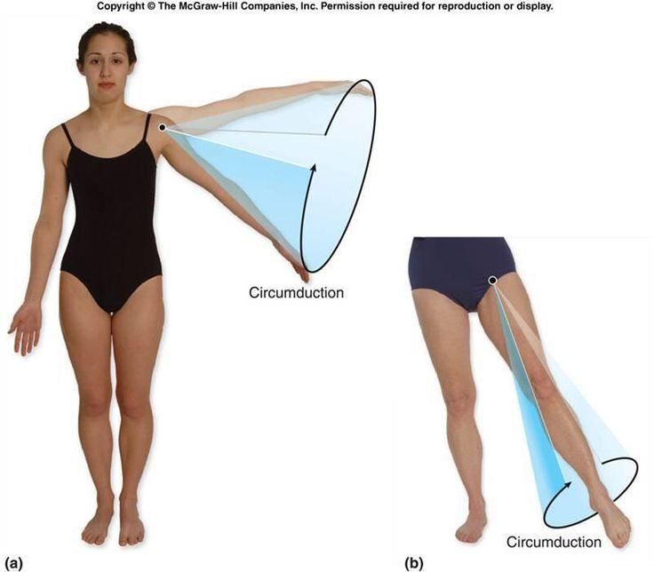
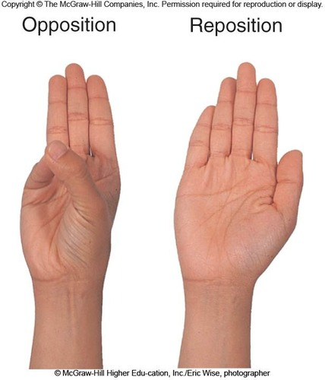
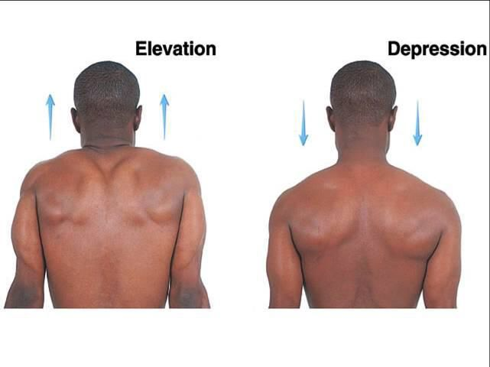

Slide 28
Source
Funamentals of Athletic Training

