Slide 1
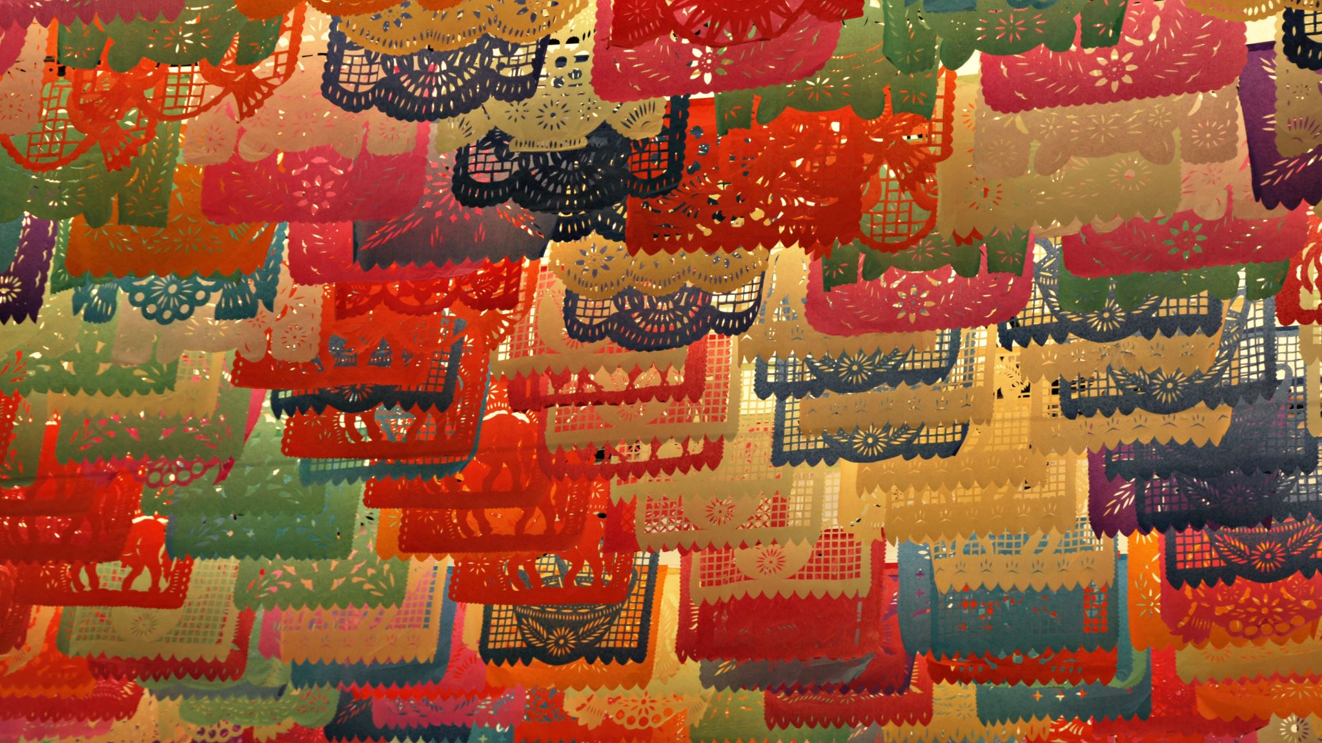
Chapter 6: Facial Injuries
Unit 3: Understanding athletic injuries to the axial region

Slide 2
Objectives
Describe the basic anatomy of the face
Explain the common types of facial injuries, how they occur, and how to prevent them
Explain common steps of care for treating facial injuries

Slide 3
ANatomy of the Facial Region
The face includes bones that are also part of the skull
There are 18 bones in the face (some are in pairs)
Major bones include the maxillae, the mandible, and the zygomatic bones
The maxillae are the two bones of the upper jaw, and the mandible is the lower jaw
The nasal bones make up the bridge of the nose
The zygomatic bones are also known as the eyes
Some facial fractures may remain hidden because blood runs into the sinuses rather than externally

Slide 4
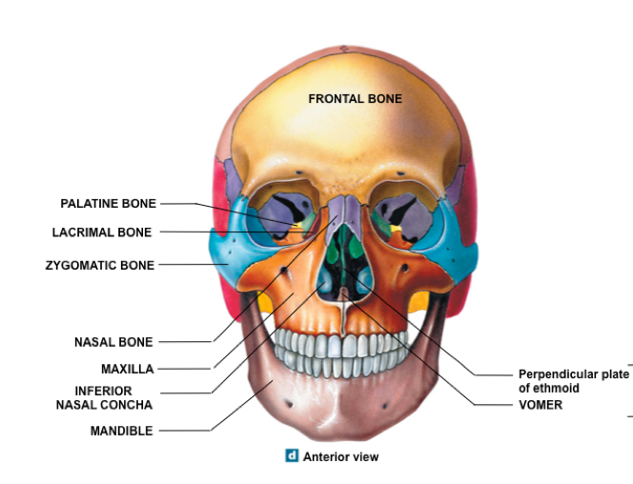

Slide 6
The eye
The eye sits in a socket known as the orbital foramen, or orbit
Most of the eye is hidden inside of the orbital foramen, which protects the eye on three sides and serves as an attachment point for the muscles that move the eye
Lack of eye movement can indicate either a head injury or a serious eye injury
The eye consists of anterior and posterior chambers that are filled with fluid, which gives the eye its rounded shape
An injury that causes fluid to drain from the eye is likely to cause permanent damage, possibly blindness
The covering of the eye has a white area and a clear center
Sclera: white outer covering of the eye
A change in color of the sclera indicates that the athlete has a problem or illness, such as liver disease, lack of oxygen, or poisoning
Cornea: clear center portion of the eyeball covering
Protects other important structures from injury

Slide 7
The Eye
Iris: contractile, colored portion of the eye, and in its center is the pupil: opening in the iris
The iris responds to light, changing the size of the pupil
Bright light=pupil gets smaller; dark room=pupil gets larger
Lens: focuses the entering light rays on retina
Poke in the eye may dislodge the lens and can caused blurred vision
Conjunctiva: lines the inner surface of the eyelid and continues over the forepart of the eyeball

Slide 8
The eye
The main structures of the posterior aspect of the eye are the retine and the optic nerve
Retina: lines the back of the eye and contains the rods and cones
Rods: provide vision in black and white
Cones: provide color vision
The retina receives the image formed by the lens and converts it into chemical and nerve signals that the optic nerve sends to the brain, where vision occurs
Damage to the optic nerve can cause blindness
Also prevents the pupils from functioning

Slide 9
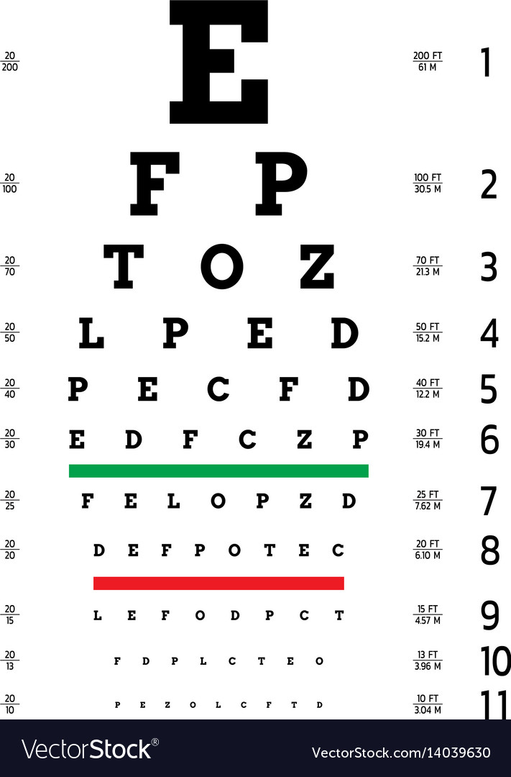
The eye
In the upper outside edge of each eye is a gland that makes tears
Tears wash diagonally across to the nose and drain into in through a duct
In the rims of the eyelid are small glands that secrete lubricating fluid, allowing the eyelid to open and close smoothly
Vision is measured via a test of reading letters from a distance
20/20 vision: can read the smallest letters standing 20 ft back
Nearsighted: can see near objects better than distance
Farsighted: distant objects better than near
Muscles of the eye are a divided into extrinsic and intrinsic functions

Slide 10
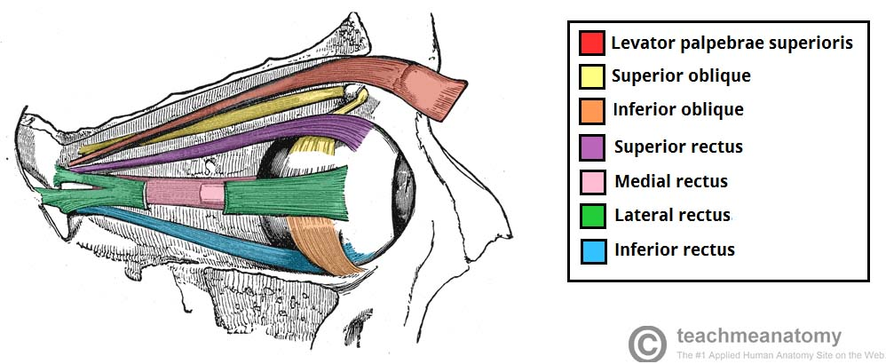
The Eye
Muscles of the Eye
Extrinsic muscles: | Attachments: | Functions:
Lateral rectus, medial rectus, superior rectus, inferior rectus, superior oblique, inferior oblique | Bones of the orbit and the eyeball | Movement of the eye superiorly and inferiorly, externally and internally, and obliquely
Extrinsic muscles: | Attachments: | Functions:
Iris, ciliary | Interior layer of the eye | Size of the pupil and shape of the lens

Slide 11
The ear
The ear has 3 distinct areas: the external ear, the middle ear, and the inner ear
The external ear is composed of the pinna, the ear canal, and the tympanic membrane
Pinna: the projecting portion of the external ear and is cartilage covered
Purpose is to catch sound and funnel it into the auditory canal
Auditory canal: carries sound from the pinna to the tympanic membrane
Tympanic membrane: eardrum
Earwax, which is designed to keep dirt away from the sensitive eardrum, is found in the auditory canal
Too much wax in the ear prevents or delays sound from reaching the middle ear

Slide 12
Anatomy of the Ear

Slide 13
The Nose
Two small bones, called the nasal bones, attach to the frontal bone of the skull
The nasal bones are about an inch in length and make up the bridge of the nose
The rest of the nose is cartilage
Septum: cartilage inside of the nose that separates the left and right sides of the nose
Hairs inside of the nose filter impurities from the air
Palate: the roof of the mouth and separates the mouth from the bottom of the nose
Air that is inhaled through the nose is warmed, moisturized, and cleansed before reaching the lungs
In winter, breathing through the nose will decrease lung pain caused by inhaling cold air through the mouth
Athletes with asthma and upper-respiratory infections should breathe moist air

Slide 14
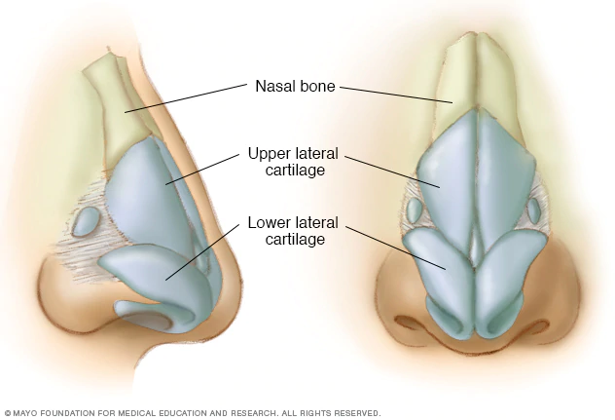
Anatomy of the Nose

Slide 15
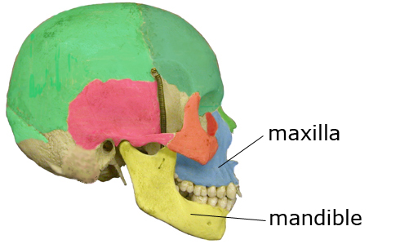
The mouth
The mouth is made up of:
Mandible: lower jaw
Maxillae: upper jaw
Temporomandibular joint: two joints connecting the jawbone to the skull
Palate: roof of the mouth
Teeth: give the face shape and are used to chew food
Adult has 32 permanent teeth

Slide 16
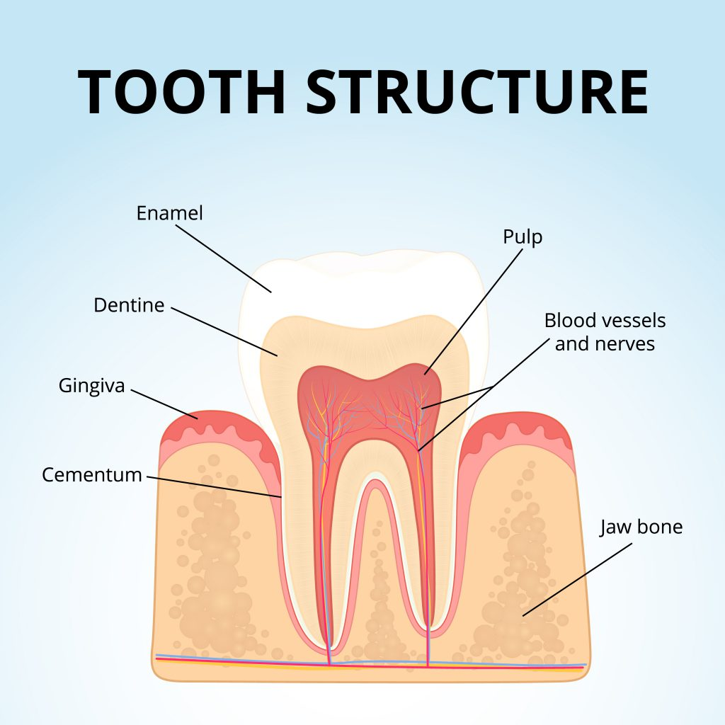
The mouth
The tooth is composed of:
Crown: visible portion above the gum line
Enamel: protects the tooth against decay
Root: below the gum line
Pulp: soft portion of the tooth containing the nerve and blood supply
Dentin: hard, bony portion of the tooth
A live tooth is white in color, while a dead tooth is dark gray

Slide 17
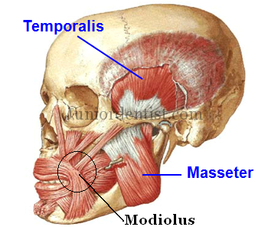
The Mouth
The teeth, tongue, and saliva work together to prepare food to be swallowed
The salivary glands under the tongue and in the back of the mouth provide saliva to begin digestion
The saliva makes it easier for the teeth to break down food and it binds food together before the food is sent to the stomach
The muscles used for chewing include the masseter, temporal, and pterygoid

Slide 18
Preventing Facial Injuries
Preventing facial injuries requires common sense
Athletes who fail to wear the proper equipment can easily become injured
Example: a catcher who does not wear a face mask when warming up a pitcher
Equipment is available in all sports to prevent facial injury
Helmets, mouth guards, face masks, goggles, protective eyewear, and headgear
Mouth guards are relatively inexpensive, but repairing injuries to the teeth and jaws are very expensive
A properly fitted athletic face mask decreases the number of eye, nose, face, and mouth injuries
The face mask should be spaced a minimum of 1 inch from the nose; if closer, an impact to the mask can cause it to distort inward, resulting in an injury on the face or nose
When selecting a face mask, make sure that no game equipment, such as a hockey puck or stick blade, can get through the openings of the mask and hit the face

Slide 19
Preventing Facial Injuries
Protective eyewear is crucial in preventing blindness
All sports have the potential for eye injuries; balls, sticks, elbows, and fingers are common items that injure eyes
Because eye injuries are unpredictable, it is best for all athletes to wear eye protection designed for their sport
Eye guards, which are like glasses and generally consist of plastic frames and lenses, or goggles should be worn
Athletes with fractures of the nasal bones, skull, or jaw should wear special padding, masks, or helmets to prevent additional injuries

Slide 20
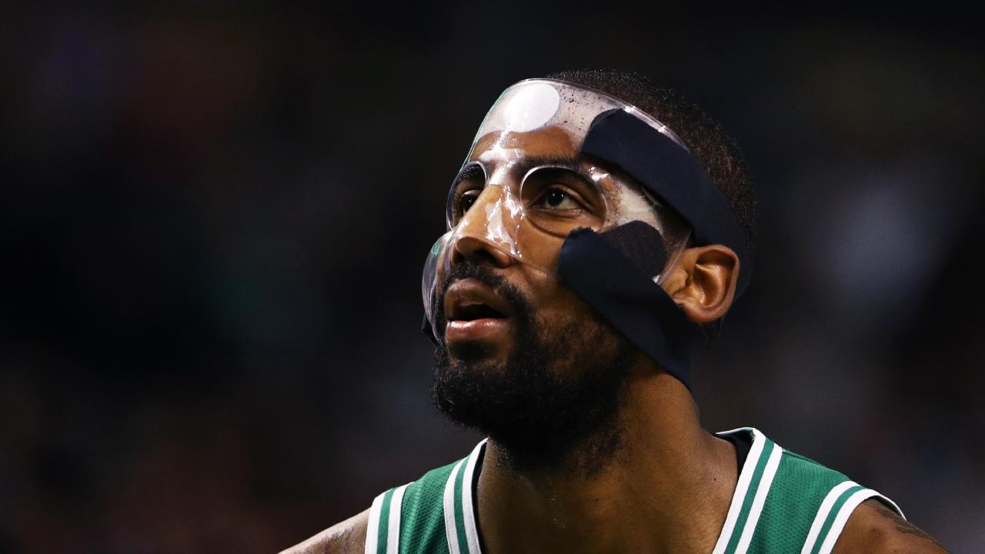
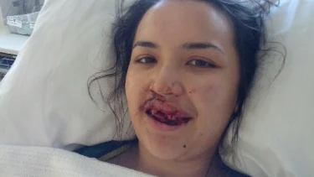
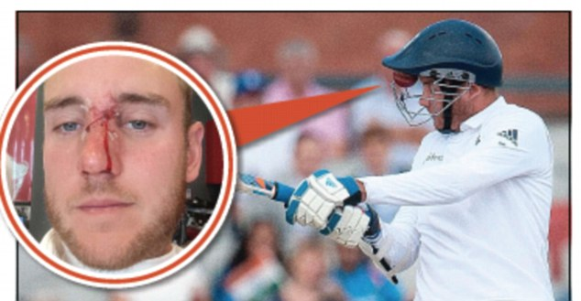

Slide 21
Treating eye injuries and conditions
Eyes are precious, and it is better to err on the side of caution and send the athlete to a doctor even if the eye injury doesn't seem serious than to discover later that injury was serious and treatment could have prevented injury or loss of vision
The AT also should be thinking about other injuries that might have occurred along with the eye injury
A head injury is a definite possibility that should be assessed
Eyes move in coordination and even if an eye is injured, it still tends to move in cooperation with the noninjured eye
If an eye must be patched or shielded, the AT should cover both eyes
This will reduce the movement of both eyes and in turn reduce irritation of the injured eye

Slide 22
Treating Eye injuries and Conditions: Conjunctivitis
Conjunctivitis: an infection and inflammatory response affecting the conjunctiva; commonly called pink eye
Variety of causes including: bacteria, allergies, eye irritants, viruses, and diseases
Symptoms include: redness of the eye, eye irritation, crusting matter along the corners and lid, blurred vision, itching
A physician needs to examine and assess eye fluids to determine the cause
Pink eye is a highly contagious virus, so to prevent others from getting it, the athlete should stay at home until effectively treated and no longer contagious
Eye drops are necessary for effective treatment

Slide 23
