Slide 1
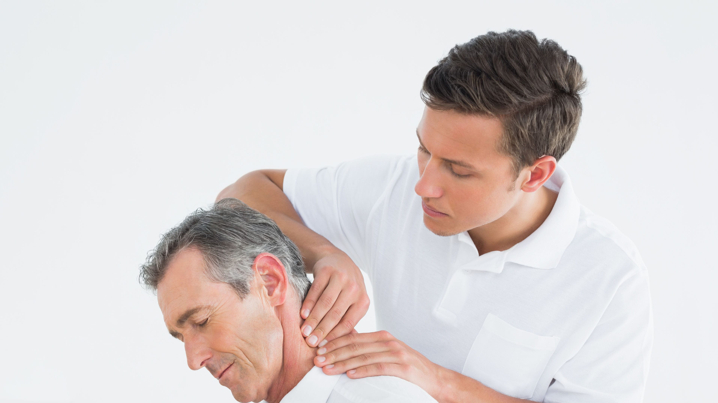
Treating Ear Injuries
The external ear helps to funnel sound to the inner ear, and the inner ear plays a role in equilibrium
With its permanent placement on the side of the head, the ear does not have a high incidence of injury
In high school athletics, earrings are barred from competition because of potential ear injury

Slide 2
Swimmer's Ear (Otitis Externa)
Swimmer's ear: an infection that results from water in the ear
Proper care of the ear requires that the ear and the canal be dried after swimming
There are times with a swimmer cannot remove the water from their ear and if it remains in the ear, inflammation of the canal can occur
The athlete will experience pain, itching, hearing loss, and possibly a smelly discharge from the ear
It is not easy to notice the discharge or swollen, red ear canal
If the infection is not controlled, it can spead deeper into the canal
Athlete should be sent to a physician for ear drops and antibiotics
Prevention of swimmer's ear can be as simple as drying the ear after swimming by using a hair dryer on a low setting
Rubber or wax plugs are sometimes used to lessen the flow of water into the ear, but these can actually increase the risk of infection because they irritate the ear canal; can impair hearing when a coach is trying to communicate with you
Many athletes clean their ears regularly to prevent infection, but this too can become problematic
The American Academy of Otolaryngology states that ear wax is an important barrier to infection and regular cleaning forces wax out of the canal

Slide 4
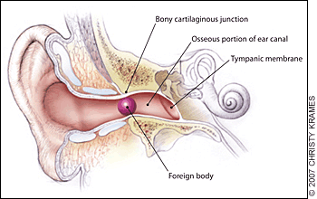
Foreign Body
In athletics, foreign bodies in the ear are rare, but bugs can end up in athlete's ears
The athlete will have the sensation that something is in the ear and may experience pain
Probing the ear with a cotton-tipped applicator may push the object further into the ear and should be avoided
The AT could also rupture the eardrum trying to get the object out
A physician can remove an object using mineral oil or special tweezers

Slide 5
Cauliflower Ear (hematoma Auris)
Cauliflower ear: a condition that occurs when the pinna (the projecting portion of the external ear) begins to bleed internally after an impact, causing swelling, redness, and pain. As the ear heals, an excessive growth of raparative tissue distorts the pinna, making it look like a piece of cauliflower
Wrestlers are the athletes who suffer the most from cauliflower ear
The wrestler involved usually is not wearing his headgear and gets hit hard in the ear, or his head and is pushed hard into the wrestling mat
Treatment: starts with ice and compression with a moldable material; physician may lance or drain the ear and use a steroid medication to to keep the hemorrhage under control
In more complicated cases, the physician may remove the tissue through surgery
Some athletes opt for plastic surgery to fix the ear if it is permanently distorted
Wearing headgear and applying petroleum jelly to reduce friction can prevent cauliflower ear

Slide 6
Pinna Laceration
Ears stick out from the head enough that they may get in the way
Athletes should never wear earrings in practice or competitions because they increase the vulnerability of an already exposed body part
An earring can be caught by another athlete's finger and tear the ear lobe
Even in sports where the ears are protected by a helmet, earrings may be jammed against the wearer's head if the head is struck
A laceration of the pinna is treated the same as any other wound---controlling the bleeding with direct pressure, which can be applied on both sides for rapid control
When a portion of the pinna is no longer attached, the missing piece must be found so that it may be reattached
The detached part should be wrapped in sterile gauze, put in a plastic bag, and placed in a container full of ice
The athlete should be referred to a physician for stitches and tetanus shot
The athlete can prevent ear lacerations by wearing proper headwear

Slide 8
Ruptured Eardrum
Ruptured eardrum: a tear of the tympanic membrane
Can occur from an ear infection, a blow to the side of the head, loud noises, and atmospheric pressure
The athlete may experience loss of hearing, buzzing in the ear, and drainage from the ear
A physician will have to examine the ear and do a hearing test to determine the extent of the injury
In some cases, no treatment is necessary and the membrane will heal on its own; sometimes antibiotics are necessary to deal with the ear infection
For sever ruptures, or ruptures that do not heal, surgery may be necessary
An athlete will need to wear headgear to protect the membrane and must not put anything in the ear

Slide 9
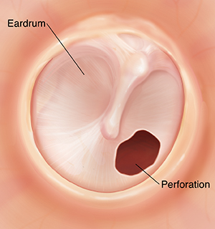

Slide 10
Treating Nose INjuries
For some athletes, the nose is always in the way
In boxing, it is constantly being smashed by a fist
Wrestlers can find their noses rubbed into the mat and even used as a carrying handle by opponents
Basketball players' noses seem to be attracted to the elbows of opposing players
The nose is vital as it warms incoming air and acts as a filter to catch particles

Slide 11
Nosebleed (Epistaxis)
Epistaxis: bloody nose
When an athletes goes to head a soccer ball and it lands on their nose, it can cause a bloody nose
An athlete may get a nosebleed during a cold from constantly blowing their nose
Athletes taking special medications, as well as those who have had a recent nosebleed, are prone to epistaxis
The nose will bleed from one or both nostrils and if the nosebleed is from a blow, it will be painful
The AT should instruct the athlete to lean forward while pinching the nose
Applying ice and packing the nose the gauze that has been soaked with an astringent are helpful
Leaning the head backwards forces blood into the throat, obstructs the airway, and should be avoided
The athlete should lean forward to allow blood to discharge from the nose and should spit out blood draining into the throat---swallowing the blood can cause vomiting
Discourage any attempt to blow the nose because this will start the bleeding process again
If there is excessive bleeding (gushing like a faucet), the athlete should be treated for shock and sent to the hospital for evaluation; physician may cauterize the bleeding vessel

Slide 13
Deviated Septum
The septum is the piece of cartilage that separates the left and right sides of the nose
A deviated septum has moved to one side, caused decreased airflow through the nasal passageway
Any form of direct impact to the nose can cause a deviation
The blow to the nose will have caused a nosebleed, so the AT will follow the instructions for epistaxis first, then wait a day or two to test the athlete for a deviated septum by blocking off one nostril and having the athlete force air out of the nose and then repeating the procedure on the other side
If one nostril forces more air through than the other, the septum may be deviated
If the athlete has the deviated septum, the nose may also be broken
The athlete should be referred to a physician to determine if surgery is necessary
Many athletes who have a deviated septum choose not to have surgery
Wearing a face mask will prevent further injury to the nose

Slide 14
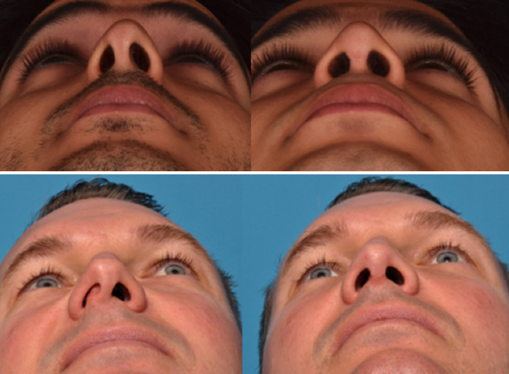

Slide 15
Nasal fracture
A direct blow to the nose can fracture one or both of the nasal bones
There will be a severe nosebleed, often similar to water running from a faucet
The AT will treat the athlete by having them lean forward, but pinching the nose may not be possible
The AT will use gauze to catch the blood as it comes out of the nose and will apply ice
Gauze should not be forced into the nostril to slow bleeding
The athlete may indicate that they heard a snap and possible pain and difficulty breathing
The AT should observe deformity (flat on one side) and swelling
Crepitus: a grinding sound that is heard by the athlete, AT, or both. Crepitus can indicate a fracture, cartilage wear, or severe joint inflammation
The athlete should be referred to a physician where they may proceed with surgery to put the bones back
Some athletes who may opt against surgery suffer from permanent deformed nose
In the days after a nasal fracture, the athlete will have black eyes from the internal bleeding that pools underneath the orbits of the eyes

Slide 16
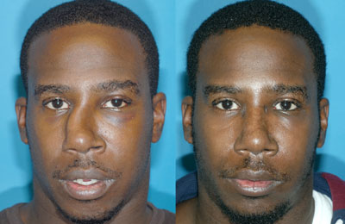

Slide 17
Treating Mouth injuries
Although some people believe that loosing teeth is no big deal because they can always get false teeth, this is not the case
False teeth are not nearly as good as real teeth at biting and chewing, making it difficult to maintain health nutrition
The AT should use caution when treating the mouth---some athletes may bit because of a seizure or because they are gagging

Slide 18
Tooth fracture
Direct impact to the lower jaw or the teeth can result in a tooth fracture
The athlete will experience pain and difficulty closing their mouth
A fracture can be seen if the tooth is examined closely
In some cases, a portion of the tooth will be gone
If a portion is broken off, it should be sent with the athlete to the dentist
Although the portion cannot be put back on, the dentist may find it helpful when reconstructing the tooth
The broken tooth may die and have to be removed

Slide 19
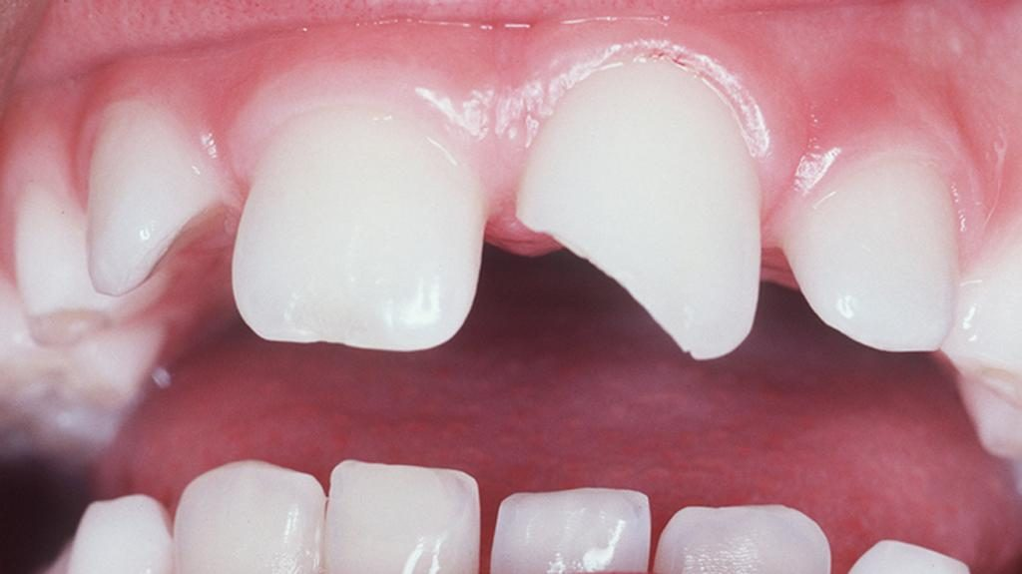

Slide 20
Tooth dislocation
Direct impact to a tooth can knock it out of the jaw
The athlete will experience severe pain, bleeding, and swelling
The tooth is dislodged and needs to be handled carefully
After putting on gloves, the AT should pick up the tooth with a sterile gauze pad and must be kept moist and should be placed in a designated saline tooth container or a glass of milk
The athlete must be seen by a dentist so that the tooth can be put back in place, assuming it is not too severely injured to be reinserted
The AT should treat the bleeding socket, placing a piece of sterile gauze where the tooth was located and having the athlete gently bite down to keep it in place with direct pressure

Slide 21
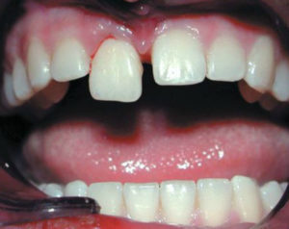

Slide 22
Jaw Fracture
Imagine getting hit in the face by a sharply hit baseball, a scenario that is not uncommon in athletics
A direct blow to the jaw, either upper or lower, can result in a fracture
The athlete will experience pain that increases with movement
If the lower jaw has been fractured, they may be able to observe a space between teeth that was not there previously
The athlete will have discoloration under the tongue and their teeth may not line up
Palpation will reveal crepitus, and the athlete will then be cautious about moving the jaw
The AT should make sure all the teeth are in place and that the airway is clear
Ice should be applied to the area as tolerated by the athlete, who should be referred immediately to a physician for care
The physician will realign the jaw for proper closure and wire the mouth shut
The athlete will eat through a straw for 4-6 weeks
Some athletes are allowed to return to activity as long as a special face mask protects the jaw
Improper care or neglect of a jaw fracture can result in permanent deformity as the jaw may not be able to open wide enough to allow for eating a hamburger, and misalignment of the teeth can lead to further mouth problems

Slide 23
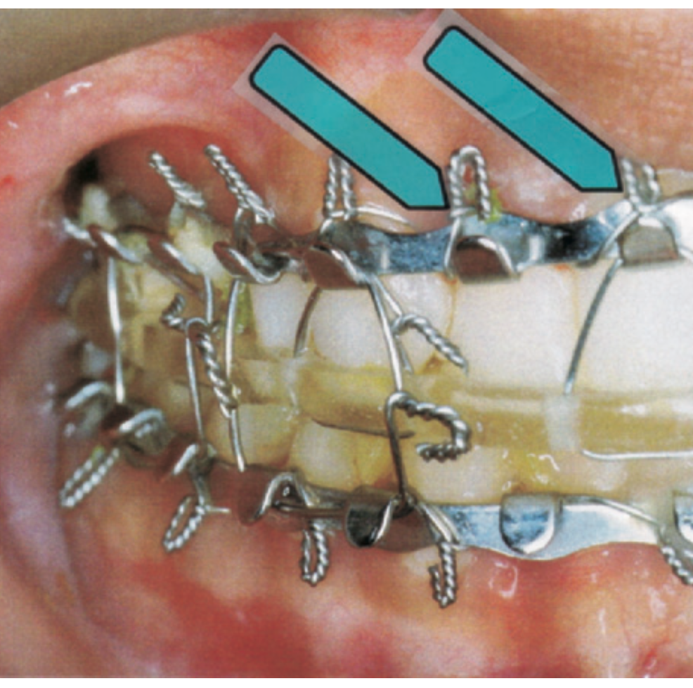
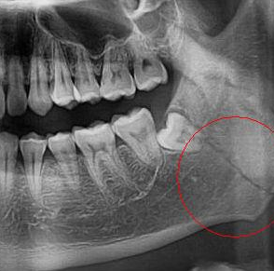

Slide 24
Temporomandibular dislocation
A blow to the chin or a violent, forced opening of the mouth can cause a dislocation
The athlete will immediately grab and hold their mouth to keep it from moving
The jaw will lock itself in place by spasm of the local muscles, and the athlete will experience extreme pain
Their jaw will look deformed, locked open, or to one side
The AT can feel that the condyles are out of normal position
The AT should put the jaw back in place because the area around the jaw is filled with nerves and cartilage that can be permanently damaged
The physician should relocate the jaw, which must then be kept shut for several weeks
Some physicians wire the jaw shut to ensure the rest

Slide 25
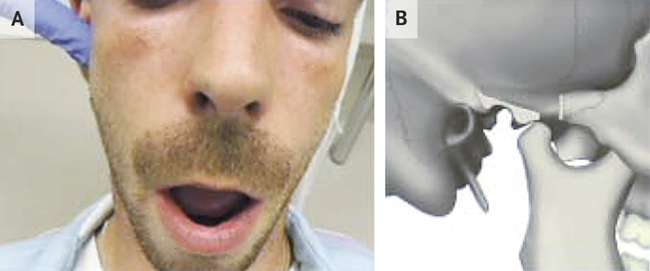

Slide 26
Temporomandibular Joint Dysfunction
Temporomandibular joint dysfunction (TMJ): a condition where the muscles surrounding the joint spasm
The spasms can be caused be stress, a blow to the mandible, or an injury to the muscles
The dysfunction can cause misalignment of the teeth, inability to open the mouth fully, clicking of the jaw, earache, pain in the musculature of the mouth, and headaches
Upon examination, the AT may find a lack of ROM, holding the jaw, poor alignment upon opening or closing, or crepitus
Treatment includes relaxation of the muscles of the jaw, such as from a massage or trigger point techniques
In some instances, the athlete may require muscle relaxers or pain medication
A dentist may choose to make a bite splint to prevent TMJ from recurring

Slide 27
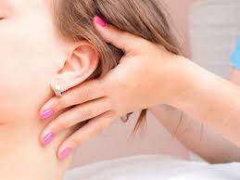
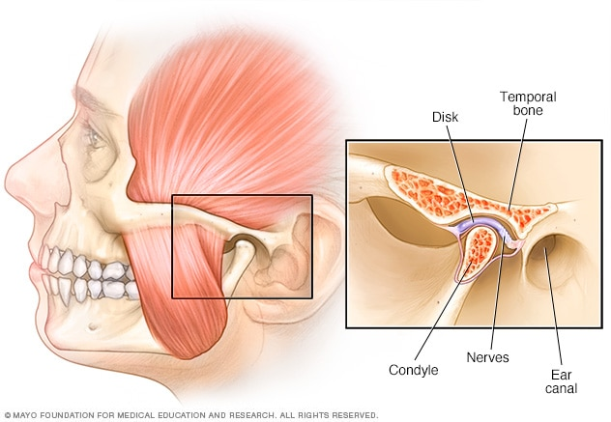

Slide 28
source
Fundamentals of Athletic Training

