Slide 1
Chapter 8: Abdominal Injuries
Unit 3: Understanding Athletic INjuries to the Axial Region

Slide 2
Objectives
Understand the anatomy of the abdomen
Understand the implications of illness or injury related to specific organs
Understand how to prevent injuries to abdomen
Describe the care necessary to treat an abdominal injury

Slide 3
Anatomy of the Abdomen
The abdominal cavity is bounded by the lumbar spine posteriorly and the diaphragm anteriorly
Abdominal cavity is divided into 4 quadrants by an imaginary horizontal line running across the abdomen through the navel and an imaginary vertical line running from the sternum through the navel to the area between the legs
The abdomen contains both solid and hollow organs, such as the bladder, intestines, stomach, and appendix
Abdominal organs can be divided into 3 categories: urinary, digestive, and reproductive

Slide 4
Digestive Organs
The stomach secretes gastric juices that assist in breaking down food before it enters the intestines
The liver has several functions, including detoxification of chemicals that the body perceives as poisons, such as alcohol
The liver stores several vitamins, produces bile, and assists with food metabolism
The pancreas produces insulin and enzymes for digestion
The small intestine completes the digestive process of breaking down food
Peristalsis occurs here
In the large intestine, water is absorbed, leaving solid waste for excretion

Slide 5
Reproductive Organs
In females, ovaries produce eggs for possible fertilization and the hormone estrogen
Estrogen is the chemical that stimulates the development and maintenance of feminine characteristics
The uterus is the organ where the fertilized egg develops
In males, the seminal vesicles and prostate gland are responsible for adding fluid and nutrients to seminal fluid
Males are particularly at risk of injuries to the reproductive organs because these organs are external
A common injury for males is a testicular contusion
Testicular trauma can be prevented by wearing a cup

Slide 6
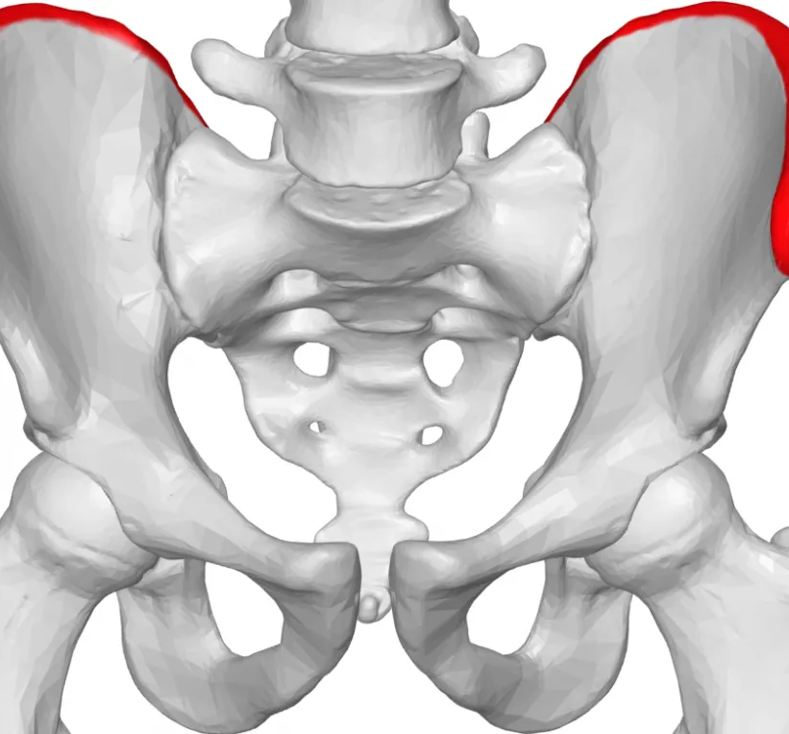
The Pelvis
The pelvis is the structure that provides a bony base and solid protection for some abdominal organs
The top edge of the pelvis is known as the iliac crest, which is the attachment point for the abdominal muscles
The pelvis of the female has a larger opening and is wider than in the male in order to permit childbirth

Slide 7
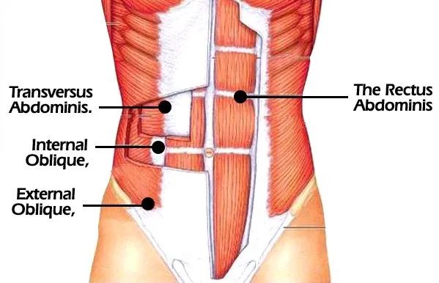
Abdominal Muscles
Although the liver and spleen are slightly covered by the inferior-most portion of the ribs, protection of the abdominal organs is mainly provided by the abdominal musculature and fat
The primary muscles of the abdomen are the rectus abdominus and the obliques
The rectus abdominis is responsible for forward flexion
The obliques help compress the abdomen
If someone threatens to hit you and you tighten your muscles, you are contracting your obliques

Slide 8
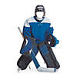
Preventing Abdominal Injuries
Preventing injuries of the abdominal organs is essential because abdominal trauma can quickly cause death
Sport rules that require protective equipment and limited contact are designed to prevent abdominal injuries
Ice hockey goalies wear protective equipment for the abdomen and reproductive organs
Other players can protect themselves by tightening their abdominal muscles
Most sports do not allow tackling from behind so that athletes can be protected
Boxing has a rule that it is illegal to hit below the belt
Athletes should empty bladders before competition because full bladders are prone to rupture on impact

Slide 9
Treating Abdominal Injuries and Conditions
Injuries within the abdominal cavity, especially to the hollow organs, are rare
The solid organs, the liver, spleen, and kidneys, can be injured and internal bleeding may result
The AT should assess any athlete who has received a blow to the abdominal area, especially if they have abdominal pain, signs of shock, muscle spasms, or blood in urine

Slide 10
Side Stitch
Side stitch: pain just below the ribs in the upper abdominal region
Can occur due to lack of oxygen, improper breathing, eating food just before exercising, air trapped in the abdominal organs, and muscle spasms
In general, people who are less fit get side stitches more often
Athletes experiencing the pain of a stitch resolve it by stopping exercise or by pressing directly over the area
A muscle spasm stitch can be resolved by raising the arm on the same side of the pain and leaning away from the painful area
If pain does not resolve, the athlete needs to see a physician

Slide 11
Hernia
Hernia: lump of tissue, usually the intestine, that bulges through a weakness in the abdominal wall
Hernias can result from increased abdominal pressure, which may occur if the athlete holds their breath while weightlifting or going to the bathroom
The lump may go away when the athlete lays down and bulge again when they stand up
In males, the intestines may go through the inguinal canal and stay in the scrotal sac
The athlete may or may not have pain
A hernia must be surgically repaired, although a truss, or strap, can be used temporarily to apply pressure to keep the bulge inside the abdomen
A truss does not work for inguinal hernias and cannot be used by athletes who participate in contact sports or weightlifting
If not treated, the bulge of tissue can get stuck in the abdominal wall, called strangulation
Strangulation cuts off the blood supply to the tissue, causing it to eventually die
If intestinal tissue is involved, a bowel obstruction will result
The obstruction prevents the passage of waste material from the body, causing pain and illness

Slide 12
