Slide 1
Pancreas Injury
The pancreas is located behind the stomach near the liver and the spinal column
It is prone to injury during deceleration
When an athlete running with the ball hits a wall; the wall does not cause the injury, but as the pancreas shifts forward when the rest of the body stops, it tears
The athlete will have pain in the middle of the abdomen to the back as well as nausea, vomiting, and signs of shock
The athlete should be referred to the hospital for additional examination
A ruptured pancreas must be surgically repaired

Slide 2
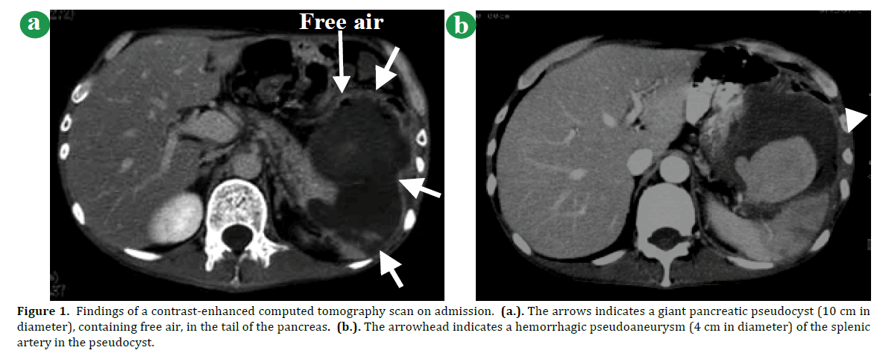

Slide 3
Liver Injury
A blow to the upper right abdomen can result in a contusion or rupture of the liver
The athlete will experience pain over the area that may radiate to the right shoulder
As the athlete loses blood, they will eventually go into shock, have a rapid and weak pulse, and experience a drop in blood pressure
They must be referred to a physician immediately
The AT should be suspicious of a liver contusion if the athlete receives a blow to the area
The athlete may die if the liver is ruptured and goes untreated

Slide 4
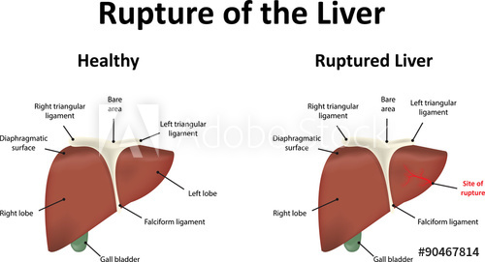

Slide 5
Kidney Injury
A direct blow over the kidney can cause a contusion, laceration, or rupture
The athlete will experience pain just under the posterior ribs to the side of the spine and the pain may radiate to the bladder
Pain will increase with trunk extension and ease with knee or hip flexion
The athlete may feel nauseated and vomit
Urine may have visible blood, and the blood loss may cause the athlete to go into shock
Injury requires prompt emergency care and hospitalization
Generally, an athlete with a kidney injury is required to rest for several weeks before returning to competition
Possible complications are scarring of the kidney and hypertension

Slide 7
Bladder Injury
A rupture of the bladder causes urine to leak into the surrounding area
The athlete may have painful urination, a contusion over the bladder, or blood in the urine
The athlete should report any of these symptoms to the AT
In severe cases, athletes go into shock, rapid heart rate, decreased BP, anxiety, and sweating
When the injury mechanism suggests a bladder injury, the athlete should be referred to a physician for immediate evaluation
The AT should instruct the athlete to look for the signs and symptoms

Slide 8
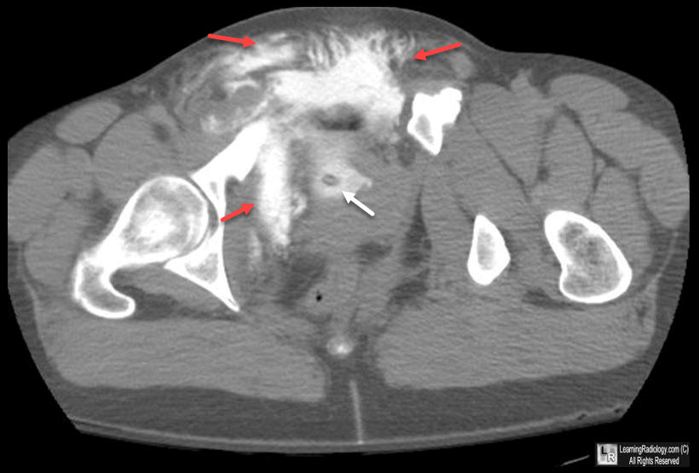

Slide 9
Spleen Rupture
A blow to abdomen may injure the spleen
The spleen that is enlarged from an infection is more prone to rupture, so athletes recovering from illness, especially mono, should not be allowed to play without a physician's permission
Athletes with a spleen injury will experience abdominal pain and pain in the left shoulder
Kehr's sign: pain in the abdomen and the left shoulder that most often indicates injury to the spleen
The athlete will often indicate nausea, cramps and weakness, and may pass out
Upon examination, the AT may not abdominal spasms, vomiting, rapid HR, decreased BP, and shock
The athlete must be transported by EMS to a hospital immediately
Medical emergency
A ruptured spleen can bleed severely, causing rapid blood loss and a drop in BP
An athlete with less severe spleen injuries will be hospitalized overnight for observation
Ruptured spleen may be surgically removed
Athletes who have their spleen removed are able to play sports after total recovery

Slide 10
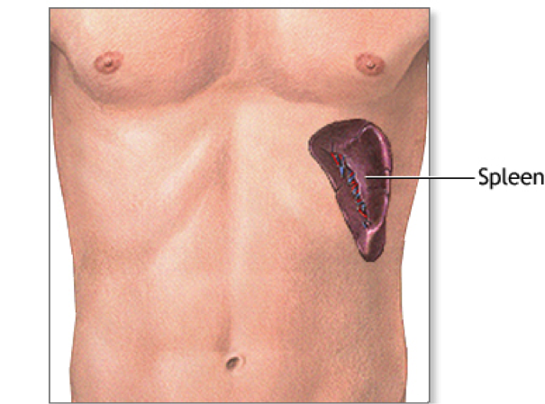

Slide 11
Reference
Fundamentals of Athletic Training

