Slide 1
Chapter 10: Shoulder Injuries
Unit 4: Understanding Injuries to the Upper Extremity

Slide 2
Objectives
Understand the basic anatomy of the shoulder
Explain how shoulder injuries occur
Describe the types of injuries to the shoulder
Explain treatment procedures for common shoulder injuries

Slide 3
Anatomy of the Shoulder
The shoulder is a ball and socket joint similar to the hip, but must shallower
Relies on muscular strength for its stability
Several bones link up at the shoulder, combining possibilities for movement across a wide range
The entire bony linkage of the shoulder is often referred to as the shoulder girdle

Slide 4
Anatomy of the Shoulder: Bones
The shoulder joint has 3 bony components, the humerus, the clavicle, and the scapula, which are held together by ligaments
The head of the humerus, which is the bone of the upper arm, is round and smooth and its into the glenoid fossa of the scapula
The humerus has a groove near the top, referred to as the bicipital groove, where the biceps tendon moves up and down during flexion and extension of the elbow
The clavicle, or collarbone, articulates at the tip of the shoulder and at the sternum near the throat
The scapula, or shoulder blade, has two forward projections that are located on the anterior aspect of the shoulder: the acromion process and the coracoid process
The rotator cuff muscles attach to the scapula

Slide 5
Anatomy of the Shoulder: Muscles and Tendons
Rotator cuff: a group of muscles around the shoulder joint; supraspinatus, infraspinatus, teres minor, subscapularis
These muscles are responsible for rotating the arm internally and externally as well as abducting the shoulder
The rotator cuff muscles are easy to remember if you use the acronym SITS
The deltoid muscle lies over the head of the humerus; it attaches to the acromion process and the lateral aspect of the humerus
The deltoid abducts, flexes, and extends the shoulder
Pectoralis major/minor: anterior portion of the shoulder
Biceps flexes the elbow and attaches to the humerus and coracoid process on one end and to the radius on the other

Slide 6
Anatomy of the Shoulder: Ligaments and Joints
The shoulder girdle is composed of several joints that are held together by ligaments, but the most commonly injured ones include the acromioclavicular joint and the glenohumeral joint
Acromioclavicular joint: acromion process of the scapular and the distal end of the clavicle
Held together by the acromioclavicular ligament
Glenohumeral joint: articulation for the head of the humerus and the glenoid fossa

Slide 7
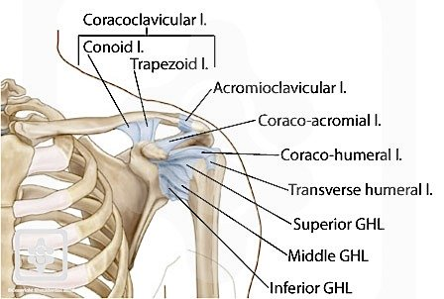
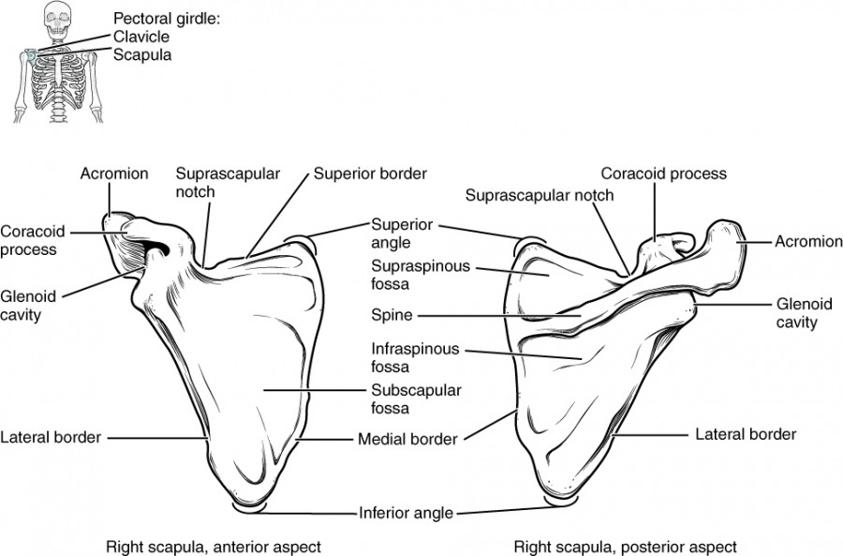
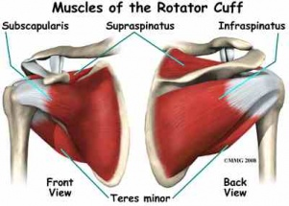

Slide 8
Preventing Shoulder Injuries
The AT and athlete must know what kinds of shoulder injuries occur to prevent them. Shoulder injuries are often caused by muscle weakness, postural problems, and nature of the sport

Slide 9
Addressing Muscular Weakness
People have a tendency to lift their "show muscles"--muscles they can see in the mirror, therefore, causing weakness in the opposing muscles
Athletes who have rounded shoulders, tight pectoral muscles, or weak posterior shoulder muscles may predispose themselves. The supraspinatus muscle, nerve, and blood vessel run through a narrow space between the acromion process and the head of the humerus, and a narrowing of that space can pinch those tissues
Repetition of activity, like swimming or throwing
Swimmer who does 300 strokes of backstroke and 300 stroke of freestyle balances their activity
Athletes involved in throwing sports need to learn proper form
During a physical, the physician must determine muscular weakness of an athlete; some athletes have one shoulder that sits higher than another---shoulder stretch

Slide 10
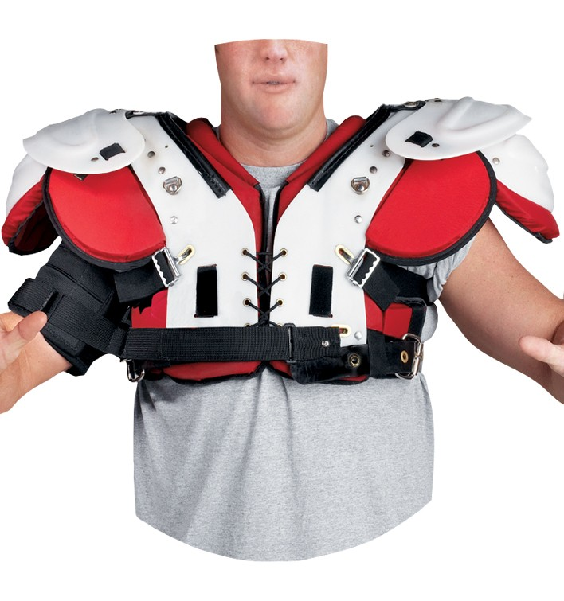
Using Protective Padding
Games that have a tremendous amount of shoulder impact allow the use of shoulder pads---the heavier the impact, the thicker the padding
Ice hockey, football, & men's lacrosse

Slide 11
Modifying Activity
Many sports require a great deal of overhead activities with high levels of stress placed on the shoulder joint and surrounding soft tissues
Consider that a throwing athlete can accelerate their limb more than 6,000 degrees a second when throwing; therefore, it's easy to see how an overuse injuries can occur
Throwing a curve ball was associated with a 50% increase in risk of shoulder pain
High number of pitches thrown can increase upper-extremity pain
To lessen extent of injury, it is advisable to modify this type of activity that an athlete engages in
Young athletes 9-14 should not throw curveballs; should be limited to 75 pitches/game and 600/season

Slide 12
Treating Shoulder Injuries
The shoulder is often overworked through throwing, striking, and catching. This makes it vulnerable to a variety of musculoskeletal injuries.

Slide 13
Bone Injuries
A lot of stress is put on the bones of the shoulder due to amount of activity and ROM
Epiphyses injuries must be considered, especially with younger athletes
The shoulder is covered by heavy musculature and ligaments
The layers of tissue can make a fracture difficult to determine

Slide 14
Bone Injuries: Clavicular Fractures
The clavicle is most often fractured at its weakest point, the distal third.
The clavicle curves as it gets closer to the tip of the shoulder
An athlete can receive a direct blow or fall on the tip of the shoulder, causing a fracture; the athlete will experience pain and hold the arm close to the body to prevent movement
The athlete is given a sling to prevent arm movement; use of ice decreases swelling and pain
The clavicle can be set using a harness
The fracture takes 6 weeks to heal, during which most athlete must wear a clavicle harness

Slide 15
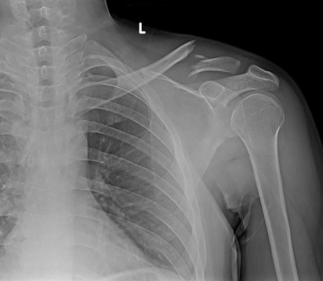
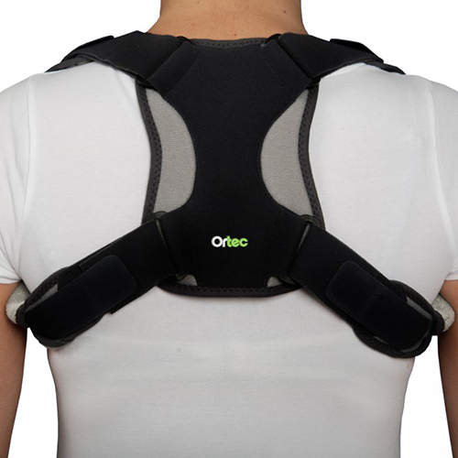

Slide 16
Bone Injuries: Humeral Fractures
Fractures of the humerus are not difficult to find if they are located midshaft, but the shoulder musculature can sometimes hide a fracture of the humeral head
A shoulder sprain can mimic a fracture, so care must be taken to ensure proper assessment
The athlete will be unable to move the arm and will experience pain; may report hearing or feeling a pop, and often times will hold the arm against the body
AT should refer athlete to a physician and place the athlete in a splint from shoulder to the fingertips
AT will need to check pulse before and after splinting; if the pulse has decrease, the fracture could have a serious complication
Nature of the fracture will determine an athlete's treatment; some may need a sling, some may need surgery and a long arm cast
It will take at least 6 weeks to heal

Slide 17
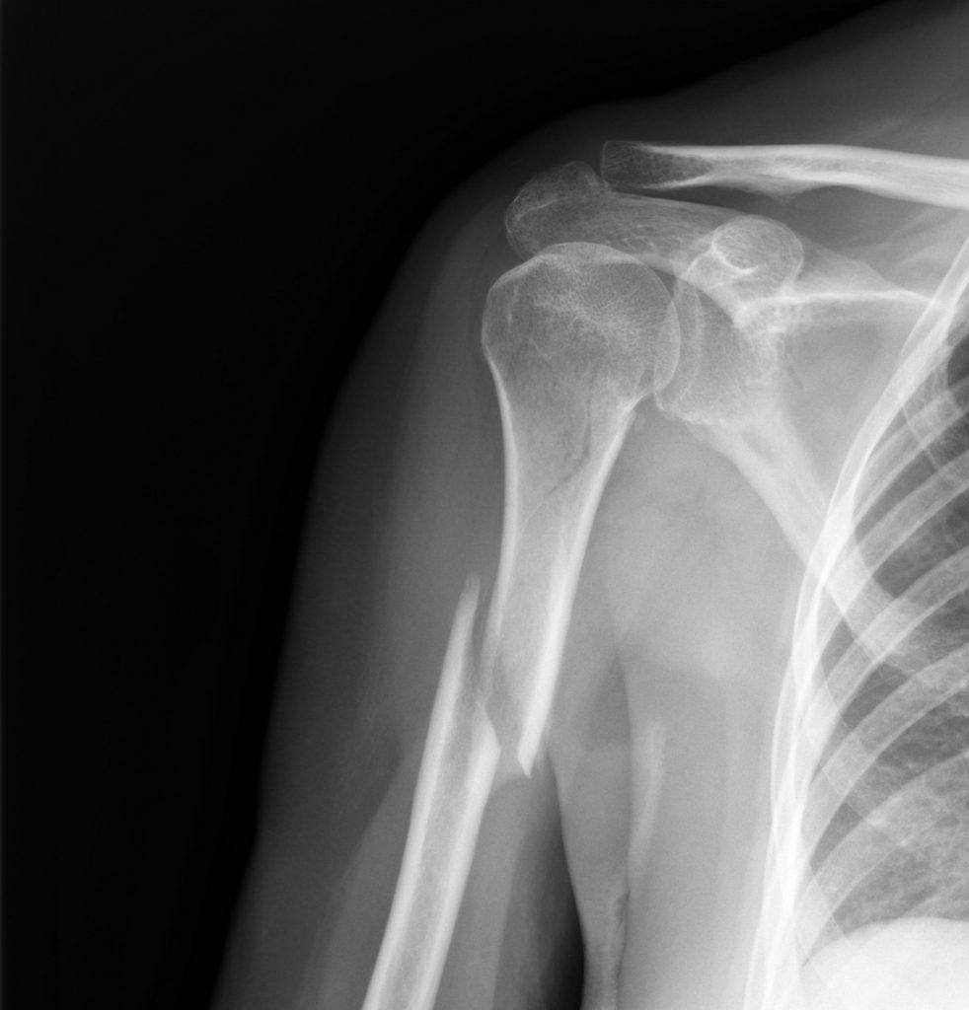

Slide 18
Bone Injuries: Epiphysis Injuries
The growth plate in a young athlete's shoulder is susceptible to direct and indirect blows
A blow to the head of the humerus and falling on the elbow can cause an epiphyseal fracture
Same signs as symptoms of humeral fractures
Pain (increased with flexion), inability to use arm, desire to hold arm close to body, hearing a pop
Can cause permanent growth impairment
Applying ice, splinting, and a sling are the best courses of action an AT can take
The physician will determine the severity of the epiphyseal injury as well as treatment
Some epiphyseal injuries require surgery to hold the humerus head to the shaft
Teenage pitches can be prone to epiphyseal injury from excessive throwing
Caution must be taken with this injury or else can result in permanent loss of ROM

Slide 19
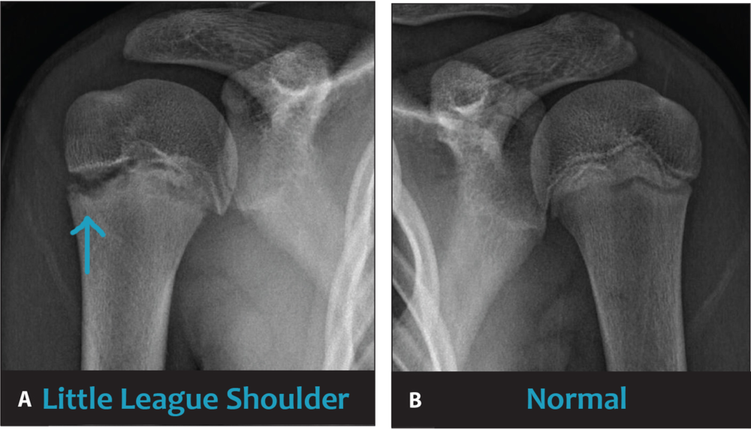

Slide 20
Bone Injuries: Avulsion Fractures
A ligament or tendon pulls away from a small portion of the bone and becomes stressed during an injury
Can occur in the shoulder and can be accompanied with a glenohumeral or acromioclavicular sprain
When the humerus is dislocating from the glenoid fossa, the capsular ligament is stressed and can sometimes pull on the scapula, resulting in an avulsion fracture
The athlete will experience pain
Challenging for the AT to determine this injury; must assume avulsion fracture until X-ray shows otherwise
Splinting and ice

Slide 21
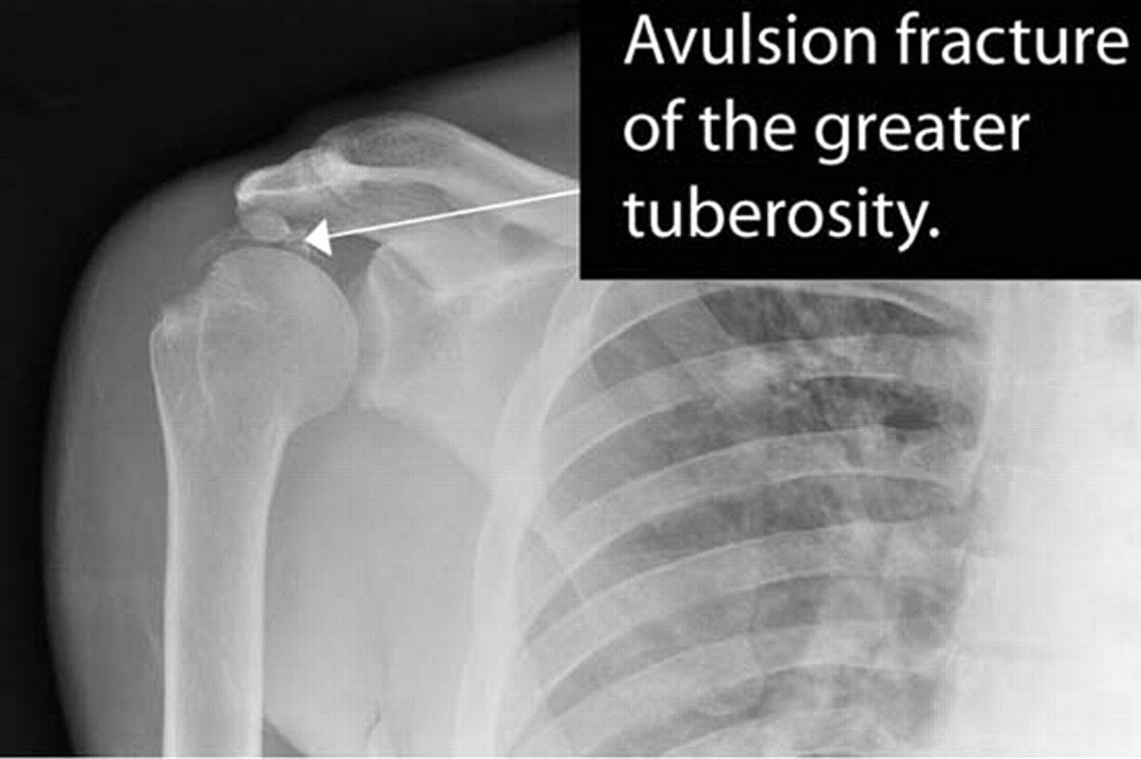

Slide 22
Bone Injuries: Glenohumeral Dislocations and Subluxations
Glenohumeral dislocation: the head of the humerus is out of the socket
Subluxation: the head of the humerus came out of its socket and then went back in
The cause of both injuries is usually the same---excessive abduction and external rotation, but the results are completely different
A dislocation will sometimes cause the head of the humerus to tear the capsular ligament anteriorly
The instability of the capsular ligament allows the head of the humerus to shift forward, which is the most common type of shoulder dislocation
Athlete will experience pain and inability to use the shoulder; AT will notice a deformity at the deltoid muscle (the shoulder will appear round, but flat)
The team physician must put a dislocation back into place
In the case of a subluxation, the athlete may indicate that they felt their shoulder go out of place and pop back in
An X-ray is necessary to determine the extent of the dislocation or subluxation

Slide 23
Bone Injuries: Glenohumeral Dislocations and Subluxations con't
An athlete may not indicate to the AT that they have experienced a shoulder subluxation, but eventually they athlete will notice some changes as most subluxations occur
There can be permanent injury of nerves, cartilage, and blood vessels
The athlete who has a dislocation or subluxation should strengthen their muscles of adduction and internal rotation
They may also wear a harness that restricts external rotation and abduction
An athlete who experiences recurrent subluxation will require surgery to repair the capsular ligaments

Slide 24
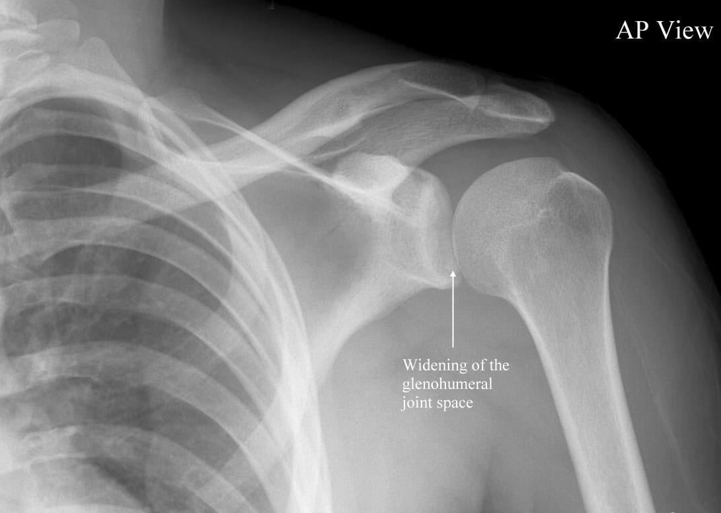

Slide 25
Muscle and Tendon Injuries
Most shoulder and tendon injuries are caused by overuse. Athletes who throw, shoot, or repeat a swim stroke are prone to overuse injuries.

Slide 26
Muscle and Tendon Injuries: Rotator Cuff Strain
Similar to other strains, a strain of the rotator cuff is categorized as a first-, second-, or third-degree strain
First-degree: pain with no loss of stability or ROM
Second-degree: pain with some loss of stability and ROM
Third-degree: pain with partial or complete loss of stability and ROM
Strains of the rotator cuff occur from excessive motion beyond normal range
Most often the supraspinatus muscle is injured
The athlete will have pain with motion and sometimes when the shoulder is not moving
The pain generally occurs with abduction of the shoulder
If the athlete is unable to abduct, a complete tear, or third-degree strain should be suspected
Strains caused by repetitive movement can also cause crepitus and impingement syndrome
A complete tear must be surgically repaired, but first- and second-degree is treated with PRICES along with gentle strengthening and stretching

Slide 27
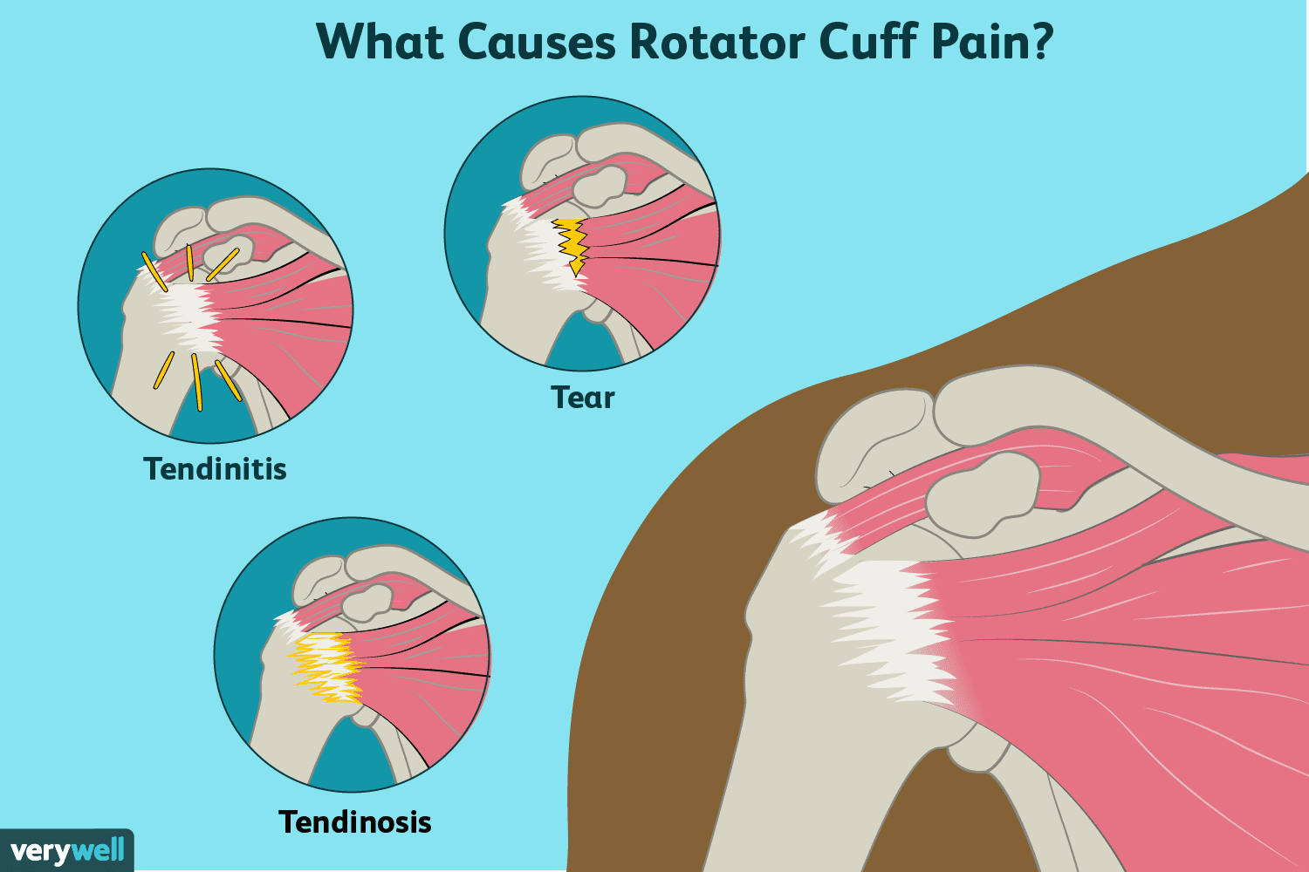

Slide 28
Muscle and Tendon Injuries: Impingement Syndrome
Impingement syndrome: collection of symptoms caused by compression of either the biceps tendon or supraspinatus tendon below the acromion of the shoulder
Freestyle swimmers, throwers, and tennis players are prone to impingement syndrome
The supraspinatus and biceps muscles run together throw a space beneath the acromion process
If the space narrows from swelling, tendinitis, weak posterior muscles, or poor posture, the two muscles are impinged in the space
This creates pain and discomfort with overhead movements
Treatment of impingement syndrome includes modifying activity, strengthening the posterior muscles of the shoulder, and improving flexibility of tight pectoral muscles

Slide 29
Muscle and Tendon Injuries: Bicipital Tendinitis
Common among athletes such as tennis players who are constantly raising their arms above their heads
The repetitive nature of the movement will cause irritation of the tendon in the bicipital groove
The AT may be able to palpate the tendon and feel crepitus
The athlete must stop the repetitive action
Pain is common, especially when repeating the motion caused by the tendinitis
Immobilization in a sling will make the athlete more comfortable
The team physician may prescribe ultrasound therapy and anti-inflammatory medication

Slide 30
Muscle and Tendon Injuries: Biceps Tendon Rupture
The biceps tendon can rupture from either a direct blow or severe contractional forces
When the tendon ruptures, the athlete will be unable to flex the elbow
There will be a noticeable change in the appearance of the muscle as the tendon rolls up on itself
It will look like a golf ball under the skin
The arm must be iced and immobilized, and the athlete should be referred to a physician

Slide 31
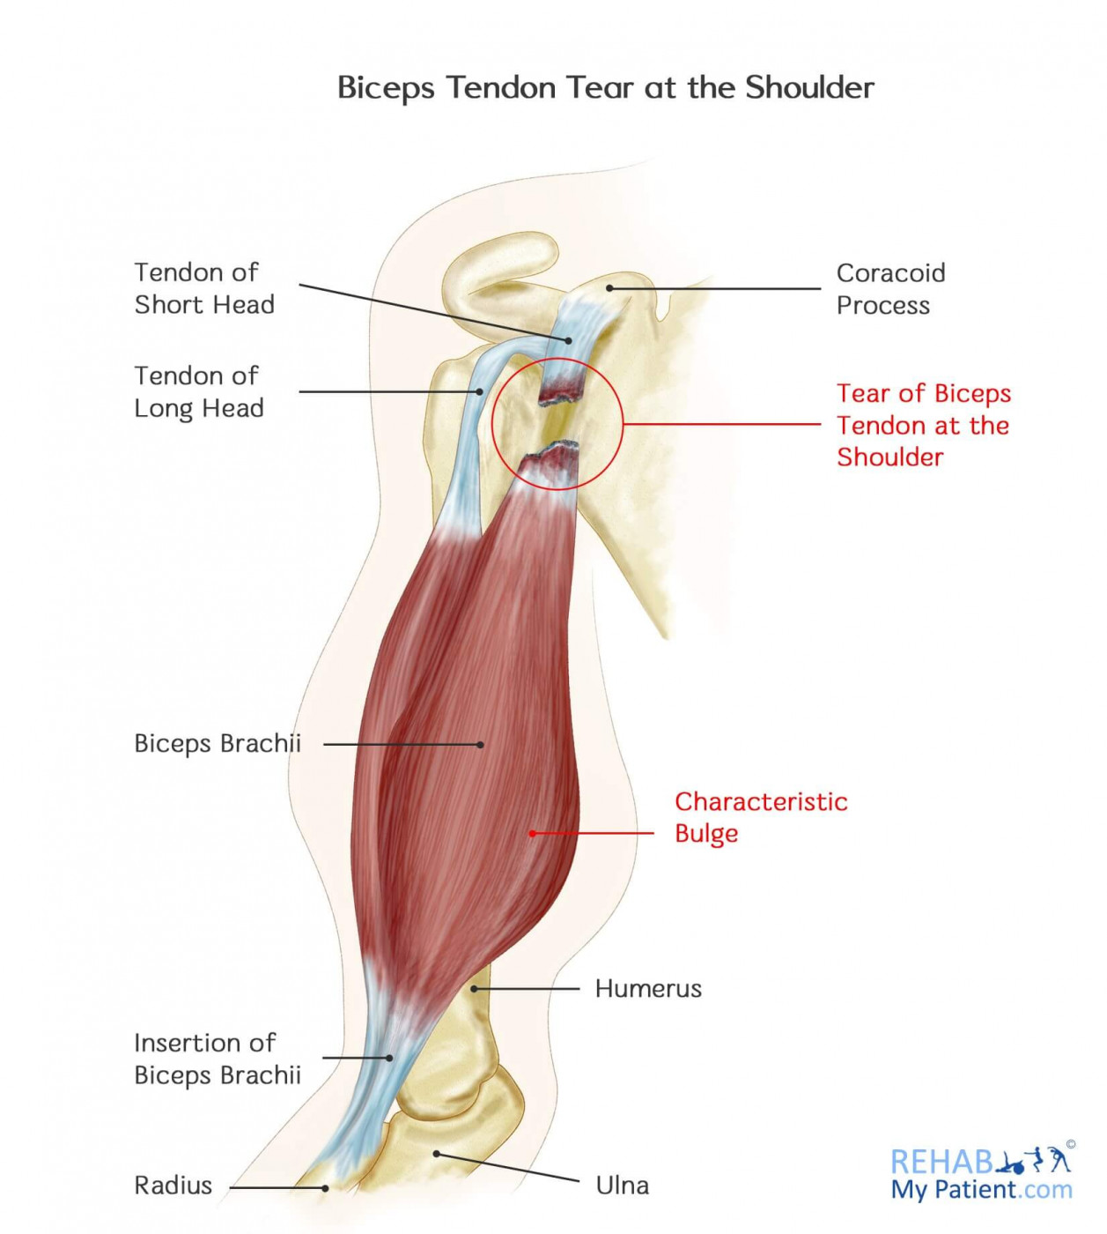
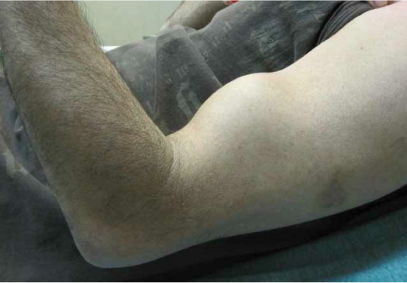

Slide 32
Ligament and Joint Injuries
Several joints of the shoulder girdle are prone to sprains. The joints that are most commonly sprained include the acromioclavicular and glenohumeral joints

Slide 33
Ligament and Joint Injuries: Acromioclavicular Ligament Sprain
A sprain of the acromioclavicular ligament is referred to as shoulder separation
Although these joints are in close proximity, they involve different structures
The acromioclavicular joint can be injured by impact to the top of the shoulder or by falling on an outstretched arm
Falling on the elbow forces the humerus up and into the acromioclavicular joint
The athlete will feel pain with movement no matter what degree
The more serious sprains cause the clavicle to move superiorly
In a third-degree separation there will be a large abnormal bump caused by excessive upward displacement of the clavicle
The athlete is usually unable to move the arm and will hold it tightly against the body
To treat a first-degree, the AT uses PRICES
A second- and third- degree is treated with PRICES initially, but also referred to an orthopedist to rule out a fracture
Surgery or harness include treatment

Slide 34
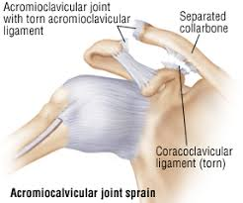

Slide 35
Ligament and Joint Injuries: Glenohumeral Ligament Sprain
The glenohumeral joint is especially vulnerable to sprains when it is placed in abduction and external rotation
If there is a second- or third-degree sprain, a more serious problem such as a subluxation or dislocation is likely
The athlete with a glenohumeral ligament sprain will have pain with motion and will be initially treated with PRICES then referred to a physician
A shoulder dislocation or repetitive subluxation are most likely causes of glenoid labrum tear
Glenoid labrum tear: a cartilage disk that surrounds the edge of the scapular fossa and deepens the socket in which the head of the humerus inserts
When the labrum tears, it can obstruct the ROM or allow excessive movement within the joint
Initial care for a tear is to immobilize the shoulder
The physician will have to evaluate the shoulder to determine the extent of the injury
Conservative treatment would be to immobilize the shoulder with the hope tha the labrum would reattach without surgical intervention
In many cases, the labrum must be surgically reattached or removed

Slide 36
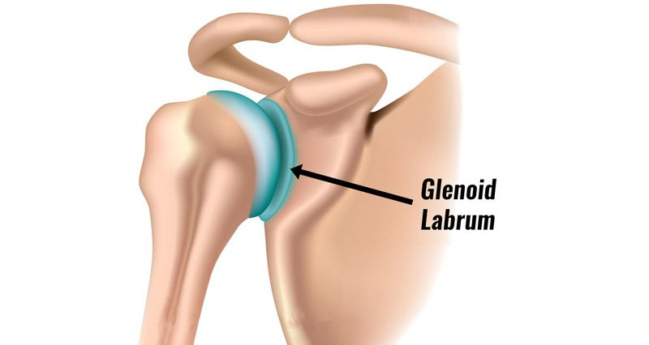

Slide 37
Steroclavicular Joint Dislocation
A blow to the clavicle that causes a rupture of the sternoclavicular joint ligaments can cause a posterior dislocation
A posterior dislocation of the clavicle can press on the trachea, causing difficulty breathing
An athlete who is in the midst of this injury will become anxious, and the AT must keep them calm and resolve the situation quickly
Treatment is to place the athlete on a backboard with the side of the affected shoulder below the board---the proximal end of the clavicle moves anteriorly away from the trachea
The athlete will have to see a physician for additional treatment

Slide 38
Reference
Fundamentals of Athletic Training

