Slide 1
Chapter 13: Hip, Pelvis, and Thigh injuries
Unit 5: Understanding Athletic Injuries to the Lower Extremity

Slide 2
Objectives
Describe the basic anatomy of the hip
Explain common hip, pelvis, and thigh injuries that occur with athletic participation
Identify common signs and symptoms of hip, pelvis, and thigh injuries
Explain the treatments performed by an AT for specific hip, pelvis, and thigh injuries

Slide 3
Anatomy of the Hip, Pelvis, and Thigh
The hip joint, which is a synovial ball-and-socket joint, is the articulation between the femur and pelvis
The femur head fits into a cup-shaped acetabulum
Acetabulum: bones that form the hip socket
It is deep and covered by thick ligaments that provide stability
Labrum: cartilaginous tissue that deepens the sockets at the hip and shoulder joints
Helps cushion the femur against the edge of the joint
The femur, largest bone in the body, and the pelvis are connected by thick, strong ligaments
Muscle groups: quadriceps and hamstrings
The hip muscles are the most powerful in the body
Hip flexor group: rectus femoris, sartorius, iliopsoas---flex the thigh
Hamstrings: gluteus maximus and extend the thigh

Slide 4
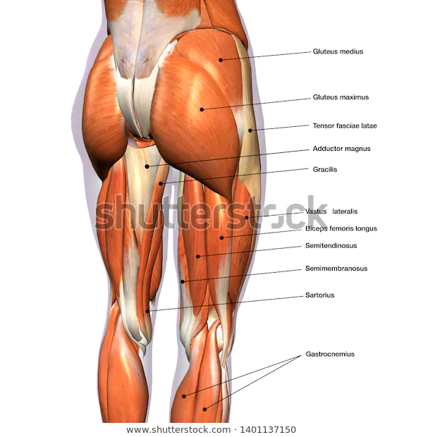
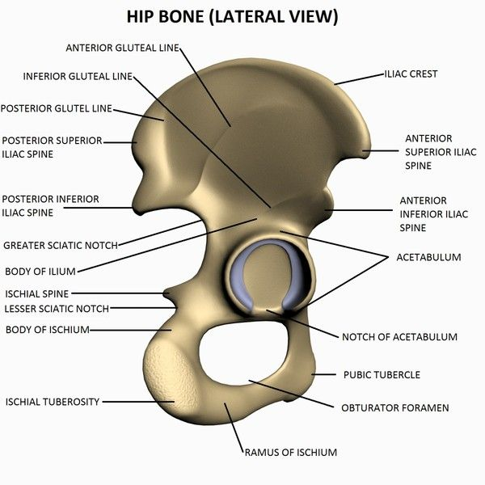

Slide 5
Preventing Hip, Pelvis, and Thigh Injuries
Because the hip is a stable joint, ATs will not see many sprained ligaments or dislocations in this area
Common: muscular strain injuries; therefore, proper flexibility, training and stretching before vigorous exercise is necessary
Because many sports expose the thigh to contact, athletes must wear proper equipment
Football players wear secure thigh pad that covers quadriceps
Contact-type injuries can happen at the iliac crest because this area has little natural protection
Football players wear a hip pad to cover iliac crest
Proper strength and training for any portion of the body can never be too strongly emphasized!
These muscles are vital for balance and stability

Slide 6
Treating Hip, Pelvis, and Thigh Conditions
Most injuries to the hip, pelvis, and thigh are strains and contusions
Fractures and dislocations do occur, but not as commonly

Slide 7
Bone Injuries: Hip Pointers
Hip pointer: a contusion to the iliac crest
The iliac crest is superficial and has little soft tissue covering it; however, many muscles attach near the crest so when a serious force impacts the bone, it can be debilitating
The area must be protected from further contact by a protective pad

Slide 8
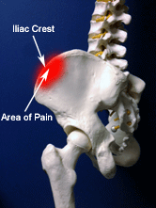
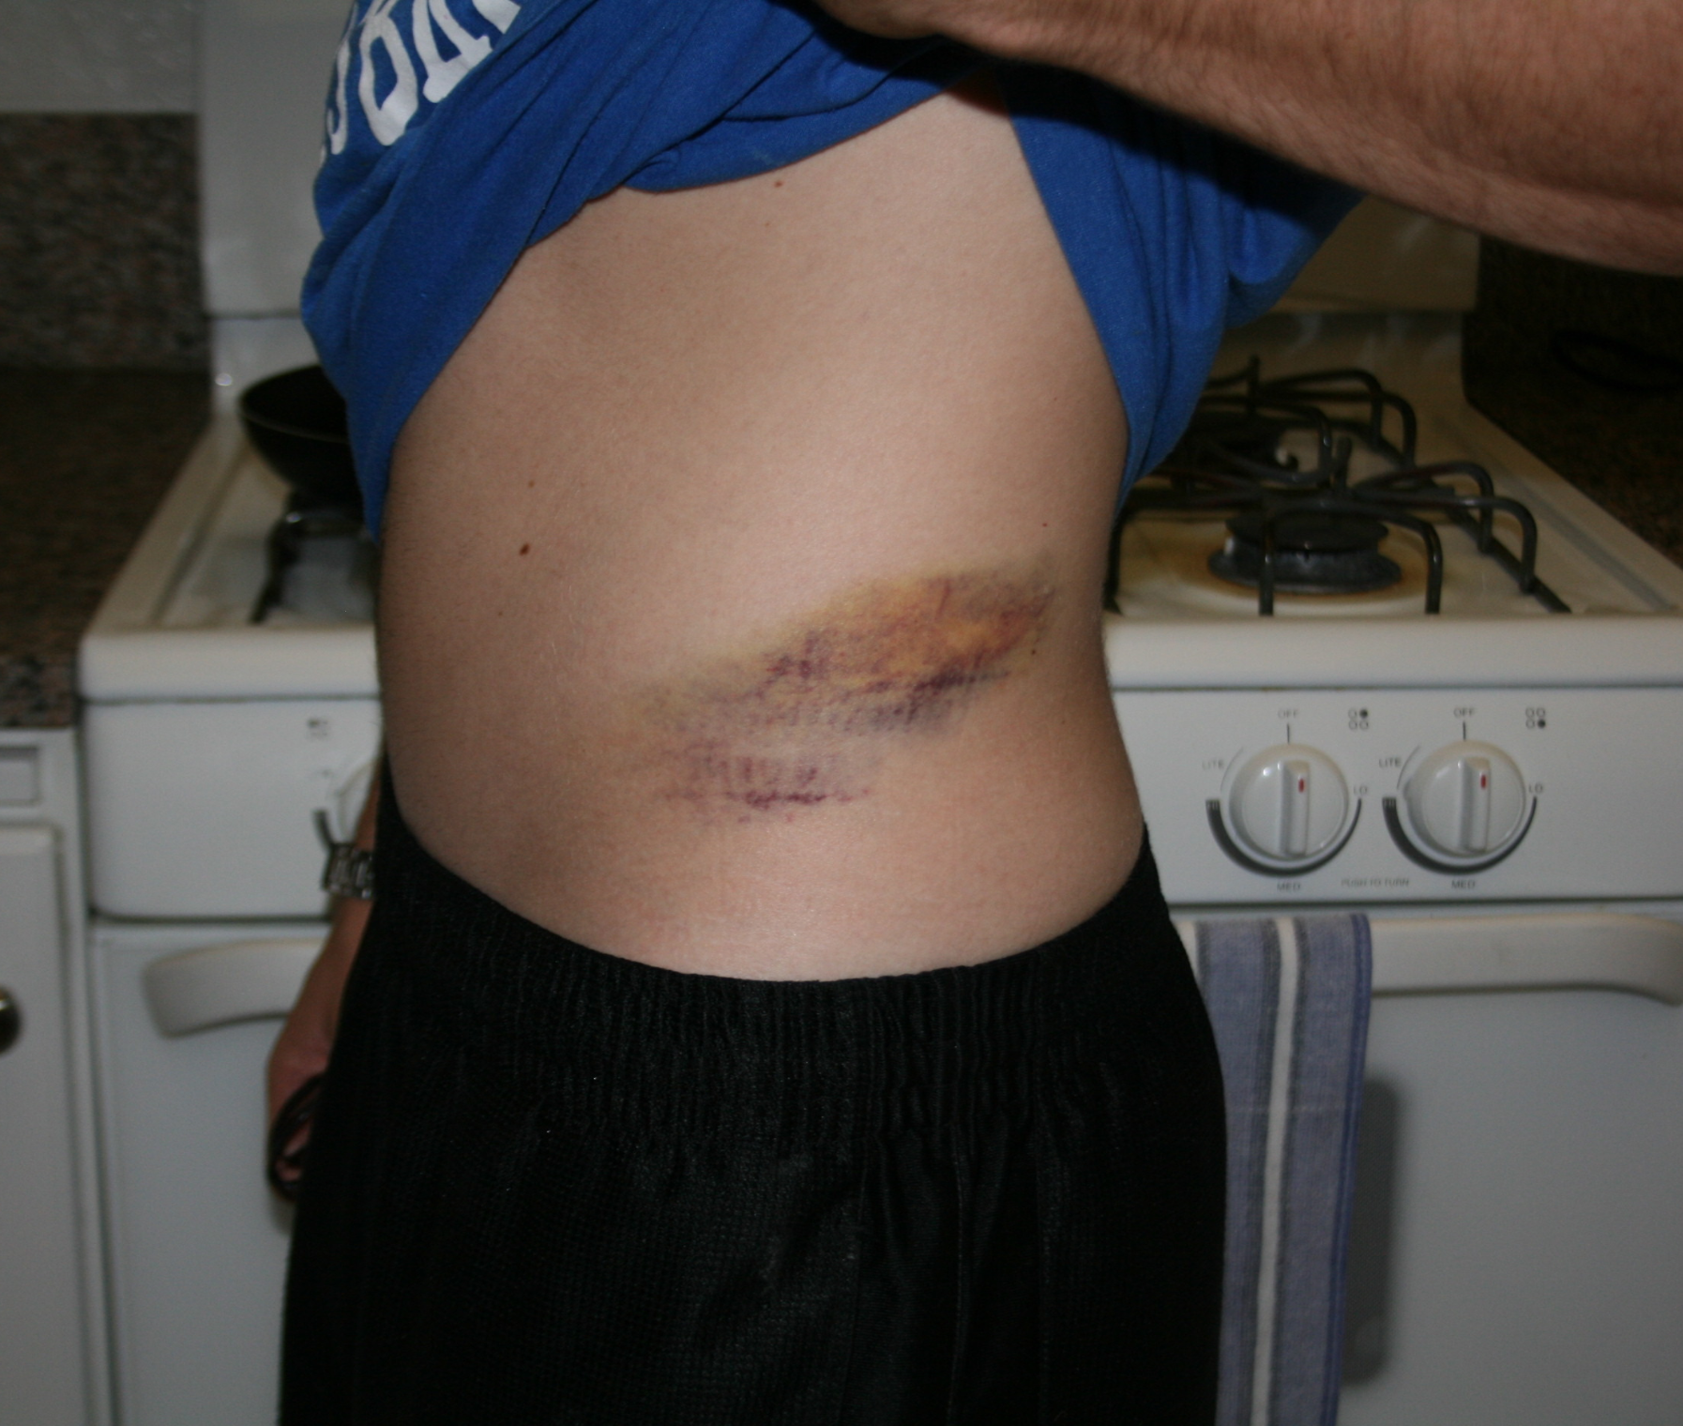

Slide 9
Bone Injuries: Labral Tears
Not very common, but the labrum can tear if an acute injury occurs
Injury can also be insidious, meaning it can occur slowly over time with no specific mechanism of injury
A torn labrum can flip into the joint and result in catching, groin pain, and restricted ROM
A labral tear will often need to be surgically repaired, but in some instances the athlete can manage the condition so that the tear does not aggravate the joint

Slide 10
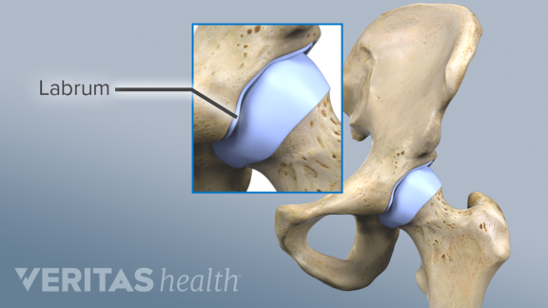

Slide 11
Bone Injuries: Avulsion
Avulsion fractures occur as a result of forceful muscle contractions that pull the bone away at the site where the tendon attaches
Football player continues to run aggressively forward while a defender is holding their leg
The hip flexor may forcefully contact, causing a fracture
AT refers to physician

Slide 12
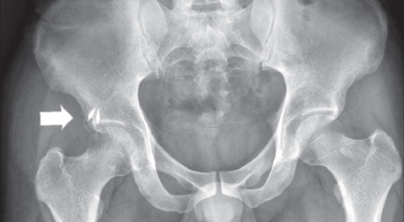

Slide 13
Bone Injuries: Growth Plate Fractures
Epiphyseal fractures occur at the growth plate of bones
Capital femoral epiphysis: the growth plate located between the head and the neck of the femur
Can be fractured in young athletes, 10-15
The head of the femur slips off of the neck, causing pain in the groin, hip, and knee
If the AT suspects this condition, the athlete should be referred to a physician
Treatment includes stopping the slippage and closing the growth plate with a surgical procedure

Slide 14
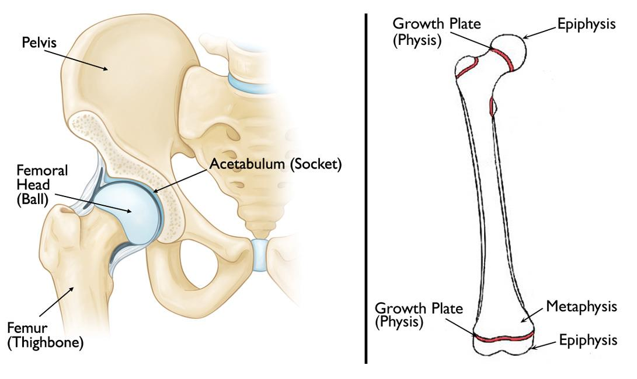

Slide 15
Bone Injuries: Stress Fracture
Although uncommon, femoral stress fractures do occur in athletes who do a great deal of running
Stress fractures are caused by repetitive stress, typically as a result of the pounding of the lower extremity while running
This pounding can cause the femur to bend slightly
Similar to a pencil bending, one side of the bone is compressed, while the other side is stretched; when the tissue is repeatedly stretched, hairline fractures can occur
Rest and an alternative activity, such as aquatic therapy, are indicated to reduce the stress on the fracture site so it can heal

