Slide 1
Chapter 15: Foot, Ankle, and Lower-Leg InJuries Unit 5: Understanding Athletic INjuries to the Lower Extremity

Slide 2
Objectives:
Describe the basic anatomy of the foot, ankle, and lower leg
Explain common injuries that occur to the foot, ankle, and lower leg
Describe signs and symptoms of lower-leg injuries
Identify strategies to prevent injuries to the ankle and lower leg

Slide 3
Anatomy of the foot, ankle, and lower leg
The lower leg, foot, and ankle play a critical role in balance, shock absorption, and movement
The bones provide structure and protection, while the muscles and tendons produce movement

Slide 4
Bones and Joints
There are 28 bones in the foot
Phalanges: bones in the toe
Numbered 1-5 with the big toe being number 1
Except for the big toe, each toe has 3 bones: the distal, middle, and proximal phalanges
The toe joints are referred to as interphalangeal joint
Under the big toe are two small bones, the sesamoids, which assist with flexion of the toe
Metatarsals: long bones of the foot
Numbered 1-5
The joints between the phalanges and the metatarsals are the metatarsophalangeal joints
The midfoot, which lies between the metatarsals and the talus and calcaneus, contains several small bones that articulate with one another and produce movement

Slide 5
Bones and Joints con't
Talus: ankle bone directly above calcaneus
Calcaneus: heel bone of the foot
The ankle is the joint between the talus and calcaneus of the foot and the fibula and tibia of the lower leg
The tibia and fibula articulate at both distal and proximal ends while muscles and ligaments between two bones hold them together from one end to the other
Medial Malleolus: end of the tibia on the medial side
Lateral Malleolus: end of the fibula at the lateral aspect
The ankle is held together by ligaments
The fibula extends past the ankle joint and stops severe eversion

Slide 6
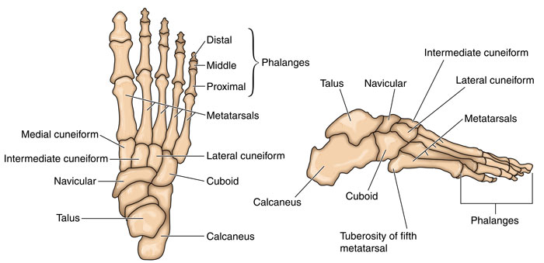

Slide 7
Arches of the Foot
There are three arches on the plantar surface of the foot that function as shock absorbers-the transverse, longitudinal, and metatarsal arches
Transverse arch is located in the front of the hell and goes to the 5th metatarsal to the navicular bone of the foot
Longitudinal arch runs from the calcaneus to the metatarsal heads
Metatarsal arch runs along the metatarsal heads

Slide 8
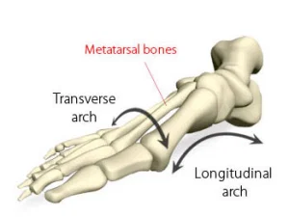

Slide 9
Muscles and Tendons
The muscles of the lower leg and ankle control movement of the foot and leg
The peroneal muscles, including the peroneus brevis and peroneus longus, attach to the lateral aspect of the lower leg and run a course to the lateral aspect and underside of the foot
Helps stabilize the lateral aspect of the ankle
Gastrocnemius: powerful muscle in the calf that is responsible for pointing the toes
Achilles Tendon: structure that attaches the gastrocnemius muscle to the calcaneus bone of the foot
Soleus: posterior lower leg muscle that plantar flexes the foot

Slide 10
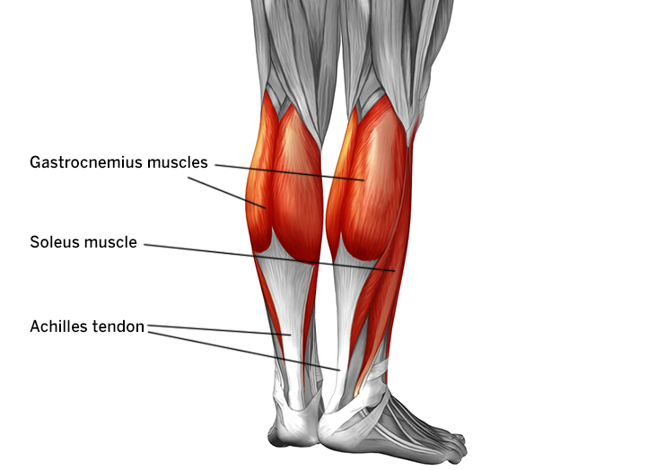

Slide 11
Ligaments
Strong ligaments of the foot are located laterally, medially, and on the plantar surface
Many of the ligaments names give the attachment points
The lateral aspect of the ankle has numerous ligaments, including the anterior talofibular, posterior talofibular, and calcaneofibular ligaments
The lateral ligaments hold the bony structures together on the lateral side, but are not as strong as the medial ligament

Slide 12
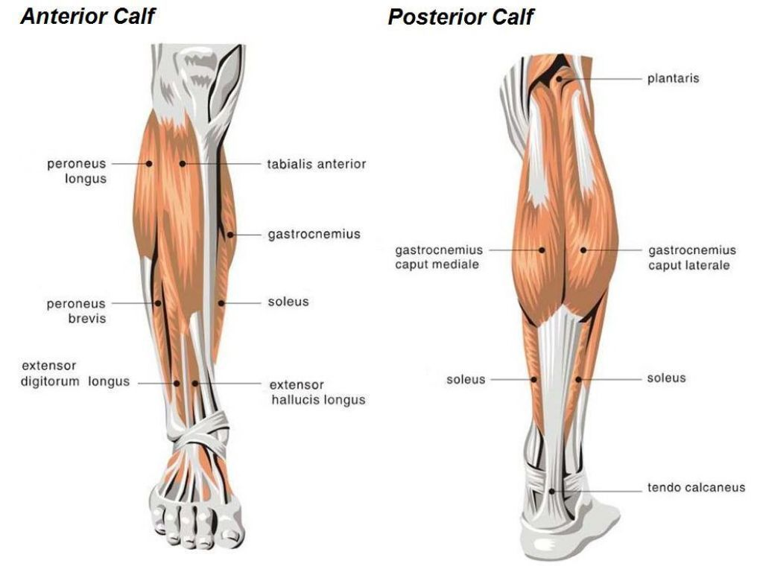

Slide 13
Preventing foot, ankle, and lower-leg injuries
Taking care of the foot, ankle, and lower leg is essential to injury prevention and continuous athletic participation
Many athletes take protective measures such as wearing shoes that provide ankle and arch support, using supportive ankle taping (to prevent inversion), and wearing shin guards (to prevent contusions)
Strengthening and conditioning programs can also help to prevent injuries
Muscles that feel tight need to be stretched
Conditioning under the guidance of a coach may prevent stress fractures
Proper footwear that is able to absorb shock can reduce metatarsal stress fractures

Slide 14
Bones Injuries: Jones Fracture (5th metatarsal Avulsion Fracture)
Jones fracture: fracture occurring at the base of the 5th metatarsal bone
Most common avulsion fracture
When the ankle is forced into inversion, the muscles contract so forcefully to stabilize the lateral aspect of the ankle that the peroneus brevis tendon pulls part of the bone away at its attachment
The AT will treat the injury using PRICES and refer the athlete to a physician
Many physicians will cast the ankle to allow the bone to heal

Slide 15
