Slide 1
Chapter 1: Understanding Health and Wellness
Unit 1: A Healthy Foundation

Slide 2
Objectives
Determine how to make healthy choices and practicing these behaviors throughout life
Understand that heredity, environment, and other factors can affect your health and influence your decision making
Identify risk behaviors that have potential to harm health and how to avoid these behaviors
List ways to promote health and wellness by making plans and putting them into practice

Slide 3
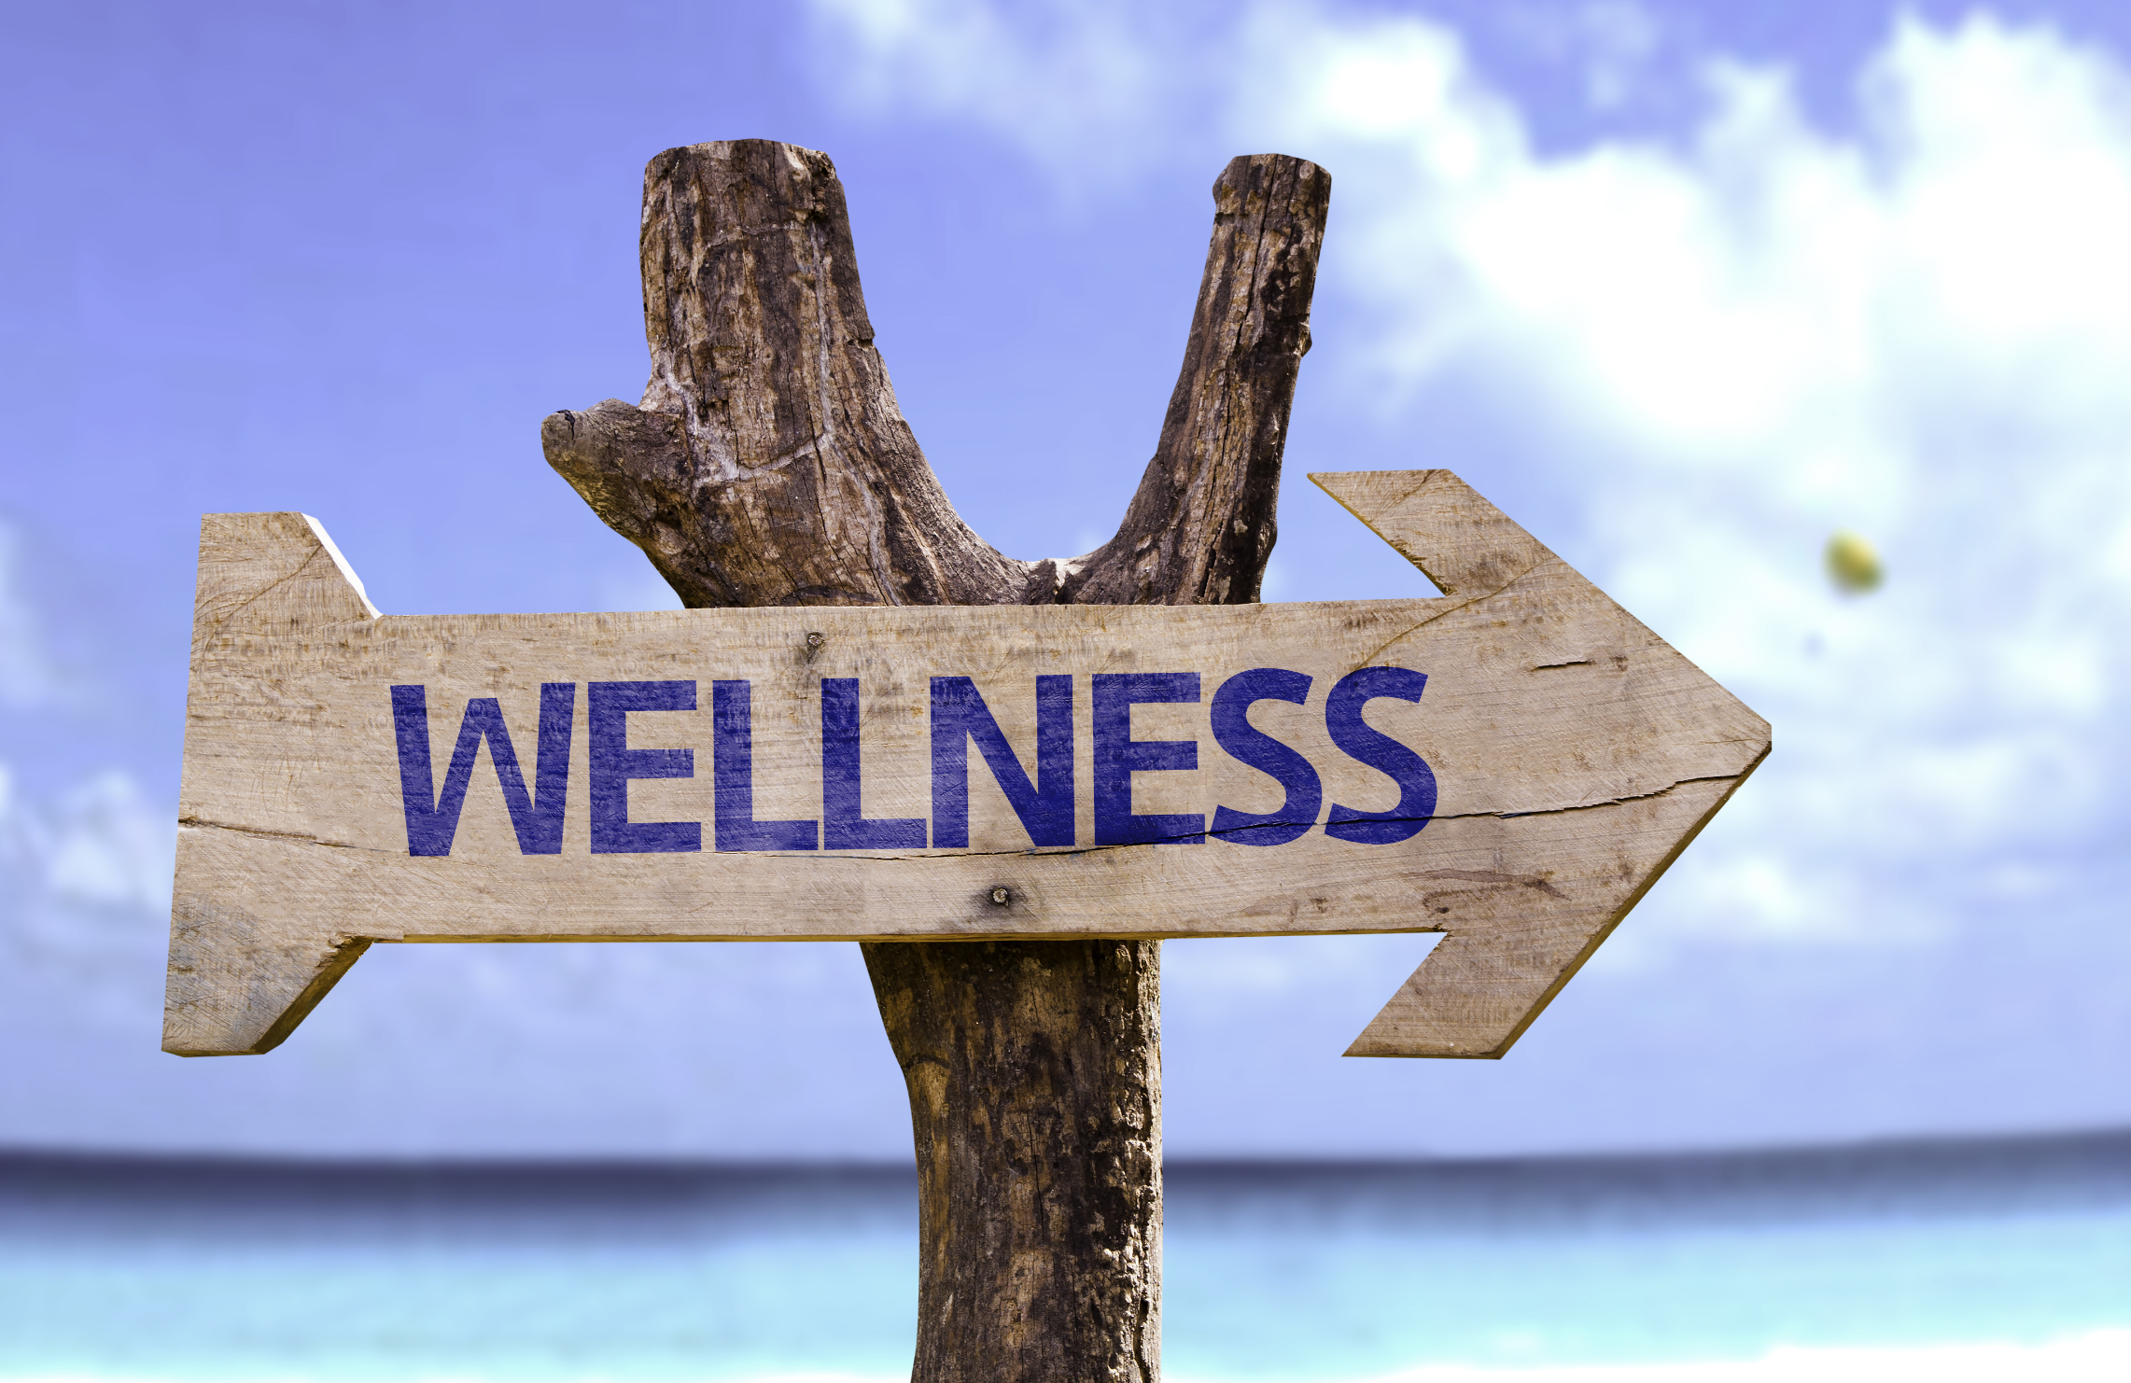
Wellness Questionnaire
z
Wellness Ratings:
Good: >50
Marginal: 40-49
Low: <39

Slide 4
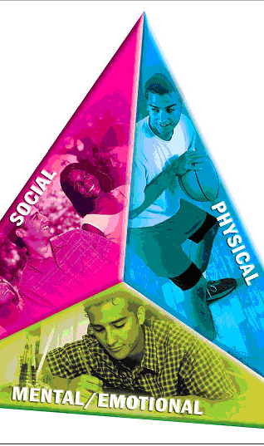
What is health?
z
Health: the combination of physical, mental/emotional, and social well-being
Health Triangle:
Social
Physical
Mental/Emotional
Spiritual
Wellness: overall state of well-being or total health.

Slide 5
The Health Continuum
z
z

Slide 6
What influences health?
Heredity: all the traits that were biologically passed on to you from your parents
Environment: the sum of your surroundings
Physical
Social
Culture

Slide 7
What influences health?
z
Attitude: way you view situations
Behavior: choices you make
To eat the donut or not?
To walk or ride in the car?
Media and Technology
Media: various methods for communicating information
Technology: radio, television, and the Internet

Slide 8
Risk Behaviors
Tobacco use
Poor nutrition choices
Inactivity
Alcohol and other drug use
Sexual behaviors that may result in HIV infection, other STD's, and unintended pregnancy
Behaviors that contribute to unintentional injuries and violence

Slide 9
Consequences
z
Risk behaviors can have short-term and long-term consequences on health
Example: smoking can have immediate consequences such as bad breath, yellow teeth, and headaches. Long term consequences include lung cancer, emphysema, and heart disease.
Cumulative Risks: related risks tht increase in effect with each added risk.

Slide 10
Reducing Risks
Prevention: taking steps to keep something from happening or getting worse.
Prevention includes:
Medical checkups
Dental checkups

Slide 11
Lifestyle Factors
z
Lifestyle factors: the personal habits or behaviors related to the way a person lives
Lifestyle factors that can improve health include:

Slide 12
The importance of Health Education
z
In 2012, the cost of U.S. healthcare reached $2.8 trillion, or $8,915 per person.
Much of these expenses are avoidable if people chose to lead healthier lifestyles.
Health Education: providing accurate health information and teaching health skills to help people make healthy decisions.

Slide 13
The Nation's Health Goals
z
Healthy People Program: a nationwide health promotion and disease prevention plan designed to serve as a guide for improving the health of all people in the United States.
Changes every 10 years
Outlines goals to improve the health status of the U.S. population
The government tracks these behaviors and outcomes to measure progress in achieving these objectives
Health Disparity: differences in health outcomes among groups

Slide 14
Healthy People 2020
Adolescent health:
Increase the proportion of adolescents who have had a wellness check up in the past 12 months
Increase the proportion of adolescents who participate in extracurricular and/or out-of-school activities
Diabetes:
Reduce the annual number of new cases of diagnosed diabetes in the population
Heart Disease and Stroke:
Reduce stroke deaths
Mental Health and Mental Disorders:
Increase depression screening by primary caregivers
Nutrition and Weight status
Increase the proportion of schools that offer nutritious foods and beverages outside of school meals

Slide 15
Activity
Make an objective that could appear on Healthy People 2020. Describe ways to achieve the objective.
Following topics:
Adolescent health
Educational and community-based programs
Nutrition and weight status
Tobacco
Physical activity

Slide 16
Becoming Health Literate
Health Literacy: person's capability to learn about and understand basic health information and services, and to use these resources to promote one's health and wellness.
To become an informed individual:

