Slide 1
Chapter 4: Managing Stress and Coping with Loss
Unit 2: Mental and Emotional Health

Slide 2
Objectives
Understand how stress can affect the individual in positive and negative ways
Manage stress by learning skills that can reduce the amount and impact of stress
Learn the grieving process and how to cope with losses by managing feelings in healthful ways

Slide 3
Understanding Stress
Lesson 1

Slide 4
So, What is stress?
Stress: the reaction of the body and mind to everyday challenges and demands
Perception: the act of becoming aware through the senses
Typically react to stress based on previous experiences
Stress can be good!
A student has an important paper due which motivates him/her to work harder to achieve a good grade
Stress becomes negative when it impacts performance and can harm health

Slide 5
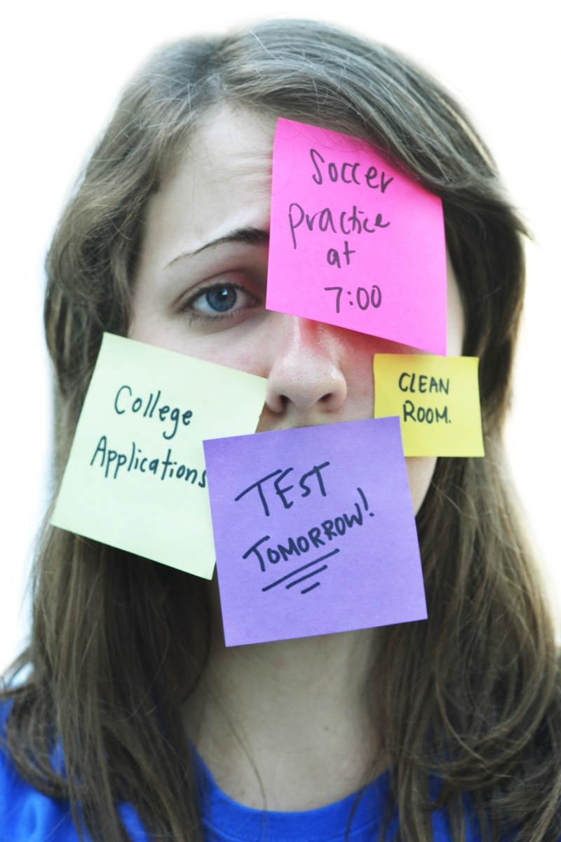
Causes of stress
Stressor: anything that causes stress.
Life situations
Environmental
Biological
Cognitive (thinking)
Personal behavior

Slide 6
Body's Response to Stressors
Alarm
Dilated pupils
Increased perspiration
Rise in blood pressure
Resistance
Fatigue

Slide 7
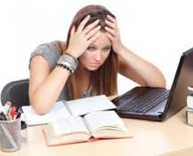
Stressors for teens
Life situations
Environmental
Biological
Cognitive (Thinking)
Personal Behavior

Slide 8
Stress and Health
Ongoing and consistent stress can affect all aspects of health and well-being
Psychosomatic response: physical reaction that results from stress rather than an injury or illness
Headache
Elevated blood pressure
Jaw clenching, grinding teeth
Digestive issues
Mental/Emotional and social effects:
Mood swings, difficulty concentrating, irritability

Slide 9
Managing stress
Lesson 2

Slide 10
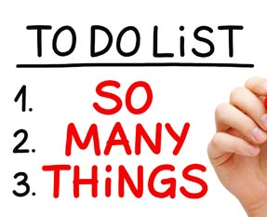
Managing Stress
Finding the source of stress are key to resolving the problem
Stress can be additive
Adds up over time
Chronic stress: stress associated with long-term problems that are beyond a person's control

Slide 11
Stress management techniques
Stress can be avoided or limited by bypassing situations that can cause stress. When stress can't be avoided here are some effective strategies to use:
Refusal Skills: Check your schedule before you commit to an activity
Plan Ahead: Manage time wisely by planning ahead; if you have a test approaching, study in advance
Think Positively: A positive outlook can limit stress by shifting your perception and the way you react to a stressor
Avoid tobacco, alcohol, and other drugs: Using these items can cause stress and harm rather than help

Slide 12
Handling Stress
Relaxation Techniques
Deep breathing, thinking positive thoughts, stretching, taking a warm bath, aromatherapy, massage, laughing
Relaxation response:
Redirect your Energy
Energy builds up from stress—use that energy in a constructive way!
Doing a project, exercising, playing a game

Slide 13
Staying Healthy
Adequate Rest
Getting Exercise Regularly
Eating Nutritious Food

Slide 14
Coping with Loss and Grief
Lesson 3

Slide 15
Expressing Grief
Stages of Grief
Denial or Numbness
Emotional Release
Anger
Bargaining
Depression
Remorse
Acceptance
Hope

Slide 16
Coping with Death
Mourning: Act of showing sorrow or grief
Showing Empathy
Recall happy, positive memories
Sympathetic listener
Not rushing the grieving process
Community Support

Slide 17
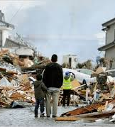
Coping
Traumatic event: any event that has a stressful impact sufficient to overwhelm your normal coping strategies
Accidents, violent assaults, suicides, natural disasters
Seek support from family, friends, community groups

Slide 18
Reference
Bronson, Mary H., Florida Health, McGraw-Hill, 2015

