Slide 1
Chapter 8: Peer Relationships
Unit 3: Healthy and Safe Relationships

Slide 2
Objectives
Understand that mutual respect and honesty are important characteristics of healthy friendships
Define effective refusal skills in order to deal with negative peer pressure
Set dating limits and practice abstinence

Slide 3
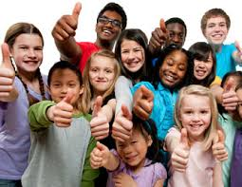
Safe and Healthy Friendships
Lesson One

Slide 4
Peer Relationships
Peers: people who are similar age and share similar interests
These relationships play an important role in your health and well-being
Friendships contain the follow attributes:
Similar Values, interests, beliefs, and attitudes
Open and honest communication
Sharing of joys, disappointments, dreams, and concerns
Mutual respect, caring, and support
Concern about each other's safety and well-being
Platonic Friendship: friendship with a member of the opposite gender in which there is affection, but the two people are not considered a couple

Slide 5
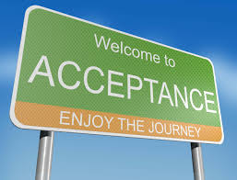
Building Strong Friendships
Traits of a positive friendship:
Empathy
Fairness
Shared Interests
Acceptance
Support
Loyalty

Slide 6
Problems in Friendships
Cliques: small circle of friends, usually with similar backgrounds or tastes, who exclude people viewed as outsiders.
Feelings of envy or jealousy:
What is making me feeling jealous? Is my friend deliberately making me feel this way? How can I manage these feelings?
When friendships change:
Pressures you into doing something you don’t want to, says hurtful or insulting things, constantly trying to change your beliefs

Slide 7
Peer Pressure and Refusal Skills
Lesson 2

Slide 8
Make your own “I Message”
I feel __________ when you __________ because __________ and I'd like/I want __________. Would you consider__________?

Slide 9
Peer Pressure
Peer Pressure: The influence that people your age may have on you
Can be positive or negative
Harassment: persistently annoying others
Can be hurtful—name-calling, teasing, bullying
Manipulation: indirect, dishonest way to control or influence other people

Slide 10
Common Methods of Manipulation
Making Threats | Promising violence or some other negative consequence if the person does not do what is asking
Blackmail | Threatening to reveal some embarrassing or damaging information if the person does not do what is asked
Mocking or teasing | Making fun of another person in a mean or hurtful way
Guilt trip | Making a person feel guilty to get desired results
Bargaining | Offering to make a deal to get what one wants
Flattery | Using excessive praises to influence another person
Bribing | Promising money or favors if the person does what is asked

Slide 11
Resisting Negative Peer Pressure
Practicing refusal skills will help you deal with negative peer pressure
Assertive Refusal: state your position and stand your ground while acknowledging the rights of others---most effective approach
3-step process for effective refusal skills:
State your position
Suggest alternatives
Stand your ground

Slide 12
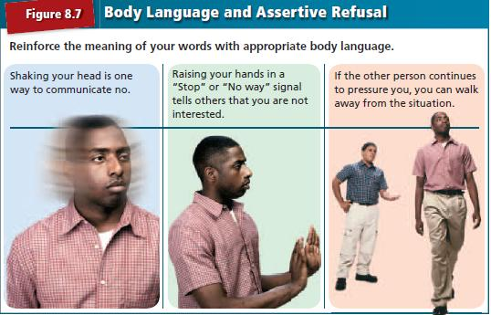
Use your body language!

Slide 13
Practicing Abstinence
Lesson 3

Slide 14
Dating Decisions
Personal values and priorities should influence your dating decisions
Priorities: goals, tasks, values, and activities that you judge to be more important than others.
Example: focusing on school, spending time with family, practicing your sport

Slide 15
Abstinence
Abstinence: deliberate decision to avoid high-risk, including sexual activity and use of tobacco, alcohol, and other drugs
Intimacy: a closeness between two people that develop over time
_______________: exaggerated feelings of passion
Self-control: person's ability to use responsibility to override emotions

Slide 16
Avoiding Risky Situations
Avoid places where alcohol and other drugs are present
Avoid being alone with a date at home or in an isolated place

Slide 17
Considering the Consequences
Abstinence from sexual activity has a positive effect on all sides of your health triangle
Sexually Transmitted Diseases (STD's): infectious diseases spread from person to person through sexual contact
Some STD's have no cure
Unplanned pregnancy

Slide 18
Committing to Abstinence
Open and honest communication with your dating partner will help you stay committed to abstinence
Make the conversation about abstinence a positive one
Be firm in setting limits in your relationship
Continue to practice refusal skills
Returning to abstinence is a positive alternative to previous sexual behaviors

Slide 19
Reference
Bronson, Mary H. Florida Health. McGraw-Hill, 2015

