Slide 1
Chapter 6: Skills for Healthy Relationships
Unit 3: Healthy and Safe Relationships

Slide 2
Objectives
Build strong relationships in order to be beneficial to health
Promote health relationships by showing respect for yourself and others
Communicate effectively in order to build successful relationships

Slide 3
Lesson 1: Foundations of a Healthy relationship
Chapter 6

Slide 4
Relationships in your Life
Relationship: bond or connection you have with other people
Family members
Friends
Teachers
Classmates
People in the community
_____________: part you play in the relationship

Slide 5
Traits of a Healthy Relationship
Mutual Respect:
_________________: You treat other people with kindness and consideration
Honesty: Open with others, rather than concealing thoughts, feelings, and actions
Commitment: Work at keeping a relationship strong, even if it means making sacrifices

Slide 6
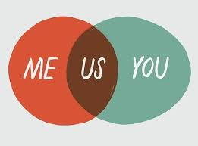
Three C's of a Healthy Relationship
Communication:
Cooperation:
Compromise:

Slide 7
Respecting Yourself and Others
Lesson 2

Slide 8
Respect for Yourself
Self-respect will strengthen your relationships.
When you respect yourself, you are more likely to seek out relationships with people who treat you with respect.
Self-respect makes you less vulnerable to taking risks that could harm your health.

Slide 9
Respect for Others
Listen to other people.
Be considerate of others' feelings.
Develop mutual trust.
Be realistic in your expectations.

Slide 10
Tolerance and Disrespectful Behaviors
__________________: an unfair opinion or judgement of a particular group of people.
Stereotype:
Tolerance: the ability to accept others' differences
Bullying: deliberately harming or threatening other people who cannot easily defend themselves
_________________: making others perform certain tasks in order to join the group

Slide 11
Communicating Effectively
Lesson 3

Slide 12
Communication Styles
Aggressive: overly forceful, pushy, or hostile
________________: unwilling or unable to express thoughts and feelings in a direct or firm manner.
Assertive: expressing your views clearly and respectfully.

Slide 13
"You" Messages and "I" Messages
"Why can't you ever show up on time?"
"You never listen to anything I say."
"I said I'd take out the trash, and I will! You don't have to nag me about it every five minutes!"
"You're always taking my CD's without asking."
"You always ignore me when your other friends are around."
"I really don't like to be left waiting—it makes me feel like you don't think I'm important."
"I feel like my suggestions aren't being taken seriously."
"I'm feeling stressed because I have a big project due tomorrow. I'll take out the trash as soon as I finish working on this."
"It bothers me when I get home and find all my CD's in your room."
"I feel hurt when I'm left out of a conversation.

Slide 14
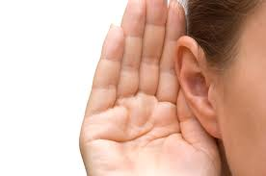
Listening Skills
Active listening: paying close attention to what someone is saying and communicating
Ways to active listen:
Don't interrupt
Show interest
Restate what you hear
Ask questions
Show empathy

Slide 15
Nonverbal communication
Body language: nonverbal communication through gestures, facial expressions, behaviors, and posture.
Sometimes one may send message through body language without realizing:
Saying "I'm Fine!" In an angry tone

Slide 16
Reference
Bronson, Mary H., Florida Health, McGraw-Hill, 2015.

