Slide 1
Chapter 11: Managing Weight and Eating Behaviors
Unit 4: Nutrition and Physical Activity

Slide 2
Objectives
Understand how maintaining a healthy weight protects your health and prevents disease
Learn the importance of a positive body image
Grasp the concept that nutritional needs change as we age

Slide 3
Maintaining a Healthy Weight
Lesson 1

Slide 4
The Calorie Connection
Weight is maintained by taking in as many calories as you use
If you use more calories than you take in, you will lose weight
The balance between calories taken in and calories burned is called energy balance
Metabolism: the process by which the body breaks down substances and gets energy from food
Your metabolism converts the food you eat into fuel
It takes roughly 3,500 calories to equal 1 pound of body fat (if you cut back 500 calories each day, you'll lose 1 pound/week)

Slide 5
Pack your Snack!
Potato Chips
Cola
Pretzels
Apple
Candy Bar
Water
Oreos
Low-fat vanilla yogurt
Cream-filled snack cakes
Granola bar
314
108
282
0
208
70
151
127
155
193

Slide 6
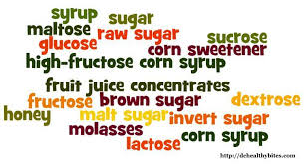
How many calories?
Calories:
1 gram of fat=9 calories
1 gram of carbs=4 calories
1 gram of protein=4 calories
Watch out for low-fat foods—can still be high in calories
Food preparation can effect calories
Fried foods
Creamy sauces
Hydrogenation
Added sugar
Salt

Slide 7
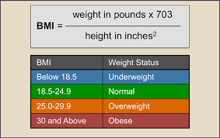
Maintaining a Healthy Weight
Overweight: heavier than the standard weight range for your height
Body Mass Index (BMI): a measure of body weight relative to height
Tired calculation
Body Composition: Ratio of fat to lean tissue in your body
Skin fold testing
Underwater weighing

Slide 8
Weight and Health Connection
Being overweight or underweight carries health risks
Higher risk of disease
15% of teens in the US are overweight (tripled since the 1980s)
Obese: having excess body fat
Being overweight can be caused by:
Heredity
Inactivity
Slow metabolism
Poor diet
Weighing too much increases your risk for:
Heart disease
Cancer
Osteoarthritis
Gallbladder disease
Type 2 diabetes

Slide 9
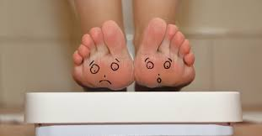
Health and Weight Connection
Underweight: below the standard weight range for your height
People underweight can have difficulty fighting off disease
Being underweight can cause:
Exhaustion
Difficulty concentrating
Weakness

Slide 10
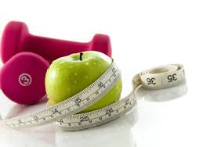
Managing Weight
Target a healthy weight
Set realistic goals
Personalize your plan
Myplate.gov
Put your goals and plans in writing
Evaluate your progress

Slide 11
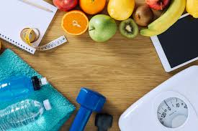
Healthful Ways to Lose Weight
Choose nutrient-dense foods
Watch portion sizes
Eat fewer foods that are high in fats and added sugars
Enjoy your favorite foods in moderation
Be active
Tone your muscles
Stay hydrated

Slide 12
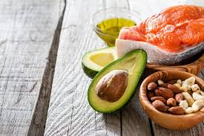
Healthful Ways to Gain Weight
Select foods from the 5 major food groups that are higher in calories
Choose higher-calorie, nutrient-rich foods
Eat nutritious snacks
Get regular physical activity

Slide 13
Body Image and Eating Disorders
Lesson 2

Slide 14
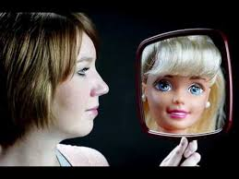
Your Body Image
Body image: that way you see your body
During your teen years, you will experience many physical changes
Where does body image come from?
Magazines
Models
Athletes
Actors/Actresses
Peers

Slide 15
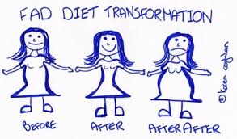
Fad Diets
Fad diets: weight-loss plans that tend to be popular for only a short period of time
JUST SAY NO :)
Weight cycling: repeated pattern of losing and regaining body weight

Slide 16
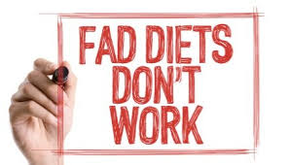
Types of Fad Diets
Miracle foods
Magic combinations
Liquid diets
Diet pills
Fasting

Slide 17
Recognizing Fad Diets
Find diets that follow MyPlate guidelines
Any diet that excludes any food group is not a good diet
Plans that promise quick weight loss are unsafe
No more than 2 pounds per week
Diets that require you to buy certain products
Supplements, Line of weight loss foods

Slide 18
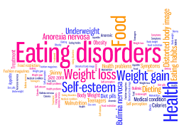
Eating Disorders
Eating orders can be extremely dangers and typically require medical attention
Eating disorder: extreme, harmful eating behaviors that can cause serious illness or even death
Mental illness

Slide 19
Types of Eating Disorders
Anorexia Nervosa: An eating disorder in which an irrational fear of weight gain leads people to starve themselves
Mainly affects girls and young women
See themselves as overweight even when they could be dangerously thin
Behaviors include:
Avoiding food and meals
Eating in small amounts
Weighing or counting calories in everything they eat
Exercising excessively
Weighing themselves repeatedly

Slide 20
Types of Eating Disorders
Bulimia Nervosa: An eating disorder that involves cycles of overeating and purging, or attempts to rid the body of food.
Typically go on binges; eating a huge amount of food in one sitting
After the binge, they purge; vomit or take laxatives
Typically in normal weight range
Health consequences:
Dehydration
Inflamed throat
Swollen glands
Stomach damage
Teeth damage

Slide 21
Types of Eating Disorders
Binge Eating Disorder: An eating disorder in which people overeat compulsively
Overeat similarly to bulimia, but do not binge as often
Do not purge
More common in males
Health consequences:
Overweight or obese
High blood pressure
Type 2 diabetes

Slide 22
Lifelong Nutrition
Lesson 3

Slide 23
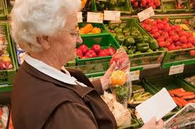
Factors that Affect Nutritional Needs
Age
Gender
Activity Level

Slide 24
Vegetarian Diets
Vegetarian: Person who eats mostly or only plant-based foods
Lacto-ovo: vegetarians who also eat dairy foods and eggs
Lacto: vegetarians add dairy foods to their diet
Ovo: vegetarian who includes eggs in their diet

Slide 25
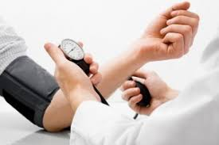
Health Conditions
Diabetes
Food allergies
Lactose intolerance
Celiac disease
High blood pressure
High cholesterol

Slide 26
Nutrition for Athletes
High activity=higher calorie needs
Teen athletes may need 2,000-5,000 cal/day depending on their needs
Hydration for athletes
Girls: 9 c/day
Boys: 13 c/day
Performance enhancers: substances that boost athletic ability
Anabolic steroids
Androstenedione
Creatine
Energy drinks

Slide 27
Supplements
Herbal supplements: dietary supplements containing plant extracts
Not a substitute for eating healthy
May be prescribed by a doctor
Concerns:
Do not take supplements that provide more than 100% of the daily values for any nutrient. Buildup of vitamins can become toxic
Take “natural herbs” to be more healthy, but can lead to heart attack
Not regulated by FDA

Slide 28
Resource
Bronson, Mary H. Florida Health. McGraw-Hill, 2015.

