Slide 1
Chapter 15: Cardiovascular, Respiratory, and Digestive Systems
Unit 5: Personal Care and Body Systems

Slide 2
Objectives
Grasp that the cardiovascular system moves blood through the body, while the lymphatic system circulates lymph throughout the body
Learn that the respiratory system provides oxygen to the blood and removes carbon dioxide from the body
Identify the digestive system and that it offers nutrients and energy for your body
Discuss the excretory system and how it removes waste from the body

Slide 3
The Cardiovascular and Lymphatic Systems
Lesson 1

Slide 4
Why the Blood Circulates
MAIN IDEA: The cardiovascular system provides nutrients and oxygen, carries away waste, and helps fight disease
Your heart pumps blood to your body's cells 24 hours a day and does the following important tasks:
Carries oxygen from the lungs to body cells
Absorbs nutrients from food and delivers nutrients to body cells
Carries carbon dioxide from your cells back to your lungs to be exhaled
Delivers waste products to the kidneys for removal
Helps WBC's fight disease by attacking infectious organisms

Slide 5
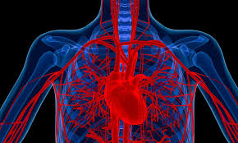
How Blood Circulation Works
MAIN IDEA: The cardiovascular system consists of the heart, blood, and blood vessels
The cardiovascular system depends on the hears and its system of blood vessels to deliver blood throughout the body
If all of your blood vessels were laid end to end, they would stretch over 60,000 miles
Enough to circle the earth almost 2.5 times.

Slide 6
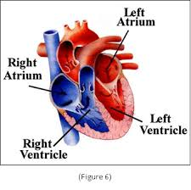
The Heart
Your heart is the muscle that makes the cardiovascular system work
Inside the heart are four chambers:
Atria: two top chambers
Ventricles: two lower chambers
Septum: a wall of tissue that separates the four chambers of the heart
Valves: located between the atria and ventricles and allow blood to flow through the chambers

Slide 7
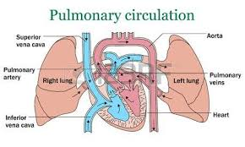
The Heart
Right atrium: an area of muscle that acts as a pacemaker for the heart
Electrical impulses stimulate the atria to contract, forcing blood to the ventricles

Slide 8
Blood
Blood: fluid that delivers oxygen, hormones, and nutrients to the cells and carries away wastes and is made of the following:
Plasma: fluid in which other parts of the blood are suspended
55% of total blood volume
Mainly water
Red Blood Cells: make up about 40% of normal blood
Hemoglobin: the oxygen-carrying protein in blood
White Blood Cells: protect the body against infection
Platelets: types of cells in the blood that cause blood clots to form

Slide 9
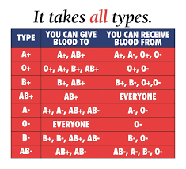
Blood
All humans have one of four types of blood: A, B, AB, and O
Blood type is determined by the absence or presence of certain substances called antigens
Blood type O are universal donors
Most blood carries a substance called Rh factor
If present, you are referred to as Rh positive, if not, you are Rh negative

Slide 10
Blood Vessels
Three main types of blood vessels:
Arteries: blood vessels that carry oxygenated blood away from the heart
Branch into progressively smaller vessels called arterioles and these deliver blood to capillaries
Capillaries: small vessels that carry blood from arterioles and to small vessels called venules, which empty in veins
Reach almost all body cells
Veins: blood vessels that return blood to the heart
Large veins called vena cava, carry deoxygenated blood to the left atrium
Many veins have valves that prevent backflow

Slide 11
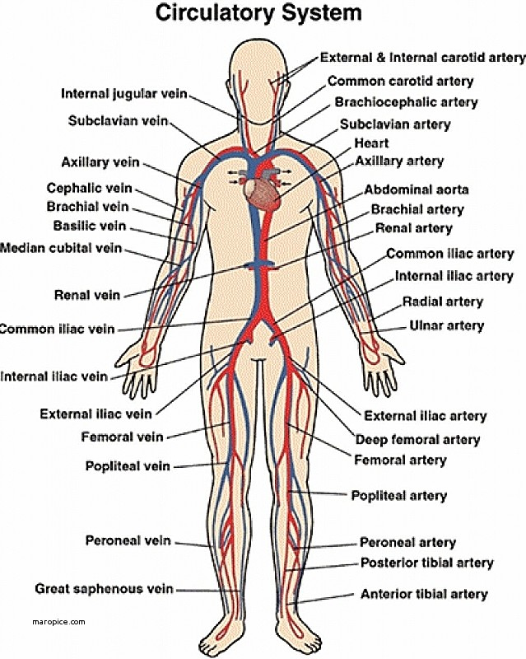

Slide 12
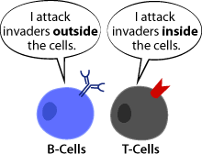
How the Lymph System Works
MAIN IDEA: The lymphatic system helps fight infection and provides immunity to disease
The lymphatic system consists of a network of vessels and tissues that move and filter lymph
Lymph: the clear fluid that fills the spaces around the body cells
Contains water, proteins, fats, and specialized white blood cells that protect against pathogens
Two types of lymphocytes: B cells and T cells
B cells multiply when they come in contact with a pathogen
Two types of T cells: killer cells and helper cells

Slide 13
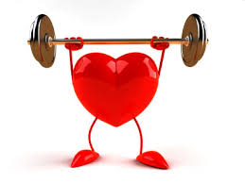
Maintaining Your Circulatory Health
MAIN IDEA: Healthy habits can help protect the health of the cardiovascular system and lymphatic system
Most problems with cardiovascular and lymphatic system appear later in life and can reduce the risk by the following:
Eat a well-balanced diet and maintain a healthy weight
Regular exercise
Avoid second hand smoke or using tobacco products
Avoid illegal drug use
Regular medical checkups

Slide 14
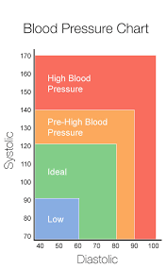
Blood Pressure
Blood pressure: a measure of the amount of force that the blood places on the walls of blood vessels, particularly large arteries, as it is pumped through the body
Blood pressure reading includes two numbers:
Systolic: maximum pressure as your heart contracts to push blood into your arteries
Diastolic: the pressure at its lowest point when your ventricles relax
Normal range is under 120/80
Exercise and stress can raise blood pressure
140/90 is considered signs of hypertension

Slide 15
Cardiovascular Problems
Congenital heart defects: conditions of the heart present at birth
Heart murmurs: hole in a heart of leaking valve
Varicose veins
Anemia: ability of the blood to carry oxygen is reduces
Hemophilia: blood does not clot properly
Leukemia: form of cancer where WBCs are produced excessively and abnormally

Slide 16
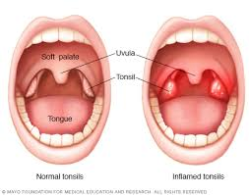
Lymphatic System Problems
Tonsillitis
Immune deficiency
Hodgkin's disease

Slide 17
The Respiratory System
Lesson 2

Slide 18
What Happens During Respiration
MAIN IDEA: The respiratory system provides oxygen to the blood and removes carbon dioxide from the body
Your respiratory system removes carbon dioxide from the body and provides it with fresh oxygen
Inhaling and exhaling causes the lungs to expand and deflate slightly
Process of respiration is divided into two parts:
External respiration: oxygen moves from lungs into the blood, and carbon dioxide moves from the blood into the lungs
Internal respiration: oxygen moves from the blood into the cells, and carbon dioxide moves from the cells into the blood

Slide 19
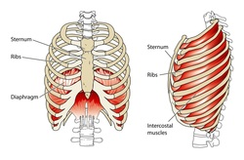
How Respiration Works
MAIN IDEA: The respiratory system consists of the lungs, trachea, and diaphragm
Your lungs automatically fill with air and are emptied in a rhythmic way
Rhythm changes with the level of your activity
Diaphragm: a muscle that separates the chest from the abdominal cavity
As you inhale, the diaphragm and the muscles between your ribs contract

Slide 20
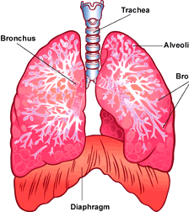
How Respiration Works
The structure of the lungs can be compared to a branching tree
Trachea: the windpipe
How air moves into the lungs
Bronchi: main airways that reach into each lung
Airways become smaller as they branch out deeper into the lunges
Bronchioles: brings air closer to the site of external respiration
At the end of the bronchioles are groups of microscopic structures called alveoli

Slide 21
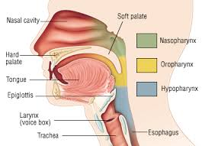
How Respiration Works
Pharynx: throat
Larynx: voice box
Epiglottis: flap of tissue located above the larynx
Folds down to close off the entrance to the larynx and trachea when you swallow
Involuntary action that keeps food and drink from entering into your respiratory system
If you eat too quickly, laugh, or talk while eating, your food may get past the epiglottis and "go down the wrong pipe."

Slide 22
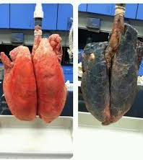
Maintaining Respiratory Health
MAIN IDEA: Caring for your lungs can prevent many respiratory disorders
Respiratory problems can affect the functioning of other body systems
Single most important decision you can make for your respiratory health is NOT TO SMOKE
Smoking can cause:
Lung cancer, bronchitis, emphysema, and increase likelihood of asthma
Regular physical activity
Washing hands regularly

Slide 23
Respiratory System Problems
MAIN IDEA: Problems of the respiratory system can be mild, such as a cold, or serious and even life-threatening
Sinusitis
Bronchitis
Asthma: inflammatory condition in which the trachea, bronchi, and bronchioles become narrowed, causing difficulty breathing
Pneumonia
Tuberculosis: contagious bacterial infection that usually affects the lungs
Emphysema: disease that progressively destroys the walls of the alveoli and symptoms include difficulty breathing and chronic cough

Slide 24
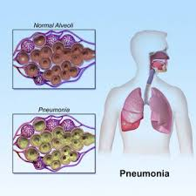
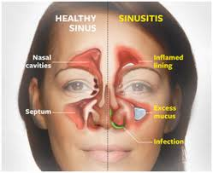
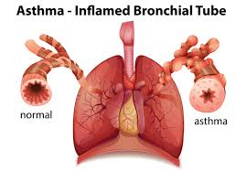
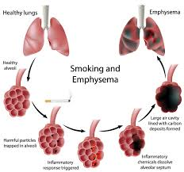
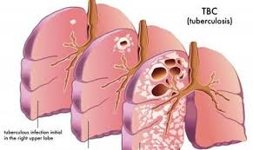

Slide 25
The Digestive System
Lesson 3

Slide 26
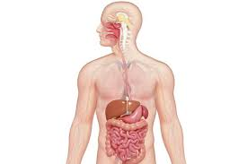
What Happens During Digestion
MAIN IDEA: In digestion, foods are broken down and absorbed as nourishment or eliminated as waste
Foods you eat provide nourishment and these foods have to be broken down into smaller nutrients in order to be absorbed into blood
Digestive system is divided into three main processes:

Slide 27
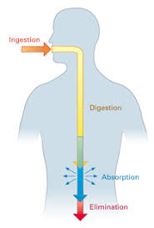
What Happens During Digestion
Digestion: mechanical and chemical breakdown of foods within the stomach and intestines for use by the body's cells
Absorption: passage of digested food from the digestive tract into the cardiovascular system
Elimination: body's expulsion of undigested food or body wastes

Slide 28
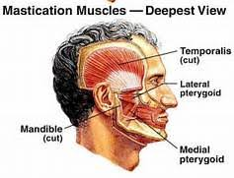
How Digestion Works
MAIN IDEA: The digestive system consists of the mouth, esophagus, stomach, and intestines
Mouth:
Teeth
Mastication: process of chewing
Salivary glands
Tongue

Slide 29
How Digestion Works
Esophagus
When food is swallowed it enters the esophagus, which is a muscular tube about 10 inches long that connects the pharynx with the stomach
Peristalsis: a series of involuntary muscle contractions that moves food through the digestive tract
Begins as soon as food is swallowed
Stomach: hollow, sac-like organ enclosed in a wall of muscles
Flexible and expand when you eat
Tasks include:
Mixing food with gastric juices
Storing partially digested food and liquid
Moving food into the small intestine

Slide 30
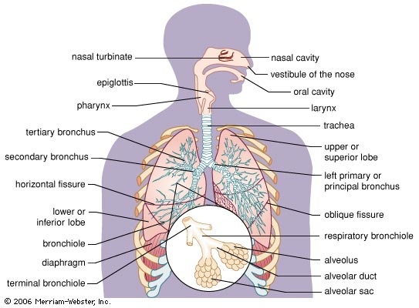

Slide 31
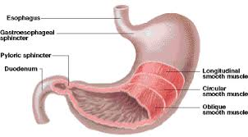

Slide 32
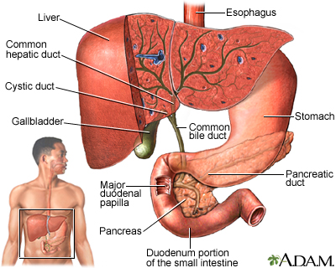
How Digestion Works
Pancreas, liver, and gallbladder
In the small intestine, juices of two other digestive organs mix with the food to continue the process of digestion
The pancreas produces enzymes that break macronutrients in foods
The liver produces another digestive juice called bile
Bile: a yellow-green, bitter fluid important in the breakdown and absorption of fats
Bile is stored in the gallbladder between meals
Bile acids dissolve the fats into watery contents of the intestine

Slide 33
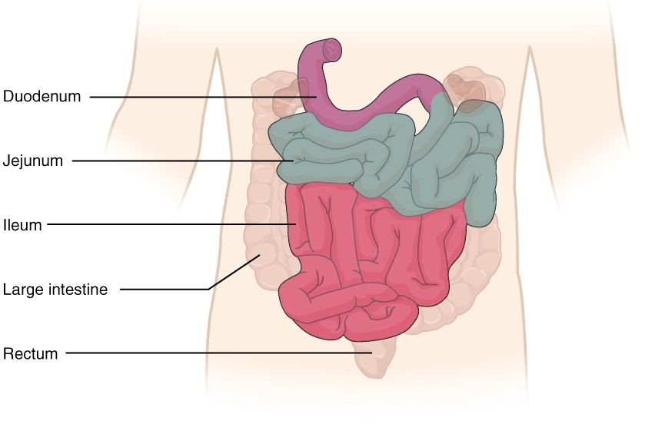
How Digestion Works
The small and large intestines:
The small intestine is 20-23 feet in length and 1 inch in diameter
Small intestine consists of 3 parts:
Duodenum, jejunum, and ileum
Undigested parts of food, fiber or roughage, pass into the colon, or large intestine
Large intestine is about 2.5 inches in diameter and 5-6 feet in length
Large intestine functions to absorb water, vitamins, salts, and eliminate waste

Slide 34
Digestive System Problems
Indigestion
Constipation
Heartburn
Gas
Nausea
Diarrhea
Tooth decay
Gastritis
Gall stone
Peptic ulcer: sore in the lining of the digestive tract
Lactose intolerance
Appendicitis
Colitis
Colon cancer
Hemorrhoids
Crohn's disease
cirrhosis

Slide 35
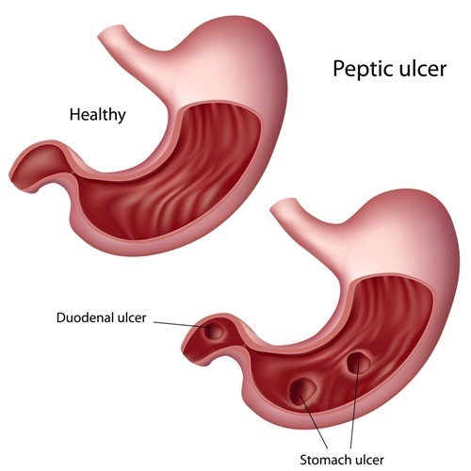
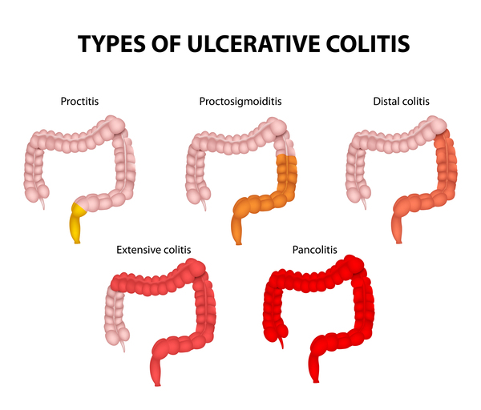
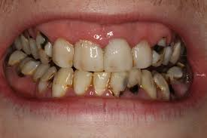

Slide 36
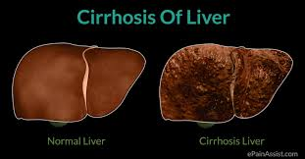

Slide 37
The Excretory System
Lesson 4

Slide 38
How Excretion Works
MAIN IDEA: The excretory system uses several orangs to remove all types of wastes
Excretion is the removing of wastes from the body
Waste is produced in the forms of solids, liquids, and gases
Wastes must be removed so body can function well
The lungs, skin, and small intestine
Sweating is a form of excretion and regulates body temperature
The liver
Removes toxins from the blood
First organ to receive chemicals absorbed from the small intestine
Detoxifies the body

Slide 39
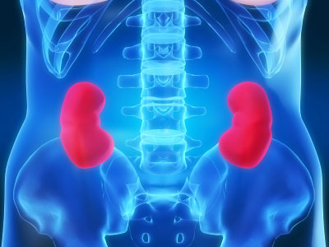
How Excretion Works
The urinary system: main function is to filter waste and extra fluid from the body
Consists of kidneys, bladder, ureters, and urethra
Urine is liquid waste material excreted from the body and consists of water and body wastes
The kidneys: bean-shaped organs about the size of a fist that remove waste products from the blood
Nephrons: tiny filtering units of the kidneys
Each kidney contains a million nephrons

Slide 40
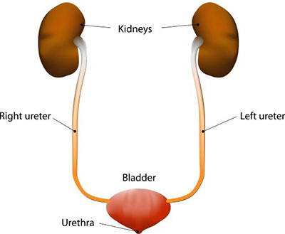
How Excretion Works
The ureters: tubes that connect the kidneys to the bladder
Each ureter is about 8-10 inches long
The bladder and urethra
Bladder: a hollow muscular organ located in the pelvic cavity
Can store about 2 cups of urine comfortably for 2-5 hours
Urethra: the tube that leads from the bladder to the outside of the body

Slide 41
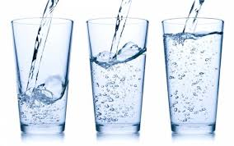
Maintaining Your Excretory Health
MAIN IDEA: Healthful behaviors will help keep your excretory system healthy
Drink at least eight 8-ounce glasses of water each day
Limit your intake of caffeine and soft drinks, which can increase the amount of water lost through urination
Follow a well-balanced diet
Practice good hygiene
Regular medical checkups

Slide 42
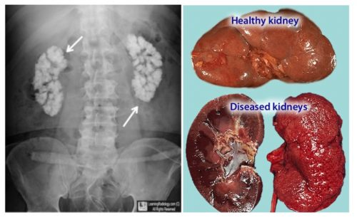
Excretory System Problems
Cystitis
Urethritis
Kidney Problems:
Nephritis
Kidney stones
Uremia
Kidney failure:
Hemodialysis
Peritoneal dialysis
Kidney transplant

Slide 43
Reference
Florida Health

