Slide 1
Chapter 21: Alcohol
Unit 7: Drugs

Slide 2
Objectives
Name the health risks of alcohol use
Choose to live alcohol-free by understanding the dangerous consequences
Discover the impact of alcohol abuse

Slide 3
Assess Your Health
1. I avoid getting into a vehicle driven by someone who has used alcohol
2. I recognize the short-term and long-term health effects of using alcohol
3. I choose to live alcohol-free
4. I recognize that teen use of alcohol is illegal
5. I understand the effects of living with an alcoholic and know where to seek help

Slide 4
The Health Risks of Alcohol Use
Lesson 1

Slide 5
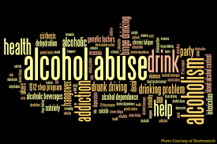
Alcohol
MAIN IDEA: Alcohol is an addictive drug
Ethanol: the type of alcohol in alcoholic beverages
Powerful and addictive drug
Fermentation: chemical action of yeast on sugars

Slide 6
Short-term Effects of Alcohol
Depressant: a drug that slows the central nervous system
Using alcohol slows down reaction time, impairs reaction time, and diminishes judgement
Intoxication: the state in which the body is poisoned by alcohol or another substance, and the person's physical and mental control is significantly reduced
Alcohol stays in a person's system until the liver can metabolize it
Amount of alcohol it takes to causes intoxication differs from person to person

Slide 7
Factors that Influence Alcohol's Effects
Body size
Gender
Food
Rate of intake
Amount
Medicine

Slide 8
Long-term Effects of Alcohol
Damage to brain cells
Increased BP
Buildup of fat cells in the liver
Damage to digestive lining of the stomach
Destruction of pancreas
Damage to relationships

Slide 9
Binge Drinking and Alcohol Poisoning
MAIN IDEA: Consuming a large amount of alcohol over a short period of time can be fatal
Binge drinking: drinking five or more alcoholic drinks at one sitting
Alcohol poisoning: severe and potentially fatal physical reaction to an alcohol overdose
Involuntary actions, such as breathing and the gag reflex that prevents choking, may be impaired
Effects of alcohol poisoning:
Mental confusion and stupor
Coma
Vomiting and seizures
Slow respiration
Irregular heartbeat
Hypothermia

Slide 10
Choosing to Live Alcohol Free
Lesson 2

Slide 11
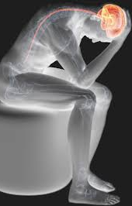
Alcohol Use
Psychological dependence: a condition in which a person believes that a drug is needed in order to feel good or to function normally
Physiological dependence: condition in which the user has a chemical need for a drug

Slide 12
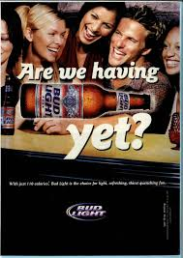
Factors that Influence Alcohol Use
Peer pressure
Family
Media messages

Slide 13
Health Risks of Alcohol Use
Nearly 30 people die each day in the US as a result of an alcohol-related traffic collision
The drinking age is 21 and teens who break the law can suffer serious consequences with law enforcement
Fights are more likely to break out at parties where alcohol is present
Alcohol impairs judgement and may cause a person to compromise their values

Slide 14
Alcohol and the Family
Alcohol abuse: excessive use of alcohol
Young people who live in a household where alcohol is abused are FOUR times more likely to abuse alcohol themselves
Alcoholism: disease in which a person has a physical or psychological dependence on drinks that contain alcohol
Effects on families include:
Neglect, abuse, or social isolation
Economic hardship
Personal use of alcohol themselves
Mental illness and physical problems

Slide 15
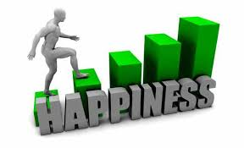
Avoiding Alcohol
Benefits of living alcohol-free:
Maintain a healthy body
Establish healthy relationships
Make healthy decisions
Avoid risky behaviors
Avoid illegal activities
Avoid violence
Achieve goals

Slide 16
Refusing Alcohol
"I don't like the taste"
"No, thanks. I need to be in top shape for the game this week"
"I don't drink alcohol—besides, I'm heading home"
"I really can't, my parents would be angry. We have an agreement."
"I don't want to risk getting kicked off the team."

Slide 17
The Impact of Alcohol Abuse
Lesson 3

Slide 18
Alcohol and Driving
1/5 of all teen drivers involved in fatal car accidents have a blood alcohol concentration of 0.01 percent
Blood alcohol concentration (BAC): the amount of alcohol in a person's blood, expressed as a percentage
BAC depends on the quantity and type of alcohol consumed, rate of consumption, body size, and gender
Any amount of alcohol in the blood can cause the following:
Slow reflexes
Reduced ability to judge distances and speeds
Increase risky behaviors
Reduce concentration and increase forgetfulness

Slide 19
Comparing Beer, Wine, and Spirits
Drink | Alcohol by Volume | Alcohol Content
Beer (12 oz.) | 4% | 0.5 oz.
Wine (5 oz.) | 10% | 0.5 oz.
Vodka or Whiskey (1.25 oz.) | 40% | 0.5 oz.

Slide 20
Driving While Intoxicated
The legal BAC limit for adult drivers is 0.08 %
For those under 21, there is no acceptable BAC
Consequences include:
Injuries or death to you or other drivers/riders
Arrest, jail time, court appearance, $$$$, police record, lawsuits
Restricted driving privileges or confiscated license
Higher auto insurance

Slide 21
Alcohol and Pregnancy
Fetal alcohol syndrome (FAS): group of alcohol-related birth defects that include physical and mental problems
Problems can include:
Small head and deformities
Heart, liver, and kidney defects
Vision and hearing problems
Central nervous system problems, developmental disabilities, and poor concentration
Difficulties learning and short attention span
Hyperactivity, anxiety, and social withdrawal
One of the leading preventable causes for mental handicap

Slide 22
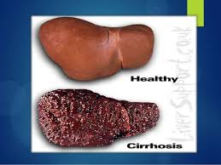
Alcoholism
Craving
Loss of control
Physical dependence
Tolerance
Alcoholic: an addict who is dependent on alcohol

Slide 23
Stages of Alcoholism
Stage 1—Abuse: May begin with social drinking; physical and physiological dependence develops; memory loss, blackouts
Stage 2—Dependence: becomes physically dependent on alcohol; drinker may try and hide problem
Stage 3—Addiction: liver may already be damaged; less alcohol may be needed to reach drunkenness; if alcoholic stops drinking, withdrawal may occur

Slide 24
Treatment for Alcohol Abuse
Recovery: process of learning to live an alcohol-free life
Sobriety: living without alcohol
Steps to recovery:
Step 1: Admission
Step 2: Detoxification
Step 3: Counseling
Step 4: Recovery

Slide 25
Programs
Al-Anon/Alateen
Alcoholics Anonymous
Mothers Against Drunk Driving (MADD)
National Association for Children of Alcoholics
National Drug and Alcohol Treatment Referral Routing Service
Students Against Destructive Decisions (SADD)
SMASHA's National Clearinghouse for Alcohol and Drug Information

Slide 26
Reference
Florida Health

