Slide 1
Chapter 1: Athletic Training as a Profession
Unit 1: Professional and Administrative Aspects of Athletic Training

Slide 2
Objectives
Define athletic training
Describe the roles of the certified athletic trainer
Describe the roles of other health care providers and the sports medicine team
List the requirements for becoming a competent certified AT
Describe the job opportunities available to certified ATs

Slide 3
Athletic Training Defined
Athletic training: a profession dedicated to maintaining and improving the health and well-being of the physically active population and preventing athletics-related injuries and illnesses
The credential for the certified athletic trainer is ATC
Although individuals have provided care to injured athletes for centuries, it wasn’t until 1991 that the American Medical Association formally recognized athletic training as an allied health care profession
National Athletic Trainers' Association (NATA): responsible for setting professional standards
Formed in 1950
NATA BOC (Board of Certification) is responsible for conducting the national certification process

Slide 4
ROLES OF THE ATHLETIC TRAINER
Injury prevention
Prevention includes pre-participation physical exams, proper strength and conditioning programs, proper equipment and equipment fitting, taping, bandaging, bracing, and good nutrition
Clinical evaluation and diagnosis
Recognize the type of injury and its severity so can figure out best treatment or when to refer athlete to a physician
Immediate care of athletic injuries
Must be ready to respond when an athlete is injured and must maintain first aid and CPR certification
Treatment, rehabilitation, and reconditioning of athletic injuries
After initial treatment, AT directs athlete through exercises and treatments to help return to normal function
Rehabilitation reconditioning: getting the athlete back into physical shape for athletic participation
Organization and administration
Manage facilities which involves good administrative skills necessary for preparing work and purchase orders and scheduling staff and injuries, treatments, and rehabilitation progress must be documented accurately
Professional development
With technology changing rapidly, ATs must continue their education to remain current with the latest development in health care and to do so, must attend seminars, read journals, write articles, and conduct research and must conduct themselves with integrity

Slide 5
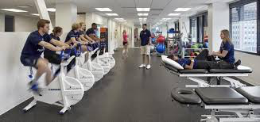
The Sports Medicine Team
Sports medicine: care of physically active people who have suffered athletic injury or illness
Sports medicine profession includes: (name 2)
ATs
Medical doctors
Physical therapist
Dentist
Chiropractors
Coaches
Sport psychologist
Strength and conditioning
School nurses
Sport nutritionists
Student assistants

Slide 6
Cardiologist Emergency Medical Technician Physician Asst
Urologist Registered Dietician Primary Care Physician
Pediatrician Podiatrist Strength & Conditioning
Coach
Chiropractor Allergist
Neurologist Team Dentist
Equipment Manager Physical Therapist
Sport Psychologist Massage Therapist Student Assistant
Athlete
Athlete's Parents
Coach
Team Physician
Athletic Trainer

Slide 7
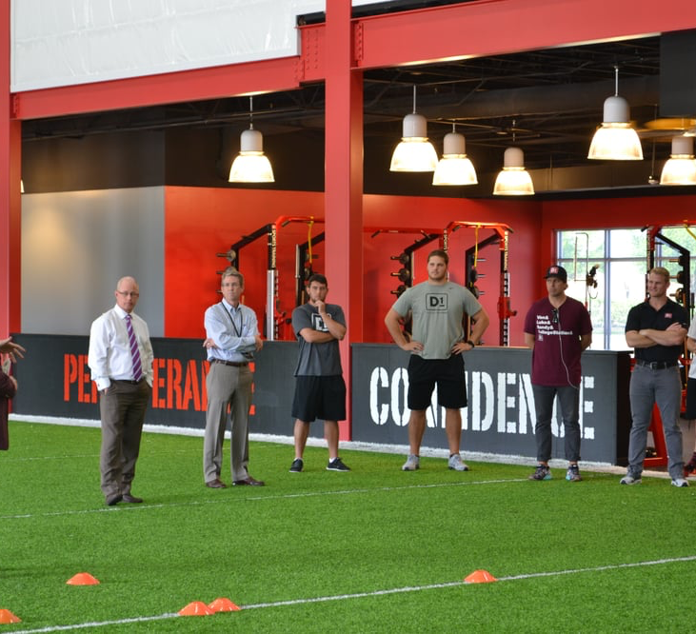
Central Team
Athlete
Athlete's parents or guardian
Team physician
X-Ray: electromagnetic waves used to make a picture of a body part
Orthopedists: deal primarily with injuries to the musculoskeletal system
Certified AT
Coach

Slide 8
Peripheral Team
Neurologist
Student assistant
Chiropractor: health professional who takes a holistic approach to patient care by focusing on spinal alignments
School nurse
Registered dietician
Emergency medical technician (EMT)
Massage therapist
Sport psychologist: works with athletes who may need help with goal setting, anxiety, frustration, self-esteem, family issues, and more
Strength & conditioning coach
Equipment manager
Primary care physician
Podiatrist
Allergist
Allergy: immune response that includes red, swollen tissue or runny nose, to a substance that normally should be tolerated
Urologist
Cardiologist
Pediatrician
Dentist
Physical therapist
Physician assistant

Slide 9
Becoming a Certified AT
Bachelor's degree
Must receive clinical experiences that provide supervised, hands-on experience as well as specified courses related to athletic training
Master's degree
Either degree must be from a program accredited by the Commission on Accreditation of Athletic Training Education (CAATE)
Must pass BOC certification exam and earn the ATC credential before practicing as a certified AT
Many states have laws that require state licensure in addition to national certification
Practicing without a license or. certification could result in legal action
Licensure: A state act that specifies who is allowed to practice athletic training and what duties they are allowed to perform
Certification: ensures that an individual has achieved basic knowledge and skill to practice athletic training
Registration: requires an individual to register with the state before practicing athletic training

Slide 10
Becoming a Certified AT
Risk management and injury prevention
Pathology of injury and illnesses
Orthopedic clinical examination and diagnosis
Medical conditions and disabilities
Acute care of injuries and illnesses
Therapeutic modalities
Conditioning and rehabilitation exercise
Pharmacology
Psychosocial intervention and referral
Nutritional aspects of injuries and illness
Health care administration
Professional development and responsibility

Slide 11
Fundamental Concepts in Professional Practice
Fundamental | Explanation
Primacy of the patient | Putting the care of the patient first and providing the best possible care to the patient
Teamed approach to practice | Understanding that the central and peripheral sports medicine teams both play a role in the rendering quality care to a patient; understanding the scope of practice in athletic training and having an ability to work with others
Legal practice | Following the laws that guide the practice and understanding what constitutes illegal practice
Ethical practice | Following the NATA code of ethics at all times and working to follow appropriate practice guidelines as a health care professional
Advancing knowledge | Examining evidence from research to guide one's practice as an AT and engaging in continuing education to improve the quality of patient care
Cultural competence | Understanding and valuing patients' differences and working responsibly with diverse patient populations
Professionalism | Acting in a compassionate manner and behaving with honesty and integrity; promoting the AT profession

Slide 12
Athletic training careers
Organized athletics
High school environment
Universities and colleges
Professional and semiprofessional teams
Youth sports leagues
Clinical & hospital settings
Sports medicine centers
Clinic outreach
Physician-owned clinics
Industrial & occupational settings
Health & fitness centers
Industrial manufacturing sites
Ergonomic specialist: measures and adapts a work environment to prevent and treat musculoskeletal disorders
Military & law enforcement settings

Slide 14
National Athletic Trainers' Association
The athletic training association is directed by its professional association, NATA.
Composed of voluntary members, including ATs, AT students, and associate members
NATA guides the advancement of the profession and sponsors the publishing of important information that affects how athletes are treated
Important publications include: Journal of Athletic Training and Athletic Training Education Journal

Slide 15
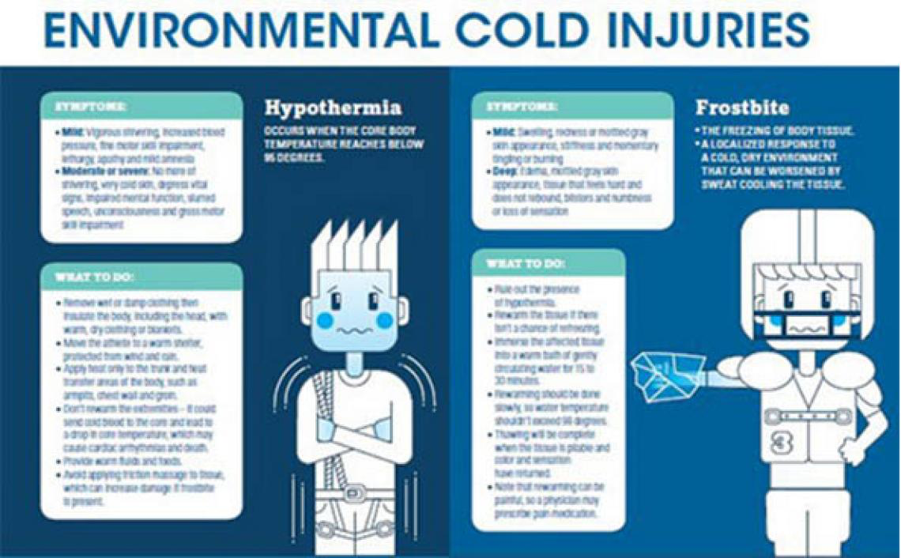
NATA Position Statements
Acute management of athletes with cervical spine injuries
Environment cold injuries
Emergency planning in athletics
Exertional heat illness
Fluid replacement for athletes
Head-down contact and spearing in tackle football
Lightning safety for athletics and recreation
Management of asthma in athletes
Management of sport-related concussion
Management of athlete with type I diabetes mellitus
Prevention, detection, and management of disordered eating in athletes

Slide 17
Reference
Fundamentals of Athletic Training

