Slide 1
Chapter 4: Basics of Tissue Injuries
Unit 2: Basics of Human Anatomy and Physiology

Slide 2
Objectives
Explain types of soft-tissue injuries
Explain tissue repair
Explain bone injuries
Explain bone repair and healing

Slide 3
Soft-Tissue Injuries
The body is made up of various tissues, each of which has unique characteristics and functions
Soft-tissue injuries are often called wounds, sprains, and strains
These types of injuries are very commonplace in athletics
When a soft-tissue is injured, it may bleed, become inflamed, or produce extra fluid
These types of injuries are often referred to as "acute" because they occur suddenly as a result of a high amount of force applied to the tissue over a short period of time

Slide 4
Soft-Tissue Injuries: Wounds
Wound: injury to the skin
Incision: open wound made by a cutting object such as a scalpel
Rarely seen in athletics
Abrasion: results from scraping off a layer of skin and may not bleed depending on the depth
A base runner in baseball or softball may acquire an abrasion when sliding into a base
Contusion: closed wound, commonly called a bruise and bleeds under the skin, which can cause swelling and discoloration
Athlete may receive a contusion from running into another person's elbow
Laceration: jagged, irregular wound created by a noncutting object, such a steel pole of a wall
A lacrosse player runs into the goal post and receives a laceration

Slide 5
Soft-tissue injuries: Wounds
Avulsion: partial tearing away of a body part
Avulsion of a finger may occur if someone catches a ring on the basketball hoop
Amputation: open wound in which the body part is completely cut away from the body
Cutting off a finger with an ice skate
Puncture: occurs when a pointed object enters the body; do not bleed much, so are more likely to become infected
Stepping on a nail
Contrecoup: occurs on the opposite side of the initial injury
Occurs when the head hits an unyielding object or surface; the impact to the back of the head forces the brain against the anterior part of the skull, resulting in the contrecoup injury

Slide 6
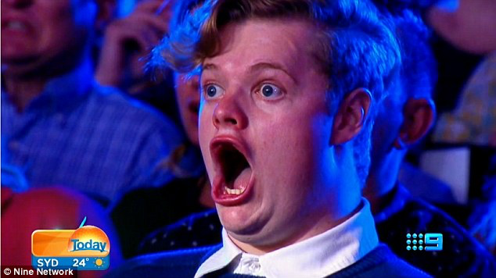
Picture Time!

Slide 7
Wounds
Incision
Abrasion

Slide 8
Wounds
Contusion
Laceration

Slide 9
Wounds
Avulsion
Amputation

Slide 10
Wounds
Puncture
Contrecoup

Slide 11
Soft-Tissue Injuries: Sprains and Strains
Sprain: injury to a ligament
Strain: injury that occurs to a muscle or tendon
Both strains and sprains are injuries that bleed internally and can cause fluid buildup
Both are categorized in order of severity as first-,second-, or third-degree injuries
First-degree: overstretched tissue with no loss of motion (mild)
Second-degree: tissue is partially torn and there is some loss of motion and swelling (moderate)
Third-degree: tissue is completely ruptured or nearly ruptured (pulled apart) (severe)

Slide 12
Chronic Soft-Tissue injuries
Soft-tissue injuries can also be chronic
Chronic injuries are the result of lesser forces being applied in the body over a long period of time
Distance runner who trains extensively every day for several months without getting enough rest may load the soft tissues enough to cause damage
Synovitis: chronic injury to the synovial lining of a join
The cause can be an acute injury that is never treated properly or rested, but more often the injury is chronic and the result of repeated joint injury
Bursitis: chronic inflammation of a bursa sac
Bursa sacs are located near your joints where soft-tissues structures may rub near a bone
When a bursa becomes irritated, it tends to swell and can create a pocket of swelling at the joint
Myositis: chronic inflammation of the muscle tissue
Condition is characterized by soreness, tenderness, and mild swelling in the muscle
Fasciitis: inflammation of the facial tissue
Fascia is a thick, tough connective tissue that surrounds the muscle and helps to loosely bind the skin to the underlying fat and muscle tissue
When fascia becomes strained due to overuse, it can become thickened, swollen, and painful

Slide 13
Stages of Soft-tissue healing
When soft-tissue is injured, it progresses through 3 stages of healing: acute inflammatory, repair, and remodeling
Stage 1: Acute Inflammatory
When a body part is injured, cells within the area die both from being ripped apart and from being cut off from their food and oxygen supply
In this stage, an increased flow of blood to the injured area brings cells and chemicals to begin the healing process
Phagocytes: specialized cells that engulf and eat dead cells
Leukocytes: infection-fighting white blood cells
Platelets: carry blood-clotting materials
Acute stage lasts about 2 days after the initial injury

Slide 14
Stages of soft-tissue healing
Stage II: Repair
The injured area has now been filled with blood, cells, and chemicals to rebuild the area
Fibroblasts: connective tissue cells that begin building fibers across an area of injury. They form the scar and take about 6 weeks to accomplish their tasks
Stage III: Remodeling
Remodeling takes up to a year or more to accomplish
Body's way of building tissue strength in tendons, ligaments, and muscles to withstand the stress applied to the body during activity

Slide 15
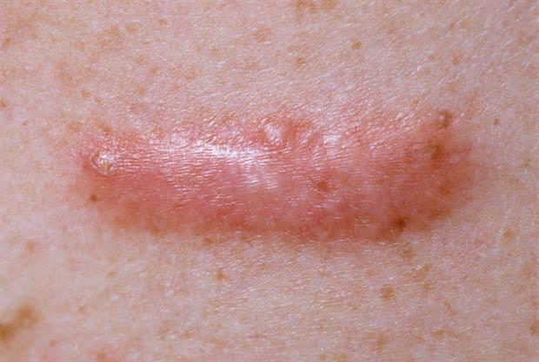
Soft-Tissue Healing
In general, the greater the injury to the tissue, the longer the healing time, although it depends on the degree of the injury, the location of the injury, the blood supply to the injury, and the age of the athlete
If blood supple to an area is poor, such as the eyeball, the healing process will take longer
Other factors that significantly slow the healing process include:
Poor nutrition
Illnesses such as diabetes
Medications such as corticosteroids
Infections
Keloid: scar tissue

Slide 16
Bone injuries
ATs must be familiar with the types of bone injuries and their stages of healing
Dislocations and fractures are common athletic injuries
Articulation: the coming together of two bones to form a joint
Dislocation: an injury that disrupts the alignment of bones at a joint, resulting in deformity
A dislocation can cause avulsion fractures, strains, sprains, disruptions of blood flow, and disruption of nerve condition
Dislocations present with deformity and pain and are not easily moved
Dislocations are care for by the team physician and are not put back in place by the AT

Slide 17
Dislocation

Slide 18
Bone INjuries: Fractures
Fracture: a break in a bone
Failure point: amount of energy required to cause a fracture
Vary with the athlete, age, and bone structure
Example: athlete with a bone-deteriorating condition such as osteoporosis will have a lower failure point than an athlete with healthy bones
Fractures are named according to the type of impact and how failure of the bones occurs

Slide 19
Bone injuries: Fractures
Stress fracture: occurs in a bone that been subject to repetitive stress; also called fatigue fracture
Athlete will complain of a persistent sore spot over the bone
Microscopic and cannot be viewed on an X-ray
Spiral fracture: torsional force along the length of the bone
In-line skater moves foot to the right while the rest of your body goes left
Looks like a stripe on a candy cane
Longitudinal fracture: runs the length of a bone and is usually caused by an impact
Pole-vaulter who misses the mat and lands on their feet

Slide 20
Bone injuries: Fractures
Compression fractures: occurs when opposing forces are applied to a bone from both ends at the same time; often occur in the spine
Athlete lands on their feet or buttocks from a height; the impact of the ground is one force, and the weight of the falling body is the other
Oblique fracture: diagonal break across a bone from one side to another
An oblique fracture in a weight bearing bone, such as a leg bone, takes longer to heal because the diagonal angle of the bones ends make it easy for the bones to move out of alignment, even in a cast
Comminuted: when a bone is crushed into smaller pieces
Baseball catcher whose barehand is hit by a bat
Greenstick: partial fracture part way through a bone
Occur most often in children and adolescents since their bones are still soft

Slide 21
Bone Injuries: Fractures
Transverse: fracture that travels across and perpendicular to a bone
Occur from impacts perpendicular to a bone; a lacrosse player who brings his stick down across another player's forearms
Depressed: occurs from a direct impact to the skills and indents
Blowout: occurs when an eye is pushed hard backward and down into the eye socket; small bones under the eye are crushed and embedded into the muscles of the eye
Baseball strikes the eye
Pathological: bones weaken because minerals are taken from them to support vital functions
Bone tumor or improper nutrition
Epiphyseal: fracture at the epiphysis
Area of bone where bone growth occurs (epiphysis) is susceptible to fracture because the bony tissue is stronger than the epiphysis
Occurs in children and adolescents close to long bones
Adults do not get them because their growth areas are closed

Slide 22
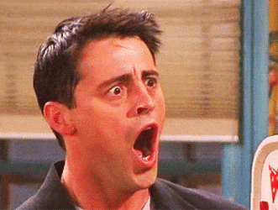
Now for the pictures

Slide 23
Bone INjuries: Fractures
Stress
Spiral

Slide 24
Bone injuries: Fractures
Longitudinal
Compression

Slide 25
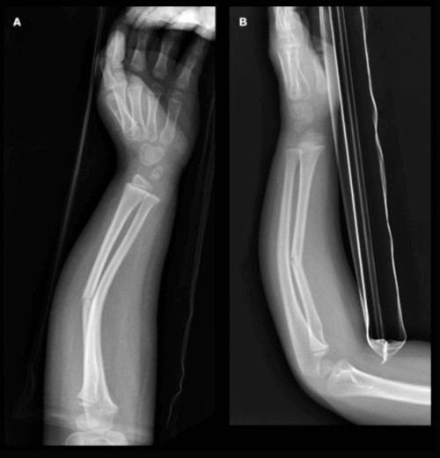
Bone injuries: Fractures
Oblique and Comminuted
Greenstick

Slide 26
Bone Injuries: Fractures
Transverse
Depressed

Slide 27
Bone injuries: Fractures
Blowout
Pathological

Slide 28
Bone Injuries: Fractures
Epiphyseal

Slide 29
Stages of Bone Fracture Healing
Similar to soft-tissue injuries, bone fractures go through the acute, repair, and remodeling stages of healing
Stage I: Acute
An injury to the bone causes the bone to break, and bleeding occurs in the area
Osteoclasts begin to eat the debris or resorb is into the body
Osteoblasts begin to add new layers to the outside of the bone tissue
This continues for about 4 days
Stage II: Repair
Osteoclasts and osteoblasts continue to regenerate the bone
A bony splint, or fibrous callus, forms and extends both externally and internally to hold the bone ends together
The process of transforming callus to bone begins in about week 3 and continues for 3 months
In most cases, after 6 weeks in a cast, the fracture is strong enough to allow participation with protection
Athlete must remember the healing process is not complete still at this point

Slide 30
Stages of Bone Fracture Healing
Stage III: Remodeling
Takes several years to complete
During the phase, the callus is reabsorbed with a fibrous cord of bone that is formed around the fracture site
Growth of the fibrous cord of bone can be stimulated through surgically implanted electrodes when the bones are not healing
Bones contain minerals that have an electrical charge, and adding electrical stimulation increases the layering of the bone
Nonunion fracture: a bone that never heals
A nonunion fracture in a weight-bearing bone, such as a leg, means the athlete will not walk
A common nonunion fracture of the wrist occurs in the scaphoid bone; such fractures are painful and may lead to arthritis and the inability to move the wrist

Slide 31
Reference
Fundamentals of athletic training

