Slide 1
CHapter 5: Head Injuries
Unit 3: Understanding Athletic INjuries to the Axial Region

Slide 2
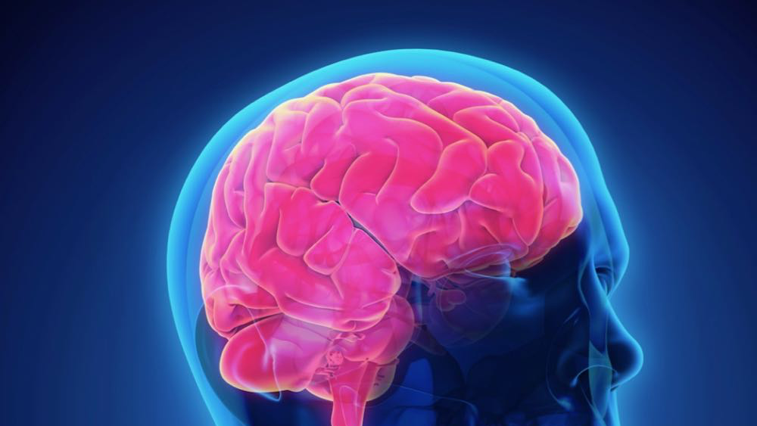
Objectives
Describe the anatomy of the head
Understand that head injuries can be prevented
Understand the urgency involved with caring for brain injuries
Describe the types of head injuries

Slide 3
Anatomy of the Head
When an athlete has a head injury, the AT must act quickly to lessen the chance of death and permanent injury
made of billions of cells
Weighs about 3 pounds
Requires 20% of the total body oxygen and 15% of body's blood supply
Depriving the brain of oxygen will cause unconsciousness and then death
Pupils will dilate (indication of the inability to control the muscle of the iris)
About 4-6 minutes without oxygen, biological brain death occurs
BRain cells grow and develop until age 18
After this, brain cells can be destroyed, but not reproduced
Brain continues to develop until about age 25

Slide 4
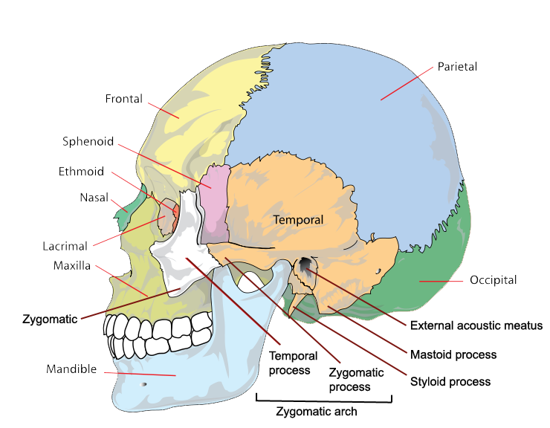

Slide 5
Anatomy of the head
The brain is divided into lobes, each named after the bony structure of the skull that covers it
Each lobe is responsible for specific body functions:
Occipital: vision
Temporal: hearing and speech
Parietal: sensation
Frontal: voluntary muscle movement. Emotion, and eye movement

Slide 6
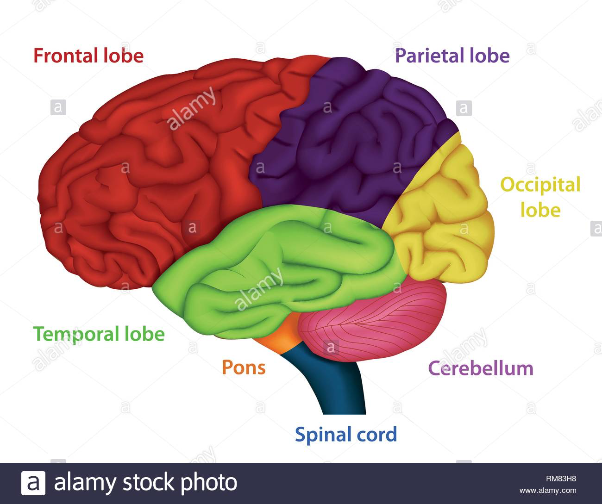

Slide 7
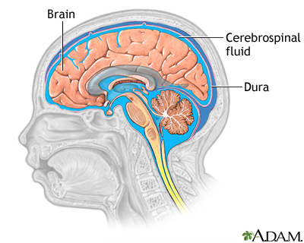
ANATOMY OF THE HEAD
THE BRAIN ATTACHES TO THE SPINAL CORD AT THE BRAIN STEM VIA A CROSSOVER
RIGHT SIDE OF THE BRAIN CONTROLS THE LEFT SIDE OF THE BODY AND VICE VERSA
PRESERVING BRAIN FUNCTION IS OF THE UTMOST IMPORTANCE TO INJURED ATHLETES
QUALITY OF LIFE DEPENDS ON HOW THE BRAIN IS HANDLED
CERBROSPINAL FLUID: LIQUID FROM THE BLOOD THAT MAINTAINS UNIFORM PRESSURE WITHIN THE BRAIN, BATHES THE BRAIN IN CHEMICALS FOR PROPER FUNCTION, AND PROTECTS THE BRAIN FROM IMPACTS
FLUID IS A CLEAR AMBER IN COLOR
IN INSTANCES OF A SEVERE INJURY, CS FLUID MAY DRAIN FROM AN OPENING IN THE SKULL, NOSE, OR AN EAR AND SHOULD BE ALLOWED TO DO SO; STOPPING THE DRAINAGE WILL ONLY INCREASE THE PRESSURE WITHIN THE SKULL AND CAN CAUSE MORE BRAIN DAMAGE

Slide 8
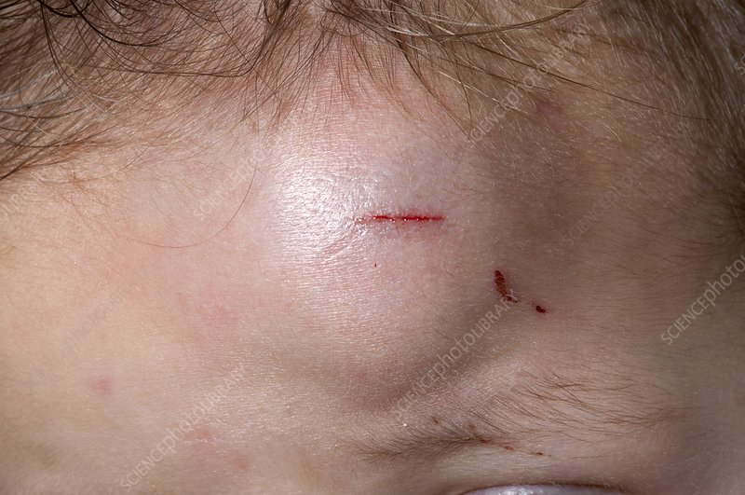
Anatomy of the Head: The Scalp
Scalp: part of the skin that covers the skull and contains a large number of blood vessels, muscles, and hair
Skin protects against infection while the hair protects the skin from the sun and keeps dirt and swear away from the eyes
So many blood vessels that even a small laceration to the scalp can bleed excessively
Hematoma: a collection of blood at an anatomical site
Blood vessels bleeding under the skin; causes a bump
Scalp has the ability to decrease the force of an impact to the skull due to the additional padding it provides

Slide 9
Preventing Head Injuries
Head injuries are prevented by helmets, mouth guards, rules, and common sense
Commonly forgotten piece: the mouthguard
Can prevent dental injuries as well as concussions
Mouthguard provides spacing and shock absorption between the mandible and maxilla so that the force of the impact will not be transmitted to the brain stem
WEaring a helmet and face mask
A properly fitted helmet helps protect a player's head from direct impacts
Spearing is now a penalty
Must teach proper skills and form and this falls on the AT and Coach
Show safety film or have coach's watch film and relay information to players

Slide 10
Head Injury Mechanisms
Injury to the brain can be caused by rotation of the head, but the most common mechanism is the impact
The region most susceptible in the skull is the temporal region because the bone is thinnest there
Contrecoup injuries occur when the head is moving and receives a blow
Upon the impact, the brain sloshes to the opposite side of the blow, where it is stopped by the skull
An athlete may complain of a headache opposite of the impact, which is evidence of contrecoup
Rotation of the head after an initial impact can cause the brain stem to stop functioning normally
Nerve receptors become overloaded with information to the brain and brain overload can cause unconsciousness
The unconscious state allows for a sorting of the impulses before the athlete returns to consciousness

Slide 11
Treating Head injuries: Skull Fractures
Skull fractures occur when there is significant force against the head
Types of skull fractures include: depressed, linear, compound, and penetrating
A depressed fracture pushes a portion of the skull inside the brain
There will be bleeding under the skin or even a laceration requiring bleeding control
A linear fracture goes across the skull
Although no bones are moved out of place, there are tears in the blood vessels on the inside of the skull
A compound fracture will result in a portion of the skull sticking through the scalp and profuse bleeding
A penetrating fracture involves an object that has gone through the scalp, skull, and likely the brain

Slide 12
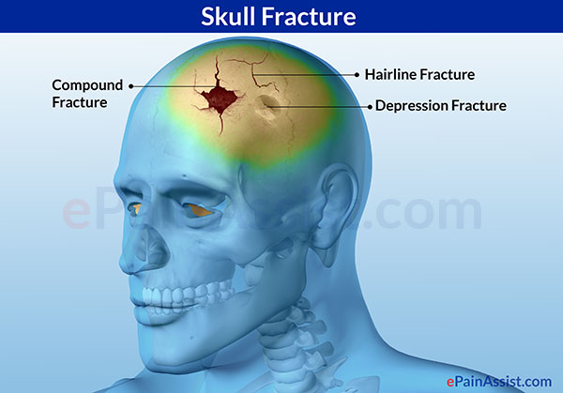
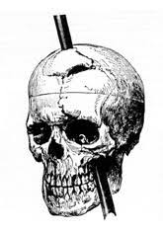
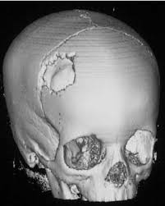
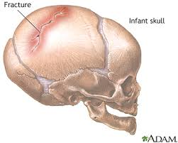

Slide 13
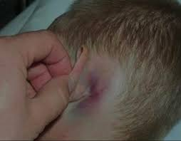
Skull fractures
A skull fracture will discolor the area behind the ear
Battle sign: A discoloration behind the ear resulting from a skull fracture
Any Skull fracture is significant and requires immediate attention of a physician

Slide 14
Treating Head Injuries: Concussion
Concussion: the temporary impairment of brain function caused by impact to the head or by rotation force
A rotation of the head during impact will send a massive number of impulses to the brain all at once
The brain, not knowing what to do with the impulses, is overwhelmed, and the athlete may appear dazed and confused or may even lose consciousness
Symptoms of concussion include: nausea, dizziness, ringing in the ears, loss of balance, unconsciousness, difficulty remembering things before or after impact, possible battle sign, and disorientation
Tinnitus: ringing in the ears
Amnesia: Loss of memory, usually due to a head injury

Slide 15
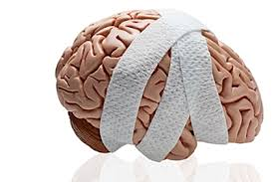
Treating Head Injuries: Concussion
The potential problems related to concussions in sport prompted NATA to create a position statement on management of sport-related concussions
The statement provides guidelines for ATs, including the idea that Ats must be sensitive to both the causes of concussions and how concussions are presented when an athlete is injured
Ats must not only recognize the common signs of concussion (balance problems, loss of memory, and difficulty concentrating), but also the symptoms (headache, tinnitus, nausea)

Slide 16
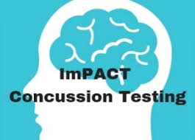
Treating Head injuries: Concussions
The NATA position statement also recommend that ATs collect baseline measures of mental functioning
This preinjury testing often involves using computers to assess an athlete's attention, reaction time, information processing speed, concentration, and memory
The use of computer programs allows an AT to identify even subtle deficiencies in brain function
Such information can help determine when an athlete can safely return to play

Slide 17
Treating head injuries: Concussion
A noncomputerized cognitive test that is often used by ATs is the Standardized assessment of Concussion (SAC)
The Sac requires an AT to obtain information from the athlete that relates to orientation (Day of the week), immediate memory (remembering 5 words), concentration (reverse the order of the string of numbers), and delayed recall (remember the 5 initial words given during the immediate memory test)
The sac test also has a neurological screening section where an AT examines loss of consciousness, memory loss, strength, sensation, and coordination
An athlete is given 1 point for a correct response and no points for an incorrect response
The sac form creates a record of an athlete's cognitive function and can be used as a pretest so the post-traumatic score can be compared
A score of 25 on the SAC is used as criterion for returning an athlete to play

Slide 18
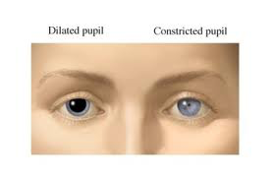
Treating head injuries: Concussion
The severity of concussions is graded the same and strains and sprains according to the AMerican Academy of Neurology
First degree (Mild): no loss of consciousness and symptoms and abnormalities are resolved in less than 15 minutes
Second degree (moderate): no loss of consciousness, but the athlete's symptoms and abnormalities last longer than 15 minutes
Third degree (severe): Unconscious of any length of time
Unconscious athlete may experience rapid eye movement that look like fluttering and pupils may be unequal in size
THe pupil of the side of the head injury will be enlarged if the head injury is serious

Slide 19
Treating Head Injuries: Concussion
Severe Concussion Continued
Athlete could potentially be in a coma, but can hear what is being said
It is important that someone keep talking to the victim while the AT is working
The AT will check for increased blood pressure, decreased pulse rate, and signs of shock
A severe concussion could lead to paralysis
AT must keep in mind that other injuries could have occurred during concussion
Should also consider the possibility of neck injury

Slide 20
Treating Head injuries: Concussion
Cantu grading system is another way to measure concussion severity
Grade 1: no loss of consciousness, loss of memory lasts less than 30 minutes, and post-concussion signs and symptoms last less than 24 hours
Grade 2: involves loss of consciousness for less than a minute of post-traumatic loss of memory between 30 minutes and 24 hours; post-concussion signs and symptoms last 1-7 days
Grade 3: loss of consciousness of over a minute, memory loss longer than 24 hours, post-concussion signs and symptoms last longer than 7 days

Slide 21
Treating Head INjuries: Concussion
When the athlete is removed from the playing field, it is not uncommon for players to hit in the teammate in the head and say "Hang in there"
Although they are trying to be supportive, they're actually contributing to the concussion
Athletes must be instructed ahead of time to keep their hands off so that only the AT is touching the injured player

Slide 22
Treating Head INjuries: Concussion
Assessing the level of consciousness should be done using the Glasgow Coma Scale, or GCS
THe scale is used to determine the severity of the brain injury and Assesses alertness, verbal, pain, and Unresponsiveness
Also referred to as AVPU
THE SCALE IS BROKEN INTO THREE AREAS: MOTOR RESPONSE, VERBAL REPSONSE, AND ETE OPENING
EACH CATEGORY HAS A GRADING SCALE AND FINAL SCORE IS DETERMINED BY ADDING ALL THE SCALES TOGETHER
A CHART IS USED TO ASSESS THE ATHLETE'S PROGNOSIS
THE HIGHER THE NUMBER ON THE GRADING SCALE, THE GREATER THE CHANCE OF RETURNING TO NORMAL

Slide 23
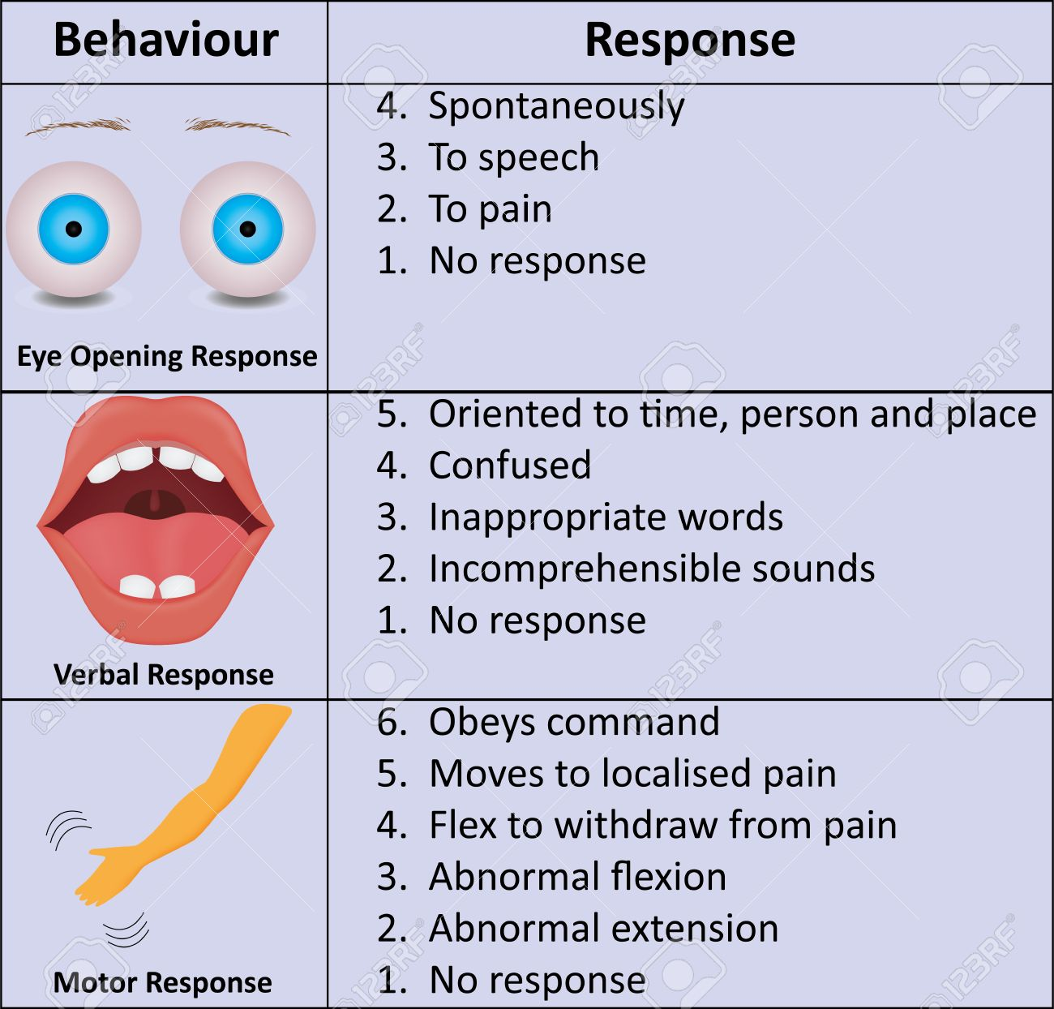

Slide 24
Treating Head INjuries: Concussions
A concussion with or without the loss of consciousness should make the AT wonder about other injuries that may have occurred
It is best to use a backboard for any athlete with a moderate or severe concussion in the event that the athlete loses consciousness and then must be referred to a physician
An athlete who has suffered a concussion will need to be monitored by a physician to determine it is safe to reenter competition
THe NATA position statement on concussion management states that an athlete should be monitored every 5 minutes after the concussion until the condition clears of the athlete is referred for advanced care
In general, an athlete will not be allowed back into competition after the first concussion until there are no remaining signs or symptoms

Slide 25
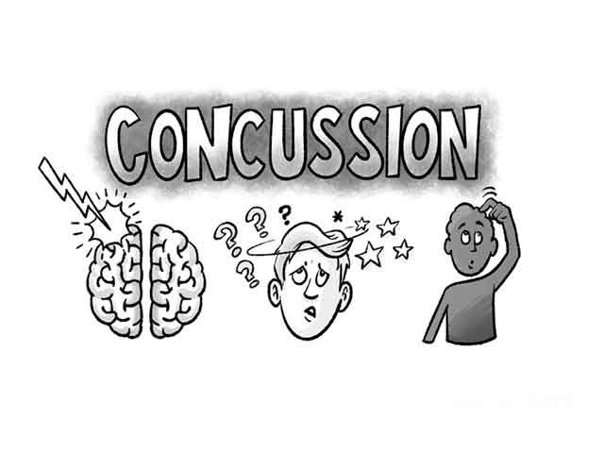
Treating Head injuries: Concussions
After a second concussion within a year, the athlete must have at least one month free of all signs and symptoms before reentering
A third concussion in one year puts the athlete out of competition for one year, starting the day of the third concussion
An athlete who has suffered a concussion should be told about the signs and symptoms of concussions and the implications of the repeated impacts
An athlete who has suffered one concussion is 4 times for likely to suffer another

Slide 26
Treating head injuries: Concussions
Decisions to return to play should be made by the at and physician
Sometimes a follow-up appointment and progression of physical therapy are necessary
Assessments should be compared to SAC tests
The progression of activity involves engaging in exercises such as stationary biking, push-ups, sit-ups, and low-level running
The AT must reassess the athlete to determine if the concussion symptoms reoccur during any activity
Neurocognitive testing: systematic, objective procedures used to examine the function of the brain; tests are often computer based and used to create baseline performance measures that are then compared with post-concussion performance to determine if an athlete can return to play

Slide 27
Treating Head INjuries: Intracranial Hematoma
Intercranial Hematoma: severe bleeding within the brain caused by a blow to the head, particularly over the temporal or parietal regions
The hematoma causes a significant increase in pressure on the brain, and rapid death can occur
Sometimes an athlete is thought to have a concussion and is allowed to go home and could cause death
If the athlete is found in a coma, the chances of survival are only 40%
Survival depends on early examination by a physician and prompt surgical care

Slide 28
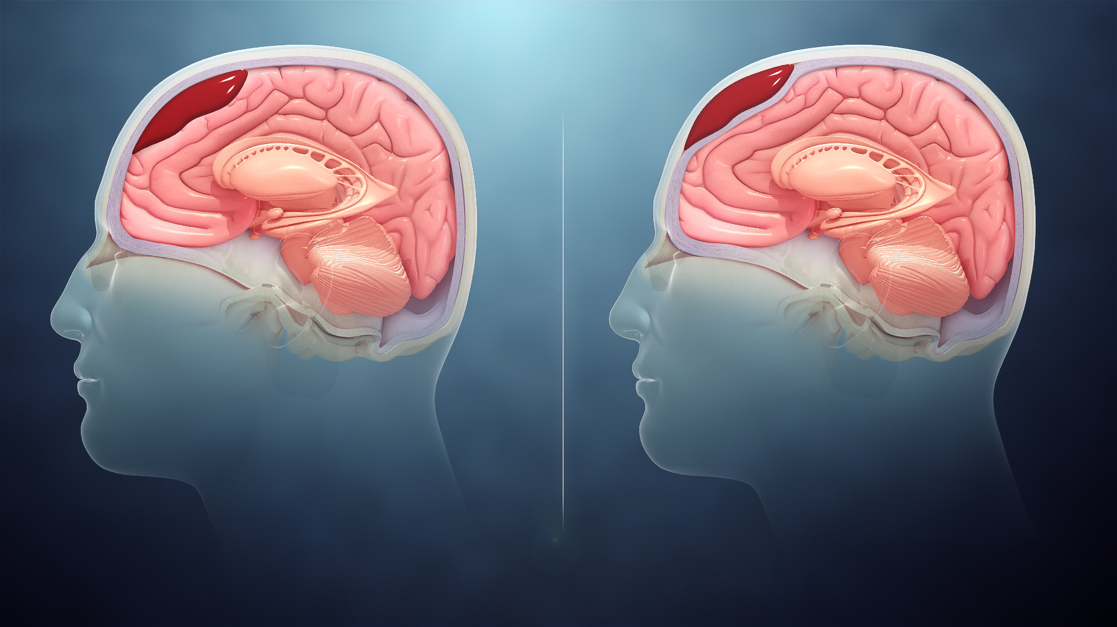
Treating Head Injuries: Intracranial Hematoma
Physicians drill a hole in the skull to allow drainage of the blood and attempt to repair the bleeding vessel
If the athlete is not in a coma, the physician must give medication to put them into a coma
Comatose state keeps the athlete calm and allows the brain to heal without movement

Slide 29
Treating Head injuries: Intracranial Hematoma
Symptoms of intracranial hematoma include: headaches, nausea, vomting, loss of consciousness, paralysis of extremities on the opposite side of the injury, and battle sign
If an intracranial hematoma is suspected, EMS should be contacted immediately
Onset of symptoms may be gradual, so athlete must be continually monitored
With the first indication that condition is worsening, the athlete must be taken immediately to a hospital
Any athlete with any possible head injury should be monitored for at least 24 hours and be awakened every couple of hours to check on status

Slide 30
Treating Head injuries: Intracranial Hematoma
The signs of a hematoma are a rise in blood pressure with a drop in pulse rate
The pupil on the same side as the head injury will be enlarged
Signs of intracranial Hematoma: The athlete may have difficulty speaking, difficulty using extremities on the opposite side of the hematoma, stiffening of posture, rapid eye movements, unconsciousness or coma, and lack of coordination
Depending on the severity of the injury, athlete can fully recover or suffer permanent brain impairment

Slide 31
Treating Head injuries: Post-concussion syndrome
Post-concussion syndrome: the persistence of symptoms after a concussion
Symptoms may include headache, ringing in the ears, dizziness, and confusion
The athlete should be seen by a physician for a follow-up evaluation
Returning to play too soon following a concussion increases the chance of developing this condition
Usually does not last more than a week or two

Slide 32
Treating head injuries: Second-impact syndrome
Damage from concussions and brain injury is cumulative
Second-impact syndrome: occurs when an athlete receives more than one concussion or blow to the head in a relatively short time
Such trauma may disturb the blood supply to the brain and present signs of a minor concussion followed quickly by a semi comatose state
Athletes who have suffered brain injuries must not be allowed to return to participate until they are symptom free and have written permission from a doctor

Slide 33
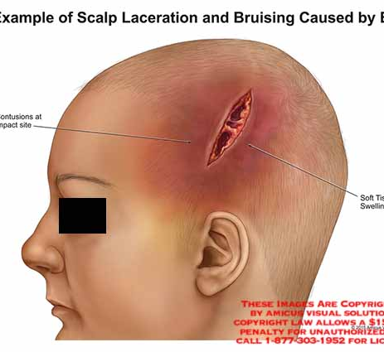
Treating Head INjuries: Laceration
A laceration to the scalp will bleed profusely because of the number of blood vessels in the scalp
Direct pressure applied to the wound will eventually stop the bleeding, but application of multiple gauze pads is usually necessary
Lacerations of the scalp may require suturing

Slide 34
Resource
Fundamentals of athletic training

