Slide 1
Treating Eye Injuries and Conditions: Foreign Body
A foreign body in the eye causes tears, which attempt to wash the foreign body toward the nose
In some cases, tears will not clear the eye and rinsing out with water from the nose outward can flush the particle out of the eye or over to one side, where it can be removed
If the object is stuck under the eyelid, the AT or athlete should lift the lid outward over the bottom lashes
The bottom lashes can brush the object out
If this process does not remove the object, it will be necessary to invert the upper eyelid and this is accomplished by grasping the lid and pulling it outward; a cotton-tipped applicator is placed in the fold of the lid, and the lid is laid over the applicator
Exposes the underside of the lid so that the object can be removed
If the inversion technique fails, the athlete should be referred to a physician
Both eyes should be patched to decrease movement and prevent scratching of the cornea

Slide 3
Treating Eye Injuries and Conditions: Embedded Object
An embedded object: object is stuck in the eye; it may have been from a blow to the eye
Blow from a ball may have shattered a contact lens
No matter how the object entered the eye, the care received will determine the quality of the athlete's vision in the future
The athlete will know the object is in the eye
Often will reach for the eye and tears will form, resulting in pain, visual impairment, and anxiety
The best treatment is to place an eye shield over both eyes and send the athlete to a physician.
If the object is sticking out of the eye, the AT will not remove the object, but will stabilize it with bulky dressings
The physician will determine the severity of the injury, surgically remove the object, and stop any fluid release
Antibiotics are prescribed and the eye will remain patched for about a week
Vision test is necessary to determine visual acuity
Eye guards or goggles will help protect an athlete from reinjury

Slide 4
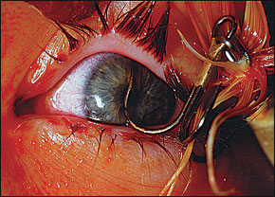

Slide 5
Dislodged Contact Lens
Contact lenses come in two types: hard and soft
A hard contact lens covers the pupil of the eye, whereas a soft contact lens covers the entire cornea
A displaced hard contact lens feels like a rock in the eye; vision will be impaired and displaced lens will irritate the eye
Usually the athlete knows where the lens is located because of the initial pain
When the eye is examined, the lens can be seen because of its color in contrast to the sclera
The lens cannot be lost in the eye
The hard lens can be moved back over the pupil and usually the athlete can perform this themselves with the AT holding a mirror
If the athlete cannot remove it, the AT has a suction-cup device that is placed over the lens
The athlete should clean the lens before putting it back in

Slide 6
Displaced Contact Lens-Soft
The displacement of a soft contact lens is less uncomfortable
The athlete will know the lens is out of place because they won't be able to see
A soft lens is more difficult to put back in place because it tends to curl up like a soggy cornflake
The athlete should wash their hands and then gently grab the lens; must continue with caution, because roughly handling a contact lens will tear it
The lens should be cleaned with solution before returning it to the eye
Sometimes an athlete believes that rinsing the lens by putting it in their mouth is acceptable; this is not the case and is comparable to dropping it in the garbage can

Slide 7
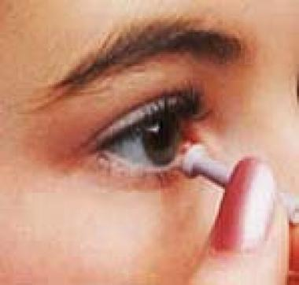
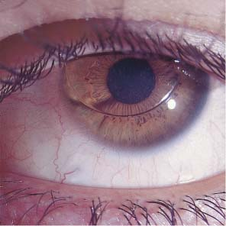

Slide 8
Corneal Abrasion
Corneal abrasion/laceration: caused by being poked in the eye with a foreign object or by wearing contact lenses for too long
Can be an abrasion (superficial) or a laceration (deep)-more severe
The athlete will experience pain and feel as if something is lodged in the eye; will have tears and sensitivity to bright light
If the injury is not treated, the eye may become infected or the athlete may have permanent vision problems
The physician treats the abrasion by patching the injured eye for 24 hours and applying antibiotic ointment
Sunglasses may be worn while recovering
Corrective lenses may become necessary if the cornea becomes distorted
The athlete may have difficulty returning to play for fear of injuring the eye again, but using eye guards or goggles will help overcome the fear

Slide 10
Eyelid laceration
Think of an athlete who reaches out to grab the head of an opposing wrestler to gain control; the opponent jerks their head away from the grasp, but gets poked in the eye and experiences immediate eye pain; the eye is bleeding
Once the athlete can relax, an AT can determine the extent of the injury
The immediate procedure is to control the bleeding with direct pressure
The AT will ask the athlete about the ability to see clearly in order to determine the extent of the injury
An eyelid laceration is similar to most lacerations, except the tear duct may be injured, possibly resulting in permanent damage
Once the bleeding is controlled, athlete must see a physician
A plastic surgeon may repair the laceration to prevent scarring or permanent deformity
An ophthalmologist will want to check the eye for proper vision and to ensure there are no other complications
Athletes should keep their fingernails cut to prevent eyelid lacerations
Goggles can prevent this type of injury

Slide 11
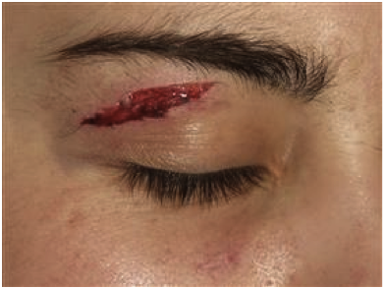

Slide 12
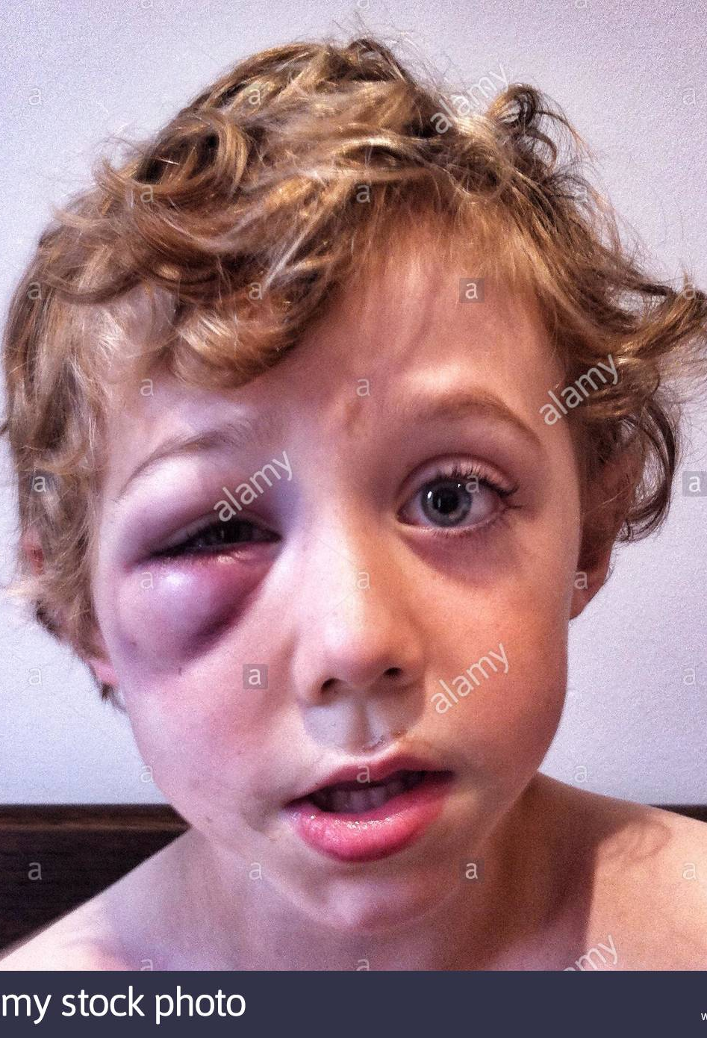
Black Eye
A hard blow to the eye may cause a black eye
As with any contusion, a black eye is caused by bleeding and discoloration just under the skin and can affect the tissue around the eye, but generally not the eye itself; therefore, an athlete will not complain of visual impairment, but there will be swelling and pain
If the athlete complains of any other difficulty, a referral to a physician is necessary
Ice application over a black eye is an acceptable treatment

Slide 13
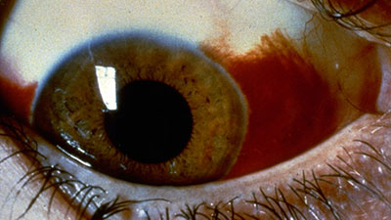
Hemorrhage into the anterior chamber (Hyphema)
Hyphema: blood pooling in the anterior portion of the eye
When looking at the athlete, the athlete will complain of both the inability to see and of pain
The AT should cover both eyes with a protective shield, but should NOT apply ice
The physician will need to determine the severity of the injury
An athlete with hyphema may suffer permanent damage, blindness, or cataracts

Slide 14
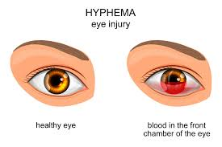

Slide 15
Detached Retina
Detached retina: a condition in which the retina of the eye is torn from its normal position
An athlete with a detached retina will have difficulty seeing and requires a physician's care
This can be caused by a blow to the eye or even a hard sneeze
The athlete may indicate that they are seeing sparks, lights, and flashes or that their vision is foggy
Laser surgery to repair the retina is necessary
When an athlete returns to play, they must wear protective equipment

Slide 17
Subconjunctival hemorrhage
Subconjunctival hemorrhage: an athlete may cough repeatedly or gets poked in the eye or hit by a ball, which causes the small vessels of the eye to rupture, turning the conjunctiva red
Although the eye looks painful, the athlete experiences minimal or no pain and no visual impairment
It is best to refer the athlete to a physician for an eye exam to be sure no other structures are injured
Treatment it to allow the eye to heal on its own
The athlete can still participate without restriction

Slide 18
Orbital Roof Fracture
A blow to the eye or the area just above the eye can cause a fracture in the roof of the orbit
When this happens, the athlete will experience pain, headache, signs and symptoms of a concussion, and a hematoma over the area
The nose may bleed and cerebrospinal fluid may drain from the nose
This require immediate care by a physician
Hospitalization for observation and care of the fracture and rest will most likely be required
The athlete most likely cannot return to competition for a year

Slide 19
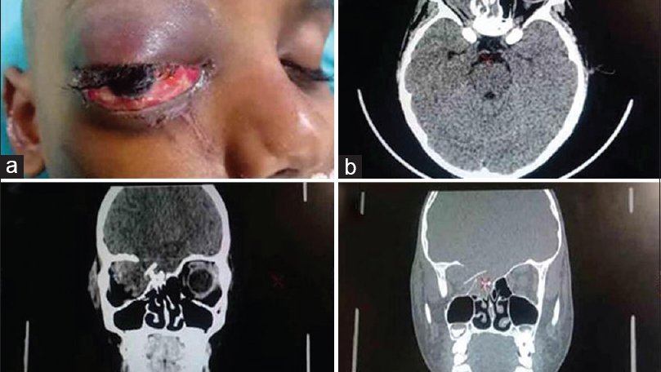

Slide 20
Sinus Fracture
A sinus fracture can occur when there is sharp blow to the face, for example, a baseball taking a bad hop
A headache, dizziness, unsteadiness, bloody nose may occur
The athlete will experience pain; once any bleeding has stopped, the AT should do a quick assessment
With this fracture, air seeps into the skin and tissues around the eye and nose, resulting in a crackling sensation when the area is touched
The AT should apply ice and immediately refer the athlete to a physician
The physician will require special X-rays to discover the exact location
A complication of this injury is a concussion

Slide 22
Blowout fracture
A blow to the eye can force the eyeball backwards into the eye socket
The thin bones beneath the eye absorb the sudden increase in pressure and fracture and is referred to a blowout
The athlete may experience double vision and may not be able to feel much pain as a result of damage to surrounding nerve endings
The athlete may also experience a numbing in the lip and upper jaw on the same side as the injury
The muscles of the eye often get caught in the fractured bones; therefore, an AT may notice that the athlete cannot control the injured eye
The eye may appear to be sunken in the socket
There will be immediate swelling and the conjunctiva will begin to discolor
The athlete may have a bloody nose on the same side as the injury, and the bleeding may fill the sinus, making it difficult to breathe
The eye may bulge if the athlete attempts to blow their nose

Slide 23
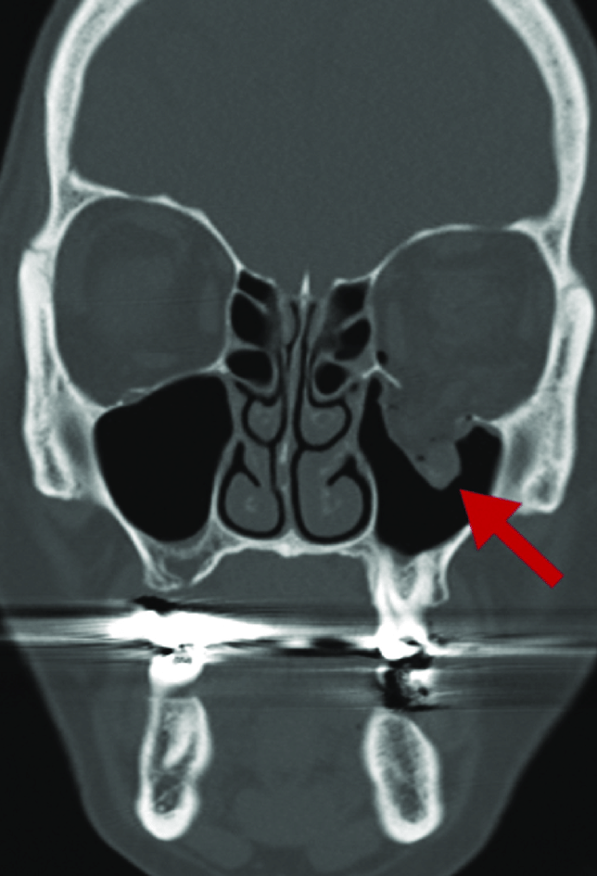
Blowout Fracture
The AT should call 911 and help control and bleeding
The athlete should be monitored in case their condition worsens
A physician may have to surgically repair the fracture and release the muscles
The athlete may suffer permanent vision problems, including glaucoma and cataracts
The athlete will remain out of competition for several months
Boxer wear headgear to prevent such eye injuries
Any sport using balls at high speeds should wear headwear

Slide 24
Ruptured Globe
The globe, the eyeball itself, can be ruptured by any object small enough to enter the eye, such as a squash ball or racquetball
Upon examination of the eye, the AT will notice a lack of roundness of the globe and a hemorrhage of the eye
Associated with the injury can include an eyelid laceration, blood in the front of the eye, interior contents of the eye spilling out, or the pupil out of round
Any sign that the globe has been ruptured requires the AT to cover the eye with a protective shield that will not allow any external pressure
The athlete must be taken to the emergency room immediately and referred to an ophthalmologist in order to save their eyesight
Will be out of competition for months

Slide 25
