Slide 1
Chapter 9: Spinal Injuries
Unit 4: Understanding Injuries to the Axial Region

Slide 2
Objectives
Describe the basic anatomy of the spine
Explain common spinal injuries that occur with athletic participation
Identify common signs and symptoms of spinal injuries
Explain the treatments performed by ATs for spinal specific injuries
Describe common postural problems

Slide 3
Anatomy of the Spine
The spine is a complex structure of bones with four segments
Sacrum: tailbone
Lumbar spine: lower spine
Thoracic spine: middle spine
Cervical spine: upper spine
Normal anatomical alignment and muscular strength keep the spinal segments aligned properly
The spine should have normal curvature at each of these areas

Slide 4
Bones
The bones in the spine are separated by disks and held together by ligaments
The muscles of the spine and trunk permit many movements and also help stabilize the spine
The bones of the spine are called vertebrae
There are 7 cervical, 12 thoracic, 5 lumbar, and 5 sacral vertebrae
Each vertebrae has a body and a spinous process and a canal through which the spinal cord passes

Slide 5
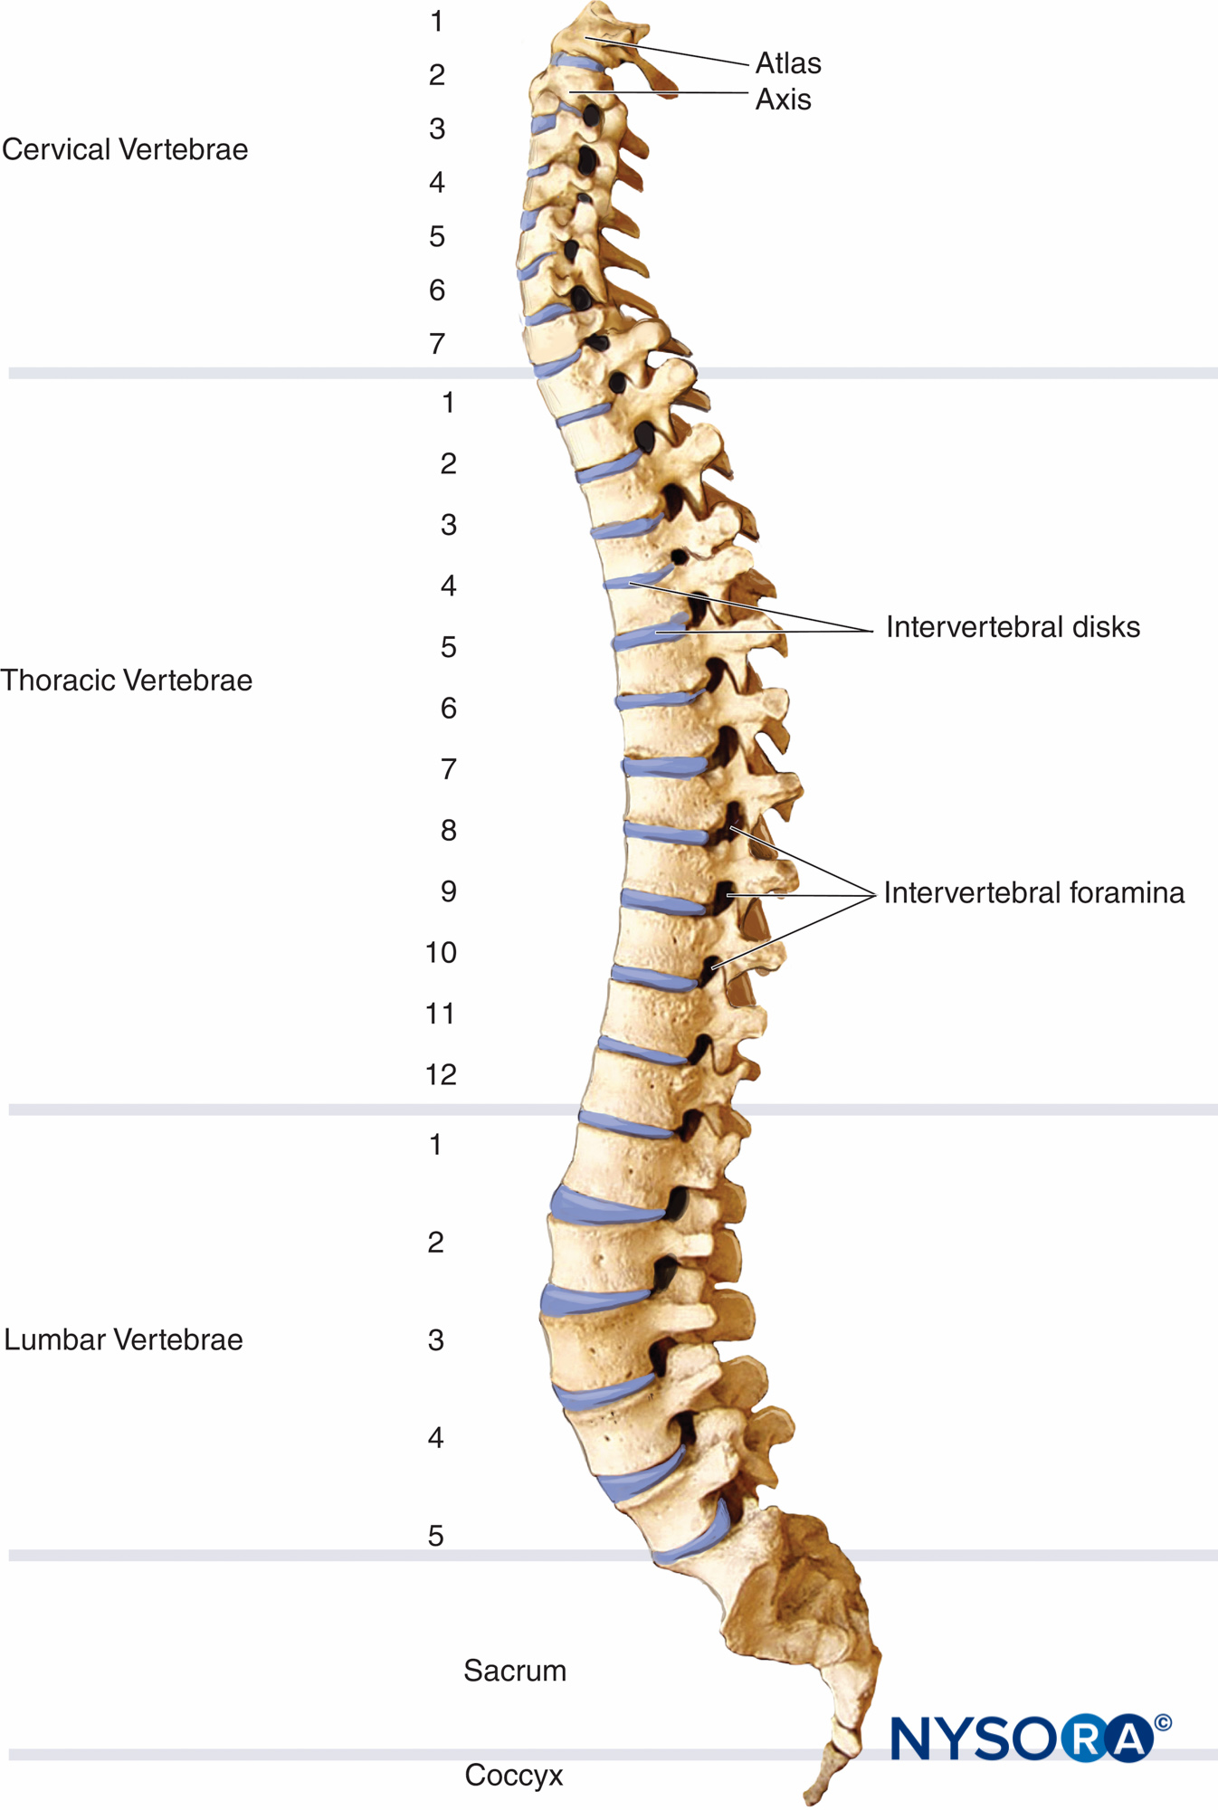
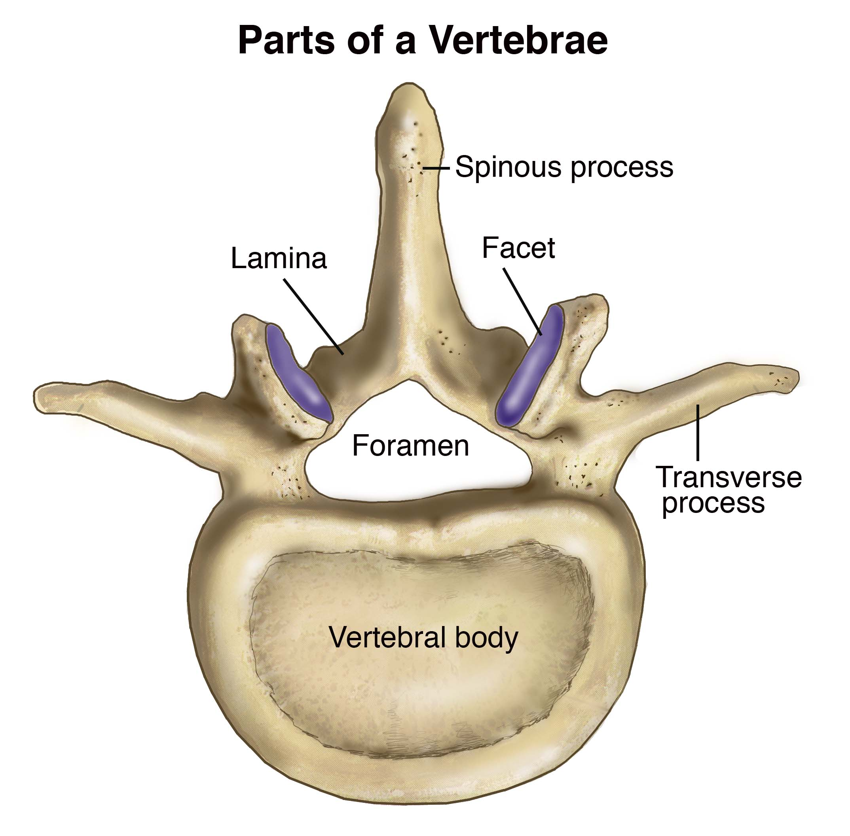

Slide 6
Disks
Intervertebral disks: structures between the vertebrae that cushion them
Nucleus pulposus: the soft structure at the center of an intervertebral disk
Annulus fibrosis: the rings of tissue that surround the nucleus pulposus of an intervertebral disk
Disks are compressible
A person is slightly taller in the morning that later in the day after gravity has been compressing their disks
In old age, we become shorter

Slide 7
Muscles and Tendons
The muscles of the trunk and neck attach to the spine via tendons and provide both a wide range of movement and much needed stability
Spine can be described like a mast on a ship
The abdominal muscles are crucial for supporting trunk movement, especially the rectus abdominis and the internal and external obliques
The spinal extensors run the entire length of the spine posteriorly and attach to the various structures including the pelvis, ribs, and vertebrae
Upper trapezius extends the cervical spine
Cervical flexion is accomplished by the scalene muscles, which attach to the cervical vertebrae and run down to the first and second ribs

Slide 8
Ligaments
Many ligaments support the vertebral segments
The anterior aspect of the spine has a thick, tough ligament called the anterior longitudinal ligament; this ligament prevents bony separation during extension
The posterior aspect of the spine contains supraspinous ligament, a thin ligament that passes from the top of one spinous process to another
As the spine flexes, this ligament supports the vertebral segments
Various other ligaments also support the vertebral segments
Intertransverse ligaments

Slide 9
Postural Considerations – Normal Posture
The AT can determine if a person has normal posture by viewing them from the side
Picture a straight line dropping from the ceiling
If an athlete were standing with proper posture beside the line, specific body segments could be observed in alignment
The line would pass just behind the ear, through the center of the should, down through the middle of the greater trochanter of the hip, just behind the patella, and down to in front of the lateral malleolus

Slide 10
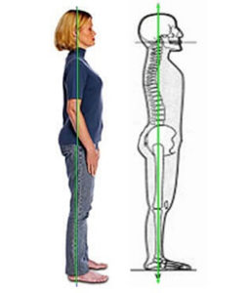

Slide 11
Postural Considerations – Abnormal Posture
Forward head posture: when the head juts forward so that the athlete's ears are not line up with the shoulders
Lordosis: excessive curvature at the lumbar spine
Kyphosis: excessive roundness that can occur at the thoracic spine
Scoliosis: excessive side-to-side curvature of the spine

Slide 12
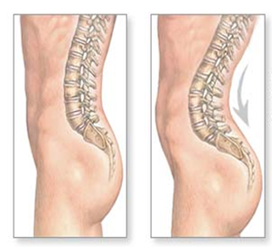
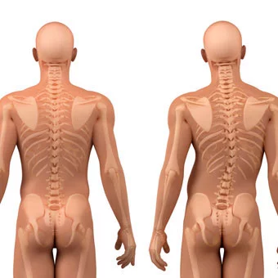
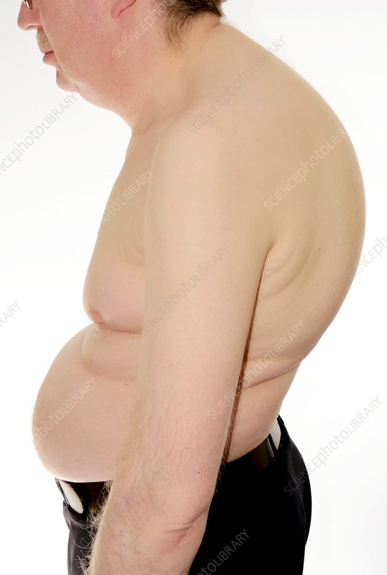
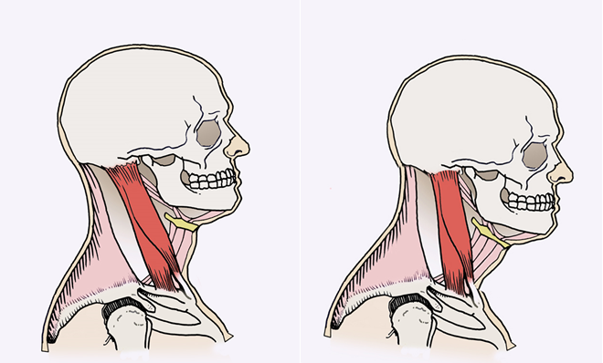

Slide 13
Preventing Spinal Injuries
Athlete should participate in exercise and flexibility programs, maintain proper posture, learn to lift properly, use proper technique (tackling), and use back support when lifting heavy
Exercise and flexibility programs are necessary for the muscles surrounding and supporting the spine, especially the abdominal muscles
A strong abdomen and help decrease stress on the lumbar spine
The muscles around the hip should also be strengthened because the hip directly influences the spine
If the hip is tilted forward, the spine will move into extension, and if the hip is tilted back, the spine will move into flexion; therefore, hip musculature should be flexible and strong

Slide 14
Preventing Spinal Injuries
Proper lifting procedures reduce the risk of injury
Business training employees in back school
Proper lifting is understanding to maintain a slight curve in the lumbar spine while lifting with the knees and the hips; also involves keeping the head up when lifting
Back supports have become popular lately and increase the pressure around the spine and decrease the amount of stress to the vertebrae
A back support should NOT take the place of other means of injury prevention

Slide 15
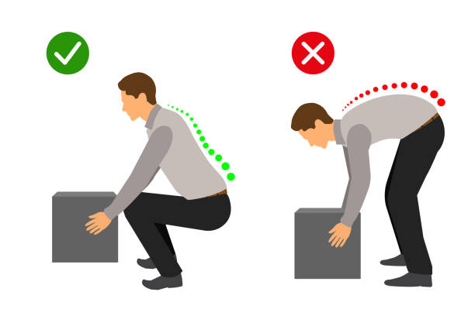

Slide 16
Preventing Spinal Injuries
Recognizing that proper technique plays a role in preventing cervical spine injuries, NATA published a position statement regarding head-down technique in football
Axial load: when force is applied to the head while the head is lowered into flexion that straightens the cervical spine like a drinking straw
Can cause vertebrae fractures
According to NATA, axial loading is the key mechanism for catastrophic injuries in football

Slide 17
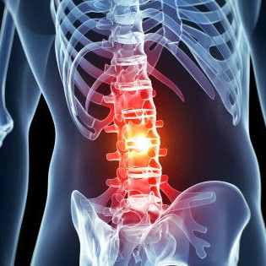
Treating Lumbar Spine Injuries and Conditions
As with other parts of the body, the spine is susceptible to ligament, muscle and tendon, and bone injuries
Disks that lie between the bodies of the vertebrae cause unique problems

Slide 18
Bone Injuries
Bone fractures are possible in the lumbar spine, especially with severe mechanisms of injury, such as compression
Forcefully landing on the buttocks
Fractures of the spine are hard to determine without an X-ray; however, if the AT knows the mechanism of injury and finds a great deal of back pain, muscle spasm, and tenderness when touching the vertebrae, a fracture should be suspected
Is the AT suspects a lx fracture, the athlete should be treated conservatively, that is, should be on a backboard with the help of appropriate emergency medical personnel and taken to a hospital

Slide 19
Bone Injuries
Spondylolysis: a stress fracture or bone degeneration of the vertebrae
Spondylolisthesis: a spondylolysis degeneration of a vertebrae that fails to heal, therefore, separating and causing the spine to become unstable
Both serious problems that require an examination from a physician

Slide 20
Disk Injuries
Disk bulge
Not common in younger athletes
The jellylike nucleus pulposus at the center of the disk pushes through the rings of cartilage
Rarely bulge toward the front of the spine
Flexion of the spine puts more pressure on the front of the disk, pushing it towards the anterior portion of the spine
Aggravating and disabling
Can put pressure on a nerve
Increased pain with sitting

Slide 21
Muscle and Tendon Injuries
An AT rarely sees a ruptured muscle at the lx spine, but mild and moderate strains are common
Pain to one side of the spine, spasms, and lack of movement
Strain pain is very localized
Once pain is decreased, flexibility can be restored
Strengthening and stretching routines can be a preventative measure

Slide 22
Ligament Injuries
Sprains at the lx joints commonly occur when athletes are forced into excessive trunk flexion or attempt to flex the spine and rotate at the same time
When a football player is tackled and forced forward
Pain to one side of the spine, muscle spasms, and limited movement
AT will perform spinal tests and determine which ligaments are involved
Sometimes hard to differentiate between a muscle strain
PRICE method
Bed rest is no longer the accepted norm

Slide 23
Treating Cervical Spine Injuries and Conditions
Types of injuries incurred at the cx spine are similar to those at the lx spine
The cervical spine has more mobility than the lx spine, making treatments different

Slide 24
Bone Injuries
Fractures and dislocations and can have devastating results including permanent disabilities and death
Fractures often are the result of an axial load
Force applied to the head while it is lowered into flexion and straightens the cervical spine
Fractures and dislocations have similar signs
Pain in cx spine, numbness, and tingling down the arms
Often a visible deformity
Emergency protocol should be followed
Neck should be immobilized

Slide 25
Disk Injuries
Not nearly as common as they are in the lx spine
Will have neck pain while sitting and while flexing the forward rather than while standing and walking
Discomfort between the shoulder blades
Cervical traction can also be used by the AT under the direction of the team physician
Full neck mobility and strength should gradually be regained
If an athlete has severe symptoms, they should be placed on a spine board and referred to a hospital

Slide 26
Ligament Injuries
Occurs when cx is forcefully moved beyond normal range
Result of hyperextension or hyperflexion
Neck and arm pain will occur and well as pain between the scapulae
Neck trauma should be evaluated by an AT
No severe injuries, treated with PRICE method

Slide 27
Brachial Plexus Injuries
Network of nerves that exit the cx spine
Burner or stinger: burning, numbing, tingling, stinging sensation in the arm
Depending on severity, the burner can last seconds or minutes
Treatment consists of neck strengthening and ROM stretching

