Slide 1
Chapter 11: Elbow Injuries
Unit 4: Understanding Athletic Injuries to the Upper region

Slide 2
Objectives
Describe the basic anatomy of the arm and elbow
Explain common arm and elbow injuries that occur with athletic participation
Identify signs and symptoms of arm and elbow injuries
Explain treatment parameters performed by ATs for elbow injuries

Slide 3
Anatomy of the Elbow
The elbow is a huge joint involving 3 major bones: the humerus, radius, and ulna
The radius and ulna are the bones between the elbow and wrist
The distal end of the humerus becomes wider, similar to the distal end of the femur, and forms medial and lateral condyles
The ulna is hooked to the end of the humerus and forms a tight joint
The radius is the bone on the thumb side of the forearm
It rests against the humerus and is able to rotate, allowing the forearm to pronate and supinate

Slide 4
Anatomy of the Elbow: Muscles
The triceps primarily performs elbow extension, whereas the biceps accomplishes elbow flexion
The wrist flexors attach at the medial epicondyle of the humerus and then run toward the hand
The wrist extensors attach to the lateral epicondyle of the humerus
These muscles stabilize the elbow
Several nerves and blood vessels pass through the small spaces and grooves around the elbow en route to the lower arm; therefore, an injury occurring at the elbow must be assessed to determine if any of these blood vessels or nerves have been damaged
Checking for a pulse and determining if the athlete is able to feel their hand is a helpful procedure

Slide 5
Anatomy of the Elbow: Ligaments
The joint capsule is a ligament that surrounds the elbow and provides some general stability to the elbow joint, but the elbow also relies on several major ligaments for stability, particularly the ulnar collateral, radial collateral, and annular ligaments
The ulnar collateral ligament helps to stabilize the inside, or medial, aspect of the elbow, whereas the radial collateral ligament helps to stabilize the outside, or lateral aspect
Bursa: fluid-filled sac located between the olecranon and the skin
The annular ligament helps to hold the radius and ulna together near the elbow joint
The tissue joins the radius and the ulna from the elbow to the wrist and keeps the two bones from separating

Slide 6
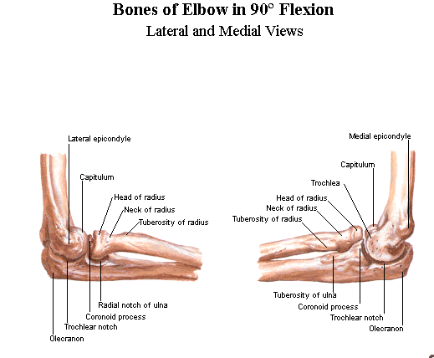

Slide 7
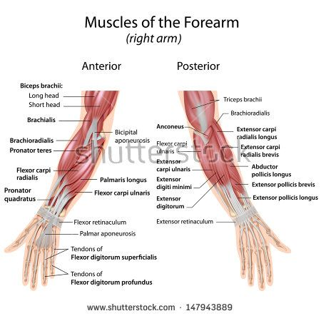

Slide 8
Preventing Elbow Injuries
The elbow is not injured frequently
Many of the injuries that ATs see at the elbow joint are caused by overuse---the repetitve movements and stresses delivered to the wrist and elbow over time eventually break down the tissue, causing chronic inflammation and pain
This is especially true in racket sports, such as tennis and racquetball, where injuries to the lateral aspect of the elbow are most common
Many athletes pay a great deal attention to strengthening the biceps and triceps muscles, but fail to properly condition some of the smaller muscles, such as wrist flexors and extensors
It is important for the AT to work with the coach to detect any improper techniques athletes are using, because they can eventually lead to overuse injuries
Equipment is also a factor in the prevention of elbow injuries, epsecially in racquet sports
Excessive stress on the elbow musculature can result from using a racquet with a grip that is too small
Many athletes who throw (such as baseball and softball players) should alter their activity and rest after long days of throwing
The rules limiting young pitchers' activity help keep overuse problems of the elbow ( and shoulder) to a minimum

Slide 9
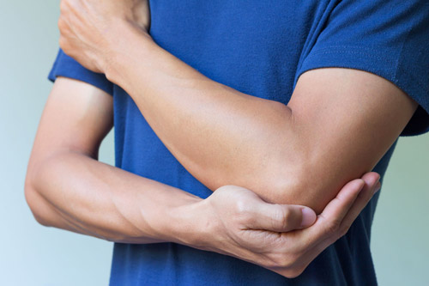
Treating Elbow Injuries and Conditions
The medial and lateral aspects of the elbow joint can suffer ligament sprains
Muscle and tendon injuries occur because of the elbow and wrist are involved in repetitive stress during athletic
Fractures of the elbow can be extremely serious

Slide 10
PRICES
PROTECTION
REST
ICE
COMPRESSION
ELEVATION
SUPPORT

Slide 11
Treating elbow injuries and conditions: Bone INjuries
Bone fractures to the distal end of the humerus are not common in athletics
If they do occur, it is often due to powerful mechanisms of injury, such as the hand being planted on the ground and someone forcing the arm into excessive side bending
Fractures between the condyles of the humerus are also rare in sport, but if direct impact is the mechanism of injury and pain is located at the medial aspect of the elbow about 2 inches above the joint, a fracture should be suspected
If either type of fracture occurs, it is an absolute emergency because it can result in compression of an artery or nerve

Slide 12
Bone injuries: Epiphyseal and Avulsion Fractures
Epiphyseal and avulsion fractures are more common on the medial epicondyle or olecranon of the elbow
An epiphyseal injury should be suspected whenever an athlete presents with swelling, pain, and loss of movement
A growing athlete is more likely to injure the growth plate than suffer a bone fracture or ligament injury
Severe pain and deformity indicate an avulsion fracture
If either of these injuries are suspected, the AT should refer athlete to a physician

Slide 13
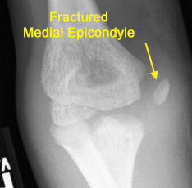
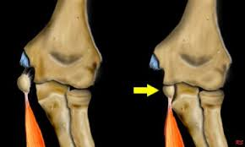

Slide 14
Bone injuries: Ulnar dislocation
The elbow is one of the most commonly dislocated joints in the body
The ulan hooks onto the end of the humerus, making the elbow a failry tight joint; therefore, it takes a very traumatic injury to dislocate the ulna from the humerus
Usually a violent hyperextension injury or severe blow to the lateral aspect of the elbow will dislodge the ulna from the humerus
When a dislocation occurs, an obvious deformity will be noticed
The arm must be immediately splinted in the position it is found in, and the athlete must be seen in the emergency room by a physician so that the dislocation can be treated

Slide 15
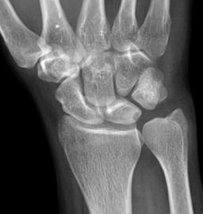
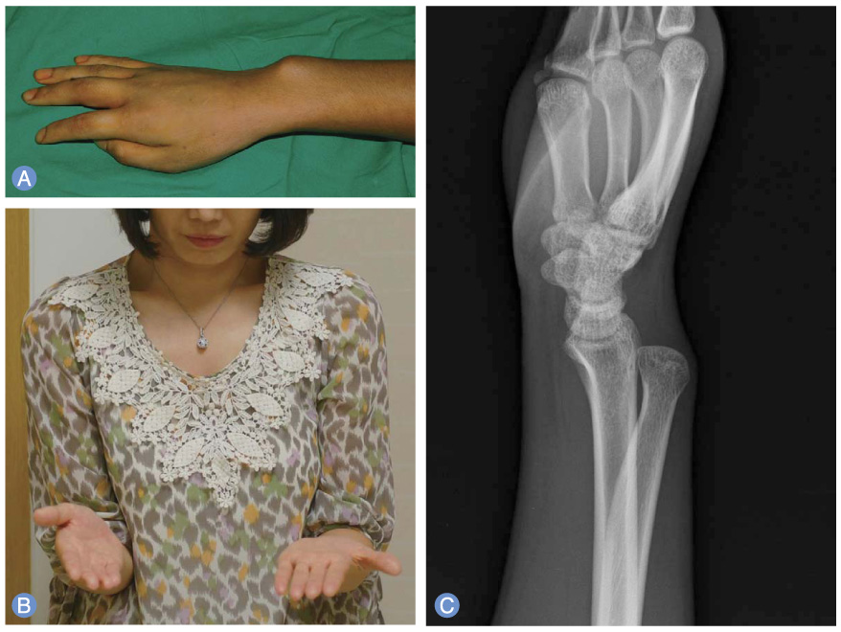

Slide 16
Muscle and Tendon injuries
Strains of the elbow musculature are most often caused by either excessive resistive forces or overuse
Elbow strains can occur in the elbow flexor and extensor musculature
Can be mild, moderate, or severe
A complete strain or rupture of a muscular structure, such as the biceps, is usually evident by the deformity caused when the muscle balls up due to elasticity

