Slide 1
Chapter 12: Wrist & hand injuries
Unit 4: Understanding Athletic Injuries to the Upper Extremity

Slide 2
Objectives
Understand the basic anatomy of the wrist and hand
Explain the various types of wrist and hand injuries
Understand common mechanisms that cause the injuries
Understand the signs and symptoms of wrist and hand fractures

Slide 3
Anatomy of the Wrist and Hand
The wrist and hand contain many bones, muscles, ligaments, nerves, and blood vessels
All being necessary for total functioning of the hand, one of the most active body parts
When injuries, it will decrease the athlete's functional ability

Slide 4
Bones and Joints
The wrist is the joint between the arm and the hand and is made up of several irregularly shaped carpal bones that articulate between the radius and ulna of the arm and the metacarpals of the hand to allow wrist movement
The scaphoid bone is of particular importance---has a blood supply on only one end and therefore has difficulty healing when fractured
When the fingers are spread, the scaphoid sits in a depression at the wrist that is called the anatomical snuffbox
At the distal end, each of the 5 metacarpals joins with the proximal phalanx of one of the fingers
Metacarpals are numbered 1 through 5 beginning at the thumb side of the hand
The fingers have a total of 14 phalanges

Slide 5
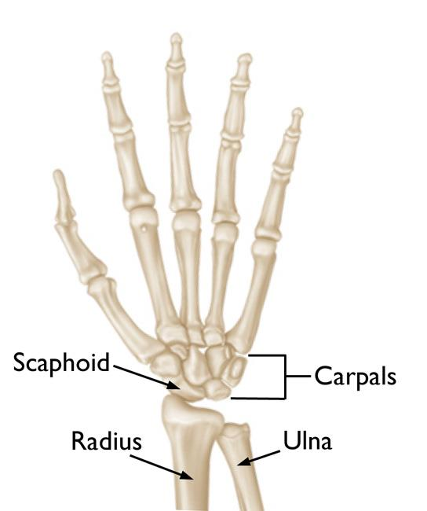
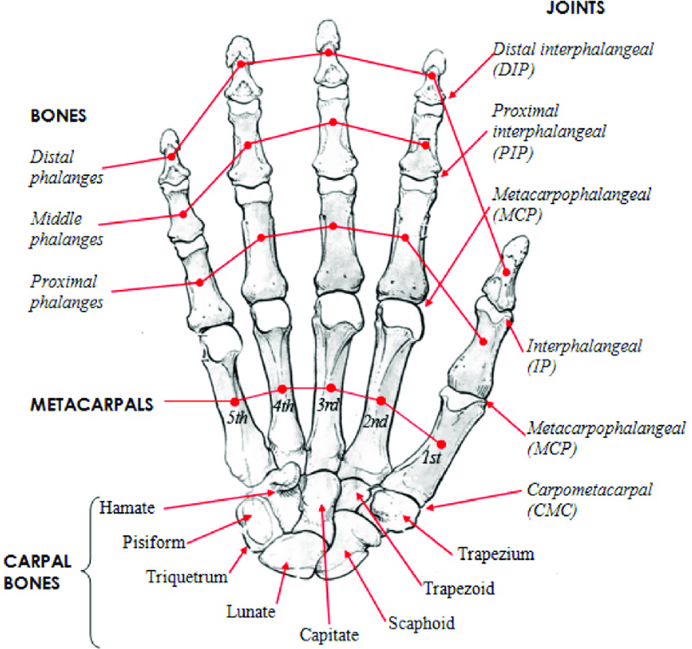
Bones and Joint Con't
Joints in the hand are named for the bones that compose them and whether they are distal or proximal
The thumb has two joints: the metacarpophalangeal joint and the interphalangeal joint
Each of the second through fifth fingers has an MCP joint, a PIP, and a DIP joint

Slide 6
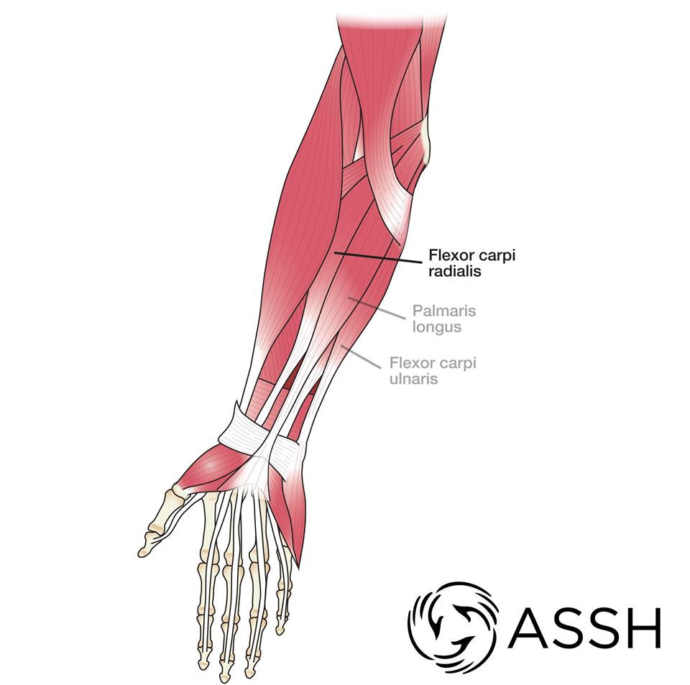
Muscles
Wrist and hand movements are controlled by many muscles, which are categorized into extensor and flexor groups
The flexor groups are found on the anterior surface of the forearm, and the extensor muscles are located on the posterior aspect of the forearm

Slide 7
Ligaments
The ligaments of the wrist and hand are intricate because of the many bones that must be connected
The wrist is stabilized by collateral ligaments medially and laterally
The ulnar collateral ligament attaches at the distal end of the ulna to the triquetral and pisiform bones
The radial collateral ligaments attaches the distal end of the radius to the trapezium and scaphoid bones
Important to ATs, is the flexor retinaculum, also known as the transverse carpal ligament
Located in the anterior aspect of the carpal bones and lies over the wrist flexor tendons and median nerves
The retinaculum stabilizes the carpal bones and also provides a protective covering over the flexor tendons and median nerves that pass beneath it

Slide 8
Preventing Wrist and Hand Injuries
Commonly used protective equipment for the wrist and hand include braces, tape, gloves, and padding
Wearing gloves or tape can protect the area from wounds of all types, and padding can prevent contusions of the dorsal hand
Many football players wear thumb braces to protect against sprains
ATs can use plastic splints and braces to prevent injury for athletes who may be susceptible
In some sports, rules prohibit equipment made of hard materials or allow the equipment only with a physician's note

Slide 9
Treating Wrist and Hand Injuries and Conditions: Bone Injuries
Avascular necrosis: the death of a body tissue from lack of blood
Boxer's fracture: a fracture to the metacarpal region, specifically to the fourth or fifth metacarpal as a result of punching
Colles' fracture: a fracture of the radius and ulna whereby the limb bends into extension at the fracture site

Slide 10
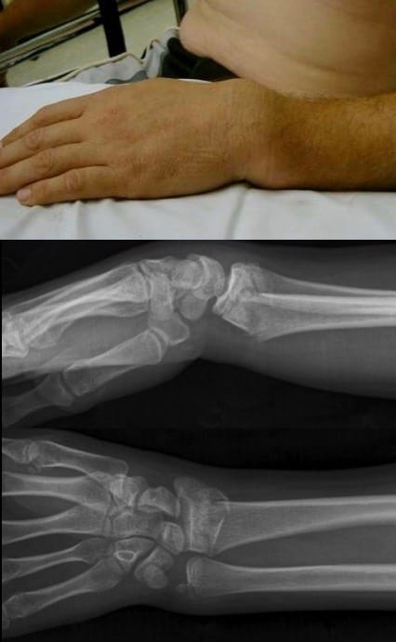

Slide 11
Muscle and Tendon Injuries: Tendinitis
Tendinitis: chronic inflammation of a tendon
Cause: overuse, stretching, or an impact
Can be difficult to overcome, so ATs goal is prevention by increasing strength and flexibility, using padding, and avoiding repetitive injuries
De Quervain's tendinitis: inflammation that affects the abductor pollicis longus and extensor pollicis brevis as they pass through the wrist
Shot putters who hold the shot while the wrist is in radial deviation are prone to this
The athlete will have difficulty with abduction of the thumb, and they may experience swelling and crepitus
Athlete will need to discontinue repetitive movements
PRICES method is appropriate

Slide 12
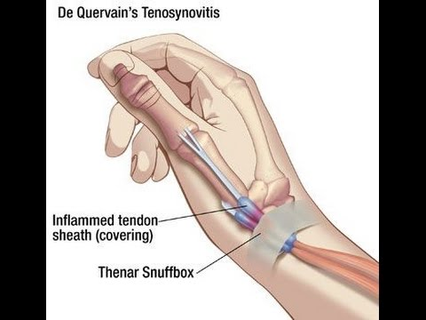

Slide 13
Muscle and Tendon Injuries: Mallet Finger
Mallet finger: an injury to the fingertip caused by impact that tears the extensor tendon from the bone. Fingertip flexion is the distinguishing feature of this injury
The athlete cannot lift the tip of the finger to straighten the bone because the tendon is no longer attached
Athlete will experience pain and some swelling; finger will need to be splinted into extension and referred to a physician for care
Two possible courses of action: treat the injury surgically or keep the finger splinted
The tendon can heal back to the bone if it is kept still and extended
In many instances, an athlete will not consider this injury to be important and may fail to report it
The negligence can result in permanent flexion of the DIP joint

Slide 14
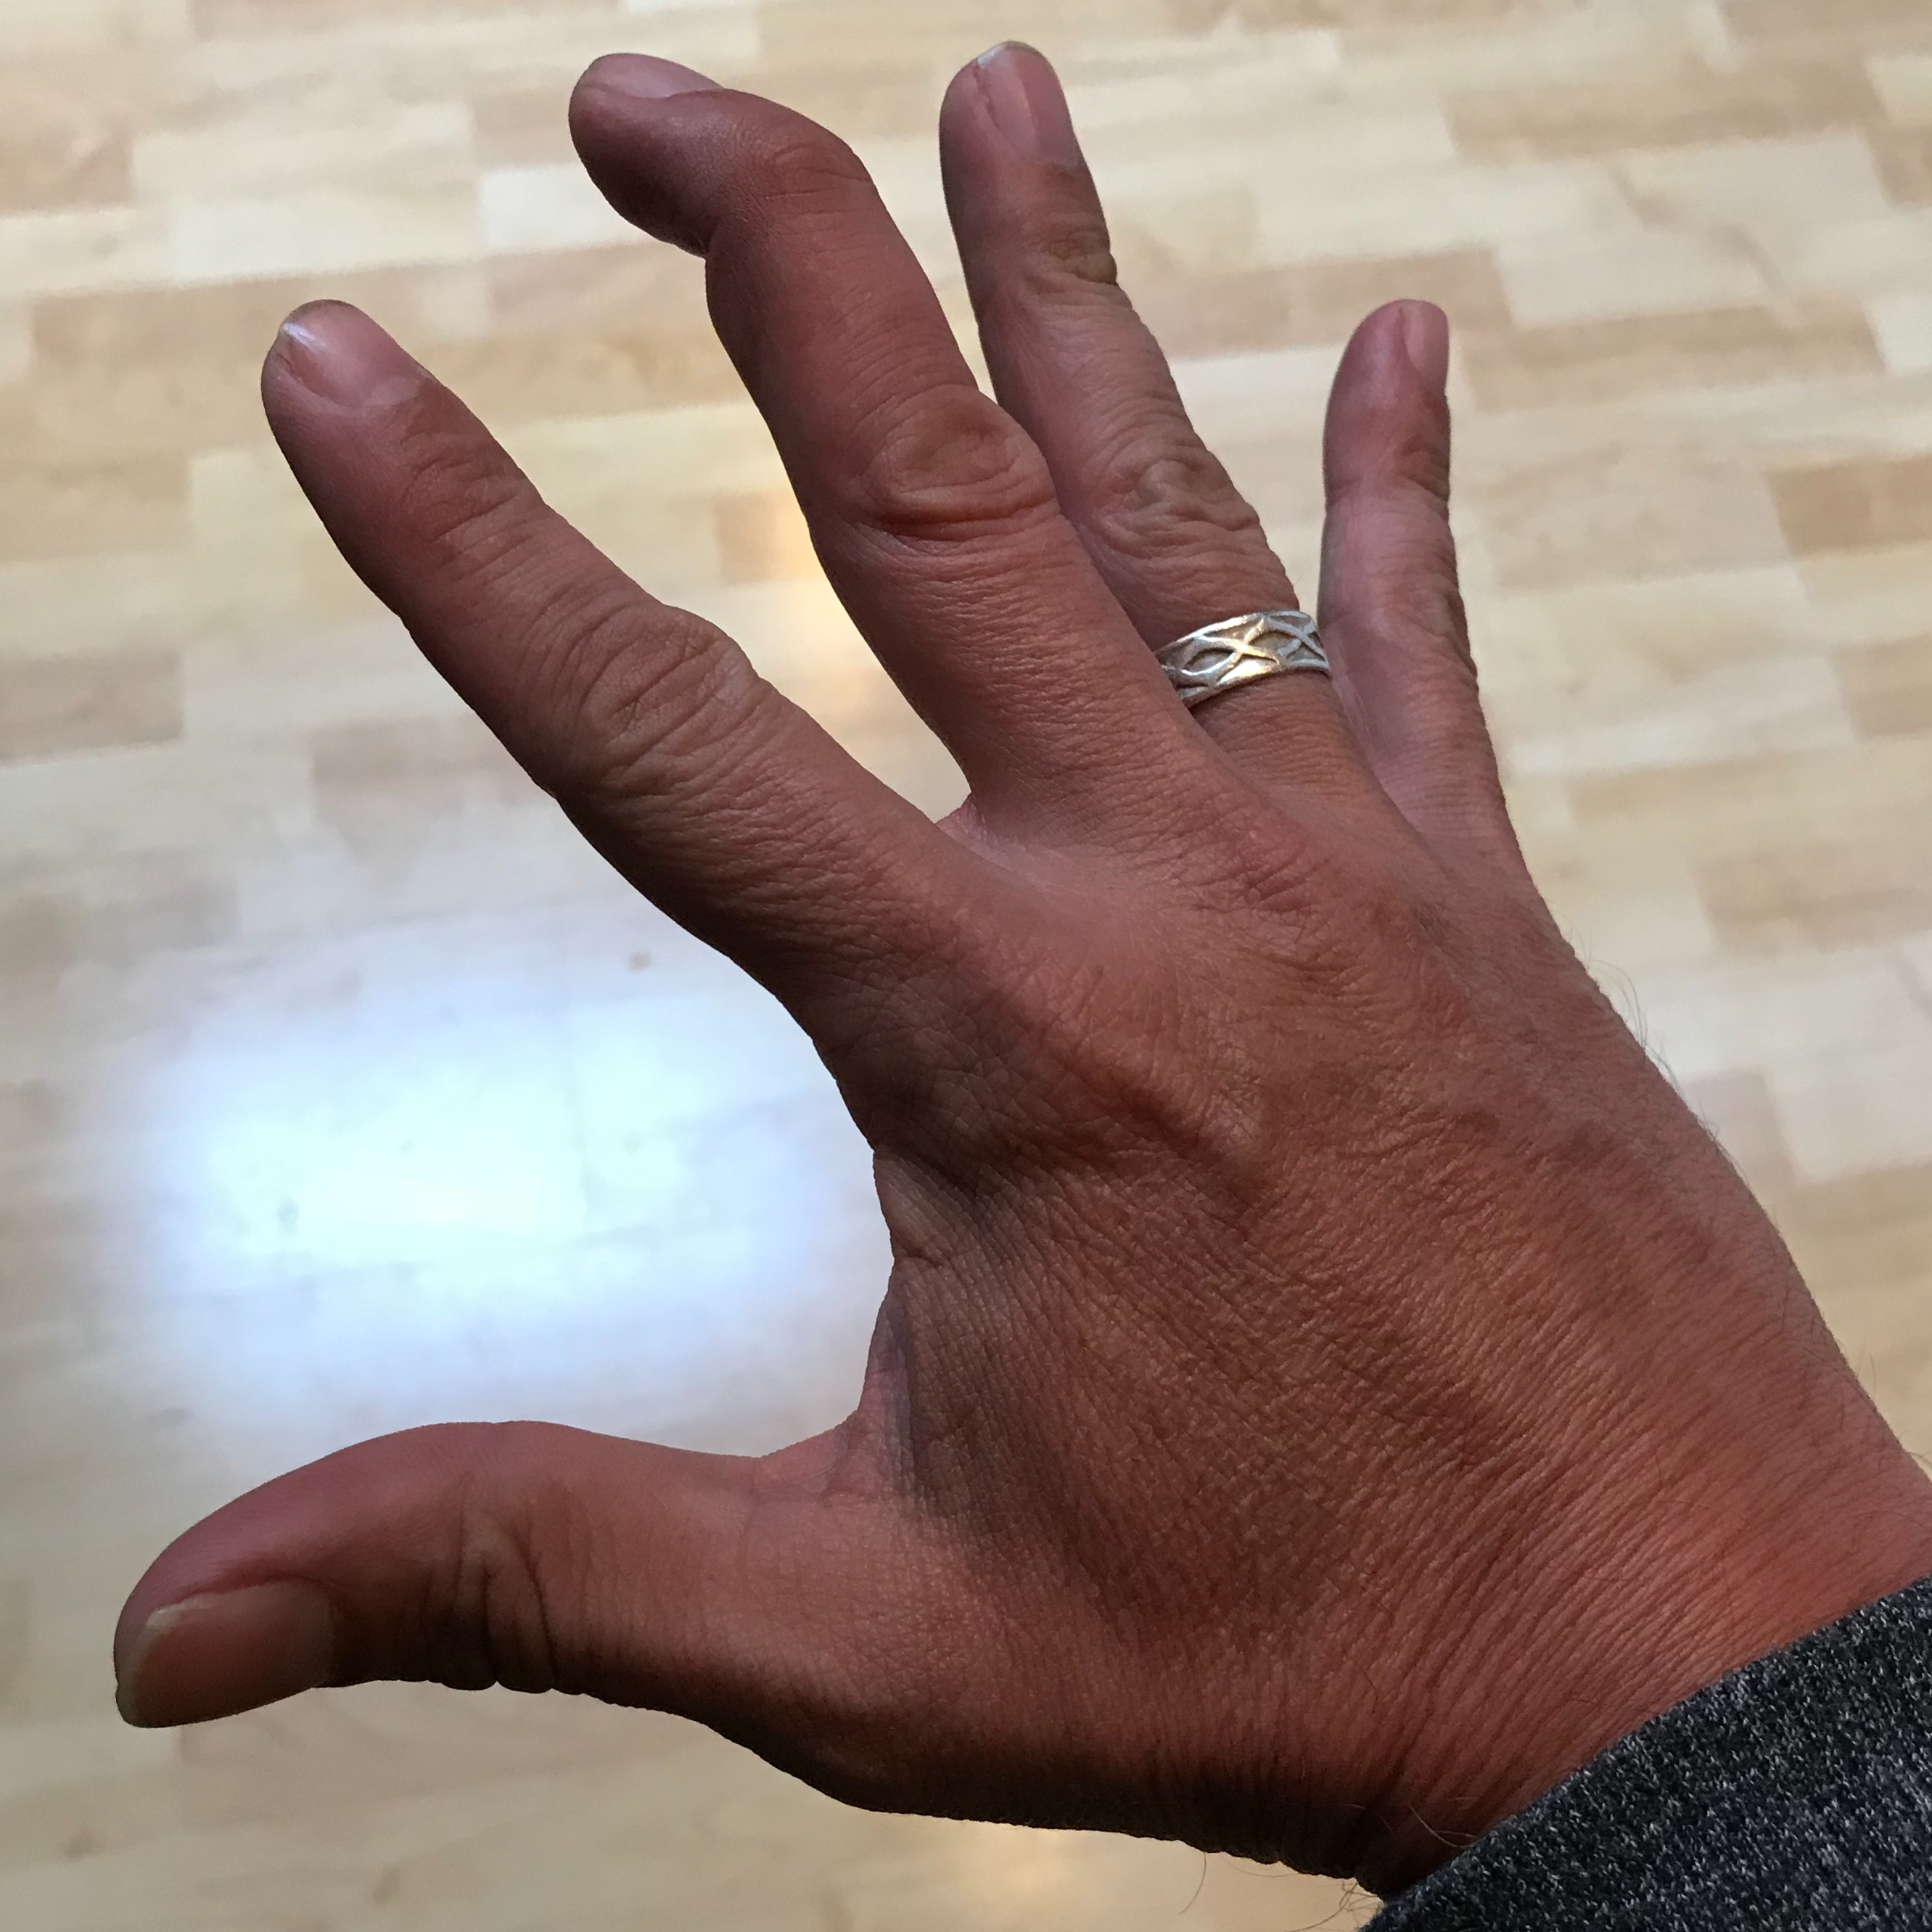
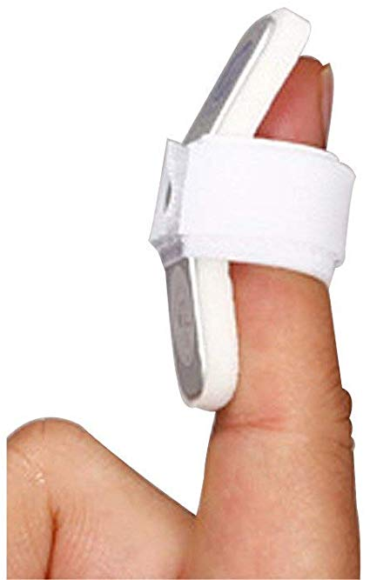

Slide 15
Muscle and Tendon Injuries: Jersey finger
Jersey finger: an injury of the finger in which the flexor tendon tears from the fingertip
The athlete will not be able to flex the DIP joint
Injury occurs with the DIP joint is forcibly flexed
Athlete will experience pain and swelling
Splinting and ice are good initial care and finger will next require an X-ray to determine extent of the injury
Physician will decide if surgery is necessary

Slide 16
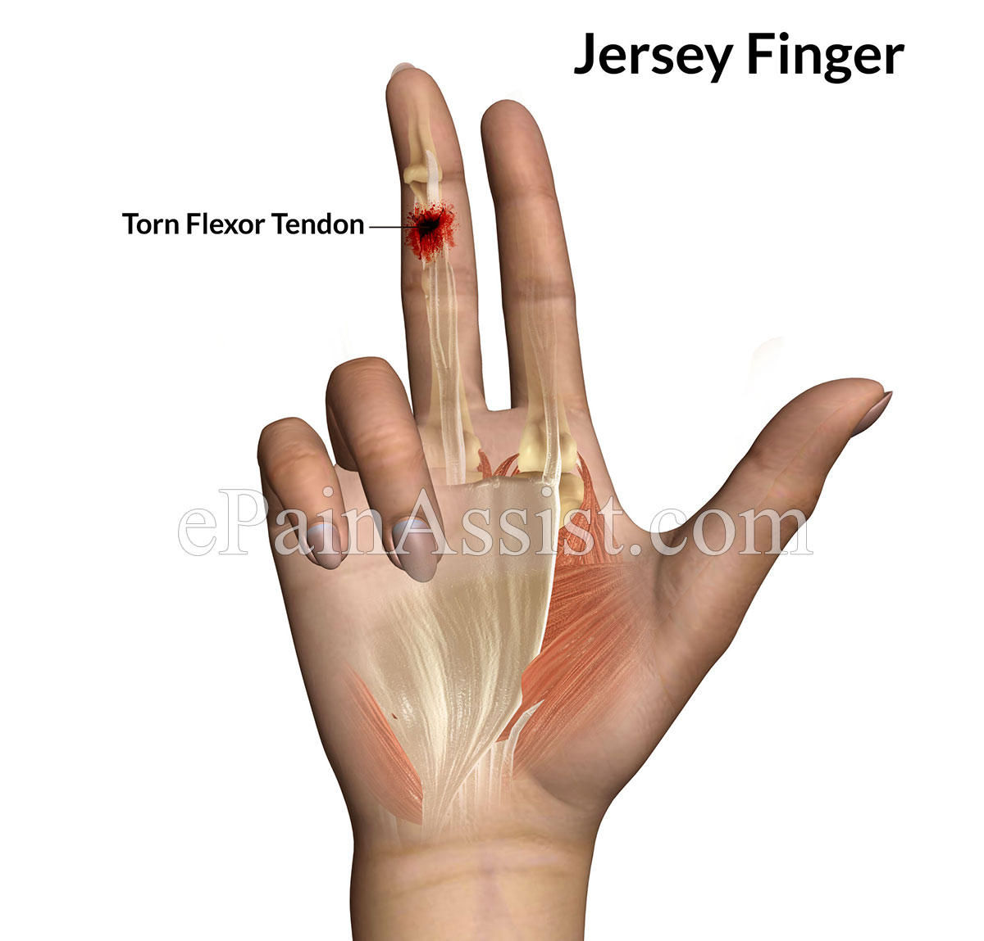
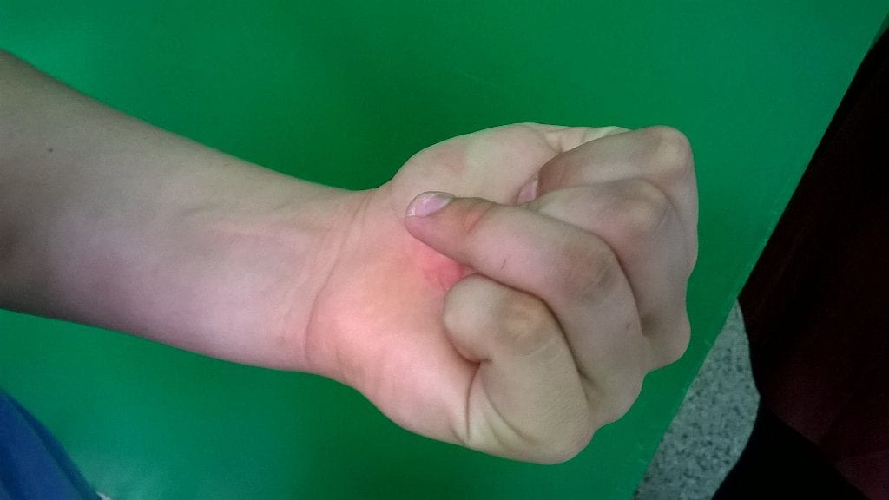

Slide 17
Muscle and Tendon Injuries: Boutonniere Deformity
Boutonniere deformity: a structural irregularity that occurs at the PIP joint of the fingers. A hard impact over the PIP joint can cause a tear in the joint capsule, which will allow the extensor tendons to fall laterally
When the tendons are in the lateral position, the contract and force flexion in the DIP joint
The athlete will not be able to extend the PIP joint, and they will experience pain and swelling
The AT should splint the finger and referral to a physician is next
In many instances, the finger can be splinted, allowing the healing of the connective tissue that keeps the extensor tendons in place
Surgical intervention could be necessary

Slide 18
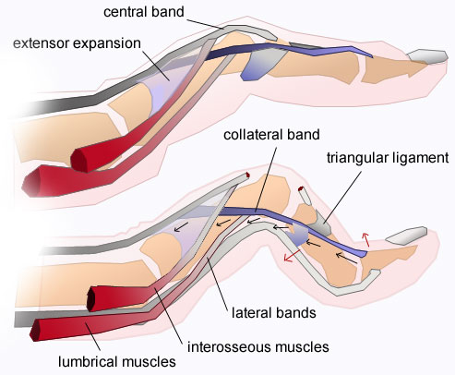
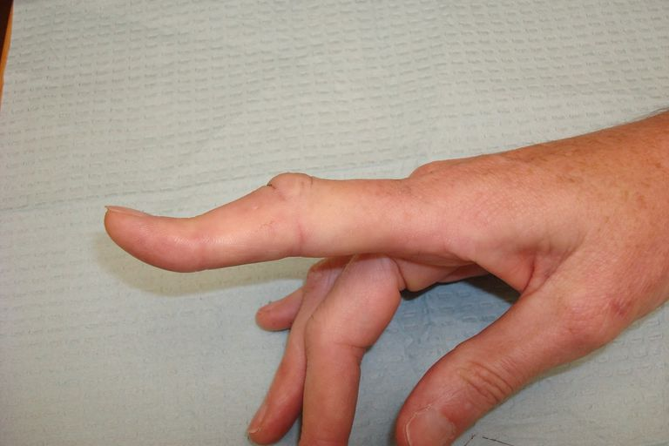

Slide 19
Ligament Injuries: Wrist Sprain
Wrist sprains commonly occur from overuse, falls, and forceful twisting motions
Which ligament is injured depends on the stress
An excessive amount of ulnar deviation of the wrist, will injure the ligament on the radial side due to too much tension or overstretching; and excessive radial deviation will injure the ligament on the medial side
The athlete will experience pain, possible decreased ROM, decreased grip strength, and some swelling
AT should recommend PRICES
When athlete returns to play, AT should tape for further injury prevention
Rehab for wrist sprains focuses on reestablishing normal ROM and strength

Slide 20
Ligament Injuries: Triangular Fibrocartilage Complex Injury
Triangular fibrocartilage complex (TFCC): an anatomical structure located at the medial end of the wrist that supports the carpal bones
Piece of cartilage located between the ulna and carpal bones and plays a role in cushioning
The TFCC is injured with forceful rotation of hyperextension of the wrist
Treatment includes immobilization followed by a rehabilitation plan to restore wrist ROM and strength
In some cases, the TFCC must be surgically repaired

Slide 21
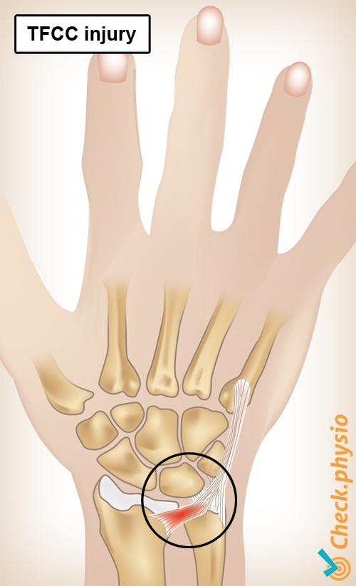
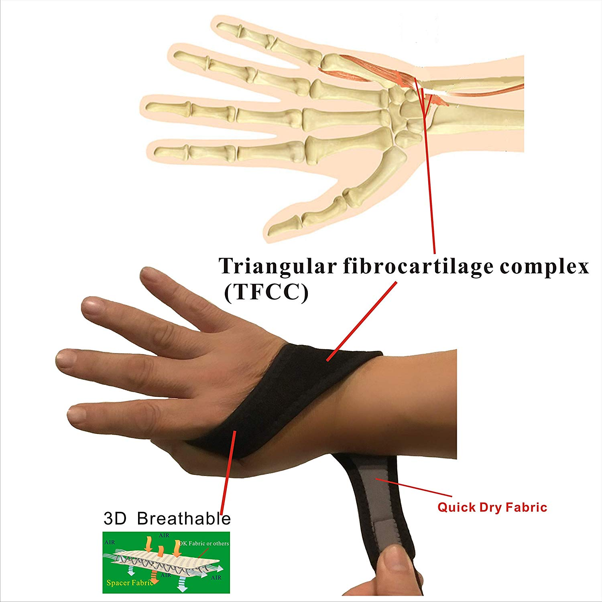

Slide 22
Ligament Injuries: Dislocation of the Lunate
When an athlete falls on their hand, it can be in flexion or extension at the time of the impact and either motion can cause a dislocation of a carpal bone, most commonly the lunate
This dislocation will cause a deformity, pain, swelling, and decreased ROM
The dislocation of any carpal bone should be splinted and referred to a physician so they can relocate the bone

Slide 23
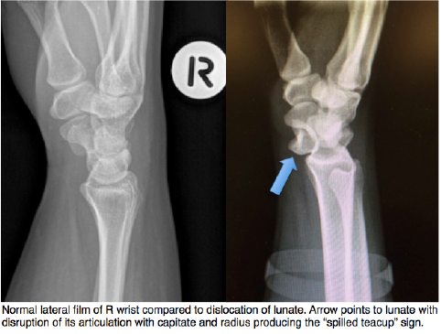

Slide 24
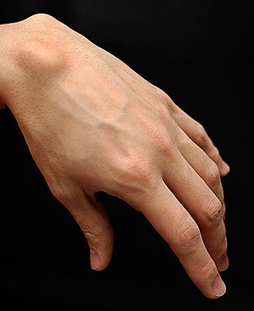
Ligament Injuries: Ganglion Cyst
Ganglion cyst: a pocket of fluid within the sheath of the wrist
Treatment often includes ice application and activity modification
This injury should be evaluated by a physician if symptoms persist

Slide 25
Ligament Injuries: Gamekeeper's Thumb
Gamekeeper's thumb: an injury to the MCL joint of the thumb
Sometimes referred to as skiier's thumb
The ligament on the medial aspect of the thumb is injured when the thumb is forcefully abducted, such as catching a basketball
Athlete will experience pain over the joint and area may be swollen
Treatment includes splinting the medial aspect of the thumb and icing
An X-ray is necessary to determine if an avulsion fracture is associated with the ligament tear

Slide 27
Ligament Injuries: Interphalangeal Collateral Ligament Sprain
A collateral ligament is located on the side of each interphalangeal joint
The ligaments provide stability when the phalanges are stressed, but they can be sprained when a joint is stressed beyond normal
If the finger is hit by a ball
Injury to the collateral ligament is painful and disabling; the joint will swell and become discolored
The AT will refer to physician to see if X-ray is necessary
Ice application will keep swelling to a minimum
If the finger swells too much, athlete will be unable to bend it
When athlete returns to competition, AT may tape injured finger to uninjured finger
Called buddy taping
Padding may be helpful with preventing additional injuries

Slide 28
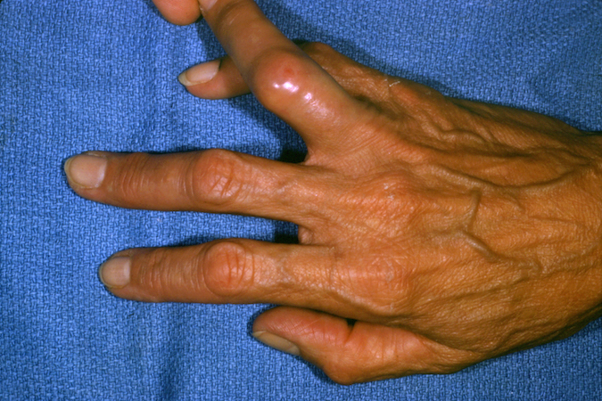
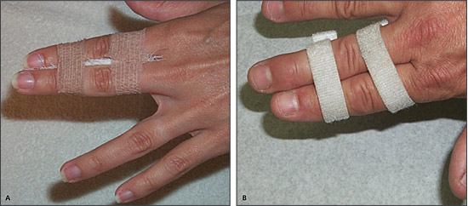

Slide 29
Ligament Injuries: Dislocation of the Interphalangeal or Metacapophalangeal Joint
When a dislocation of the interphalangeal or MCP joint occurs, one bone usually moves dorsal and one moves volar
The team physician should relocate all dislocated fingers and thumbs because tiny tendons, nerves, and blood vessels make their way through joint spaces
If the relocation is done incorrectly, there can be permanent damage to the finger
In the case of a dislocation the ligament may tear, with possible fractures also occurring
Softball player who dove for a ball and dislocated finger, teammate pulled on finger in an attempt to help, driving the splintered bone pieces into the tendon and severing it
Four pins later and one surgery later, the finger was straight again

Slide 30
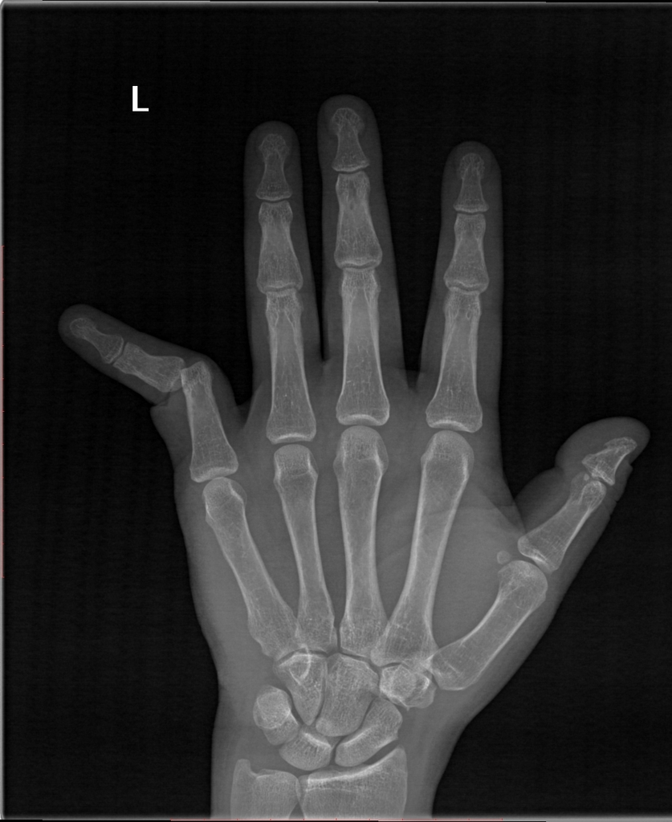
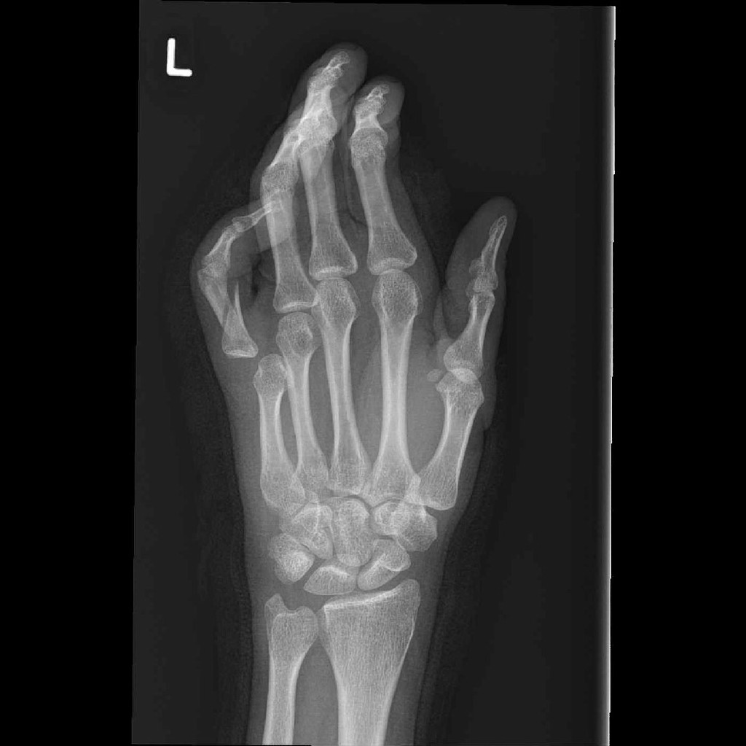

Slide 31
Nerve Injury
Carpal tunnel syndrome: a chronic condition caused by compression of the medial nerve where it runs through the carpal tunnel at the anterior aspect of the wrist
Occurs from overuse from gripping, typing, or other repetitive movements
Compression of the median nerve causes pain, tingling, numbness, and weakness in the thumb, index finger, and third digit of the hand
Treatment involves a wrist splint, stretching the flexor muscles of the wrist, and medication
If this fails to work, a physician will inject the area with a steroid, or surgical procedures may be performed to open the space

Slide 32
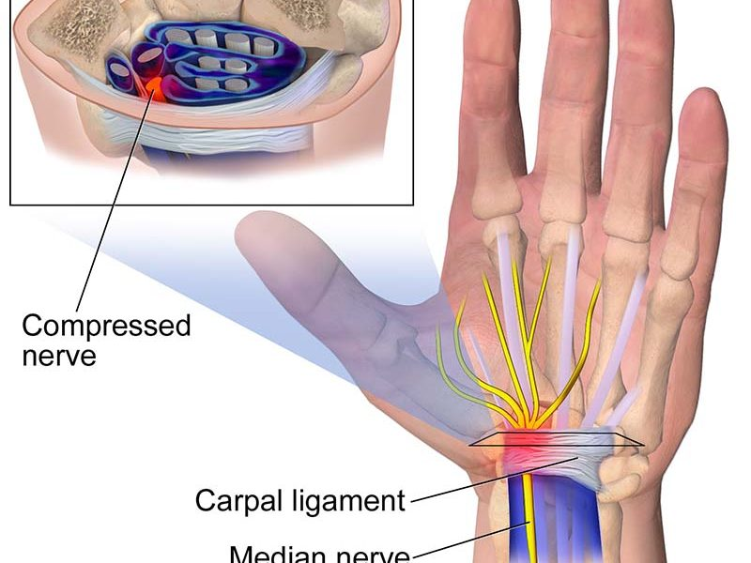

Slide 33
Resource
Fundamentals of Athletic Training

