Slide 1
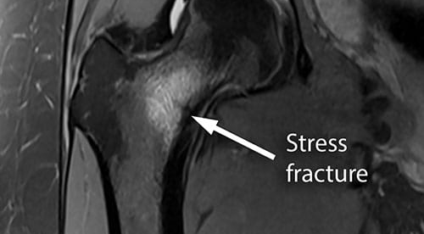

Slide 2
Bone Injuries: Femur Fracture
Because the femur is the largest bone in the body, the stress required to fracture is often extreme
A femur fracture is characterized by severe pain and loss of function as well as internal bleeding, swelling, or tearing of muscles, tendons, nerves, and arteries
Athlete will most likely not be able to move leg
Often causes the leg to externally rotate
Initial treatment includes immobilization and transportation to a hospital by EMS
They will often use a traction splint that gently pulls the femur, reducing leg pain spasm

Slide 3
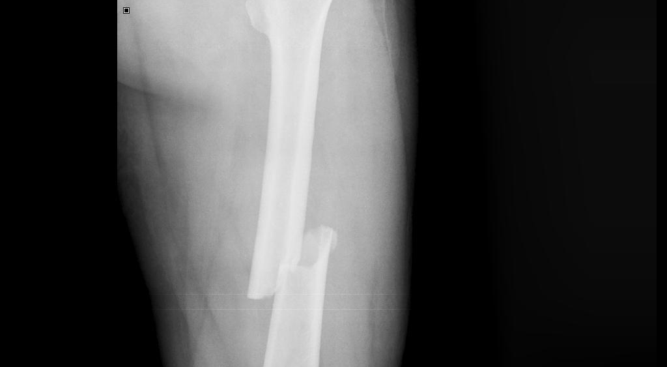

Slide 4
Bone Injuries: Hip Dislocation
Extreme stress can cause a dislocation
Most hip dislocations occur posteriorly and accompany other trauma, such as fractures
Severe damage can occur in this area because of the nerves and vascular structure
An athlete with a dislocated hip is likely to be in extreme pain, and leg will look internally rotated
With this injury, EMS should be called to transport
Only a physician should reduce the hip dislocation
Follow-up appointments are necessary before an athlete can return to play
Rehab includes: restoring ROM and strength, gait training

Slide 5
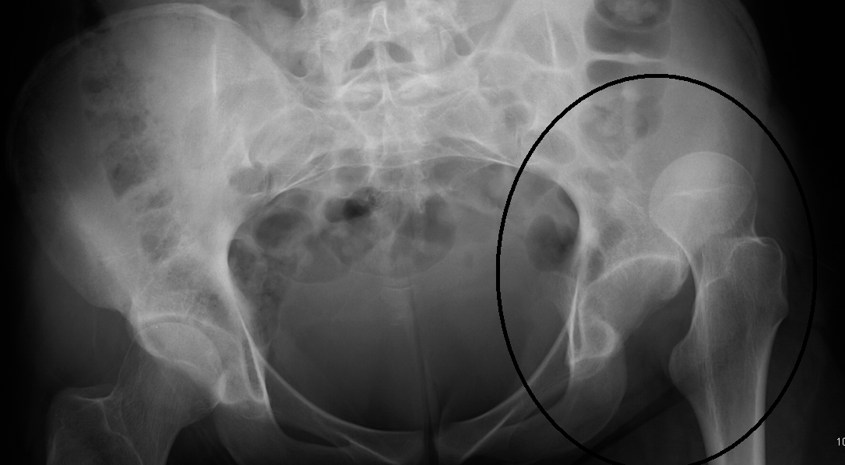

Slide 6
Bone Injuries: Legg-Calve-Perthes Disease
Legg-Calve-Perthe disease: a condition found in some children that is characterized by a disruption of blood flow to the head of the femur, which causes the tissue at the head of the femur to die
Typical signs and symptoms include groin or knee pain, and walking with a limp
If condition is suspected, the athlete should be referred to a physician immediately

Slide 8
Muscle and Tendon Injuries
Thigh strains are common athletic injuries, especially to the hip flexor, extensor, and groin musculature
Many muscles in the leg cross two joints and sometimes is cause of strains in this region
Another cause: when strength imbalance occurs, the stronger muscle group puts excessive tension on the opposing muscle group
Example: great deal of strength in the quadriceps, but have weak hamstrings
Strains should be initially treated with PRICES and wrapped with a supportive elastic bandage
Moderate and severe strains may need to be referred to a physician and may be prescribed rehabilitation that includes increasing strength, ROM, and enhancing flexibility

Slide 9
Muscle and Tendon Injuries: Hip and Thigh Muscle Contusions
Deep thigh contusions are common, especially in collision sports
Rugby, football, lacrosse
Although many bruises suffered in athletics are minor, thigh contusions can cause disability
The more severe contusions can cause tissue tearing and extensive bleeding
If not managed appropriately, serious thigh contusions can cause myositis ossificans
Myositis ossificans: the buildup of bone tissue in a muscle following an injury
Because bone tissue is not as extensible as muscle tissue, disability and loss of function are typical consequences

Slide 10
Muscle and Tendon Injuries: Hip and Thigh Muscle Contusions Con't
When treating a thigh contusion, it is important to proceed with PRICES, but the knee should be flexed during ice application
An AT may put an athlete in a hinged knee immobilizer with the knee locked into flexion, limiting total loss of flexibility due to the injury
With a moderate to severe contusion, the athlete should be placed on crutches to minimize the stress to the area then referred to the team physician
Active rest and the use of ice and gentle stretching routines are effective in restoring mobility
Ultrasound is often used to help reabsorb the blood that collects internally and to break up bony tissue deposits
The AT must make certain that a protective pad is placed over the contusion to prevent repeated contusions to the area, because this can also create myositis ossificans

Slide 11
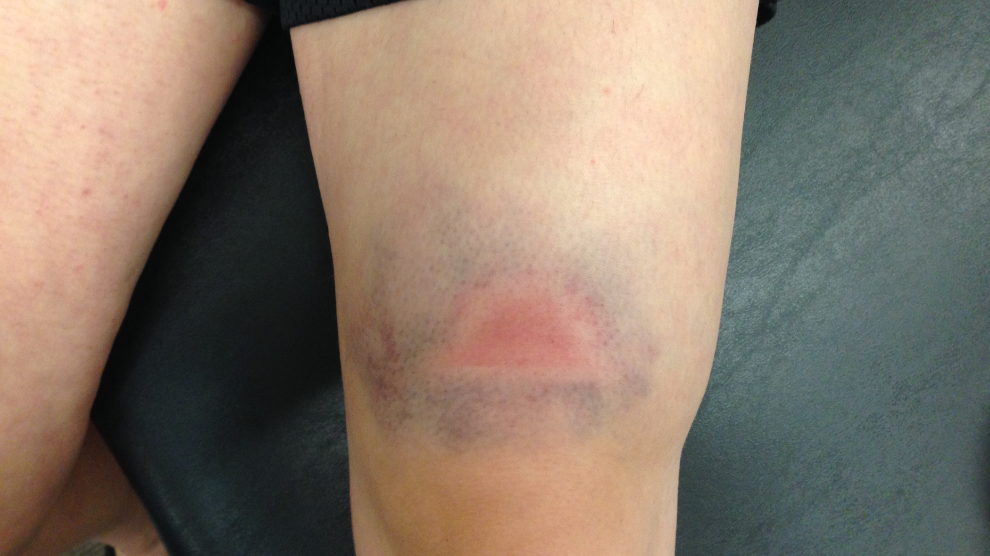

Slide 12
Muscle and Tendon Injuries: Hip Bursitis
The lateral hip, specifically over the greater trochanter of the femur, can create pressure over the bursa
The bursa is a fluid-filled sac that reduces friction of tendons that cross this bony prominence
When the bursa is irritated from too much pressure from the tendons, it becomes inflamed
Athletes with hip bursitis will report snapping of the hip when they climb stairs

Slide 13
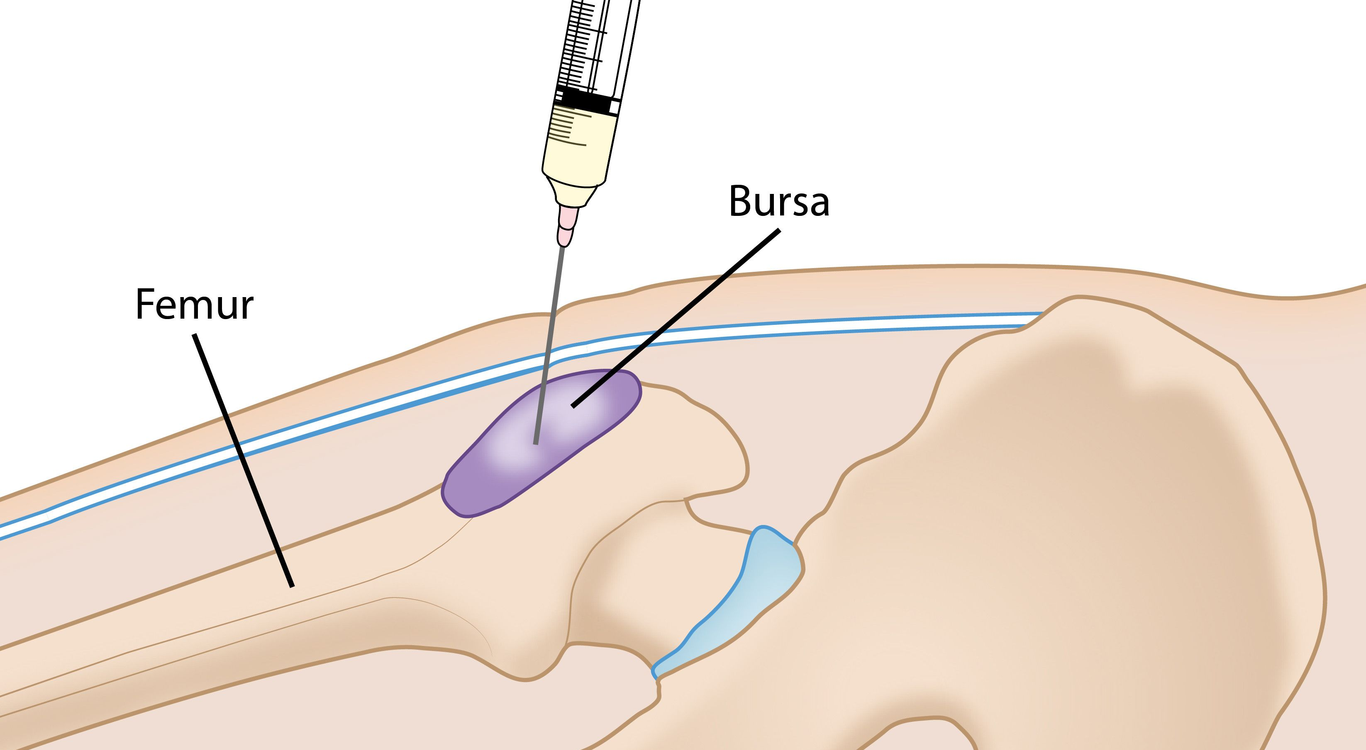

Slide 14
Ligament Injuries
The hip is a ball-and-socket joint that is extremely stable, mostly because the head of the femur sits so deeply in the pelvis
Thick ligamentous structures and strong muscles also surround the hip

Slide 15
Reference
Fundamentals of Athletic Training

