Slide 1
Chapter 14: Knee Injuries
Unit 5: Understanding Athletic Injuries to the Lower Extremity

Slide 2
Objectives
Describe the basic anatomy of the knee
Explain common knee injuries that occur with athletic participation
Identify signs and symptoms of knee injuries
Explain treatment parameters performed by an AT for specific knee injuries

Slide 3
Anatomy of the Knee: Bones
The bones that form the knee joint are the femur, tibia, and patella
The primary movement of the knee occurs at the articulation of the tibia and femur, which is called the tibiofemoral joint
The patella is a sesamoid, or floating bone, which is embedded in the patellar tendon that attaches the quadriceps muscles to the front of the tibia and protects the front of the joint
As the knee flexes and extends, the patella glides up and down on the front of the femur---this is called the patellofemoral joint

Slide 4
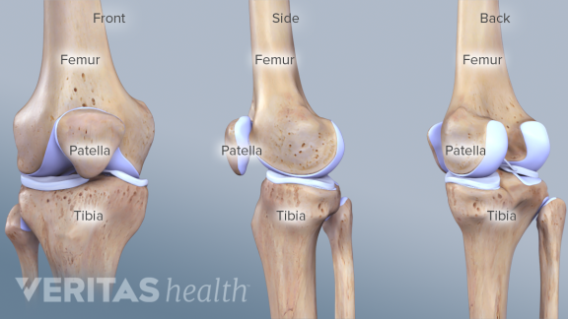

Slide 5
Anatomy of the Knee: Muscles
The muscles of the lower knee provide both movement and stability
The primary muscles spanning the knee include the quadriceps and the hamstrings
Knee extension is primarily performed by the 4 quadriceps muscles: vastus medialis, vastus lateralis, vastus intermedius, and rectus femoris
The vastus muscles of the quads originate on the femur, whereas the rectus femoris originates at the anterior aspect of the pelvis
All the quadriceps muscles run toward the patella and attach to the patellar tendon at the anterior knee
The patella tendon crosses the anterior aspect of the knee joint and inserts on the superior aspect of the tibia

Slide 6
Anatomy of the Knee: Muscles Con't
Flexion of the knee is predominately the result of contracting the hamstring muscles
Biceps femoris, semimembranosus, and semitendinosus muscles
The 3 hamstring muscles attach on the posterior aspect of the lower pelvis and run down the back of the thigh and across the knee to their attachment on the tibia
The location of their attachments help to prevent movement of the tibia on the femur
Besides the quads and hamstrings, other important muscles around the know joint allow movement and provide stability
Posteriorly, the gastrocnemius is known mainly as muscle that allows us to point our toes (plantar flexion), but also functions with the popliteus muscle to flex the knee
Medial aspect: gracilis muscle cross the knee joint and originates near the groin and inserts on the medial tibia---function is to adduct the femur
Lateral aspect: iliotibial band crosses the knee joint
Tough connective tissue that the tensor fasciae latae and gluteus maximus of the hip mesh into; help abduct the hip

Slide 7
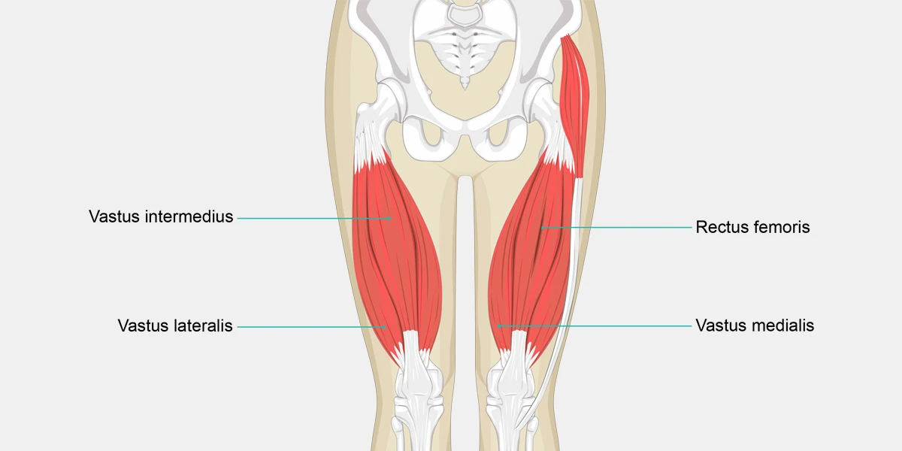
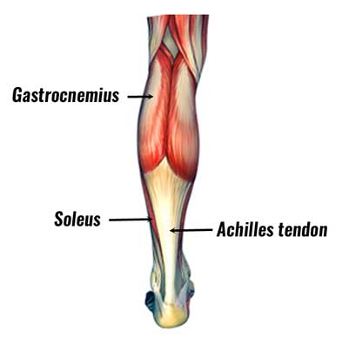
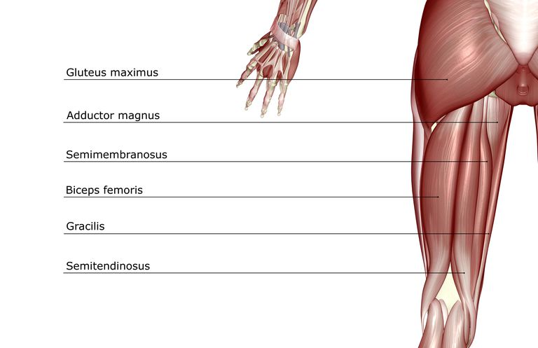

Slide 8
Anatomy of the Knee: Ligaments
There a four primary knee ligaments
Medial Collateral Ligament( MCL): helps stabilize the inside of the knee
Lateral Collateral Ligament (LCL): helps stabilize the outside of the knee
Anterior Cruciate Ligament (ACL): helps the tibia from moving forward on the femur
Posterior Cruciate Ligament (PCL): prevents the tibia from moving backward on the femur
The ACL and PCL pass through the middle of the knee joint and cross each other

Slide 9
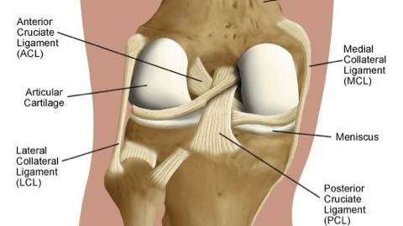

Slide 10
Anatomy of the Knee: Cartilage
The ends of the tibia and the femur are covered and cushioned by pieces of tough cartilage tissue called the menisci
Meniscus: a piece of cartilage within a joint which lie between the femur and tibia
Without the menisci, the tibia and femur would rub against each other, which would cause the bone to wear down quickly; the menisci also help stabilize the knee joint
The top of the tibia is flat, like a tabletop and the ends of the femur, specifically the condyles, are rounded like an orange; therefore, without something to stabilize the joint, the femur would move a great deal on the tibia
The menisci are thicker on the sides and thinner in the middle, forming a dish-shaped hollow
They are also attached to the top of the tibia, which provides a seat for the femoral condyles to sit in on top of the tibia

Slide 11
Preventing Knee Injuries
Ligament sprains are among the most common injuries to the knee
Remembering that the muscles in this area provide stability to the knee and help resist abnormal bony movements, athlete should develop strength in these muscles
Quadriceps, hamstrings, gastrocnemius, and hip adductors and abductors
Exercises to strengthen these?
Some ATs and athlete use preventative knee braces that are designed to protect the MCL; however, the American Academy of Pediatrics states that there is insufficient research to warrant the use of braces to prevent ligament injuries
If an athlete has a problem with their knees, the AT should examine leg structure to determine if they have genu valgus, also known and knock-knees, or genus varus, also known as bowlegs
Current research supports neuromuscular training as an effective way to prevent knee injuries, particularly injuries to the ACL
Teaches athletes how to land from a jump, change direction, flex the knee and hip, balance training, proper acceleration and deceleration

Slide 12
Bone Injuries: Patellofemoral Syndrome
Patellofemoral syndrome involves a set of symptoms that include pain and discomfort around the patella, often caused by patellar tracking problems
As the knee bends, the patella is grated across the femur instead of riding smoothly, causing the cartilage on the back of the patella to soften or wear away
Chondromalacia: the softening or wearing away of the cartilage that lies on the back of the patella
Athlete will report a grinding sensation with flexion and extension
AT can feel the grinding if athlete flexes and extends knee
Treatment includes correcting any problems with patellar tracking, strengthening the vastus medialis, and improving flexibility of the quads and hamstrings
Bent-leg activities should be avoided because they tend to aggravate the condition
Treatment should also address any weakness around the hip joint

Slide 13
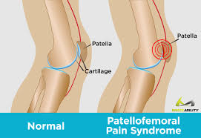

Slide 14
Bone Injuries: Patella Dislocation
Sometimes an athlete will be forced to the lateral aspect of the knee, usually while the knee is bent and forced to twist inward---there will be a noticeable deformity
The athlete is often in distress and EMS must be called
Only a physician should reduce a dislocated patella; otherwise, complications may result, and the posterior aspect of the patella may be further injured
Treatment involves immobilizing the knee for a short time, and then the athlete should begin exercising to regain mobility and strength around the knee joint
Sometimes athletes are advised to wear a knee sleeve with a patella hole to help keep the patella in place during activity

Slide 16
Muscle and Tendon Injuries: Patella Tendinitis
Patellar tendinitis: inflammation of the patellar tendon
Also known as Jumper's Knee
Characterized by weakness, tenderness, and swelling
In the early stages, the athlete typically has pain after activity, but in the later stages, the condition can result in pain during activity and loss of strength
The AT will attempt to control inflammation by applying ice and modifying the athlete's activity level—usually restrict running and jumping
The rehabilitation program should address flexibility problems of the quads and weakness of the leg
If the tendon is already weak and the athlete continues to play, a rupture can occur

Slide 17
Muscle and Tendon Injuries: Osgood-Schlatter Disorder
Younger athletes who perform a great deal of running and jumping sometimes develop an irritation at the site of the patellar tendon attachment to the front of the tibia, or the tibial tuberosity
Osgood-Schlatter Disorder: a condition characterized by an irritation or loosening of the patellar tendon at its attachment at the top anterior aspect of the tibia, usually seen in younger athletes who perform a great deal of running and jumping
Causes discomfort of the knee, swelling, tenderness, and pain during activity
Athletes should restrict activity until it is resolved
Example: basketball player should stop aggressive running and jumping and instead can work out on a stationary bike
Activity should be modified based on player's pain level
Ice application before and after activity is helpful; a special pad may need to be made to fit over the front of the tibia
Usually improves by age 16-17, but a bony growth can still occur on top of the tibia

Slide 18
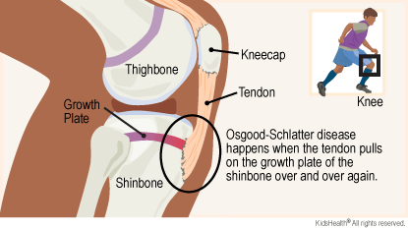
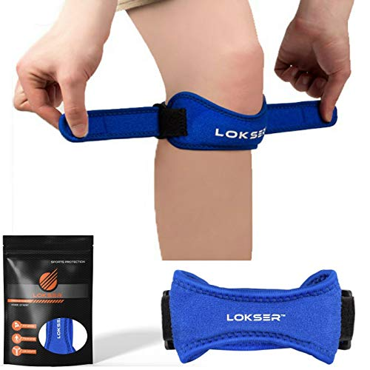
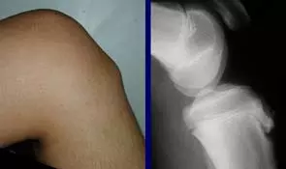

Slide 19
Ligament Injuries: Anterior Cruciate Ligament
The ACL keeps the tibia from moving forward on the femur
If this ligament is injured, the athlete is often disabled, complaining of knee giving away, collapsing, and popping
ACL injures are the most serious of all knee ligament injuries and the ACL is the ligament that is most frequently surgically reconstructed
The ACL is usually injured as the athlete attempts to change directions quickly and twists the lower leg; they may hear a popping sound during the twisting mechanism; can also be injured from excessive hyperextension
Torn ACL causes rapid swelling and loss of knee function; immediate treatment is PRICES and a knee immobilizer; crutches are provided for additional knee protection
Follow-up with an orthopedist is necessary if a torn ACL is suspected

Slide 20
Ligament Injuries: Anterior Cruciate Ligament Con't
An athlete rarely functions well with a torn ACL, and the injury often needs to be surgically reconstructed
Decision is made by the family, player, and doctor based on amount of instability that exists, the level of function desired by the athlete, and the age
Surgical reconstruction involves two types of tissues, autografts and allografts
Autograft: piece of tissue from the athlete's body
Allograft: a tissue graft from a donor of the same species as the recipient but not genetically identical
Rehabilitation focuses on restoring ROM and strengthening the hamstrings to stabilize the tibia as well as to regain full function
Even with aggressive ACL rehabilitation, it may be 6 months before the athlete can return to full participation

Slide 22
Ligament Injuries: Posterior Cruciate Ligament Injuries
The PCL prevents posterior tibial movement on the femur; it is frequently injured when an athlete falls and a bent knee bears the full weight, when the knee is hyper flexed, or when a blow to the knee is delivered to the front of the tibia
After determining the mechanism of the injury, the AT may suspect a PCL injury if the athlete reports having heard a pop
There tends to be little swelling and initial treatment is PRICES and referral to a physician
Rehabilitation for mild to moderate PCL sprains will focus on strengthening the quadriceps and regaining full function
Though some physicians disagree about whether or not surgery should be performed on a severe PCL injury, even complete PCL tears can be rehabilitated without surgical intervention
Many athletes can become functional again after the initial pain and swelling are controlled and the knee is strengthened

Slide 23
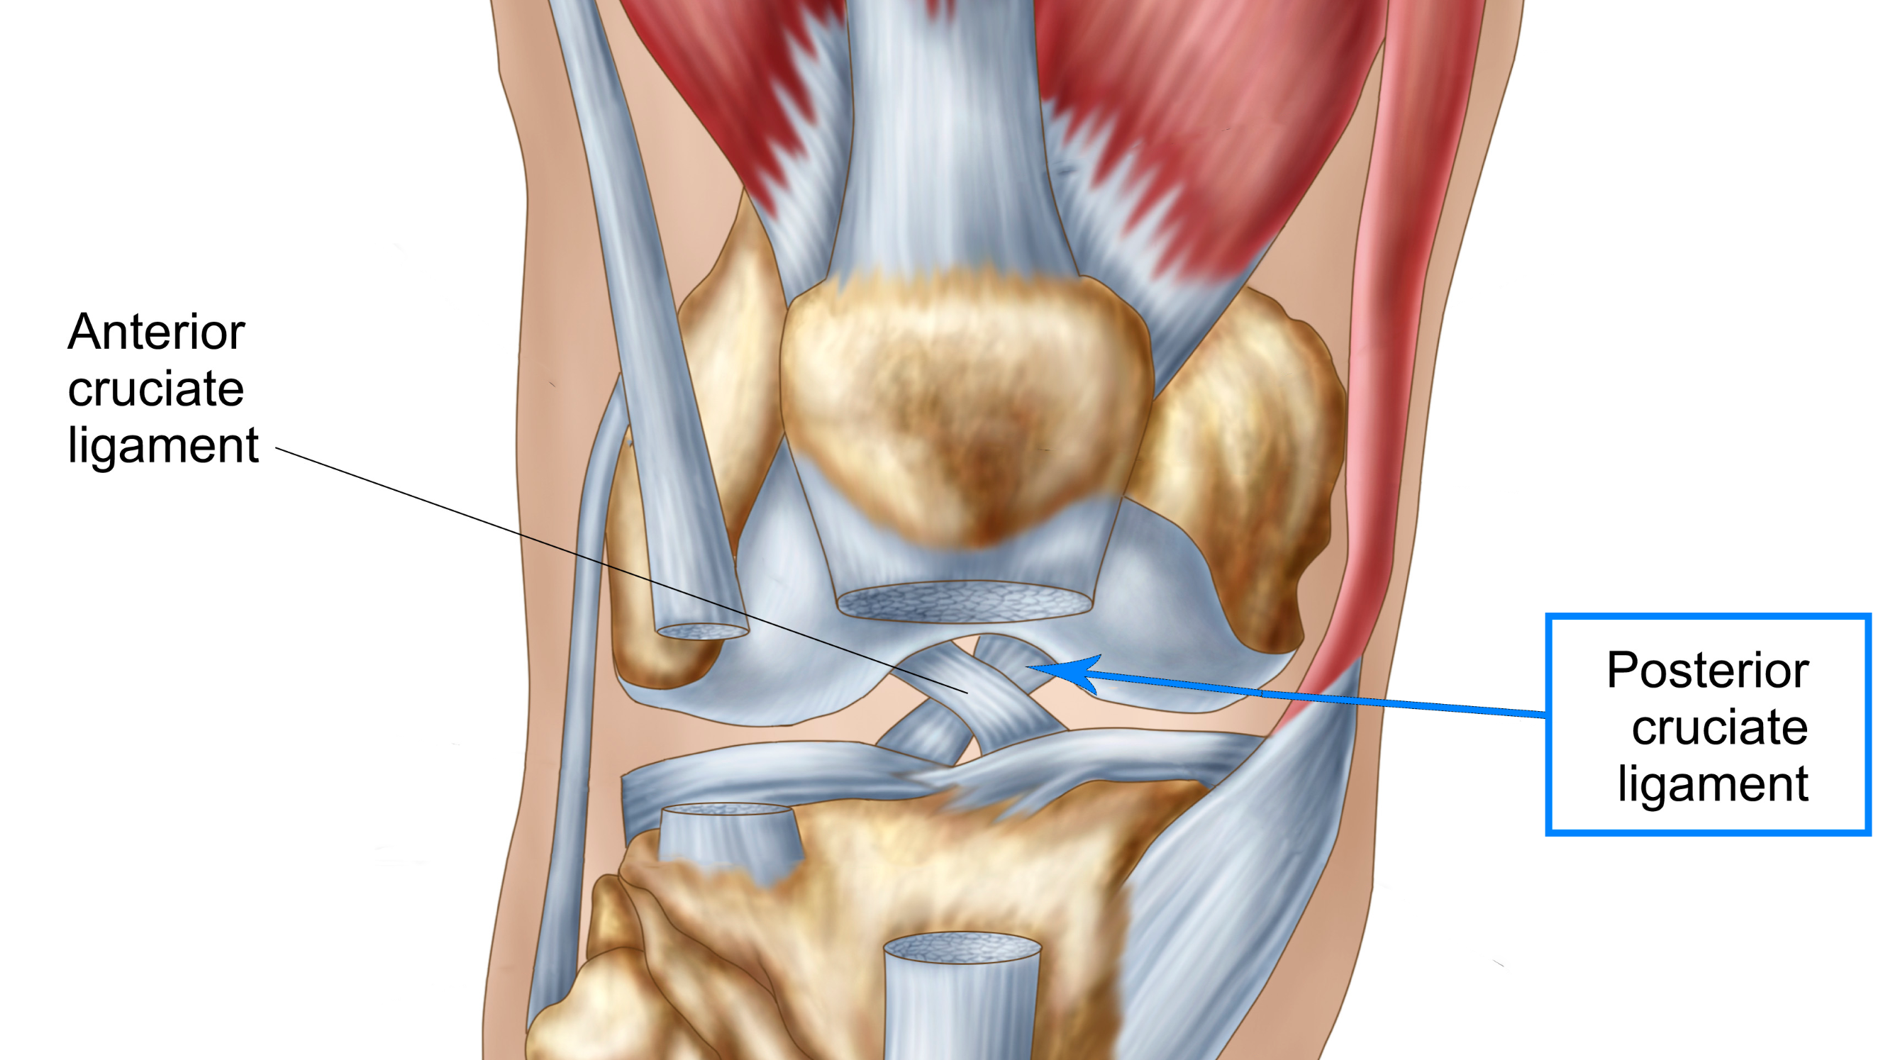

Slide 24
Ligament Injuries: Medial Collateral Ligament Sprains
The MCL is frequently injured when an athlete receives a blow to the outside of the knee, causing the knee to bend inward (valgus stress) and stresses the MCL
A mild MCL sprain usually results in medial joint line pain, little swelling, no joint laxity when stressed by the AT, and full knee flexion and extension
A moderate MCL sprain causes mild swelling, discomfort, and some joint laxity
A severe sprain shows moderate swelling, loss of function, and a great deal of joint laxity
Regardless of the severity of the injury, the athlete's knee should be treated with PRICES
A mild injury may only require an elastic wrap for compression and support
Moderate to severe sprains require the knee to be immobilized and rehabilitation that includes strengthening of the muscles that cross the medial aspect of the knee
If the knee has moderate or severe MCL damage, the AT should consider the possibility of damage to the menisci or an ACL injury

Slide 25
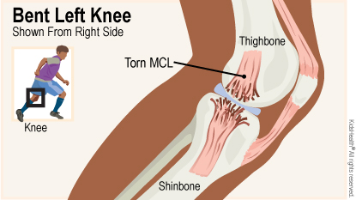

Slide 26
Ligament Injuries: Collate Ligament Injuries
LCL injuries occur less frequently than MCL injuries
Signs and symptoms are similar except the discomfort is at the lateral aspect of the knee
Treatment is the same as an MCL injury
To regain joint stability, strengthening exercises should focus on the lateral thigh muscles and hamstrings

Slide 28
Cartilage Injuries
Each large piece of fibrous cartilage in the knee joint is a meniscus; they function to absorb shock and stability
Menisci are vulnerable to significant injury, specifically tears
The most common injury to the meniscus is a tear, which can be on the outer edge, middle, inside edge, or ends (horns) of the meniscus
Tears of the meniscus typically happen with a twisting movement of the knee or with hyperflexion and hyperextension
An athlete with a torn meniscus will often complain of pain at the joint line; have problems putting weight on the limb; complain of clicking; and walk with a limp

Slide 29
Cartilage Injuries Con't
Tears of the meniscus used to be treated surgically removing the entire meniscus
Meniscetomy: surgical procedure to remove the meniscus from the knee joint
Arthroscopic surgery: a type of surgery performed on a joint using only small puncture holes to insert instruments, including a camera, to observe and fix injured structures
Depending on where the meniscus is torn, sometimes surgeons are able to suture it back together
During rehabilitation after an injury or surgery, an athlete initially will use exercises that do not involve placing weight on the injured legs
Aquatic therapy programs are ideal for helping to reestablish ROM and strength
The athlete will slowly progress to more weight-bearing exercises as tolerated

Slide 30
Fat Pad Syndrome
Fat Pad Syndrome: a condition where the fat pad of the knee becomes trapped between the patella and the femur; also known as Hoffa's syndrome
The infrapetllar fatr pad lies behind and just beneath the patella and acts as a barrier and cushion between the patella and femur
When an athlete extends their knee, the fat pad can become trapped between these bones
The signs and symptoms of this condition include tenderness and beneath the knee, swelling, and pain with extension
The area should be rested and treated with ice and ultrasound

Slide 31
Reference
Fundamentals of Athletic Training

