Slide 1
Bones injuries: Epiphyseal injury of the distal tibia and fibula
The distal tibia and fibula epiphyses can becomes injured when the ankle is forced into plantar flexion and inversion
The athlete will experience pain and swelling over the epiphysis and will have difficulty walking or running due to pain
The AT will splint the injury and refer to a physician for X-rays
Potentially a serious injury because it is possible for the epiphysis to close prematurely, stunting bone growth at the site

Slide 2
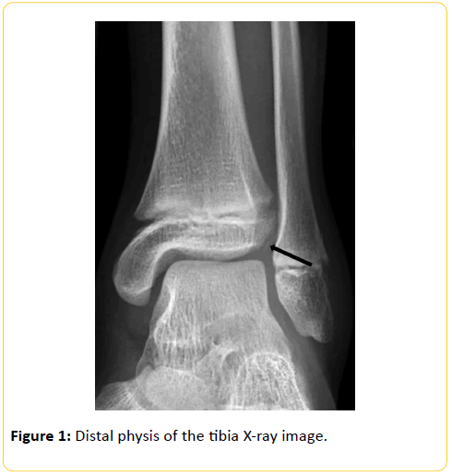

Slide 3
Bone Injuries: Stress Fracture
Stress fractures of the lower leg and foot most commonly occur to the tibia, fibula, and metatarsals, and repetitive stress due to running is usually the cause
Athlete will present with pain that becomes more intense at night and following activity
Pain and swelling will be located over the bone
Some physicians believe that a stress fracture can be distinguished using a turning fork---the vibrations from the tuning fork vibrate the bone but do not irritate the muscles
A bone scan can verify diagnosis; an X-ray will not show a stress fracture until two weeks after the initial injury, when a callus begins to form on the site
Stress fractures are rarely casted, but the athlete will be encouraged to use crutches to eliminate pressure on the limb
If the injury is not detected early, a complete fracture may result

Slide 4
Muscle and tendon Injuries: Shin Splints (Medial Tibial Stress Syndrome)
Shin Splints: pain of the lower leg, often along the tibia
The muscles fibers on the medial side of the tibia become torn and irritated
Athlete will complain of pain and the inability to run or walk properly
Pain is located over the distal medial side of the tibia, although there may be swelling on the lateral side as well
Symptoms include tight calf muscles
PRICES is most successful treatment
AT can wrap the medial side of the leg, pulling soft tissue toward the bone
New shoes are often recommended, stretching

Slide 5
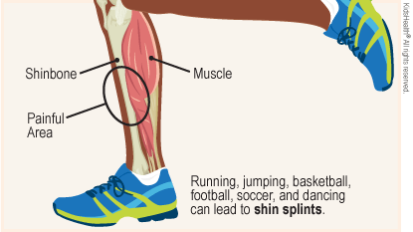

Slide 6
Muscle and tendon Injuries: Achilles Tendinitis
The Achilles tendon is the strong tendon joining the gastrocnemius muscle to the heel
Any sport involving repeated running, jumping, and landing may cause cells in the tendon to break down prematurely, and this irritation and inflammation is referred to as tendinitis
AT will note swelling, tenderness, crepitus, and an expression of pain on the athlete's face when they palpate the Achilles tendon, especially with dorsiflexion
Athlete must rest the tendon and ice and may need referral to a physician for medication
If the athlete does not follow protocol and returns too soon, the tendon may thicken as a protective response and will limit the athlete's ROM and decrease running and jumping ability
Severe damage may cause an Achilles rupture

Slide 7
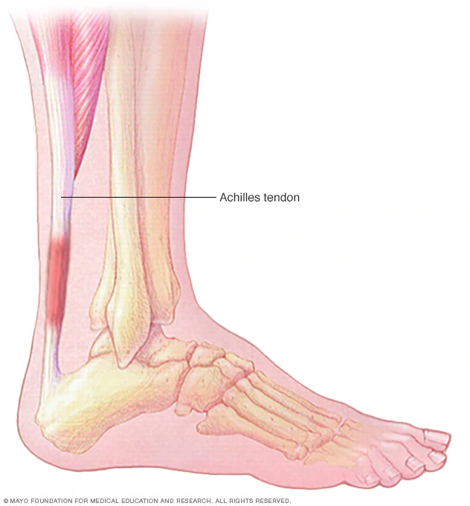

Slide 8
Muscle and Tendon Injuries: Achilles Tendon Rupture
Athlete feels as if someone shot them in the back of the leg
Rupture occurs when there is forced dorsiflexion of the foot, a blow over the Achilles tendon, or sudden forceful contraction of the gastrocnemius muscle
The athlete will feel tearing and will have difficulty walking; weakness or complete loss of plantar flexion
AT will observe swelling and an obvious depression where the Achilles tendon used to be attached
Athlete will have obvious pain and should be referred to a physician immediately after a splint has been placed, iced, and given crutches
Tendon must be repaired surgically

Slide 9
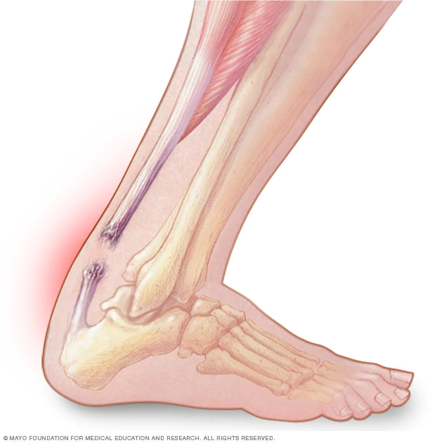

Slide 10
Ligament Injuries: Great toe Sprain
The great toe helps an athlete kick a ball, push off when walking or running, and maintain balance
When excessive force is applied to the great toe, such as forced flexion or extension, the ligaments can be sprained
Some sports medicine specialists believe that artificial turf causes more great-toe sprains than real grass does
Symptoms include pain, swelling, discoloration, and inability to walk or run normally
AT will recommend PRICES
When athlete returns, great toe can be taped and padded to provide support and decrease pain

Slide 11
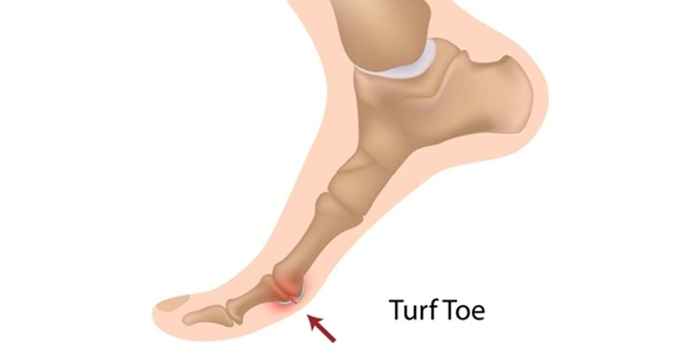

Slide 12
Ligament Injuries: Arch Sprain (Metatarsal and Longitudinal)
An arch sprain can be caysed by running on a hard surface, wearing improper footwear, or subjecting the foot to repetitive stress
The athlete will report significant pain over the involved arch and will experience difficulty walking or running
An injury to the longitudinal arch will result in pain at the medial aspect of the foot
An injury to the metatarsal arch will result in pain at the ball of the foot, just proximal to the toes
During the assessment, the AT will notice swelling and possibly some discoloration over the plantar surface
PRICES is the best way to handle an arch sprain
Athlete should strengthen the arch by exercising the muscles of the foot and by stretching the Achilles tendon

Slide 13
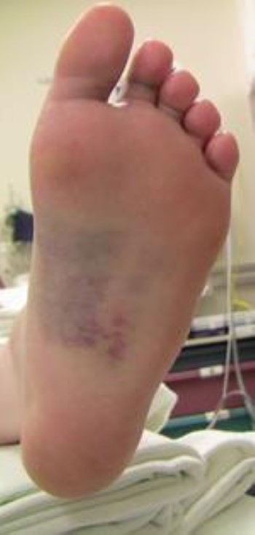

Slide 14
Ligament INjuries: Plantar Fasciitis
Plantar Fasciitis: inflammation of the plantar fascia of the foot
Injured with chronic stress
Tenderness begins at the calcanues and progresses towards the toes
Rest is an important intervention, as is arch support, or orthotics; can also use a night splint which keeps the foot dorsiflexed so the plantar fascia stays in a slightly stretched position
Heel spur: a small, pointy, bony growth at the bottom of the calcaneus, often caused by plantar fasciitis

Slide 15
