Slide 1
Ligament INjuries: Lateral and Medial Ankle Sprains
About 85% of ankle sprains are caused by excessive inversion
Deltoid ligament is much stronger than the lateral ligaments and the fibula prevents severe eversion
When the ankle inverts, the lateral ligaments are injured; the serverity of the injury will depend upon the amount of force, the amount of taping, the type of shoes, and strength of the muscles
Ankle injuries must be evaluated to determine their servity; shoe and sock must be removed
AT will notice swelling and discoloration and will determine the servity based on athlete's ability to move the ankle
If there is no decreased ROM or strength, the athelte may be allowed to play with the ankle protected by a brace or tape
Any decrease in ROM will be treated with PRICES along with a referral to a physician to ensure no fracture
Syndemosis sprain: high ankle sprain

Slide 2
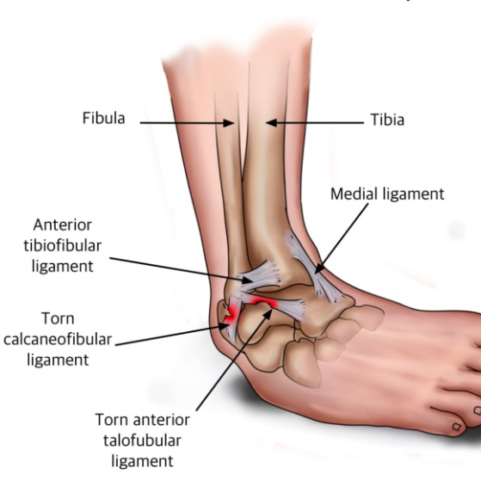

Slide 3
Ligament Injuries: Ankle Dislocation
Can occur either anteriorly or posteriorly
Anterior dislocation occurs when the heel of the foot strikes the ground forcefully; posterior dislocation occurs with a blow to the anterior aspect of the leg while the ankle is in plantar flexion
Athlete will be in pain and will refuse to move or allow the foot to be touched
There will be a deformity and an inability to use the foot; swelling will appear rapidly
AT should call EMS; splint the lower leg and ankle; and apply ice
Nerves and blood vessels can be injured and a physician will need to put the bones back in place

Slide 5
Tissue Injuries: Contusions
Soccer and field hockey players are prone to contusions of the lower leg; thus shin guard intervention
The impact of a ball, stick, or foot on the shin will cause swelling, pain, and discoloration
The athlete may limp and have limited ROM
The AT will recommend ice and rest until full ROM is restored
The athlete will need additional padding to protect from more impacts

Slide 7
Tissue injuries: Toe Abnormalities
Hammertoe: a deformity in which the middle joint of the toe is flexed and the metatarsophalangeal and distal phalangeal joints are hyperextended
Hallux valgus: excessive valgus stress at the great toe, also known as a bunion
Bunion: excessive deviation or valgus stress a the great toe
Ingrown toenail: injury where the nail grows into the surrounding soft tissue

Slide 8
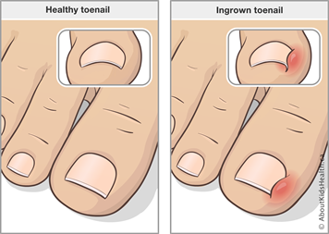
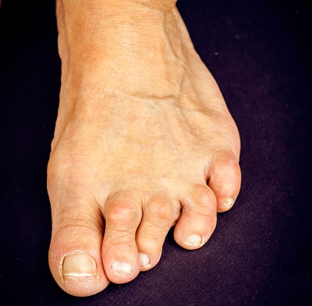
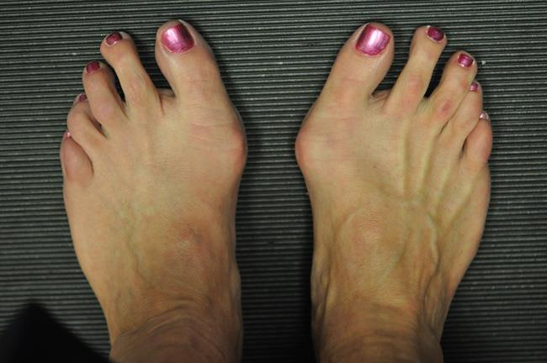

Slide 9
Tissue injuries: Heel bruises
Beneath the calcaneus exists a thick fat pad that helps absorb shock as we walk
If there is too much impact on the heel, a contusion can result
The heel bruising can be debilitating because we strike with our heel as we walk and the fat pad is tender when it is bruised
Area must be treated with ice and padded to help absorb shock

Slide 10
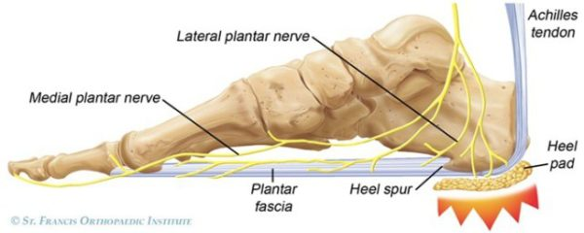

Slide 11
Tissue Injuries: Anterior Compartment Syndrome
Sometimes mistaken for shin splints
Muscles to the anterior aspect of the tibia are enclosed in connective tissue; when the tissue in the compartment swells due to overuse or a severe impact, the swelling increases the pressure on the connective tissue, which causes severe pain that increases with activity and does not subside when there is no activity
The AT will note heat, red skin, loss of foot motion, and hardness to the area
The athlete must be seen by a physician immediately to prevent nerve damage from the pressure
The physician will make an incision in the leg to relieve the pressure, and the athlete can return to activity while wearing a supportive brace or bandage

Slide 12
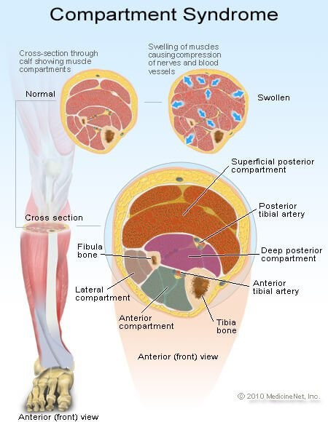
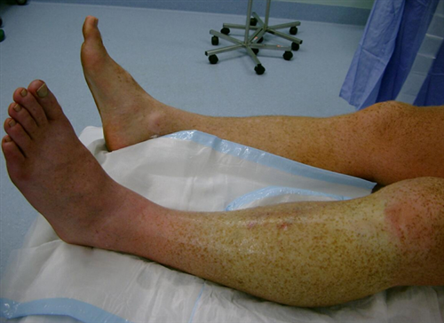

Slide 13
Reference
Fundamentals of Athletic Training

