Slide 1
Chapter 2: Taking Charge of Your Health
Unit 1: A Healthy Foundation

Slide 2
Objectives
Develop skills that will help manage health throughout life
Promote well-being by making healthful decisions and setting positive, attainable goals
Evaluate health products and services carefully and effectively
Understand how to hand consumer problems

Slide 3
Building Health Skills
Health skills: specific tools and strategies to maintain, protect, and improve all aspects of your health; can also be referred to as life skills.

Slide 4
The Health Skills
Step-by-step process to evaluate your options and make healthy choices
Resolve problems with others in healthy ways
Set goals and develop a plan to achieve these goals
Use healthy ways to reduce and manage stress in your life
Locate valid resources of health information, products, and services
Share ideas and feeling, and listen carefully when others express theirs
Act to reduce risks and protect yourself against illness and injury
Say no to unhealthy behaviors
Work to improve health and the health of family and community
Understand the many influences on your health, including peers, family, culture, media, and technology
Communication
Refusal
Conflict resolution
Accessing information
Analyzing influences
Practicing healthful behaviors
Stress management
Advocacy
Decision making
Goal setting

Slide 5
Communication and Refusal Skills
Interpersonal communication: the exchange of thoughts, feelings, and beliefs between two or more people.
Strong interpersonal communications allows the building of strong relationships
How to strengthen interpersonal communication:
Use "I"messages to express feelings
Communicate with respect
Be an active listener
Refusal Skills: communication strategies that can help you say no when you are urged to take part in behaviors that are unsafe, unhealthful, or go against your values

Slide 6
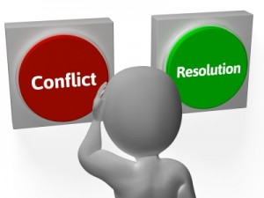
Conflict Resolution Skills
Conflict Resolution skills: the process of ending a conflict through cooperation and problem solving.
These skills include:
Stepping away from an argument
Using good interpersonal communication skills
Maintaining an attitude of respect for yourself as well as others
Compromise: both parties give up something, but still gain a desired result.

Slide 7
Accessing Information and Analyzing Influences
Valid sources of information include:
Health care providers and professionals
Valid Internet sites, such as health agencies and professional health organizations (end in .org or .edu)
Parents, guardians, and other trusted adults
Recently published materials written by known science and health professionals
Influences:
Personal values
Personal beliefs
Perceptions
Curiosity/Fears
Family and Culture
Media and technology
Friends and peers
School and Community

Slide 8
Self-Management Skills and Advocacy
Self management: taking charge of your own health. By managing these behaviors, you act in ways that protect health and promote well-being.
Stress: the reaction of the body and mind to everyday challenges and demands.
Stress management skills: skills that help reduce and manage stress in your life.
Exercise
Relaxation
Time management
Advocacy: taking action to influence others to address a health-related concern or to support a health-related belief.

Slide 9
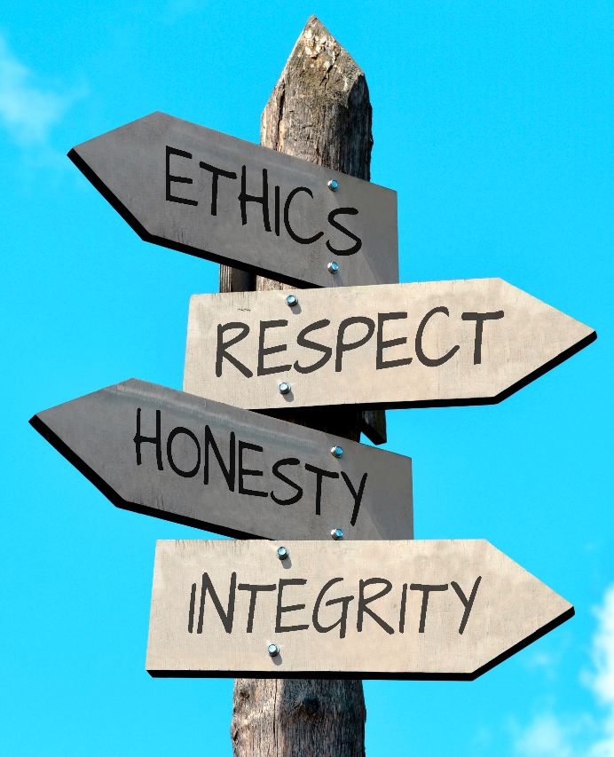
Decision Making
We make decisions each and every day, some being small, while some are life-changing
Values: ideas, beliefs, and attitudes about what is important that help guide the way you live
Decision-making process: steps that enable you to make a healthful decision
H
E
L
P

Slide 10
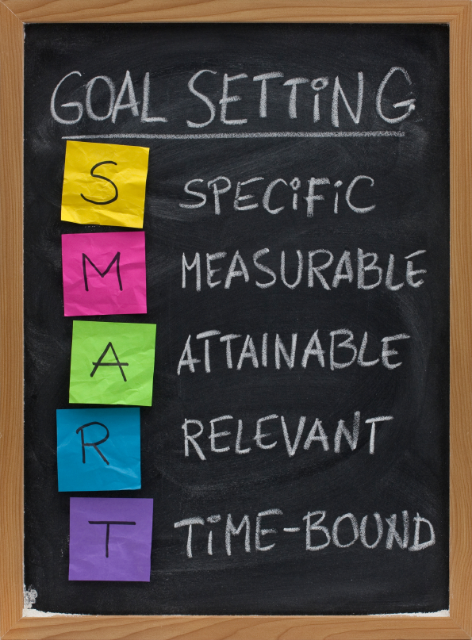
Goal Setting
Goals: things you aim for that take planning and work
Short-term goal: goal that you can reach in a short period of time
Long-term goal: goal that you plan to reach over an extended period of time
Action plan: multistep strategy to identify and achieve your goals
Activity!

Slide 11
Making Informed Choices and Evaluating Products
Health consumer: someone who purchases or uses health products or services
Advertising: written or spoken media message designed to interest consumers in purchasing a product or service
Evaluating products:
Reading the label
Comparison shopping
Criterion for comparison shopping

Slide 12
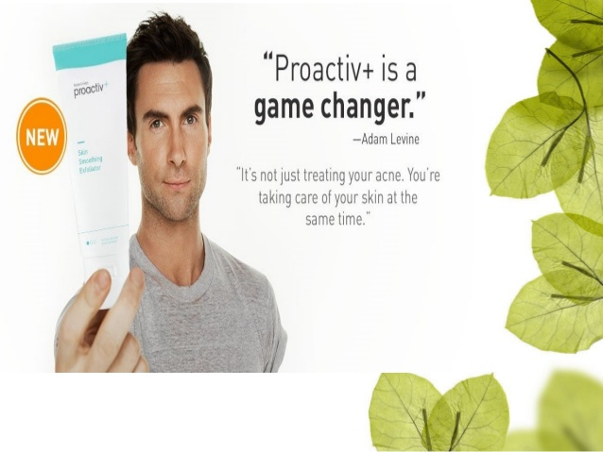

Slide 13
Resolving Consumer Problems
If there is an on-going issues when a product:
Better Business Bureau
Consumer Advocates: people or groups whose sole purpose is to take on regional, national, and even international consumer issues
Local, state, and federal government

Slide 14
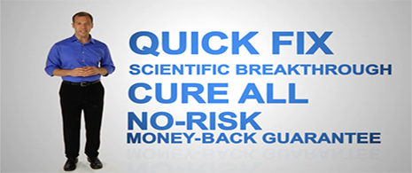
Health Fraud
Health Fraud: the sale of worthless products or services that claim to prevent disease or cure other health problems. Also referred to as quackery.
Key health fraud terms:
Secret Formula
Miracle cure
Overnight results
All natural
No-risk
Ancient remedy
Money-back guarantee

