Slide 1
Chapter 3: Achieving Mental and Emotional Health
Unit 2: Mental and Emotional Health

Slide 2
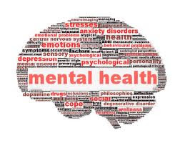
Objectives
Develop a healthy self-esteem by having good mental and emotional health
Learn how a healthy identity is based on being a person of good character
Express emotions in healthful ways

Slide 3
Self-Esteem
Mental/emotional health: the ability to accept yourself and others, express and manage emotions, and deal with demands and challenges you meet in your life
Characteristics of good mental and emotional health:
Sense of belonging
Sense of purpose
Positive outlook
Self-sufficiency
Healthy self-esteem
Resilient: ability to adapt effectively and recover from disappointment, difficulty, or crisis.

Slide 4
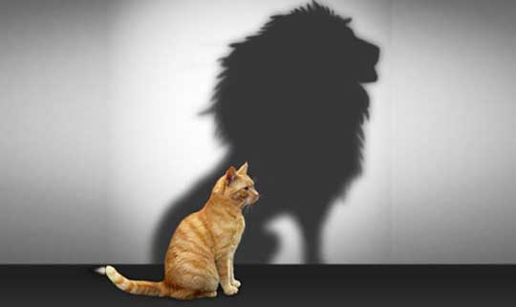
Self-Esteem
Self-esteem: how much you value, respect and feel confident about yourself
Competence: having enough skills to do something
Developing self-esteem:
Praise
Believe in succeeding
Master new challenges
Benefits:
Feel proud of yourself
Believe setbacks are temporary
Confront challenges and overcome them
Try new things

Slide 5
Improving self-esteem
Choose friends who value and respect you
1
Focus on positive aspects about yourself
2
Replace negative self-talk with supportive self-talk
3
Work toward accomplishments rather than perfection
4
Consider your mistakes learning opportunities
5
Try new activities and discover your talents
6
Write down goals and the steps you will talk to achieve them
7
Exercise regularly
8
Volunteer your time
9
Accept the things you cannot change and focus energy on things you can
10

Slide 6
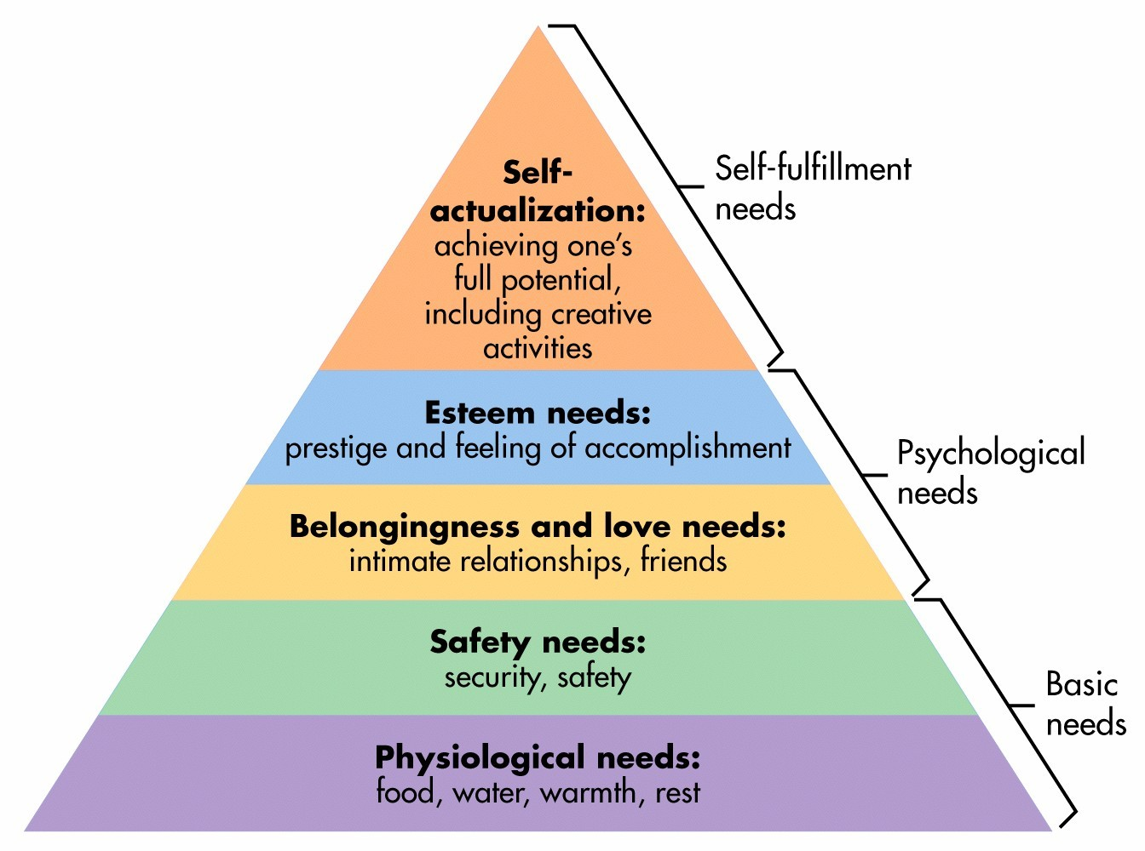
Developing self-awareness
Hierarchy of needs: ranked list of those needs essential to human growth and development, presented in ascending order, starting with basic needs and building toward the need to reach highest potential
Developed by Abraham Maslow
Self Actualization:

Slide 7
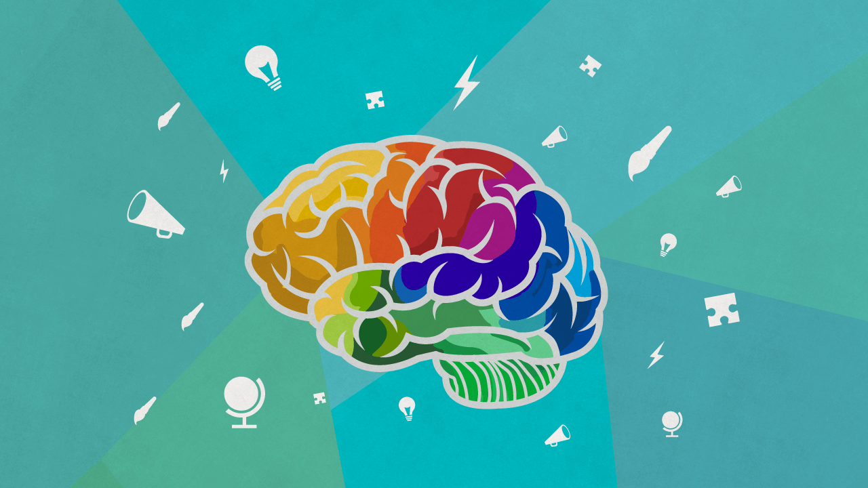
Personal identity
Personal identity: sense of yourself as a unique individual
Role model: someone whose success or behavior serves as an example
Who's your role model?
Personality: a complex set of characteristics that makes you unique

Slide 8
The importance of Good character
Character: the distinctive qualities that describe how a person thinks, feels, and behaves.
It is an outward expression of your inner values
Core ethical values:
Responsibility
Honesty
Respect
Integrity: a firm observance of core ethical values

Slide 9
Traits of good character
Trustworthiness
Respect
Responsibility
Fairness
Caring
Citizenship

Slide 10
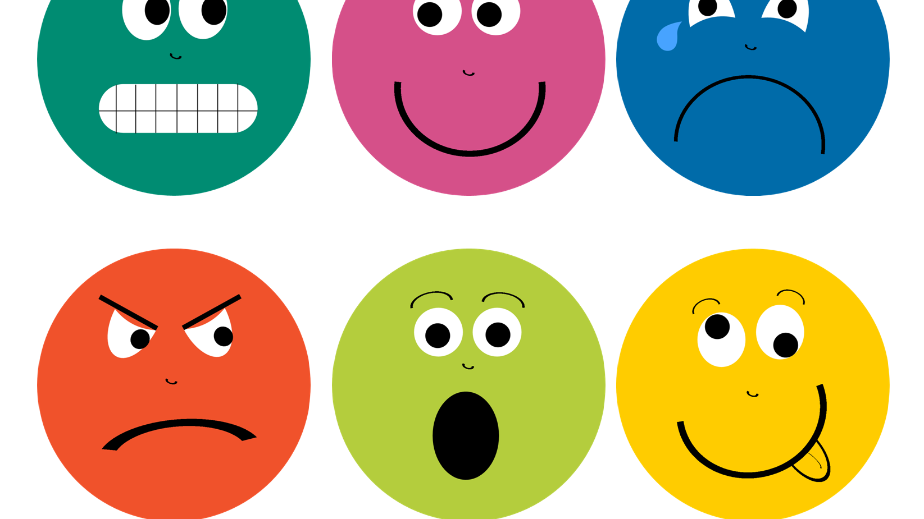
Understanding emotions
Emotions: signals that tell your mind and body how to react
Hormones: chemicals produced by your glands that regulate activities of different body cells
Common emotions:
Happiness
Sadness
Love
Fear
Guilt
Anger

Slide 11
Managing emotions
Emotions are neither good nor bad—it all depends on how you express your emotions!
Empathy: ability to imagine and understand how someone else feels
Supporting a friends through a tough time
Managing difficult emotions:
Take a deep breath and relax your muscles
Escape from the situation until you are calm again
Analyze your emotions by writing them down or talking with someone you trust
Defense mechanism: mental processes that protect individuals from strong or stressful emotions and situations

Slide 12
How do I respond to....?
Handling fear: Recognize what you are afraid of and what could be causing the fear
01
Example: you are afraid to speak in front of people, but have a huge presentation. How do you respond?
Dealing with Guilt: Decide what could cause the guilt to occur; admitting to fault, apologizing, and being more thoughtful in future situations can overcome feelings caused by guilt
02
Managing Anger: One of the most challenging emotions to handle. Decide what could cause the anger to occur. Take time to calm down. Try deep breathing. Remove yourself from the situation
03

