Slide 1
CHaPter 7: Family Relationships
Unit 3: Healthy and Safe Relationships

Slide 2
Objectives
Discuss how relationships with family members influence your overall health
Understand how to strengthen family relationships
Note that families may seek outside help in order to deal with serious conflict

Slide 3
HEalthy Family Relationships
Lesson One

Slide 4
Types of Families
Siblings: brothers and sisters
_________ ____________: two parents and one or more children living in the same place
Single-parent families: Families with one parent caring for one or more children
Blended Families: a married couple and their children from previous marriages
Extended Families: family that includes additional relatives beyond parents and children
Adoptive Families: a parent or parents and one more adopted children
Foster Families: temporary placement of children in the homes of adults who are not related to them

Slide 5
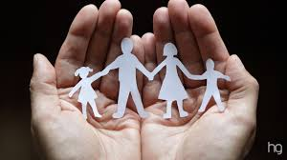
Family and Health
Your family members contribute to your health
Provide medical care
Set limits on behavior
Teach health skills

Slide 6
Promoting Mental and Emotional Health
As you age, you rely less on family for physical needs, but still count on them to assist with mental and emotional needs
Provide a safe environment for you to express emotion—in return family members offer support
Affirmation: positive feedback that helps others feel appreciated and supported
Celebrate achievements with you

Slide 7
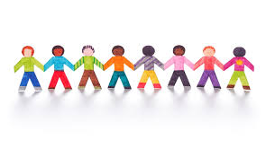
Promoting Social Health
Families promote social health by teaching you values
Responsibility, honesty, respect
Families promote social health by passing down traditions
Lighting candles at Kwanzaa

Slide 8
Strengthening Family Relationships
Lesson Two

Slide 9
Characteristics of Strong Families
Good Communication
Caring and Support
Respect
Commitment
Trust

Slide 10
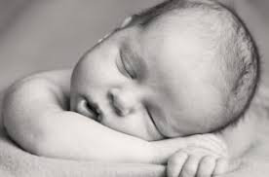
Changes in Family Structure
Birth and Adoption
Separation and Divorce:
Separation:
Divorce:
Custody:
Remarriage
Death of a Family Member

Slide 11
Changes in Family Circumstance
Moving to a new home
Changes in the Family's Financial situation
Illness and disability
Alcohol and other Drug Abuse

Slide 12
Help For Families
Lesson Three

Slide 13
Violence in Families
Abuse: The physical, mental, emotional, or sexual mistreatment of one person by another
Domestic Violence: acts of violence involving family members

Slide 14
Abuse
Spousal Abuse:
_________________: domestic abuse directed at a child
_________________: the failure to provide for a child's basic needs
Elder Abuse: the abuse or neglect of older family members

Slide 15
Effects of Abuse
Domestic abuse can cause physical injuries and emotional harm
Cycle of Violence: Pattern of repeating violent or abusive behaviors from one generation to the next
Children should seek help from an adult they trust

Slide 16
The Three R's of Stopping Domestic Abuse
Recognize
Resist
Report

Slide 17
Where to Get Help
Family Counseling Services
Support Groups
Community Services
Crisis Center: a facility that offers advice and support to people dealing with personal emergencis
Law Enforcement Officials
Hospitals or Clinics
Faith Communities

Slide 18
Resource
Bronson, Mary H. Florida Health. McGraw-Hill, 2015.

