Slide 1
Chapter 10: Nutrition for Health
Unit 4: Nutrition and Physical Activity

Slide 2
Objectives
Learn how to make healthful choices by understanding the importance of nutrition
Grasp how each nutrient plays an essential role in keeping you healthy
Use MyPlate as a tool for choosing healthy snacks and meal planning
Note how to read food labels to avoid food-related problems

Slide 3
The Importance of Nutrition
Lesson 1

Slide 4
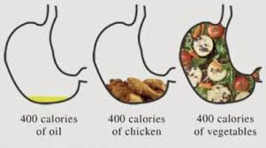
Why Nutrition Matters
Nutrition: the process by which your body takes in and uses food
________________: substances in food that your body needs to grow, to repair itself, and to supply you with energy
Calorie: a unit of heat used to measure the energy your body uses and the energy it receives from food

Slide 5
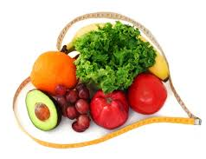
Why Nutrition Matters
Good nutrition can lower your risk of developing conditions that can threaten your life as you age:
Cardiovascular disease
Stroke
Certain cancers
Osteoporosis

Slide 6
Nutrition Influences
Hunger: the natural physical drive to eat, prompted by the body's need for food
When the body is hungry, you may notice you feel tired or light-headed
Appetite: the psychological desire for food
Smell of fresh baked cookies tempting you, even if you're full

Slide 7
Food and Emotions
Sometimes we eat in response to an emotional need
Stressed, frustrated, lonely, sad
At times we may snack out of boredom or use food as a reward
Ran a mile=eat the brownie?
Emotional snacking can lead to weight gain---recognizing your response to different emotions can lead to making better decisions

Slide 8
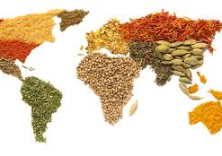
Food and Environment
Family and culture
New Orleans, LA
Friends
Time and money
Advertising

Slide 9
Nutrients
Lesson 2

Slide 10
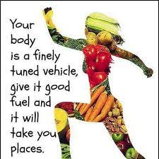
Fueling your Body
How your body uses nutrients:
Energy source
Heal, build and repair tissue
Sustain growth
Transport oxygen to cells
Regulate body functions

Slide 11
Nutrients that Provide Energy
Carbohydrates: starches and sugars found in foods, which provide your body's main source of energy
45-65% of your daily calories from carbs
Types of carbs:
Simple: sugars (fructose and lactose) that are contained in many processed foods like cereals, breads, and bakery items
Complex: starches with long-chains of sugars linked together. Common sources include grains, grain products, pasta, beans, and root vegetables
Fiber: tough complex carb that the body cannot digest
Moves waste through your digestive system
Sources of fiber include: fruits, vegetables, whole grains, nuts, seeds, and legumes

Slide 12
Nutrients that Provide Energy
Proteins: nutrients the body uses to build and maintain its cells and tissues
10-15% of your calories should be from protein
Types of protein:
Essential, nonessential, complete
Role of protein:
Basic building material of all your body cells
Muscles, bones, skin, and internal organs are made of protein
Carries oxygen to all of your body cells
Function as hormones,
Can be used as an energy source

Slide 13
Nutrients that Provide Energy
Types of Fats:
Unsaturated Fats: vegetable oils, nuts, and seeds; eating these in moderate amounts may lower your risk of heart disease
Saturated Fats: animal-based foods such as meat and diary products; consuming too many may increase your risk of heart disease
Trans Fats: fats that are formed by hydrogenation (what causes vegetable oil to harden). Found in stick margarine, many snack foods, and packaged baked goods like cookies and crackers
When these harden, the fats become more saturated
Can raise cholesterol (waxy, fatlike substance)
USDA enforces trans fat being listed on nutrition label

Slide 14
Other types of Nutrients
Vitamins: compounds found in food that help regulate many body processes
Minerals: elements found in food that are used by the body
Osteoporosis: condition in which the bones become fragile and break easily

Slide 15
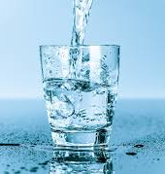
Water
Water is essential for most body functions
Moving food through the digestive system
Digesting carbs and protein, and aiding other chemical reactions
Transporting nutrients and removing wastes
Storing and releasing heat
Cooling and body through perspiration
Cushioning the eyes, brain, and spinal cord
Lubricating the joints

Slide 16
Healthy Food Guidelines
Lesson 3

Slide 17
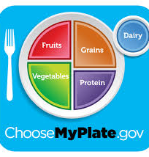
Guidelines for Healthy Eating and Active Living
Dietary Guidelines for Americans: set of recommendations about smart eating and physical activity for all Americans
Published by the USDA and HHS
MyPlate: an interactive guide to healthful eating and active living
Level of physical activity should balance out the calories you take in
MyPlate website can provide individually tailored advice about your daily calorie needs based on age, gender, and activity level

Slide 18
The Best Nutrition Choices
Focus on
Focus on Fruit: eat a variety of fresh fruit
Vary
Vary your Vegetable: eat a wide rainbow of veggies
Get
Get your Calcium-rich foods: milk, yogurt, cheese
Make
Make half your grains whole: at least 3 ounces of brown rice or whole-grain cereals, breads, crackers, and pasta
Go
Go lean with protein: lean meats such as poultry
Limit
Limit certain foods: avoid foods high in saturated and trans fat, limit foods with high salt and added sugar

Slide 19
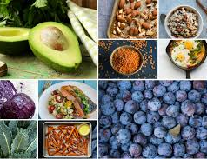
Balancing Food and Physical Activity
Nutrient-dense foods: a high ratio of nutrients to calories
Use MyPlate or the Dietary Guidelines to help plan meals or snacks

Slide 20
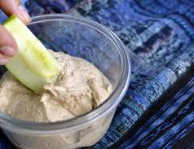
Sensible Snacks
When looking for a snack it is important to find something to provide enough energy between meals
Fresh fruit
Cut up vegetables
String cheese
Unsalted nuts
Air-popped popcorn
Yogurt (Greek)

Slide 21
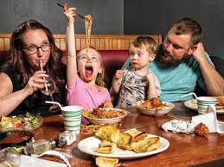
Dining Out
Watch your potion size
Pay attention to how foods are prepared
Add fresh fruits and vegetables
Go easy on toppings
Don't drink your calories
RETHINK YOUR DRINK ;)

Slide 22
Nutrition Labels and Food Safety
Lesson 4

Slide 23
Nutrition Label Basics
Ingredient List
Appear on the label in descending order
Food additives: substances added to produce a desired effect
Nutrition Facts
Nutritional Claims
Free, Low, Light, Reduced, High, Good Source of, Healthy

Slide 24
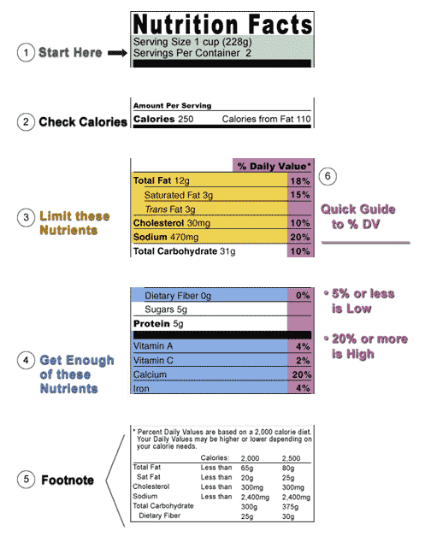

Slide 25
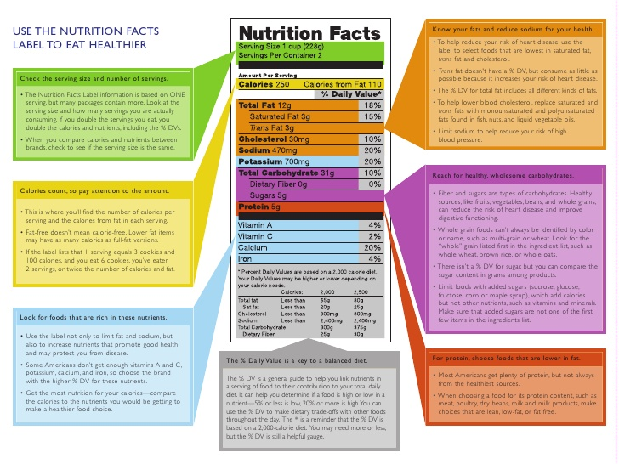

Slide 26
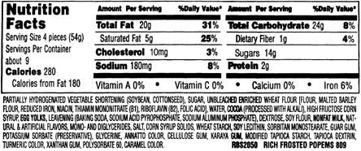

Slide 27
Food Safety
Foodborne Illness: food poisoning
About 76 million Americans become ill as a result of foodborne illness each year
Dietary Guidelines notes 4 basic steps to keeping food clean:
Clean, Separate, Cook, and Chill
Keeping foods safe to eat:
Pasteurization: treating a substance with heat to kill or slow the growth of pathogens
Cross-contamination: the spreading of pathogens from one food to another

Slide 28
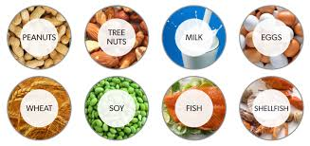
Food Sensitivities
Food allergy: a condition in which the body's immune system reacts to substances in some foods
Food intolerance: negative reaction to food that doesn’t involve the immune system

Slide 29
Reference
Bronson, Mary H. Florida Health. McGraw-Hill, 2015.

