Slide 1
Chapter 16: Endocrine and Reproductive Health
Unit 5: Personal Care and Body Systems

Slide 2
Objectives:
Describe body's endocrine system and understand how it sends and receives chemical messages that control many body functions
Understand the male reproductive system and how there are a series of organs involved in producing children
Learn about the female reproductive system and how it matures at puberty and enables women to reproduce

Slide 3
The Endocrine System
Lesson 1

Slide 4
How the Endocrine System Works
MAIN IDEA: The endocrine system includes various organs that work together to regulate body functions
Endocrine glands: ductless or tubeless organs or groups of cells that secrete hormones into the bloodstream
Hormones: chemical substances that help regulate many of your body's functions
Chemical messengers that influence physical and mental responses
Hormones produced during puberty trigger physical and emotional changes in the body

Slide 5
How the endocrine system works
The pituitary: the master gland
Three sections, or lobes:
Anterior: stimulates normal body growth, thyroid gland to produce hormones, production of hormones in the adrenal glands, and all other sex hormones
Intermediate Lobe: controls the darkening of the pigments in the skin
Posterior Lobe: regulates the balance of water in the body

Slide 6
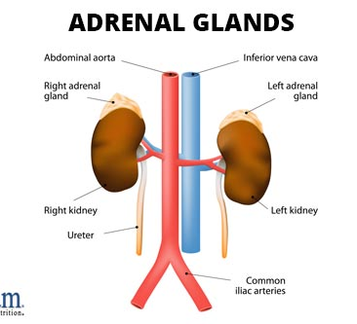
How The endocrine System Works
The Adrenal Glands: help the body deal with stress and respond to emergencies
The adrenal glands have two parts:
Adrenal cortex
Adrenal medulla

Slide 7
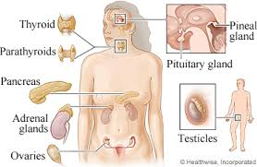
Maintaining your Endocrine Health
MAIN IDEA: To keep your endocrine system working at its peak, you need to follow sound health practices
Eat balanced meals
Sleep 8-10 hours a night
Regular physical activity
Regular medical checkups

Slide 8
The Male Reproductive System
Lesson 2

Slide 9
How Male Reproduction Works
MAIN IDEA: The male reproductive system includes both external and internal organs that, with the help of hormones, allow physically mature males to produce children
The two main functions of the male reproductive system are to produce and store sperm and transfer them to the female body during sexual intercourse
Sperm: the male gametes, or reproductive cells
Usually between 12 and 15 the male reproductive system reaches maturity
Hormones stimulate testosterone and initiates physical changes that signal maturity
Testosterone: male sex hormone and controls the production of sperm
After puberty, males are capable to produce sperm the rest of their life

Slide 10
External Reproductive organs
Testes: two small glands that secrete testosterone and produce sperm
Scrotum: an external skin sac where the testes are located
Penis: tube-shaped organ that extends from the trunk of the body just above the testes
Composed of spongy tissue that contains many blood vessels
When blood flow to the penis increases, it becomes large and an erection occurs (normal body function that can occur for no reason)
Semen: thick fluid containing sperm and other secretions from the male reproductive system
At the height of sexual arousal, ejaculation occurs

Slide 11
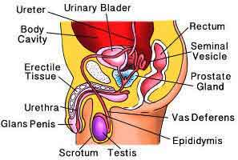
Internal Reproductive Organs
Vas deferens
Urethra
Seminal vesicles
Prostate
Cowper's glands

Slide 12
Maintaining reproductive health
MAIN IDEA: Male reproductive health involves care and monitoring throughout a male's lifetime
Bathe regularly
Wear protective equipment
Practice abstinence
Perform regular self-examinations
Get regular checkups

Slide 13
Male Reproductive System Problems
Inguinal hernia
Sterility: inability to reproduce as a result of too few sperm or sperm of poor quality
Testicular cancer
Most common in males 14-40
Prostate problems and prostate cancer

Slide 14
How to Do a testicular self-examination (TSE)
1. Standing in front of a mirror, look for swelling. Examine each testicle with both hands. Roll the testicle gently between the thumbs and forefingers.
2. Cancerous lumps usually are found on the side of the testicle, but can appear on the front. Find the epididymis so that you won't mistake that for a lump.
3. Most lumps are no cancerous. If you do find a lump or experience pain/swelling, consult a health care professional.

Slide 15
The Female Reproductive System
Lesson 3

Slide 16
The Female Reproductive System
MAIN IDEA: The organs of the female reproductive system enable pregnancy to occur with the first monthly ovulation
The female reproductive system has several functions, including producing female sex hormones and storing eggs
Eggs: female gametes
Ovaries: female sex glands that store the ova and produce female sex hormones
Uterus: the hollow, muscular, pear-shaped organ that nourishes and protects a fertilized ovum until birth
A female at birth has 400,000 immature ova
Ovulation: process of releasing a mature ovum into the fallopian tube each month

Slide 17
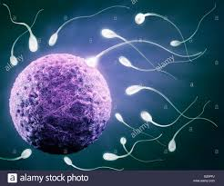
Female Reproductive organs
Fallopian tubes: a pair of tubes with fingerlike projections that draw in the ovum
Vagina: muscular, elastic passageway that extends from the uterus to the outside of the body
If sperm are present in the fallopian tubes, the sperm cell and ovum may unite, resulting in fertilization, or pregnancy

Slide 18
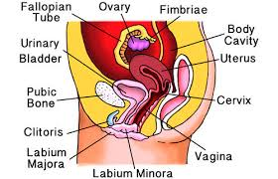
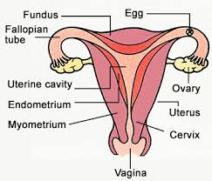

Slide 19
Menstruation
As a female matures, the uterus prepares each month for possible pregnancy. If pregnancy does not occur, the thickened lining of the uterus breaks down into blood, tissue, and fluids
Menstruation: the shedding of the uterine lining
Cervix: the opening to the uterus
Most females begin their first cycle between 10-15
May be irregular at first and as female matures, can be more predictable
Menstruation occurs from puberty to menopause
End of the reproductive years usually between 45-55

Slide 20
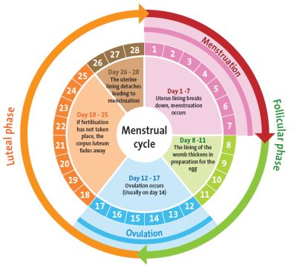

Slide 21
Maintaining Reproductive Health
MAIN IDEA: Good hygiene, breast self-exams, and abstinence from sexual activity help female reproductive system health
Bathe regularly
Have regular medical exams
Practice abstinence

Slide 22
Breast Self-Exam (BSE)
1. Lie down with a pillow under your right shoulder. Put your arm behind you head. Place the three middle fingers pads of your left hand on your right breast. Move your fingers in a circular motion, pressing first with light, then medium, then firm pressure. Follow this process in an up-and-down path over the breast. Be sure to check all of the breast tissue, from the underarm edge to the middle of the chest bone, and from the collarbone to the ribs. Repeat using your right hand on your left breast.
2. Stand in front of a mirror with your hands pressed firmly on your hips. Inspect your breasts for any changes in size, shape, or appearance. Look for dimpling, rash, puckering, or scaliness of the skin or nipple
3. Next, raise your arms over your head (palms pressed together) and look for changes
4. Examine your underarms with your arms only slightly raised so you can more easily feel these areas

Slide 23
Female Reproductive System Problems
MAIN IDEA: Several disorders can affect the female reproductive system, and some can lead to infertility
Menstrual cramps
Premenstrual syndrome (PMS)
Toxic shock syndrome (TSS)
Endometriosis
Sexually transmitted diseases
Vaginitis
Ovarian cysts
Cervical, uterine, and ovarian cancers

Slide 24
Reference
Florida Health

