Slide 1
Chapter 17: The Beginning of the Life Cycle
Unit 6: Growth and Development

Slide 2
Objectives
Describe fetal development during pregnancy and understand the care that needs to be taken to ensure the fetus and mother remain healthy
Describe heredity and genetics and where certain traits, like eye and hair color, come from
Understand infancy and childhood are times of great changes and growth

Slide 3
Prenatal Development and Care
Lesson 1

Slide 4
The Very Beginning
MAIN IDEA: A single cell, formed from one egg and one sperm, can grow into a complex human being
Fertilization: union of a male sperm cell and a female egg cell
Also known as conception
Zygote: cell that results from fertilization
Implantation: process by which the zygote attaches to the uterine wall
Embryo: cluster of cells that develops between the third and eighth week of pregnancy
Fetus: group of developing cell
Called a fetus after about 8 weeks

Slide 5
The Growing Embryo
The cells of an embryo will continue to divide as it grows.
Amniotic sac: thin, fluid-filled membrane that surrounds an protects the developing embryo
Umbilical cord: thick, blood-rich tissue that lines the walls of the uterus during pregnancy and nourishes the embryo
Substances that are harmful to a developing embryo can pass through the umbilical cord
The time from conception to birth usually takes 280 days and is divided into three trimesters

Slide 6
Implantation

Slide 8
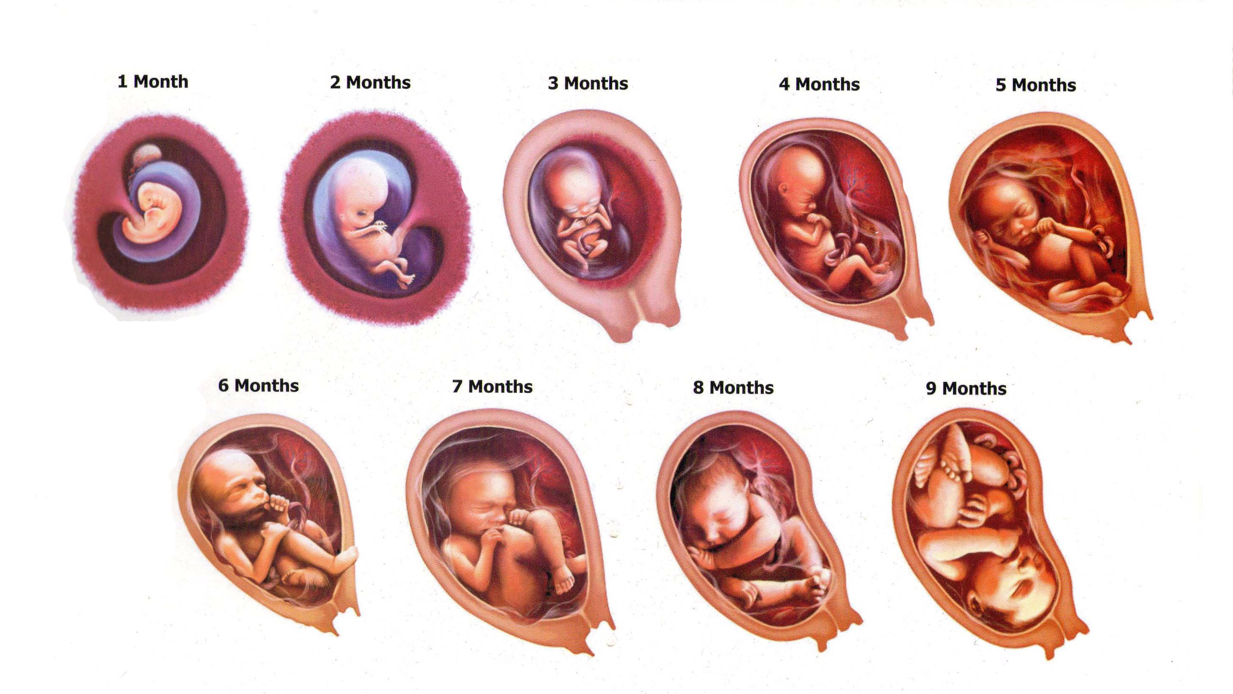

Slide 9
A Healthy Pregnancy
Prenatal: steps that a pregnant female can take to provide for her own health and the health of her baby
Seeing a doctor regularly throughout the pregnancy will provide a new mother with the care and nutritional advice she needs
What to eat: calcium, protein, iron, vitamin A, vitamin B complex, and folic acid
Most pregnant females need to only consume an extra 300 calories/day
Females at a healthy weight should gain 25-35 pounds
Too little weight can result in small, undeveloped baby
Too much weight can result in an early delivery

Slide 10
A Healthy Fetus: Things to Avoid
Tobacco
Alcohol
Fetal alcohol syndrome: a group of alcohol-related birth defects that includes both physical and mental problems
Drug Use
Hazards in the Environment:
Lead
Mercury
Smog
Radiation

Slide 11
Complications of Pregnancy
Most pregnancies result in birth of a healthy baby
About 70% of births occur through vaginal delivery
Complications can result in caesarean section (C-section)
Premature birth
If a baby comes 3 weeks or more before due date
Serious complications may result in miscarriage
Spontaneous expulsion of fetus occurring before 20th week
Stillborn
Delivery of fetus that has died after 20 weeks of pregnancy
Gestational hypertension
Pre-eclampsia
Ectopic pregnancy

Slide 12
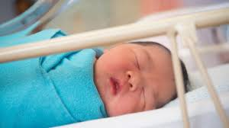
Childbirth
1.Labor
2. Delivery
3. Afterbirth

Slide 13
Heredity and Genetics
Lesson 2

Slide 14
Heredity
MAIN IDEA: Heredity is the passing of physical traits from parents to their children
Chromosomes: found within the nucleus of a cell that carry the codes for inherited traits.
Most of the cells in human body contain 46 chromosomes in 23 pairs
Genes: basic units of heredity that occur in pairs
DNA: chemical unit that makes up chromosomes
All living things are made up of DNA

Slide 15
Genetics and Fetal Development
MAIN IDEA: Chromosomes from a sperm and an egg unite to carry the hereditary traits from parents
When a sperm and egg unite during fertilization, the resulting zygote will have 46 chromosomes, 23 from each parent
A zygote divides many times, ultimately producing the trillions of cells that make up the human body
Dominant and recessive genes
Dominant traits generally appear in the offspring when they are present
Recessive usually appear only with dominant aren't present
Example: one parent has brown eyes and one has blue; brown eyes are the dominant gene; offspring has blue eyes however, they then have two recessive genes for blue eyes

Slide 16
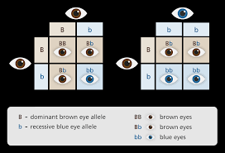

Slide 17
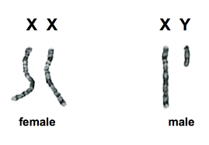
Genes and Gender
One pair of chromosomes determine gender
Females have two chromosomes and look exactly alike—these are called X chromosomes
Males have two different chromosomes, one shorter than the other. The shorter one is called the Y chromosome; thus males have X and Y chromosomes
Sperm from a male determines a child

Slide 18
Genetic Disorders
Genetic disorders: disorders caused partly or completely by a defect in genes
Some are apparent at birth
Most cannot be cured
Amniocentesis: a procedure in which a syringe is inserted through a pregnant female's abdominal wall to remove a sample of the amniotic fluid surrounding the developing fetus
Chorionic villi sampling: a procedure in which a small piece of membrane is removed from the chorion, a layer of tissue the develops into the placenta
Genetic testing is possible after birth

Slide 19
Common Human Genetic Disorders
Sickle-cell anemia
Tay-Sachs disease
Cystic fibrosis
Down syndrome
Hemophilia

Slide 20
Battling Genetic Disease
Genetic disorders occur when an individual is missing a functioning gene
Gene therapy: an experimental treatment and is the process of inserting normal genes into human cells to correct genetic disorders
Genetic engineering: placing parts of DNA from on organism into another

Slide 21
Birth Through Childhood
Lesson 3

Slide 22
Childhood
MAIN IDEA: Each child passes through four stages of development during infancy and childhood
Our lives can be divided into 8 developmental stages and the first four occur during infancy and childhood
Developmental tasks: events that need to happen in order for a person to continue growing toward becoming a healthy, mature adult

Slide 23
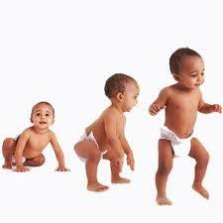
Infancy
Fastest growth in a person's life
It is a time of learning: how to eat solid food, sit up, crawl, walk
This includes birth to 12 months
Experiences 5 basic emotions
Wants companionship

Slide 24
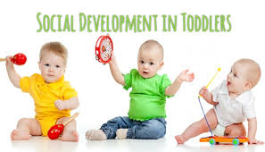
Early Childhood
Children begin to feel proud of their accomplishments and are eager to learn new tasks
Autonomy: the confidence that a person can control their own body, impulses, and environment
Includes ages 1-3
Walks well
Pick up object without losing balance
Shows defiance
Desires approval
Takes part in group activities

Slide 25
Middle Childhood
Children learn to initiate play rather than following the lead of others
Children must be taught to recognize emotions and how to deal with them in appropriate ways
Ages 4-6
Dresses and undresses
Uses utensils to eat
Self-confidence grows
Eager to explore larger world
Respects others belongings
May want to do things their own way

Slide 26
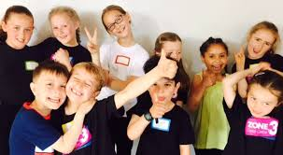
Late Childhood
School becomes an important part of a child's life
Develop a conscious
Ages 7-12
Puberty may begin
Develops sense of self
Becomes aware of dangers in the world
Peer pressure
Moral decisions

Slide 27
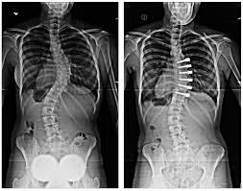
Childhood Health Screenings
Vision and hearing
Nearly 1 in 4 school-aged children in the US have a vision problem
Newborns receive screening and continue through childhood
2-3 in every 1,000 children in the US are born with a hearing impairment severe enough to affect their language
Scoliosis: an abnormal lateral curvature of the spine
May begin in childhood and go unnoticed until the teen years
Cause is unknown
More common in females
Lead poisoning
Blood pressure
Cholesterol
Anemia

Slide 28
Reference
Florida Health

