Slide 1
Chapter 22: Illegal Drugs
Unit 7: Drugs

Slide 2
Objectives
Learn the health risks of drug use, misuse, and substance abuse
Understand serious mental and physical side effects from marijuana, inhalants, and steroids
Describe psychoactive drugs
Take on the role of living drug free

Slide 3
Health Risks of Drug Use
Lesson 1

Slide 4
Substance Abuse
Medicines cure and prevent disease, but sometimes medicines are accidentally used in an improper way, while sometimes they are intentionally abused
Substance abuse: any unnecessary or improper use of chemical substances for non-medical purposes
Illegal drugs: chemical substances that people of any age may not lawfully manufacture, possess, buy, or sell
Illicit drug use: use or sale of any substance that is illegal or otherwise not permitted

Slide 5
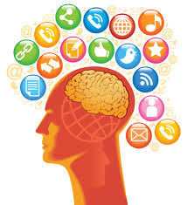
Factors that Influence Teens
Peer pressure
Family members
Role models
Media messages
Perceptions of drug behaviors
Misleading information

Slide 6
How Drugs Affect Your Health
Unlike medicines, illegal drugs are not monitored for quality, purity, or strength. They don't come with labels that list safety guidelines or suggested dosages.
Physical health:
Overdose: strong, sometimes fatal reaction to taking a large amount of a drug
Increased risk of Hepatitis B and HIV
Mental health:
Impair ability to reason and think
Alters brain's structure and function
Social health:
Lose friendships
Family relationships may suffer
Leading cause of crime, suicide and unintentional injuries

Slide 7
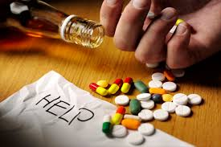
Other Effects of Drug Use
Tolerance
Psychological dependence
Physiological dependence
Addiction

Slide 8
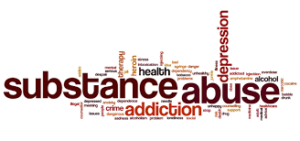
Drugs Take a Heavy Toll
Some people believe that drugs can help them escape their problems
Consequences for the individual
Consequences for friends and family
Consequences for others
Consequences for society

Slide 9
Marijuana, Inhalants, and Steroids
Lesson 2

Slide 10
Marijuana
Using marijuana has serious physical, mental, social, and legal consequences
In 2013, two U.S. states decriminalized the use of marijuana
Marijuana: a plant whose leaves, buds, and flowers are usually smoked for intoxicating effects
Some states have passed laws legalizing marijuana medicinally
It is still illegal for anyone under age 21 to use marijuana or carry any amount
It is also illegal for anyone to use marijuana un public or to drive after use

Slide 11
Marijuana
Marijuana is considered a gateway drug
A drug that may lead the user to try other drugs
All forms of marijuana are mind-altering and can damage health
Particularly true if use starts in the teen years
New Zealand study
Teens who are heavy users lost an average of 8 IQ points between ages 13-38

Slide 12
Physical Consequences of Marijuana Use
Face some of the same risks as tobacco users if smoked
Marijuana smoke contains carcinogens
THC reduces pain and nausea associated with cancer and HIV, however, the FDA has approved drugs that deliver THC without the other risks associated with marijuana use
Immune system damage
Risks to reproductive system
Hallucinations
Lung irritation/coughing
Heart and lung damage
Increased appetite

Slide 13
Mental and Emotional Consequences
Raises levels of dopamine (chemical that produces pleasurable feeling) and in some users it can trigger the release of so much dopamine that the user reaches an intense feeling of well-being or elation, called "high"
When the drug wears off, the sensation dramatically drops, causing the "drop"
Slow mental reflexes
Increased anxiety and paranoia
Loss of coordination

Slide 14
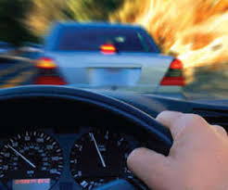
Driving and Marijuana Use
The National Highway Traffic Safety Administration estimates 10.3 million drivers involved in car crashes were on drugs
Marijuana interferes with depth perception, causes sleepiness, impairs judgement, and slows reaction time
Legal consequences include suspension of license, fines, loss of eligibility, and possibly jail time

Slide 15
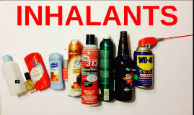
Inhalants
Inhalants can cause death of brain cells
Inhalants: substances whose fumes are sniffed or inhaled to give effect
Some inhalants are prescribed by a doctor to treat allergies, asthma, or other medical conditions, however, some substances are inhaled to achieve a high
Solvents, aerosols, glues, paints, varnishes, and gasoline

Slide 16
Steroid Use
Anabolic-androgenic steroids: synthetic substances similar to male sex hormones that are used for muscle building
Steroids can be prescribed for medical conditions, but using steroids without medical supervision is dangerous
Unnatural muscle growth
Tendons and ligaments may not get stronger causing injury
Weight gain, acne, high BP, and liver and kidney tumors
HIV/Hep B
Violent behavior, mood swings, depression, paranoia
Shrinking testicles, reduced sperm count, baldness, development of breasts, prostate cancer, facial hair, deepened voice

Slide 17
Psychoactive Drugs
Lesson 3

Slide 18
Effects of Psychoactive Drugs
Psychoactive drugs change the functioning of the central nervous system
Psychoactive drugs: chemicals that affect the central nervous system and alter activity in the brain
Four main groups of psychoactive drugs:
Stimulants
Depressants
Opiates
Hallucinogens

Slide 19
Health Risks of Psychoactive Drugs
Stimulant | Consequences to your Health
Amphetamine | Decreased appetite, weight loss, malnutrition, high BP, heart failure, death, aggressiveness, and addiction
Cocaine | Nausea, abdominal pain, malnutrition, headache, stroke, seizure, heart attack, death, exposure to HIV, addiction
Crack | Extreme addiction with same consequences as cocaine, increased HR, BP, premature death
Methamphetamine (Meth) | Memory loss, heart and nerve damage, increased tolerance, addiction

Slide 20
Health Risks of Psychoactive Drugs
Depressants | Consequences to Your Health
Barbiturates | Fatigue, confusion, impaired muscle coordination, reduced heart rate, BP, and respiratory function, death
GHB | Drowsiness, nausea, vomiting, loss of consciousness, impaired breathing, coma, death
Rohypnol (roofies) | Decreased blood pressure, drowsiness, memory loss, gastrointestinal disturbances
Tranquilizers | Depression, fever, irritability, loss of judgement, dizziness

Slide 21
Health Risks of Psychoactive Drugs
Opiates | Consequences of Your Health
Codeine | Reduced respiratory function, respiratory arrest, death, exposure to HIV, addiction
Heroin | Confusion, sedation, unconsciousness, coma, addiction
Morphine | Rapid onset of tolerance, addiction
Opium | Nausea, constipation, addiction
Oxycodone (OxyContin) | Drowsiness, nausea, constipation, addiction, reduced respiratory function, respiratory arrest, death

Slide 22
Health Risks of Psychoactive Drugs
Hallucinogens | Consequences to Your Health
DXM (tussin) | Nausea, dizziness, lack of coordination, rashes, hallucinations, disorientation, paranoia, panic attacks, seizures
Ecstasy (MDMA) | Confusion, depression, paranoia, muscle breakdown
Ketamine | Kidney and cardiovascular failure, death, memory loss, numbness, impaired motor function
LSD | Delusions, illusions, hallucinations, flashbacks, numbness, tremors
Mescaline (peyote) | Delusions, illusions, hallucinations, flashbacks, numbness, tremors
PCP | Loss of appetite, depression, panic, violent actions
Psilocybin (shrooms) | Delusions, illusions, hallucinations, paranoia, extreme anxiety, nausea

Slide 23
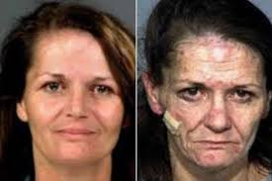
Club Drugs, Stimulants, and Depressants
Designer drug: synthetic drugs that are made to imitate effects of other drugs
Hallucinogens: drugs that alter moods, thoughts, and sense perceptions
Euphoria: feeling of intense well-being or elation

Slide 24
Hallucinogens and Opiates
Hallucinogens overload the brain's sensory controls
Alter mood and impair judgement
Heart and respiratory failure
Ecstasy, ketamine, LSD, PCP, DXM, and mushrooms
Opiates are highly addictive, causing confusion and dull senses
Opiates: drugs that are only obtainable by a prescription and are used to relieve pain
Morphine, oxycodone, codeine
Drowsiness, constipation, slow and shallow breathing
Convulsions, coma, and death

Slide 25
Living Drug-Free
Lesson 4

Slide 26
Resisting Pressure to Use Drugs
Most teens NEVER experiment with illegal drugs
By deciding not to use drugs, your protect your health and become a role model to others
Examples of refusal statements:
"No, thanks, I don't do drugs."
"I can't. I'm on medication."
"I'm not interested. That stuff makes me sick."
"No. I have to be in great shape for tomorrow's game."

Slide 27
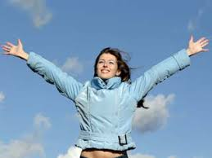
Healthy Alternatives
Hobbies
Sports
Community activities
School organizations

Slide 28
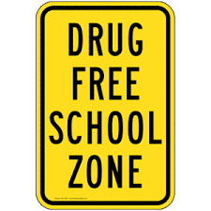
Drug Prevention Efforts
Schools and communities are working together to support students in their efforts to be drug-free
Drug-free school zones: areas within 1,000 to 1,500 feet of school are designated by signs, within which people caught selling drugs receive especially severe penalties
Drug watches: organized community efforts by neighborhood residents to patrol, monitor, report, and otherwise try to stop drug deals and drug abuse

Slide 29
Becoming Drug-Free
Many types of counseling are available for those who want to become drug-free
How to help:
Identify sources of help in the community
Talk to the person when he or she is sober
Listen to the person's response. Be prepared for anger or denial.
Offer to go with your friend or family member to a counselor or support group.

Slide 30
Warning Signs of Drug Use
Lies about the drugs that he or she is using, constantly talks about drugs
Stops participating in activities that once were an important part of his or her life
Changes eating or sleeping habits, shows rapid weight loss
Takes unnecessary risks, participates in unsafe behaviors
Gets in trouble with authorities
Seems withdrawn, depressed, tired, and care less about appearance
Has red-rimmed eyes and runny nose not related to cold or allergies
Has blackouts and forgets what he or she did under the influence
Has difficulty concentrating

Slide 31
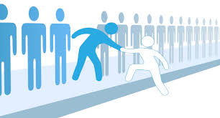
Getting Help
Out-patient Drug-free treatment
Short-term treatment
Maintenance therapy
Therapeutic communities
Drug counselors

Slide 32
Reference
Florida Health

