Slide 1
Chapter 20: TObacco
Unit 7: Drugs

Slide 2
Objectives
Identify the health risks of tobacco use and how the chemicals in tobacco products harm your body
Commit to choosing to live a tobacco-free lifestyle
Promote a smoke-free environment by discussing harmful effects of secondhand smoke

Slide 3
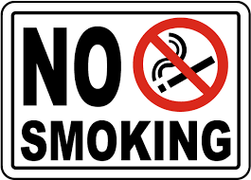
ASSESS YOU HEALTH
1. I avoid tobacco products
2. I stay away from situations where tobacco products may be used
3. I practice refusal skills in advance so that I know what I would say if someone offers me tobacco
4. I surround myself with people who do not use tobacco
5. I know how to find help if someone I know wants to quit smoking

Slide 4
The Health Risks of TObacco Use
Lesson 1

Slide 5
Health RIsks of Tobacco Use
MAIN IDEA: All forms of tobacco contain chemicals that are dangerous to your health
Advertisements for tobacco products typically contain healthy and attractive people that send the message that there are no health risks with smoking
All tobacco products display warnings stating that using tobacco products can be harmful for your health
Tobacco use is the leading cause of preventable death in the US
Smoking, chewing or dipping tobacco
Smoking can cause lung disease, certain cancers, and heart diease
The reality is quitting is very difficult; therefore, it's easier to avoid tobacco rather than begin in the first place

Slide 6
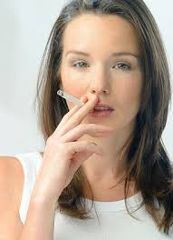
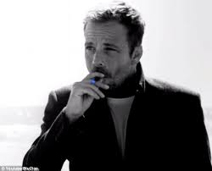
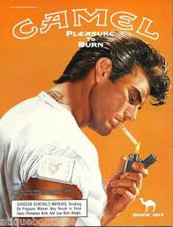

Slide 7
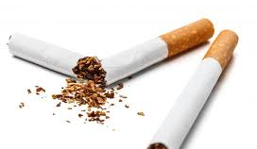
Nicotine
Addictive drug: a substance that causes physiological or psychological dependence
Nicotine: the addictive drug found in tobacco leaves
Stimulant: drug that increases the action of the central nervous system

Slide 8
Poisonous Substances in tobacco smoke
Carcinogen: cancer-causing substance
Contains tar and carbon-monoxide as well as some poisonous substances that can be found in paint, rat poison, and toilet cleaner
Tar: thick, sticky, dark fluid produced when tobacco burns
Damages a smoker's respiratory system
Damages lung tissue
Carbon monoxide: a colorless, odorless and poisonous gas
Found in cigarette smoke
Absorbed more easily than oxygen
Increases risk of high BP, heart disease, and hardening of arteries

Slide 10
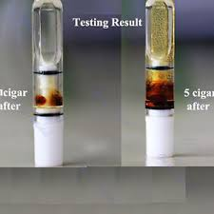
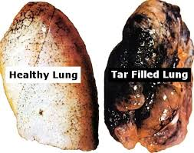

Slide 11
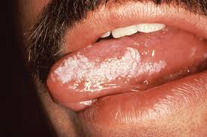
Pipes, cigars, and smokeless tobacco
MAIN IDEA: No tobacco product is safe to use
Smokeless tobacco: tobacco that is sniffed through the nose, held in the mouth, or chewed
NOT a safe alternative to smoking
Harmful chemicals are absorbed into the body up to THREE times the amount of a single cigarette
Leukoplakia: thickened, white, leathery-looking spots on the inside of the mouth that can develop into oral cancer

Slide 12
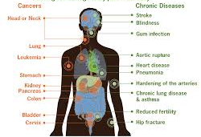
Harmful Effects of Tobacco Use
Short-term effects:
Brain chemistry changes
Respiration and heart rate increase
Taste buds are dulled and appetite is reduced
Users have bad breath, yellowed teeth, and smelly hair, skin, and clothes
Long-term effects:
Chronic bronchitis
Emphysema
Lung cancer
Coronary heart disease and stroke
Weakened immune system

Slide 13
Other COnsequences of TObacco Use
Costs to society
Tobacco-related illnesses cost the US $167 billion each year
Costs to individual
A person who smokes one pack a day will spend $3,561/day on average
Legal consequences

Slide 14
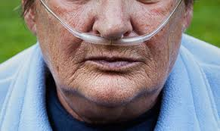
Other COnsequences of TObacco Use
Costs to society
Tobacco-related illnesses cost the US $167 billion each year
Costs to individual
A person who smokes one pack a day will spend $3,561/day on average
Legal consequences

Slide 15
Choosing to Live Tobacco-Free
Lesson 2

Slide 16
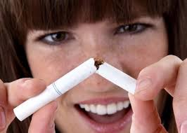
Teens and Tobacco
MAIN IDEA: Fewer teens are starting to use tobacco
Some teens falsely believe that smoking will help control their weight or cope with stress
Reduces the capacity for physical activity which in turn leads to weight gain
Most teens are influenced to try smoking by media or peer pressure

Slide 17
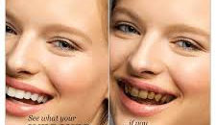
Reduced tobacco use among teens
Tobacco legislation
No-smoking policies
Family values
Positive peer pressure
Health risks

Slide 18
Benefits of Living TObacco-Free
Better cardiovascular endurance and lung function
Improve fitness and athletic performance
Reduce risk for lung cancer, heart disease, and stroke
Less stress
More confidence

Slide 19
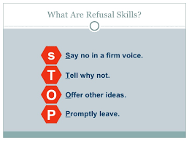
Strategies for avoiding tobacco
Surround yourself with positive influences
Reduce peer pressure
Be prepared with refusal skills

Slide 20
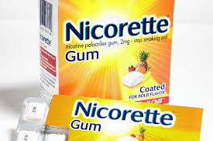
Ending the Addiction cycle
Nicotine withdrawal: process that occurs in the body when nicotine, an addictive drug, is no longer used
Nicotine substitutes: products that deliver small amounts of nicotine into a user's system while he or she is trying to give up the habit
Gum patches, nasal sprays, and inhalers

Slide 21
Getting Help to End Tobacco Use
Prepare for the quit day
Get support and encouragement
Access professional health services
Tobacco cessation program: a course that provides information and help to people who want to stop using tobacco
Replace tobacco use with healthy behaviors

Slide 22
Promoting a Smoke-Free Environment
Lesson 3

Slide 23
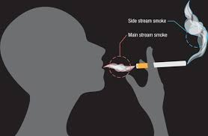
Health Risks of TObacco Smoke
Environmental tobacco smoke (ETS): air that has been contaminated by tobacco smoke; is also secondhand smoke
Mainstream smoke: smoke exhaled from the lungs of a smoker
Sidestream smoke: smoke from the burning end of a cigarette, pipe, or cigar
More dangerous
ETS contains 4,000 chemical compounds
More than 50 are carcinogens

Slide 24
Health RIsks
Secondhand smoke causes about 3,400 deaths from lung cancer a year
Can also cause eye irritation, headaches, infections, and coughing
Worsens asthma
Smoking during pregnancy can harm the fetus
Impair fetal growth
Deformities
Stillbirths
SIDS
Children of smokers tend to be sick more often
Secondhand smoke around children can slow lung development

Slide 25
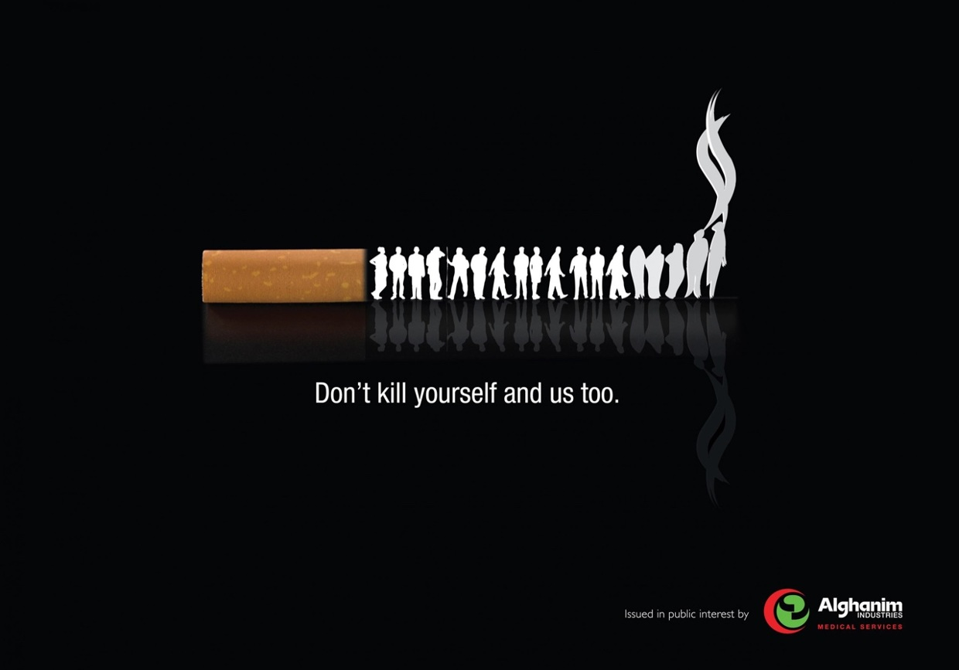
Reducing risks and Creating a Smoke-Free Society
Try to establish smoke-free areas in your house or encourage the smoker to go outside
Prohibit smoking in public places
Prohibit smoking in the workplace
Public service announcements
Healthy People 2020

Slide 26
Reference
Florida Health

